Slide 1
Southern Coastal Plain
Fire Danger Rating
Area:
FIRE DANGER
POCKET CARD
Energy Release Component
RAWS
Beaufort – 317801
New Bern – 319004
Turnbull Creek – 319302
Whiteville – 319701
Nature Conservancy – 319802
Sunny Point – 319803
NWS Forecasting Office
Newport/Morehead City, NC
Summer Card
MAXIMUM: Highest ERC by day for 2003-2011
AVERAGE: Shows mean daily ERC value through the year
Memorable Fires
Summer Card
Energy Release Component is a number relating to the available energy released from forest fuels at the head of a fire’s flaming front. ERC is a composite of live & dead fuel moistures. It is a very good reflection of drought conditions. It is a “build up” type index. Given a fire start in a fuel with a high ERC, fire containment can be expected to be difficult. ERC is very valuable in assessing the depth of a burn, consumption of the various fuel sizes, residual burning, mop-up requirements & Air Tanker support.
EXTREME: >98 percentile. Only 2% of the days from 2004-2011 had an ERC 39 or above.
VERY HIGH: 90-98 percentile. ERC values range from 30-38
Fuel Model G | Energy Release Component
 | Average | Average | Max
 | Monthly | Max | Value
 | Value | Value | Observed
May | 26 | 34 | 41
June | 25 | 35 | 37
July | 24 | 32 | 36
August | 21 | 29 | 34
HIGH: 55-90 percentile. ERC values range from 22-30, most fires occur in this range
MODERATE: 11-55 percentile. ERC values range from 09-22, large and multiple fires pick up at an ERC of 21
LOW: <11 percentile. ERC values range from <9,
LOCAL THRESHOLDS THAT SHOUT WATCHOUT!
Wind – 20’ winds above 7 mph (RAWS-10 min avg) or 20’ winds above 17 mph (NWS-2 min avg). Wind is most
critical weather factor to stay aware of. Sudden changes in winds cause more firefighter fatalities than any other
weather factor.
Relative Humidity – Rh’s below 48% are where large & multiple fires increase. When Rh’s drop below 20% , this is
a critical event. Expect elevated fire behavior!
Temperature – Temperatures above 70F are where large & multiple fires typically begin.

Slide 2
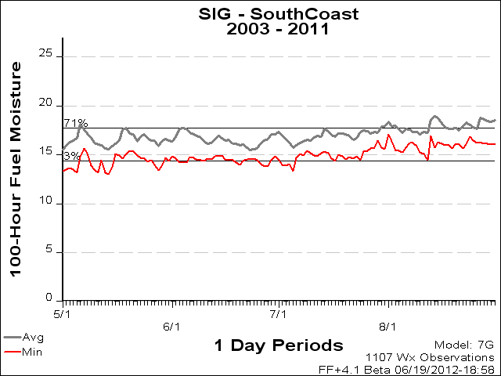
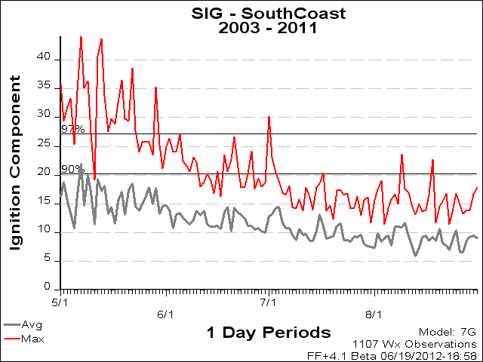
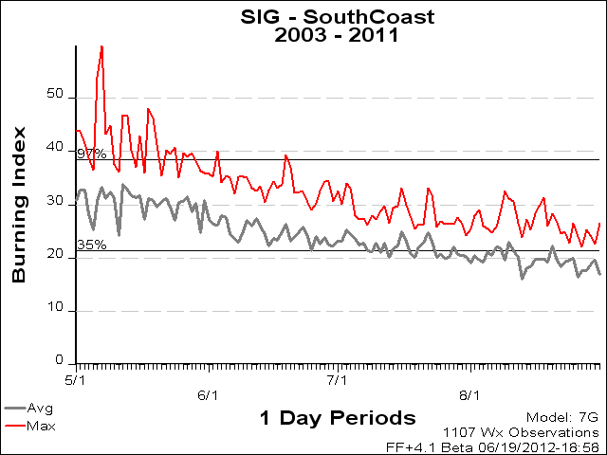
100 Hour Fuel Moisture (100hr) – Moisture content of fuels 1 to 3 inches in diameter. 100hr fuel moisture aids in assessing holding tactics & mop-up that may be required. 100hr value of 17% or lower is a critical threshold value and is a good indicator of when large and multiple fire days can be expected..
Ignition Component (IC) – the probability a firebrand will cause an “actionable” fire, and requires suppression action. IC is more than just a probability of a fire starting. It has to have the potential to spread. IC can be an aid in assessing spotting potential. An IC value of > 15 + is a critical threshold value. Values at this level are critical especially during February, March, & April as firebrands initiate spot fires.
Burning Index (BI) - relates to the contribution of fire’s behavior, in containing the fire. The difficulty of containment is directly proportional to the fireline intensity. BI is derived from the combination of the SC & ERC. BI can be a cross reference to fireline intensity & flame length. It assists in accessing spotting & crown fire potential as well as suppression resource needs & tactical considerations. In Hardwood fuels BI’s of 23+, are known to contribute to large and multiple fire days. The doubling of the BI, 10 to 20 can increase flame length from 2 to 4ft. yet, increases fireline intensity 5 times.

