Slide 1
NATIONAL BAER TEAM MEETING
2014 Year in Review

Slide 2
Two Years In
Old Model
2 Standing National Teams
Either you had a full team ordered or you didn’t
Quite inflexible
New (Current) Model
Rostered Team Members
Team Leaders ordered
Team Leaders size up the situation and order appropriate team members for the assignment
Better flexibility

Slide 3
Two Years In
Previous National DOI BAER model
2 Standing Teams
3 Assignments in 5 years
2013
57 Individual Assignments
526 Days on Assignment
2014
21 Individual Assignments
171 Days on Assignment

Slide 4
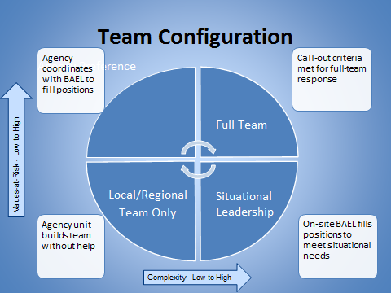
Team Configuration

Slide 5
Team Call-Out

Slide 6
BAER Tracker
3 Pieces
DOI National BAER Team Roster
BAER Team Member Availability
BAER Team Member Assignment Log

Slide 7
National BAER Team Roster
Poll Name | 1st Position | 2nd Position | 3rd Position | 4th Position | Last Name | First Name | Agency | Organization | Office Address | City | State | Zip | Primary Email
Luther Arizana | GISS |  |  |  | Arizana | Luther | BIA | NIFC | 3833 S Development Ave | Boise | ID | 83705 | luther.arizana@bia.gov
Rebecca Biglow | BAHY | BAGE | BAEL |  | Biglow | Rebecca | AD | Pike San Isabel NF | 550 E 3rd Street | Salida | CO | 81201 | becbiglow@gmail.com
Johanna Blanchard | BABO(T) |  |  |  | Blanchard | Johanna | BLM | Klamath Falls Resource Area | 2795 Anderson Ave, Bldng 25 | Klamath Falls | OR | 97603 | jlblanchard@blm.gov
Bryce Bohn | BAHY(T) |  |  |  | Bohn | Bryce | BLM | Idaho State Office |  | Boise | ID | 83709 | bbohn@blm.gov
Andrew Breibart | BAHY |  |  |  | Breibart | Andrew | BLM | Gunnison Field Office | 210 West Spencer St, Suite A | Gunnison | CO | 81230 | abreibart@blm.gov
Karl Brown | BAFO |  |  |  | Brown | Karl | NPS | Natural Resources Program Center | 1201 Oakridge Drive, Suite 200 | Ft. Collins | CO | 80525 | karl_brown@nps.gov
Carla Burnside | BACS |  |  |  | Burnside | Carla D | FWS | Malheur NWR | 36391 Sodhouse Lane | Princeton | OR | 97721 | carla_burnside@fws.gov
John Chatel | BAEL | BABI |  |  | Chatel | John | USFS | Region 6 Regional Office | 1220 SW 3rd Ave | Portland | OR | 97204 | jchatel@fs.fed.us
Rocco Clark Jr. | BAEN | BADO |  |  | Clark | Rocco | BIA | Yakama Agency | P.O. Box 632/401 Fort Road | Toppenish | WA | 98948 | rocco.clarkjr@bia.gov
TJ Clifford | BAEL | BAHY |  |  | Clifford | TJ | BLM | Boise District | 1287 Development Way | Boise | ID | 83709 | thomas_clifford@blm.gov
Sean I Daugherty | BACS |  |  |  | Daugherty | Sean | BLM | Rio Puerco Field Office | 435 Montano Rd NE | Albuquerque | NM | 87107 | sdaugher@blm.gov
Marsha Davis | BADO(T) |  |  |  | Davis | Marsha | NPS | Pacific West Regional Office | 909 First Avenue | Seattle | WA | 98006 | marsha_davis@nps.gov
Lara Derasary | BAGE | BABO |  |  | Derasary | Lara | BLM | Ely District (Contractor) | HC33 Box 33500 | Ely | NV | 84532 | lderasar@blm.gov
Garrett Dickman | BABO | BAGE(T) | BAHY(T) |  | Dickman | Garrett | NPS | Yosemite | PO Box 700 | El Portal | CA | 95318 | garrett_dickman@nps.gov
Mike Dolan | BABO |  |  |  | Dolan | Michael | BLM | Alturas Field Office | 708 West 12th St | Alturas | CA | 96101 | mdolan@blm.gov
Richard Easterbrook | GISS |  |  |  | Easterbrook | Richard | FWS | National Wildlife Refuge System | 1201 Oakridge Drive, Suite 320 | Fort Collins | CO | 80526 | richard_easterbrook@fws.gov
x | GISS |  |  |  | Endfield | Rachel | AD | Tribal | 6302 N Chief Ave | Whiteriver | AZ | 85941 | rach_endfield@frontiernet.net
Steve Femmel | BAFO |  |  |  | Femmel | Stephen | NPS | Whiskeytown NRA | 14412 Kennedy Memorial Drive | Whiskeytown | CA | 96095 | stephen_femmel@nps.gov
Anthony Gareau | GISS |  |  |  | Gareau | Anthony | NPS | Cuyahoga Valley NP | 15610 Vaughn Road | Brecksville | OH | 44141 | anthony_gareau@nps.gov
Erv Gasser | BAEL | READ |  |  | Gasser | Ervin | NPS | Pacific West Regional Office | 909 First Avenue | Seattle | WA | 98104 | erv_gasser@nps.gov
Jessica Gould | BAHY | BASS | BAGE |  | Gould | Jessica | USFS | Black Hills National Forest | 8221 S. Hwy. 16 | Rapid City | SD | 57702 | jjgould@fs.fed.us
Kenneth Griggs | BABI | BABO |  |  | Griggs | Kenneth | FWS | Humboldt Bay NWR | PO Box 576 | Loleta | CA | 95551 | kenneth_griggs@fws.gov
Dan Hall | BACS |  |  |  | Hall | Harold (Dan) | BIA | Pacific Region | 2800 Cottage Way | Sacramento | CA | 95825 | hdanhall@gmail.com
Peter Hall | BAFO(T) |  |  |  | Hall | Peter | BLM | Alturas Field Office | 708 West 12th St | Alturas | CA | 96101 | phall@blm.gov
chris holbeck | BAEL |  |  |  | Holbeck | Chris | NPS | MWRO | 601 Riverfront Dr | Omaha | NE | 68102 | chris_holbeck@nps.gov
Tedd Huffman | BASS | BAHY |  |  | Huffman | Edward (Tedd) | USFS | Umpqua NF | 2900 NW Stewart Parkway | Roseburg | OR | 97471 | elhuffman@fs.fed.us
x | BAFO | BAEL | GISS |  | Ivans | Davin (DW) | NPS | Big Thicket National Preserve | 860CR 860 | Woodville | TX | 75979 | DW_Ivans@nps.gov
Chuck Jachens | BAHY | BAEL |  |  | Jachens | Chuck | BIA | Pacific Regional Office | 2800 Cottage Way | Sacramento | CA | 95825 | charles.jachens@bia.gov
juliette jeanne | BAEN | BADO |  |  | Jeanne | Juliette | BIA | Fort Apache Agency | 2 W. Elm Street | Whiteriver | AZ | 85929 | juliette.jeanne@bia.gov
Shauna Jensen | BAHY |  |  |  | Jensen | Shauna | USFS | Dolores Ranger District | 29211 Hwy 184 | Dolores | CO | 81323 | smjensen@fs.fed.us
Rusty Kaiser | BABI |  |  |  | Kaiser | Rusty | BLM |  | PO Box 768 | Pinedale | OR | 82941 | rckaiser@blm.gov
Michael Kellett | BABI |  |  |  | Kellett | Michael | USFS | Pacific Southwest Region | 1323 Club Drive | Vallejo | CA | 94592 | mkellett02@fs.fed.us
heidi klingel | BAHY | BAGE |  |  | Klingel | Heidi | USFS | ACT2 Enterprise Unit, WO | PO Box 89 | Miranda | CA | 95553 | heidimklingel@fs.fed.us
Greta Krost | BAGE(T) | BASS(T) |  |  | Krost | Greta | BLM | Coos Bay District | 1300 Airport Lane | North Bend | OR | 97459 | gkrost@blm.gov

Slide 8
BAER Team Member Availability
 |  |  | Requested Position | Under the availability section, filter the starting date desired by selecting OK. Use the dropdown in cell D2 to select the position desired. The potential selectees will be highlighted. |  |  |  | 2 | 3 | 4 | 5 | 6 | 7 | 8 | 9 | 10
 |  |  | BAEL
 |  |  |  |  |  |  |  | October |  |  |  | November
Poll Name | Last Name | First Name | 1st Position | 2nd Position | 3rd Position | 4th Position | Unit ID | Sun 5 | Sun 12 | Sun 19 | Sun 26 | Sun 2 | Sun 9 | Sun 16 | Sun 23 | Sun 30
Luther Arizana | Arizana | Luther | GISS | 0 | 0 | 0 | IDFCA | OK | OK | OK | OK | OK | OK | OK | OK | OK
Rebecca Biglow | Biglow | Rebecca | BAHY | BAGE | BAEL | 0 | COPSF | OK | OK | OK | OK | OK | OK | OK | OK | OK
Johanna Blanchard | Blanchard | Johanna | BABO(T) | 0 | 0 | 0 | ORKFD
Bryce Bohn | Bohn | Bryce | BAHY(T) | 0 | 0 | 0 | IDISO
Andrew Breibart | Breibart | Andrew | BAHY | 0 | 0 | 0 | COMRD |  | OK | OK | OK | OK | OK | OK | OK | OK
Karl Brown | Brown | Karl | BAFO | 0 | 0 | 0 | CORMP
Carla Burnside | Burnside | Carla D | BACS | 0 | 0 | 0 | ORMAR |  |  |  | OK | OK | OK | OK | OK | OK
John Chatel | Chatel | John | BAEL | BABI | 0 | 0 | ORR06
Rocco Clark Jr. | Clark | Rocco | BAEN | BADO | 0 | 0 | WAYAA |  |  |  |  | OK | OK |  |  | OK
TJ Clifford | Clifford | TJ | BAEL | BAHY | 0 | 0 | IDBOD | OK | OK |  |  | OK | OK |  | OK | OK
Sean I Daugherty | Daugherty | Sean | BACS | 0 | 0 | 0 | NMRPD
Lara Derasary | Derasary | Lara | BAGE | BABO | 0 | 0 | NVELD
Garrett Dickman | Dickman | Garrett | BABO | BAGE(T) | BAHY(T) | 0 | CAYNP |  |  |  | OK | OK | OK | OK | OK | OK
Mike Dolan | Dolan | Michael | BABO | 0 | 0 | 0 | CANOD |  | OK |  | OK | OK | OK | OK | OK | OK
Richard Easterbrook | Easterbrook | Richard | GISS | 0 | 0 | 0 | COFTC
Steve Femmel | Femmel | Stephen | BAFO | 0 | 0 | 0 | CAWNP
Anthony Gareau | Gareau | Anthony | GISS | 0 | 0 | 0 | OHCVP | OK | OK | OK | OK | OK | OK
Erv Gasser | Gasser | Ervin | BAEL | READ | 0 | 0 | WAPNP | OK | OK | OK | OK | OK | OK | OK | OK | OK
Jessica Gould | Gould | Jessica | BAHY | BASS | BAGE | 0 | SDBKF
Kenneth Griggs | Griggs | Kenneth | BABI | BABO | 0 | 0 | CALKR
Dan Hall | Hall | Harold (Dan) | BACS | 0 | 0 | 0 | CAPAA |  | OK | OK | OK | OK | OK | OK | OK | OK
Peter Hall | Hall | Peter | BAFO(T) | 0 | 0 | 0 | CANOD
chris holbeck | Holbeck | Chris | BAEL | 0 | 0 | 0 | NEMWP | OK | OK | OK | OK | OK | OK | OK | OK | OK
Tedd Huffman | Huffman | Edward (Tedd) | BASS | BAHY | 0 | 0 | ORUPF | OK | OK | OK | OK |  |  | OK | OK | OK
Chuck Jachens | Jachens | Chuck | BAHY | BAEL | 0 | 0 | CAPAA | OK | OK | OK | OK | OK | OK | OK | OK | OK
juliette jeanne | Jeanne | Juliette | BAEN | BADO | 0 | 0 | AZFTA |  |  | OK | OK | OK | OK | OK |  | OK
Shauna Jensen | Jensen | Shauna | BAHY | 0 | 0 | 0 | COSJF | OK | OK | OK |  | OK | OK |  |  | OK
Rusty Kaiser | Kaiser | Rusty | BABI | 0 | 0 | 0 | WYRWC |  |  |  | OK | OK | OK | OK | OK | OK
Michael Kellett | Kellett | Michael | BABI | 0 | 0 | 0 | CAR05 | OK | OK |  | OK | OK | OK | OK | OK | OK
heidi klingel | Klingel | Heidi | BAHY | BAGE | 0 | 0 | 0 |  | OK | OK

Slide 9
BAER Team Member Assignment Log
BAER Assignment Log
 | Use the dropdown to select an indivual's name. Enter the fire name and firecode with the start and end dates of the assignment. The number of days is calculated automatically.
Name | Incident Name | Fire Code | Assignment Start Date | Assignment End Date | Position | Length of Assignment
Joe Svinarich | Caldwell Fire |  | 7/2/14 | 7/3/14 |  | 2
Joe Svinarich | Coleman Fire |  | 7/6/14 | 7/10/14 | Read | 5
Joe Svinarich | Mountain Fire |  | 7/15/14 | 7/18/14 | BACS | 4
William Sims | DeHose | H55K | 7/1/14 | 7/9/14 | BASS | 9
Wayne Waquiu | Asaayi Lake | H5ZQ | 6/20/14 | 7/3/14 | BADO | 14
Fred von Bonin | Asaayi Lake | H5ZQ | 6/22/14 | 7/2/14 | BAFO | 11
Brian Scott Sheppard | Asaayi Lake | H5ZQ | 6/22/14 | 6/26/14 | BAHY | 5
Joe Svinarich | Pumice Flat Complex | H9SG | 8/5/14 | 8/10/14 | READ | 6
Brian Scott Sheppard | Devil's Elbow Complex |  | 8/16/14 | 8/28/14 | BAES | 13
TJ Clifford | Celebration Fire |  | 6/15/14 | 6/16/14 | BAHY | 2
TJ Clifford | Whiskey Complex |  | 7/18/14 | 7/21/14 | Read | 4
TJ Clifford | Logging Unit |  | 7/24/14 | 8/3/14 | BAHY | 11
TJ Clifford | Devil's Elbow Complex |  | 8/14/14 | 8/22/14 | BAHY | 9
Tedd Huffman | Chiwaukum Creek |  | 8/18/14 | 9/2/14 | BAHY | 16
Tedd Huffman | Deception |  | 9/10/14 | 9/14/14 | BAEL | 5
John Perez | Carlton Complex |  | 9/1/14 | 9/18/14 | BAEL | 18
Rebecca Biglow | Asaayi Lake |  | 6/20/14 | 7/3/14 | BAHY | 14
Rebecca Biglow | Patch Springs |  | 8/29/14 | 9/4/14 | BAHY | 7
Rich Pyzik | Carlton Complex |  | 9/1/14 | 9/16/14 | BAHY | 16

Slide 10
BAER Team Member Assignment Log
Provides a tracking method for assignments
Tracks participation in the program
Helps the IBAER make the case for annual team meeting and equipment funding support
Does not replace your IQCS inputs

Slide 11
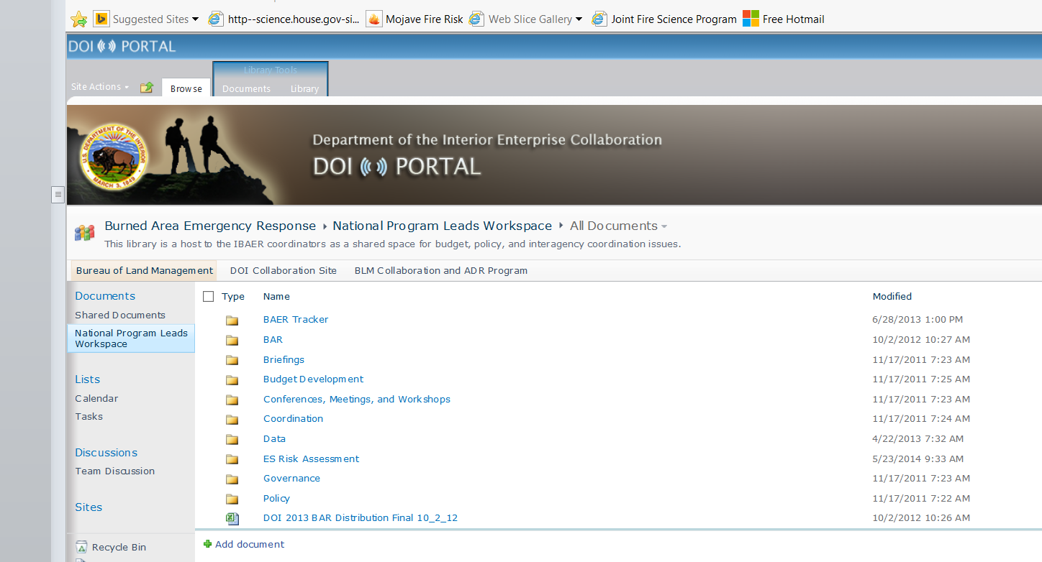
BAER Tracker

Slide 12
BAER Tracker
DOI Sharepoint Site
Access will be given to DOI BAER Team members
FS cannot access the DOI Sharepoint
https://portal.doi.net/blm/portal/BAER/National%20Program%20Leads%20Workspace/Forms/AllItems.aspx
As of 4/20, 34 out of 55 team members have responded to the Doodle Poll for availability

Slide 13
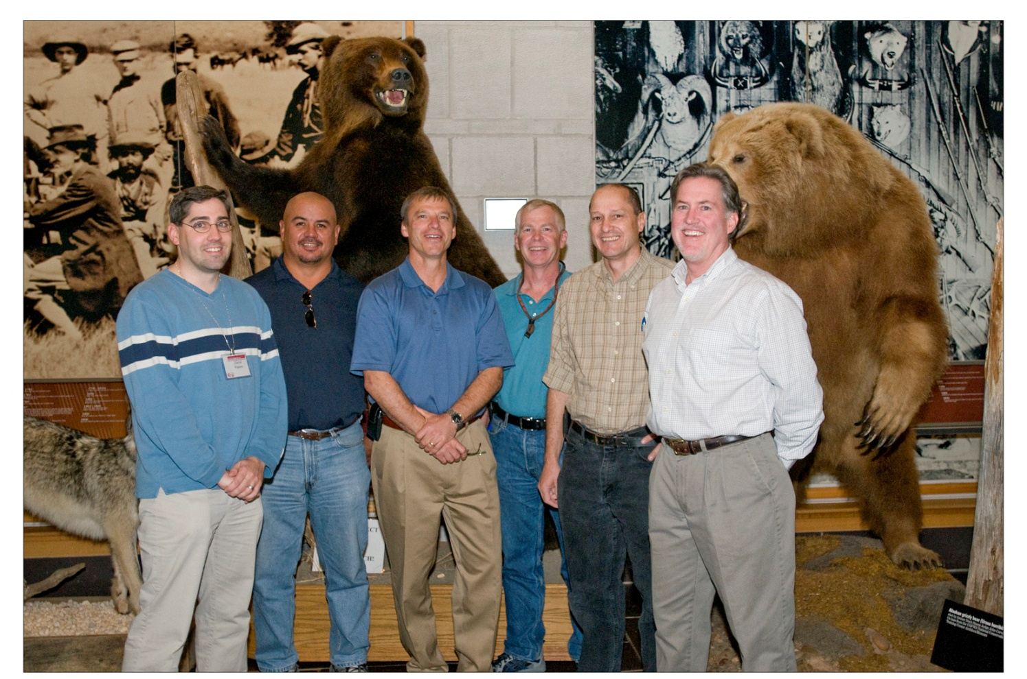
Questions?

