Slide 1
National BAER Team Members Monthly Call
We will be starting at
0900 Pacific
1000 Mountain
We are currently
on mute.
We will be using the Webinar provided telephone number.
Not 1-866-700-8920

Slide 2
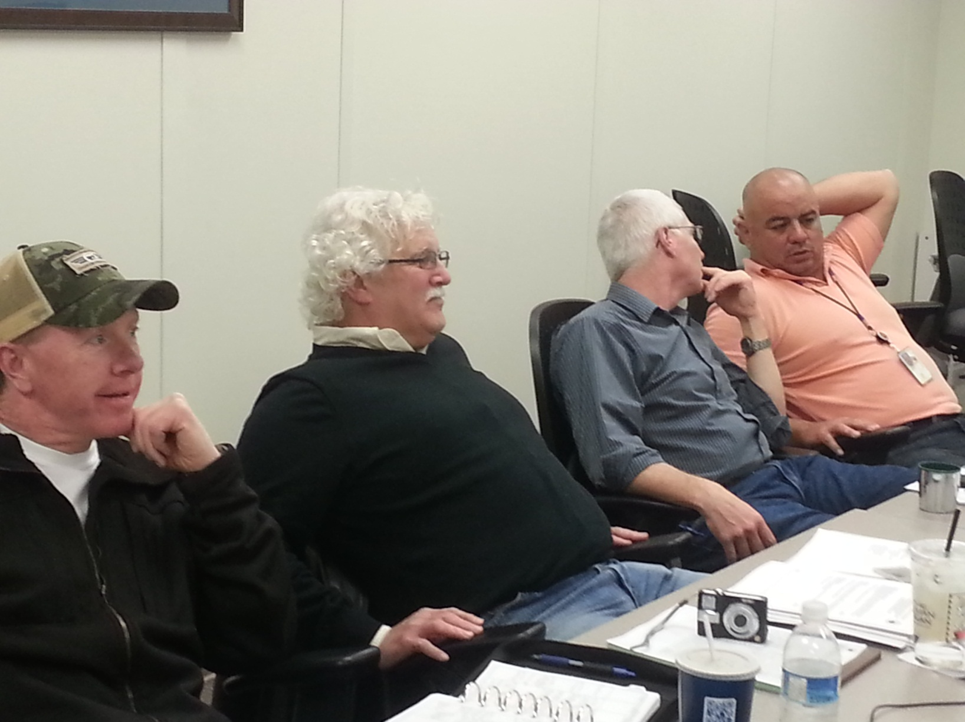
Your Leadership Team

Slide 3
National BAER Team Members Monthly Call
Agenda:
Fire Fighter Refresher and Work Capacity Test Reminder
Re-up for Current National Team Members
Recruitment for New Members
Annual Team Meeting Agenda
Training Opportunities
USFS BAER
NPS READ
Webinar on Rx Soils
Southeast and Southwest Fire Outlook
Anything Else?

