Slide 1
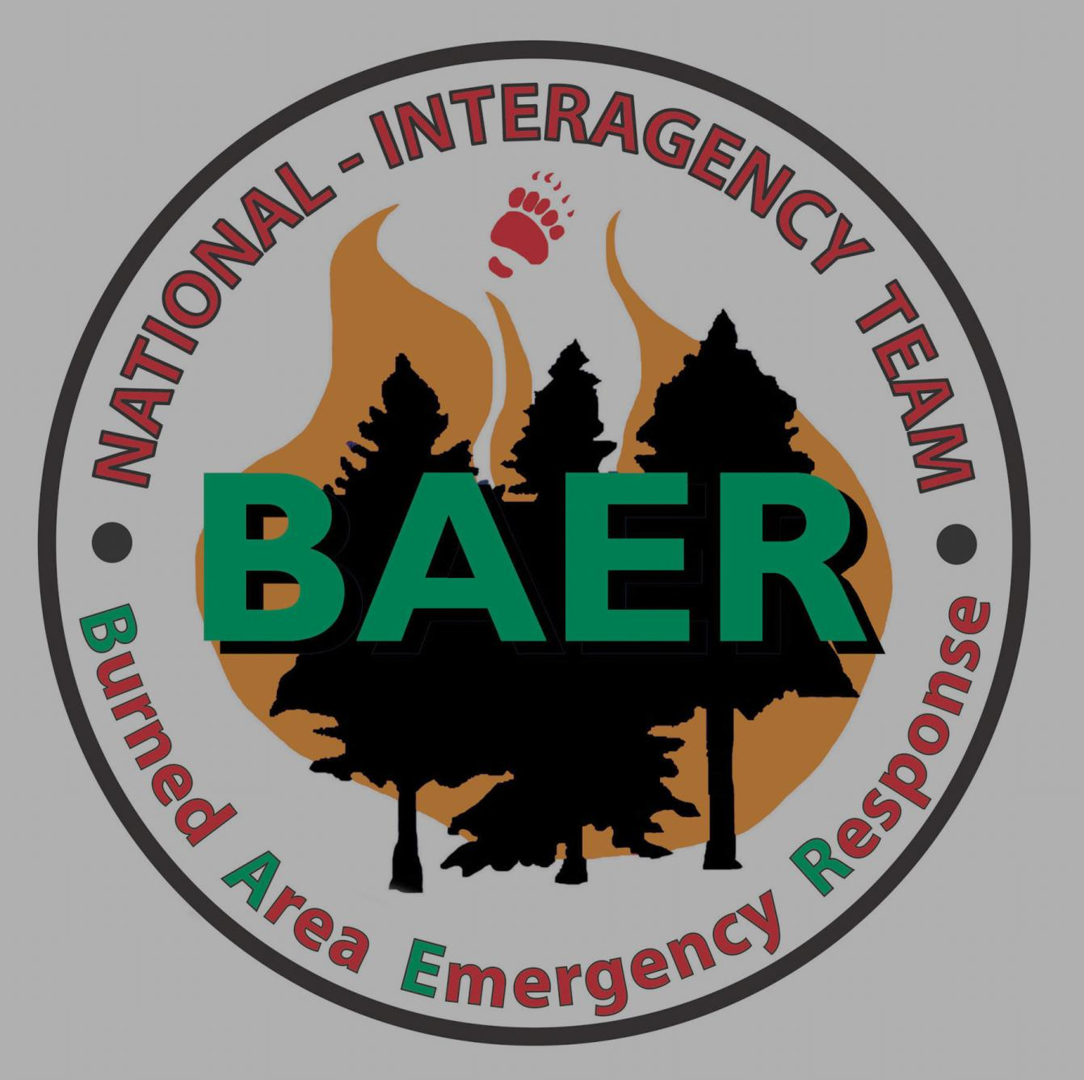
Retirees & Requiem - 2014

Slide 2
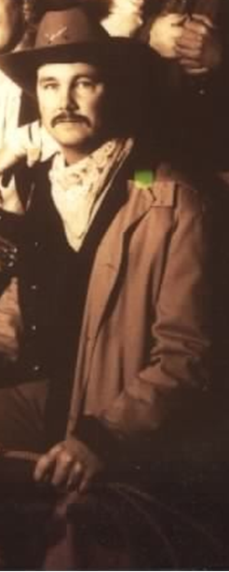
Dave Smith
Vegetation Specialist
Range Conservation
BAER Team Leader
DOI BAER Team
1994-2006
Retired
2014

Slide 3
Judy Hallisey
Hydrologist
DOI BAER Team
2000 – 2014
Retired
2014

Slide 4
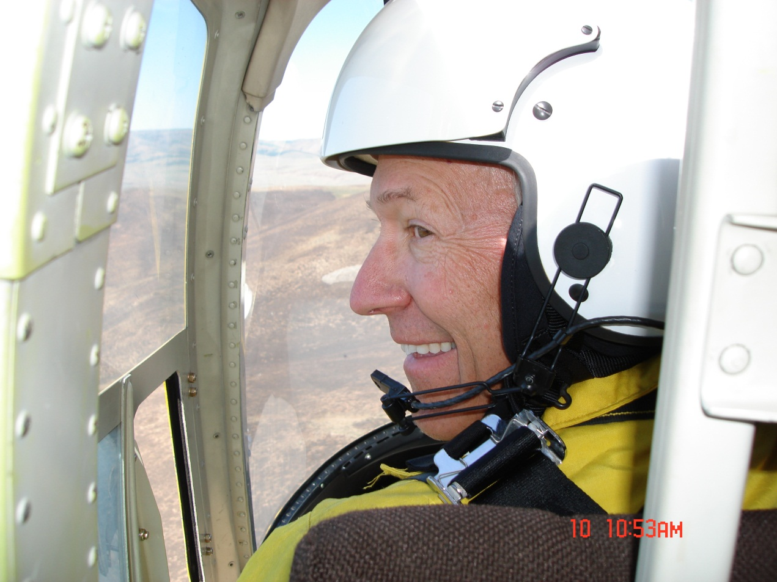
In Loving Memory John Morris Henderson Wildlife Biologist DOI National BAER Team 2006-2012

Slide 5
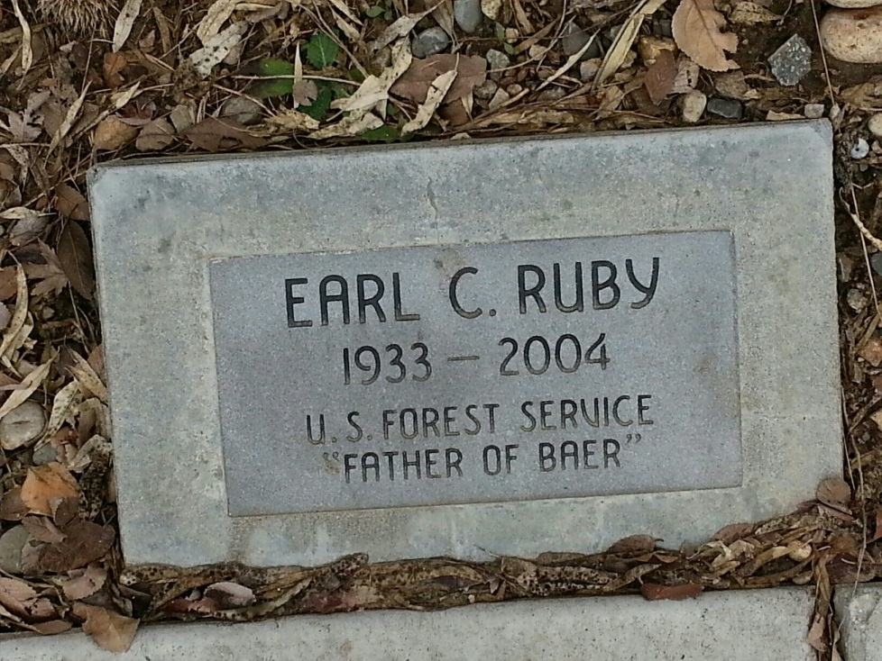
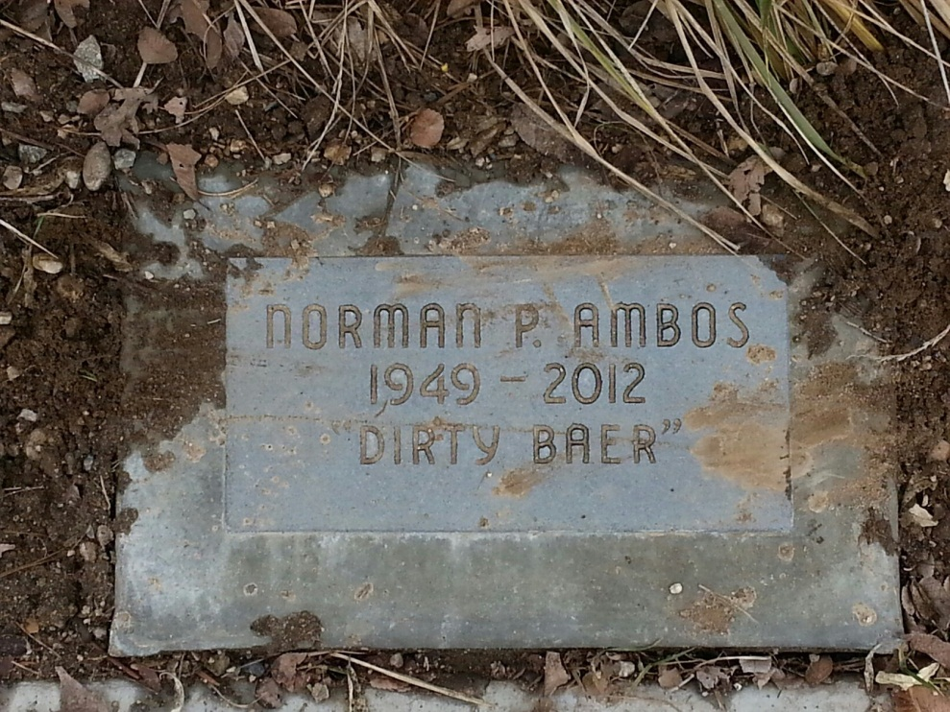
Wildland Firefighters Monument
National Interagency Fire Center
Boise, Idaho

