Slide 1

NATIONAL BAER TEAM MEETING
NATIONAL COORDINATORS REPORT
STATE of the BAER
April 21, 2015

Slide 2
MEETING OBJECTIVES
BAER Program
Policy Updates
Prepare for this Season
Preview of Upcoming Issues

Slide 3

Great Job!!!!!
The Interior Burned Area Emergency Response Coordinators and the National BAER Team Leaders would like to recognize and thank all of you who participate in the DOI BAER program.

Slide 4

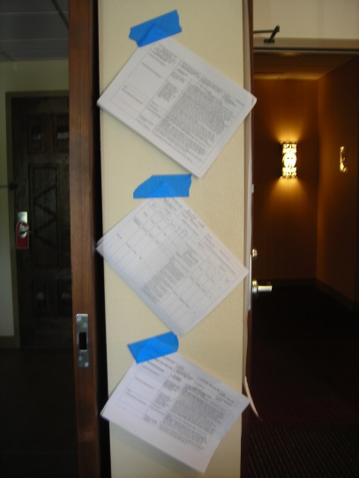
SAFETY FIRST!

Slide 5
Interior’s Expectations of BAER
  Professionalism
  Timely response
  Produce a good product (ES plan)

Slide 6
Who We Are
  Resource Specialists
  Team Leaders
  BAER Coordinators
The “A” Team

Slide 7
How You Do Your Job
Values at Risk
How you do your assessments
How you do your basic reports
How the final package is put together

Slide 8
BAER Programs:
  Emergency Stabilization (ES)
    Primary focus of your plans
What’s Kind of New:
  Burned Area Rehabilitation (BAR)
    Are including BAR recommendations in the more “national” level incidents & BAR treatments in the “regional/state” level plans.
  Restoration - Need to look long-term to determine what our ultimate goal of the site might be.

Slide 9
Tools:
  AGWA modeling
  Risk Assessment tool
  Use of ADs – 90 days after plan signature

Slide 10
BAER TRACKER:
  You have to apply or re-up (form)
  You have to respond to the Doodle poll on availability
  You have to report your assignments

Slide 12
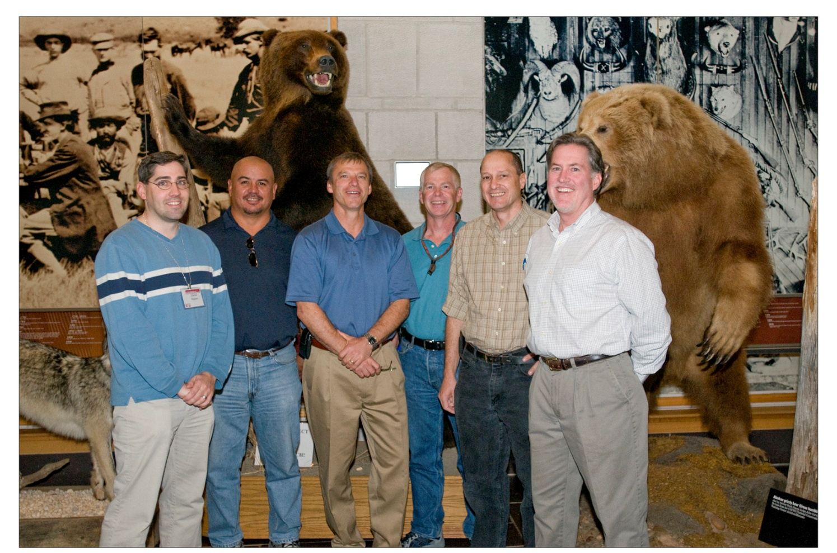
Questions?

