Slide 1



Watershed Modeling
Risk Assessments/Decisions
D. Phillip Guertin
University of Arizona
David C. Goodrich
USDA Agricultural Research Service
With comments from T.J. Clifford and Dr. Richard (Pete) Hawkins

Slide 2
Tools for Estimating Post-Fire Peak Flow
USGS Regression Equations
Rule of Thumb by Kuyumjian
Distributed Curve Number Based Methods
  WILDCAT5
  TR55
Distributed Watershed Models with channel routing
  AGWA/KINEROS2
  HEC Hydrologic Modeling System

Slide 3
USGS Regression Equations
Use with care.
  Empirical relationships based on USGS gaging station data.
  Represent the typical conditions – not post disturbance.
Appropriate for large watersheds that are > 5 square miles.
  Will only estimate Peak Discharge at a point.
Return period Peak Discharges can be a result of rainfall, snowmelt or rain on snow events.
  In mountainous areas low return periods events are typically the result of snowmelt events.
  Comparing modeling results for a rain event to a regression result based on snow events is not appropriate.
Method for estimating post-fire response is subjective.
  Data is needed from disturbed watersheds to create new regressions or to develop robust schemes for adjusting predicted values based on fire severity.

Slide 4
WILDCAT5
Developed by Pete Hawkins
Several empirical methods for estimating excess rainfall.
  Curve Number – The only method that addresses post-fire.
  Exponentially Distributed Infiltration Capacities
  Distributed Infiltration (F)
  Phi Index
  Constant Fraction
  Complacent – Violent
Need to estimate the time of concentration.
Uses the Unit Hydrograph approach to estimate Peak Discharge.
EXCEL Spreadsheet Application – Relatively easy to use.

Slide 5
WILDCAT5
Estimates Peak Discharge at a point (watershed outlet).
Needs watershed data:
  Curve Number Distribution (Soil/Land Cover Combinations)
    Users must select the Curve Number.
  Watershed Size, Length of Longest Channel, Average Land Slope or Channel Slope.
  Curve Numbers are changed to address fire effects.
  GIS analysis is needed for post-fire assessment to get best results.
Only appropriate for watersheds < 5 square miles, because of rainfall assumptions and empirical routing.
The curve number method has difficulties with systems dominated by subsurface flow.

Slide 6
AGWA/KINEROS2
KINEROS2 is physically-based model – AGWA automates the parameterization of KINEROS2 based on soil, land cover and terrain GIS data.
Runoff is routed down channels making it more appropriate for larger watersheds.
KINEROS2 models both hydrology and erosion; peak discharge, hillslope erosion and sediment yield across the whole watershed.
To address fire effects cover, interception, saturated hydraulic conductivity, and Manning’s n are changed.
Requires more training then WILDCAT5. GIS knowledge is useful.
KINEROS2 has difficulties with systems dominated by subsurface flow.

Slide 7
Performance
ALL models will perform better if they are calibrated for a specific watershed using local rainfall and runoff data.
    For the most accurate results models should be calibrated for both pre- and post-disturbance.
    Data (and time) is usually not available.
Un-calibrated models should only be used for relative change analysis which is very appropriate for planning situations.
  For planning representing trends is more important than accuracy.
A model typically does well in a limited set of hydro-meteorological regimes.
    WILDCAT5 and AGWA/KINEROS2 both perform poorly, without calibration, for systems dominated by subsurface flow and high water tables.

Slide 8
KINEROS2 Modeling Expectations
Recent study compares pre- and post-fire modeling results for Rule of Thumb (ROT), Modified Rational Method (MODRAT), HEC-HMS Curve Number, and KINEROS2 in San Dimas Exp. Forest (Chen et al. 2013).
  ROT & MODRAT – OK with careful local calibration
  HEC-HMS CN better for pre-fire prediction
  KINEROS2 better for post-fire prediction
  Evidence that pre-fire runoff is Sat. Excess or Subsurface and post-fire is Inf. Excess
  KINEROS2 (as currently setup in AGWA) only does Inf. Excess (can do Sat. Excess from shallow soils over rock)

Slide 9
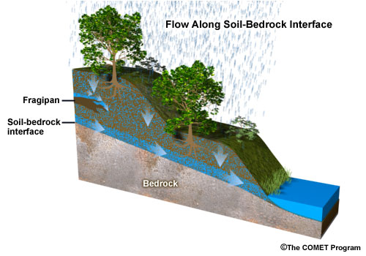
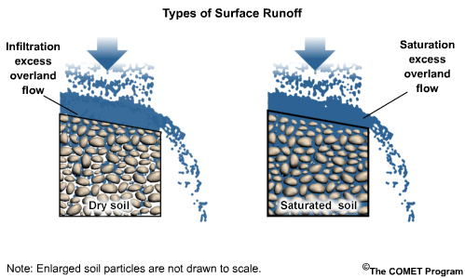
Basics of Runoff Generation
Interflow – Shallow
Subsurface Flow
Infiltration
Excess
Saturation
Excess
Rainfall Int. >
Soil Infil. Rate
Typical in burned areas – high Int. rain
Soil pores saturated
Wet areas – shallow water table or shallow soil over rock
Infiltrated rain hits restrictive layer and flows laterally to stream (slow response, attenuated peak)
Typical in unburned areas with shallow soils and heavy litter
KINEROS2 – as set up in AGWA
CN better represents this mechanism
IF EXCESS MORE CRITICAL FOR FIRE
RISKS – LIKE HYDROPHOBIC FOR
INITIAL FLUSH
MORE RELATED TO SNOW
NOT AS CRITICAL IN A FIRE SITUATION

Slide 10
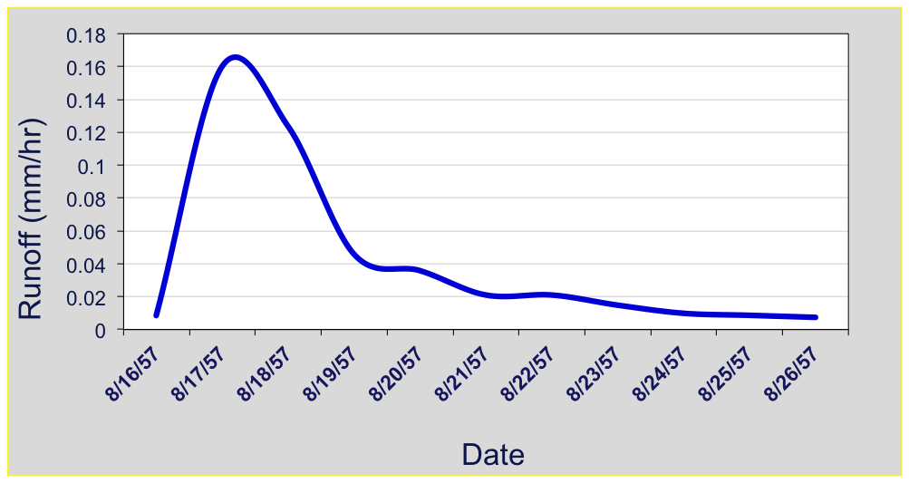
Marshall Gulch
0.16
Avg. Storm Depth ~ 54 mm
Runoff Vol. ~ 10 mm
Runoff/Rainfall Ratio = 0.19
Qp = 0.16 mm/hr
(~ 5yr, 60 min design storm)
Pre - Fire Hydrograph
8/16/57 – 8/26/57
10 days
Post - Fire Hydrograph
7/24/03
(Aspen Fire – 6/17/03 ~ 7/10/03)
~3 hours
4.0
Avg. Storm Depth ~ 43.9 mm
Runoff Vol. ~ 4.6mm
Runoff/Rainfall Ratio = 0.10
Qp = 4.14 mm/hr
(10-25yr, 60 min design storm)
3.0
2.0
Runoff (mm/hr)
1.0
0
Time (minutes)
200
Runoff / rainfall ratio similar; timing & peak runoff rate are profoundly different (also noted by Springer & Hawkins 2005; McLin et al. 2001).
14

Slide 11
Percent Change for Observed Storms
(no modeling results on this slide)
Unburned Condition 2013
7/27/2013 – 45 mm storm depth
Burned Condition 2003
7/24/2003 – 41 mm storm depth
I30 =71 mm/hr
I30=65 mm/hr
Qp = 0.83 mm/h
Qp = 4.14 mm/h
399% Difference in Qp from burned to unburned for an Obs. ~5 year, 1 hr design storm
NOTE: 5 year – 1 hour design storm for this location is 43 mm
Notes:
Note that unburned conditions are not modeled well by K2 (physically based models) with low runoff ratios. Also remind that K2 does not model saturation excess runoff generation (expected mechanism for forests) but does model burned conditions well (infiltration excess)

Slide 12
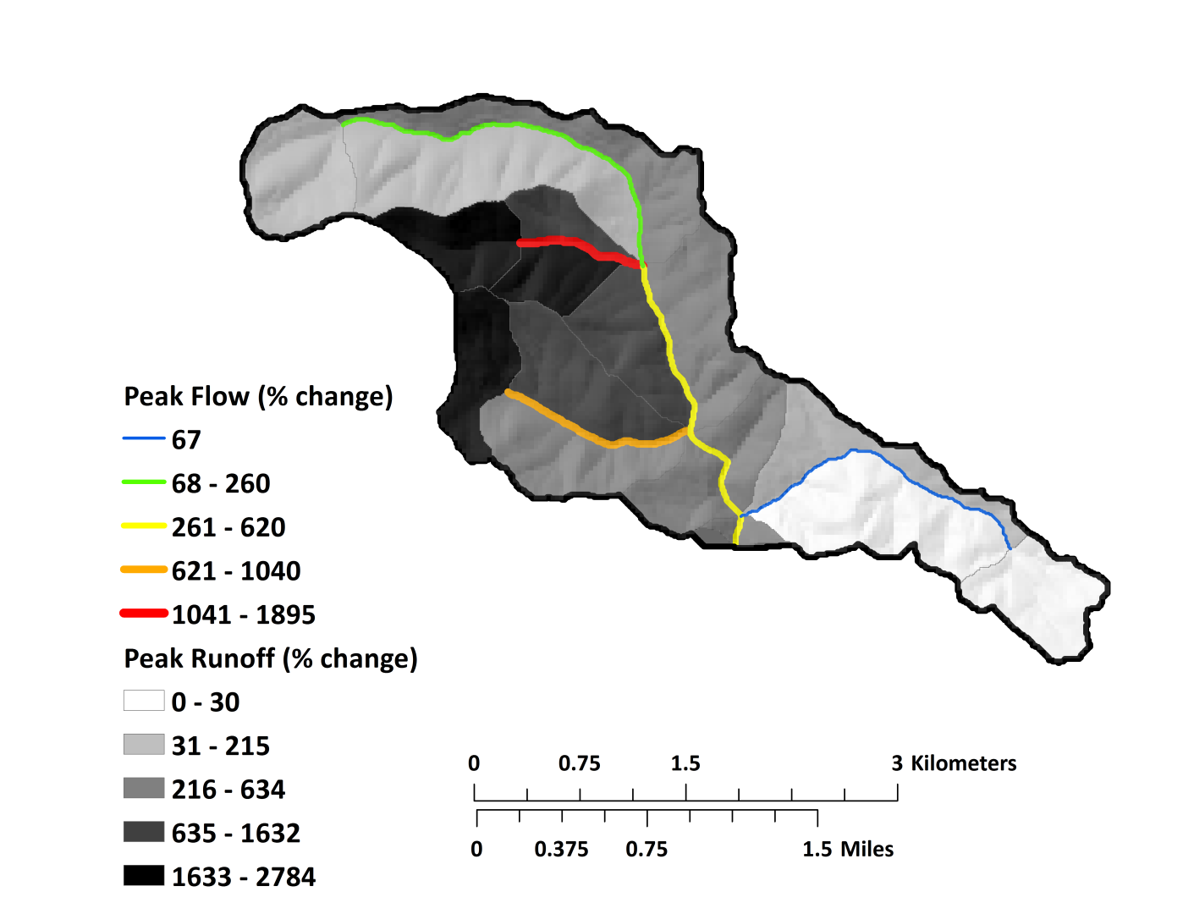
Percent Change for Simulated Design Storm
Model Burned & Unburned using default (uncalibrated) AGWA parameters
Total Rainfall = 43mm
I30 = 70 mm/hr
Qp=50 mm/h
Qp=9 mm/h
456% Diff. in Peak Flow at Outlet for a 5 yr - 1 hr Design Storm
POINT: Relative change in Qp between burned and unburned is about
the same for Observed (399%) and Modeled (456%) using out of the box (uncalibrated) AGWA parameters for an ~5 yr-1 hr storm

Slide 13
Rainfall Representation
All hydrologic models are highly sensitive to rainfall characteristics.
  Rainfall Amount
  Rainfall Duration
  Rainfall Distribution (i.e. hyetograph)
  Amount, Duration, & Distribution → Pattern of Rainfall Intensity
For both WILDCAT5 and AGWA/KINEROS2 the largest source of uncertainty is how rainfall is represented.
Neither model will accurately predict an observed runoff event without using the observed rainfall.
However, relative risk can be assessed using design storms.

Slide 14
Rainfall representation when there is no observed data
SCS 24-hour Rainfall Distributions with NOAA
Design Storm Depths
II
Type I and IA – Pacific maritime climate with wet winters and dry summers. Long duration, low intensity events.
Type III – Gulf of Mexico and Atlantic coastal areas where tropical storms bring large 24-hour rainfall amounts.
Type II – Everywhere else, intense short duration rainfall, smaller extents.

Slide 15
WILDCAT5
Rain Amount (inches) | Duration (hours) | Distribution Type | Pre-Fire Peak Discharge (CFS) | Post-Fire Peak Discharge (CFS) | Percent Change
2 | 1 | NEH4B | 247 | 1076 | 436
2 | 1 | FARMER-FLETCHER | 271 | 1088 | 401
2 | 1 | GENERIC | 426 | 1506 | 354
1 Square Mile Watershed – a 25 year return period event in Alpine, AZ
WILDCAT5 has 10 Distribution Types and can also use “custom” storms.

Slide 16
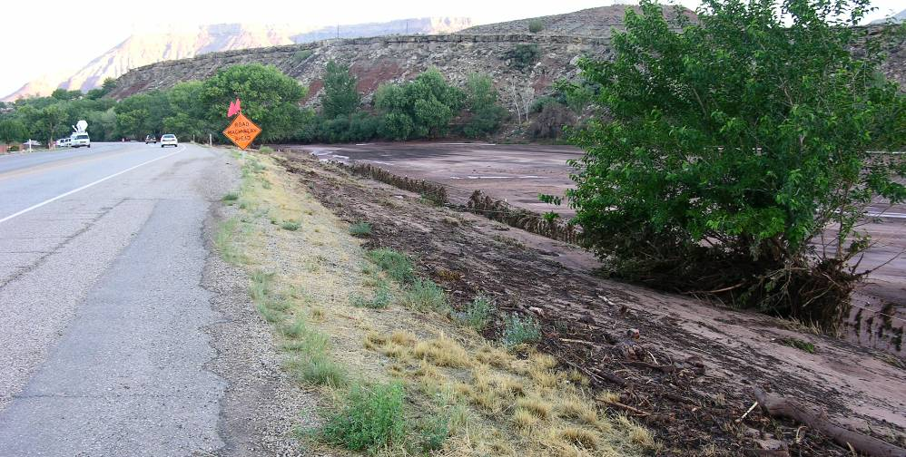
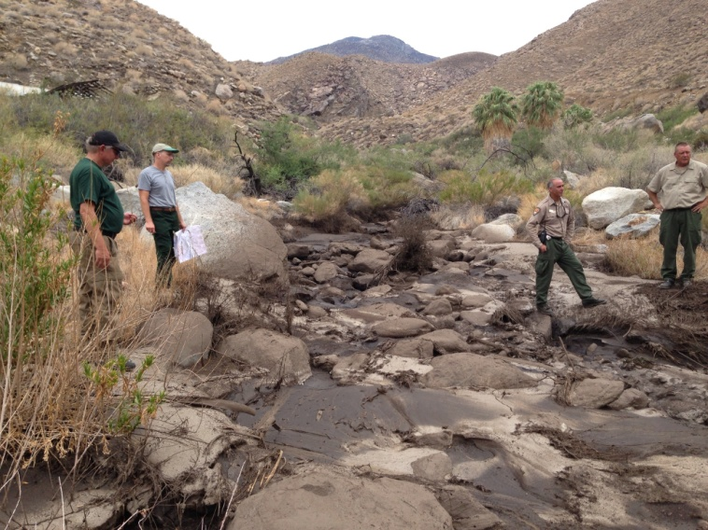
Typical goals when modeling post-fire runoff
How should rainfall be input into the model?
1. Accurately predict or
reproduce magnitude of an
event.
2. Predict which stream reaches
and hillslopes are at risk
(values at-risk).
How does rainfall representation affect our ability to meet these goals?
Sidman et al. 2015 IJWF

Slide 17
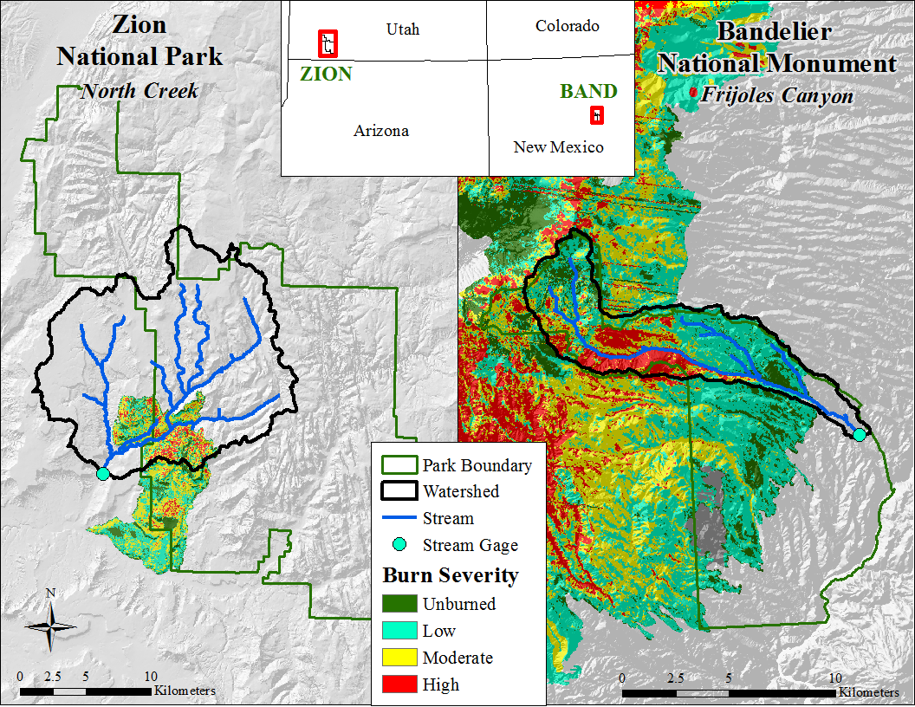
August 1, 2007 storm
>1 year after the fire
August 21, 2011 storm

Slide 18
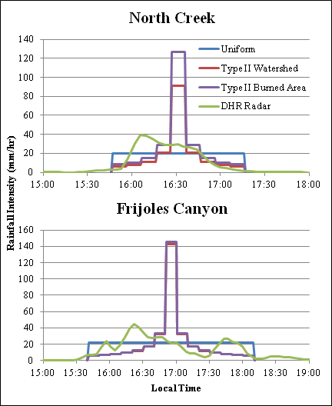
Reproducing Post-fire Flood Magnitude
What rainfall representation gives us the best estimate of peak discharge?
Rainfall Representations modeled:
Uniform rainfall intensity over the entire watershed
SCS Type II storm over the entire watershed
SCS Type II storm centered over the burned area
Digital hybrid reflectivity (DHR) radar data

Slide 19
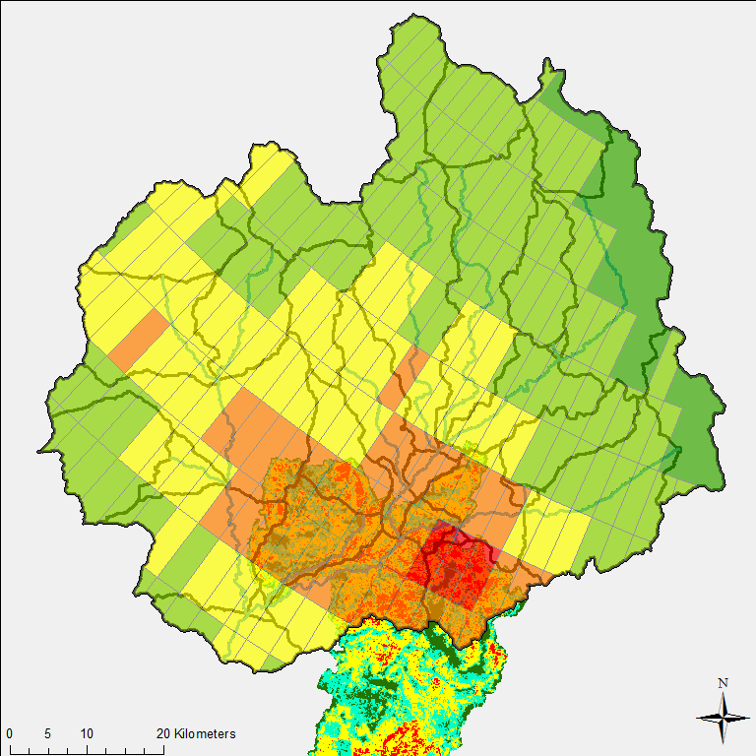
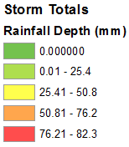
Radar Representation in KINEROS2
North Creek
Storm Totals
Average rainfall depth
over watershed: 30.22mm
(1.19’’ )
Approximate duration of
event: 1.5 hours
Correlates to ~10-year
rainfall event

Slide 20
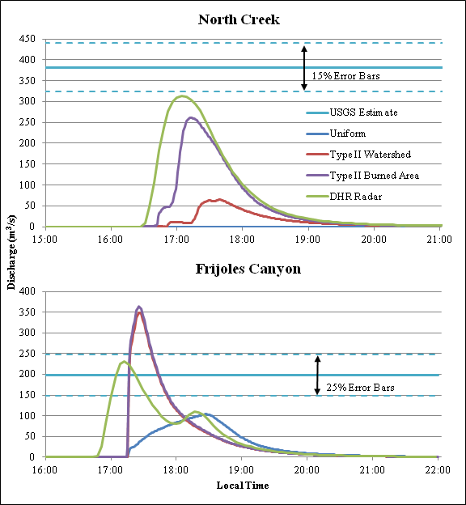
Post-fire Magnitude: Results
Uncertainty USGS
Indirect Meas. (15%)
Rainfall Representation | Peak Discharge (m3/s) | Time to Peak (min)
Uniform | 3 | 355
Type II | 65 | 215
Type II Burned Area | 261 | 189
DHR Radar | 313 | 184
USGS Estimate | 382 | ~180-240
USGS Est.
Uniform.
Type II All Area
Type II Burned
DHR Radar
Uncertainty USGS
Indirect Meas. (25%)

Slide 21
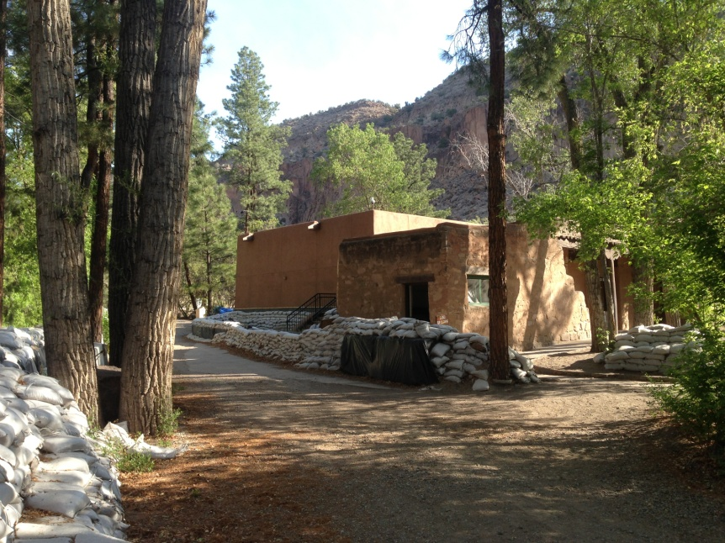
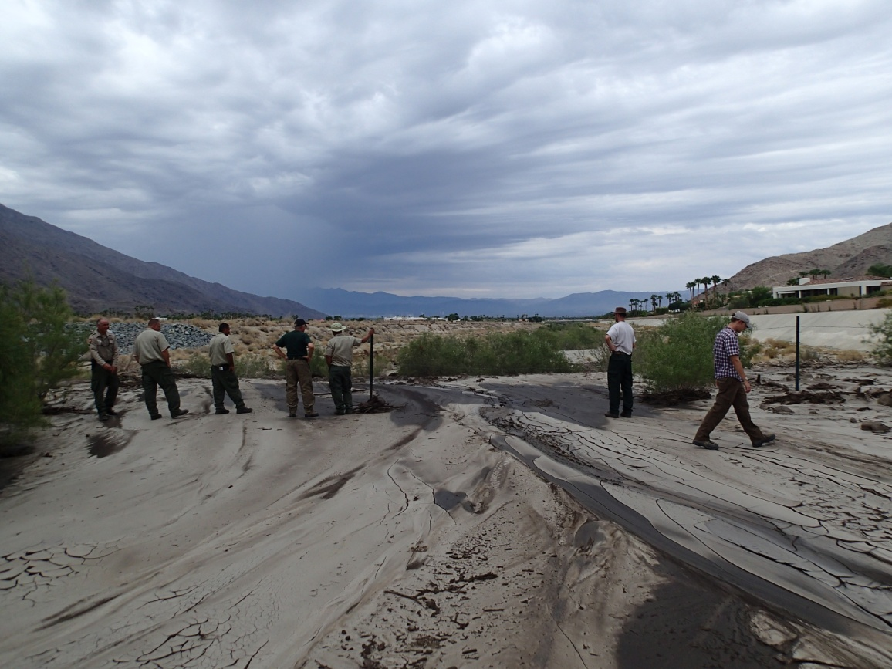
Predicting At-Risk Areas
Does rainfall representation change the model’s prediction of high-risk areas?
For rapid assessment of post-fire risk, a design storm is used:
Monsoon Storm: 2-year 30-minute, 13.18mm (0.52’’)

Slide 22
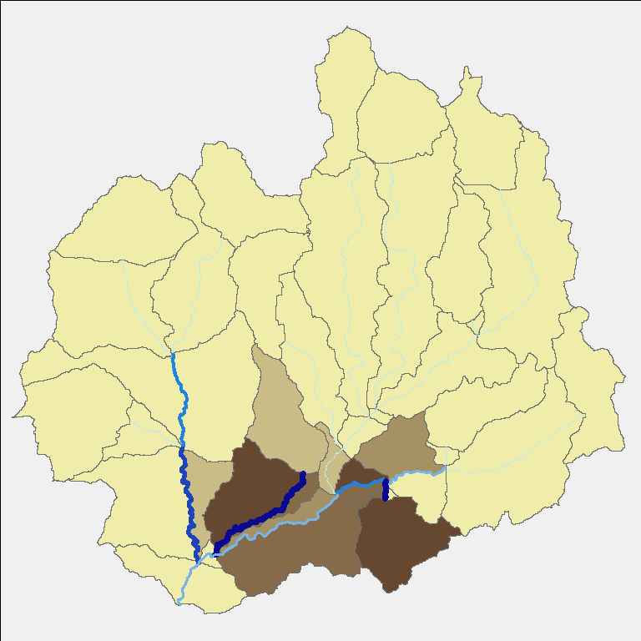
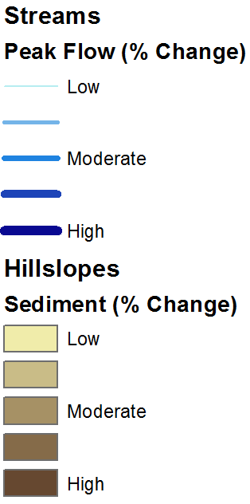
Predicting At-Risk Areas
Compare peak flow and sediment yield change from 4 storms:
Monsoon Storm
Uniform Intensity
SCS Type II over watershed
SCS Type II over burned area
Which stream reaches and hillslopes change the most pre- to post-fire?
SCS Type II over burned area

Slide 23
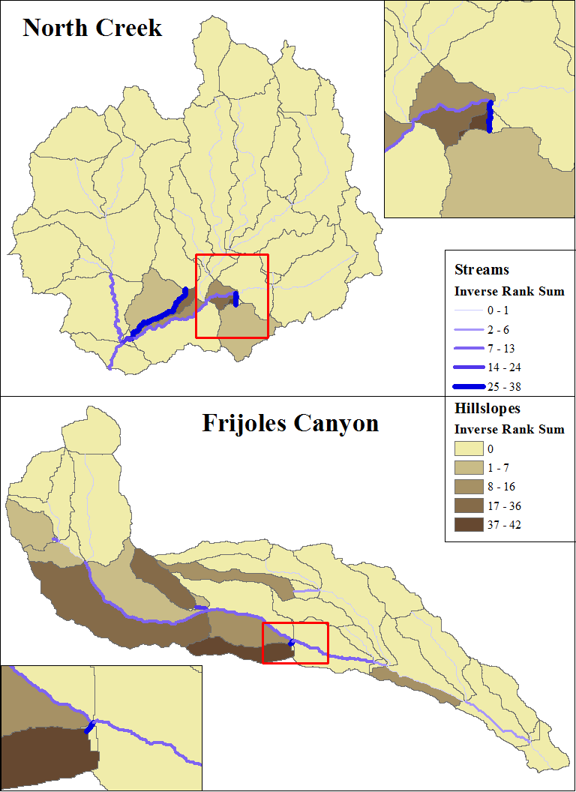
High-Risk Stream Reaches
Map of high risk areas.
To determine if rainfall representation changed the model’s predicted areas of high risk, peak runoff rate of stream reaches and sediment yield of hillslopes were ranked from highest to lowest percent change from pre- to post-fire for each rainfall representation.

Slide 24
Comparing Ranking of Risk Areas
Spearman’s Rank Coefficients (SRC) are generally high (SRC = 1 implies a perfect agreement in ranking, SRC = -1 corresponds to an inverse in ranking order)

Slide 25
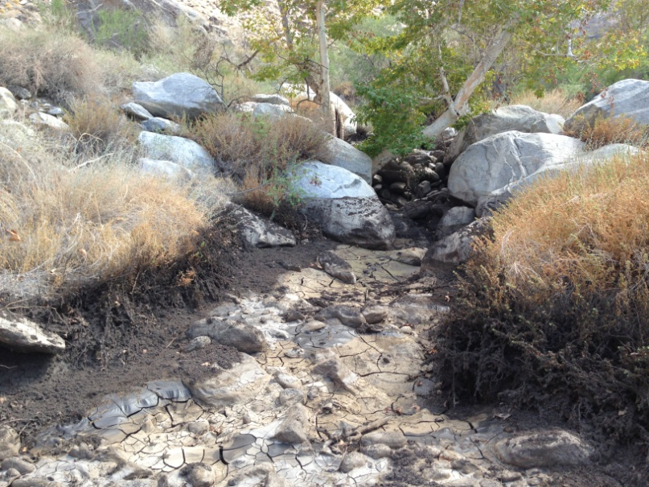
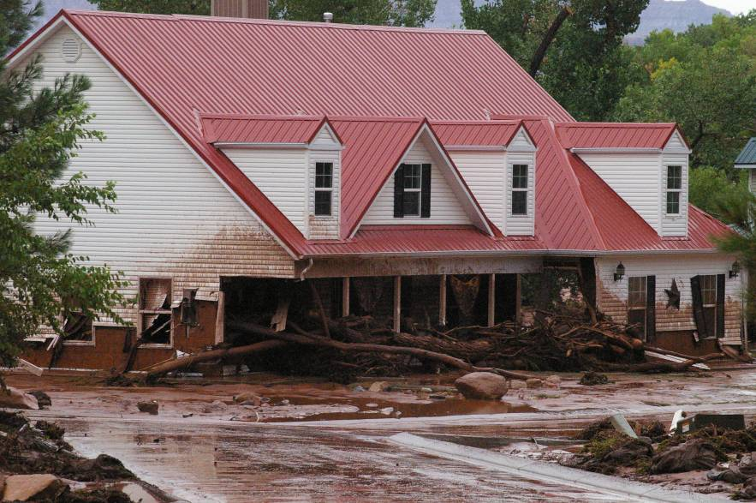
Rainfall-Representation Conclusions
Rainfall representation drastically changes
our ability to accurately model post-fire
storm magnitude.
Radar is the best method for modeling
magnitude.
High-risk areas do not vary drastically
between different rainfall representations
AGWA/KINEROS2 can reliably be used
to predict relative pre- to post fire change
to identify these areas
Models, when not calibrated, are more reliable at predicting relative change than absolute change

Slide 26
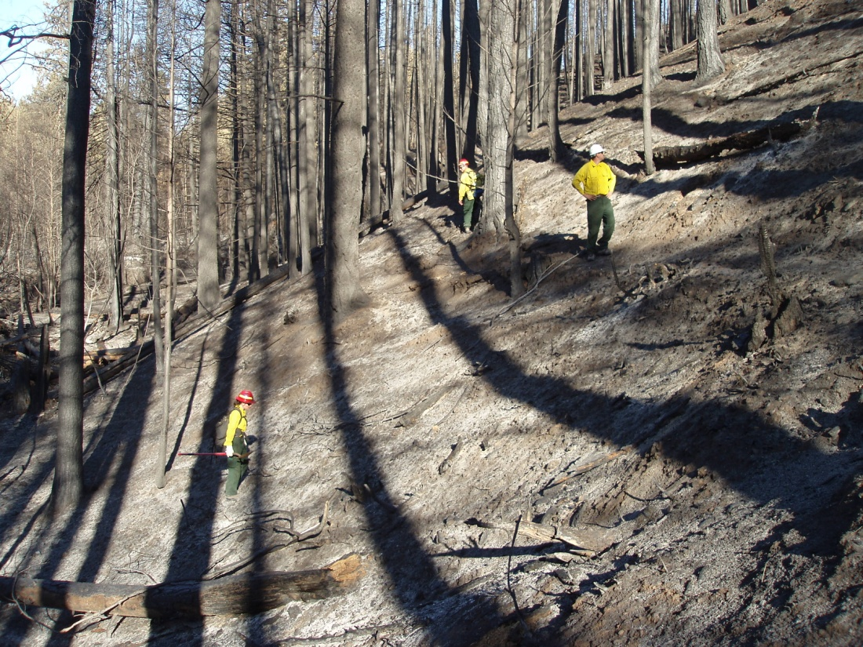
Questions

