Slide 1
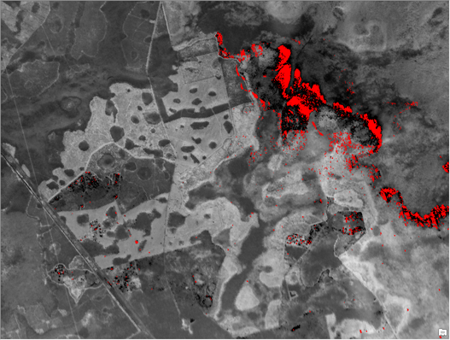
2017 Pre-Season Webinar for IRINs
Wednesday, May 10
0900 AKDT
1000 PDT
1100 MDT
1200 CDT
1300 EDT
Teleconference:
Dial: 1-888-844-9904
Passcode: 1470935#
Session is being recorded for posting along with presentation.
West Mims Fire GA/FL, April 17, 2017
Notes:
West Mims first mission of 2017

Slide 2
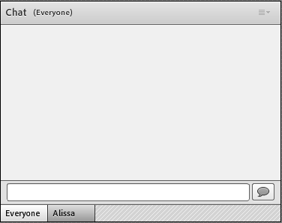
If you have a question during the webinar
Please use the Chat pod to ask a question. They will be monitored by the host and relayed to the presenters at the end. Follow these steps to submit a question:
Click in the text box in the Chat pod
Type your question and click on Send Message to the right of the text box OR click Enter
Text Box
Notes:
Unlike Webex, we can’t make Q & A chat private, only the A

Slide 3
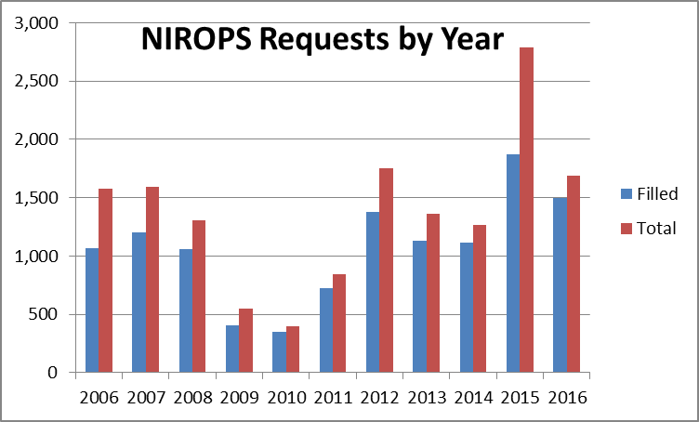
2016 NIROPS Requests
1,692 total requests with 1,495 filled
10 yr avg (2006-2015) 1,343 requests and 1,030 filled
10% UTF rate
Aircraft 3 filled
3% of missions
(28% in 2015)
Notes:
Numbers are for all of 2016 including SA November missions.
2015 - 33% UTF (26% non-weather)
2015 was record year for requests and missions.

Slide 4
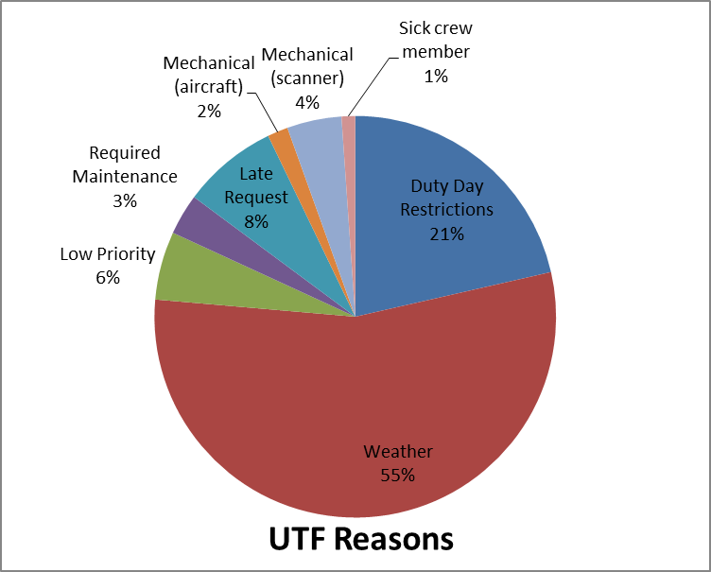
UTFs (Unable to Fill)
182 total UTFs (NIROPS only)
UTF rate drops from 10% to 4% when weather UTFs are not counted
UTF for Aircraft 3 - 17% (10% non-weather)
Notes:
NIROPS only (182 UTFs)
14 UTFs for late orders
No UTFs for Mandatory days off this year (compare to last year
208 orders went submitted after 1530 cutoff, 31 orders after 1600, only 12 UTFs for late request

Slide 5
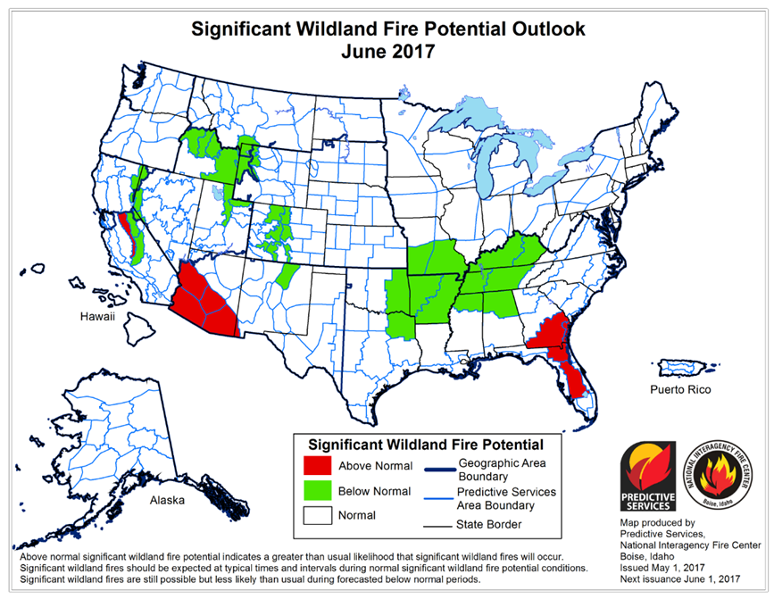
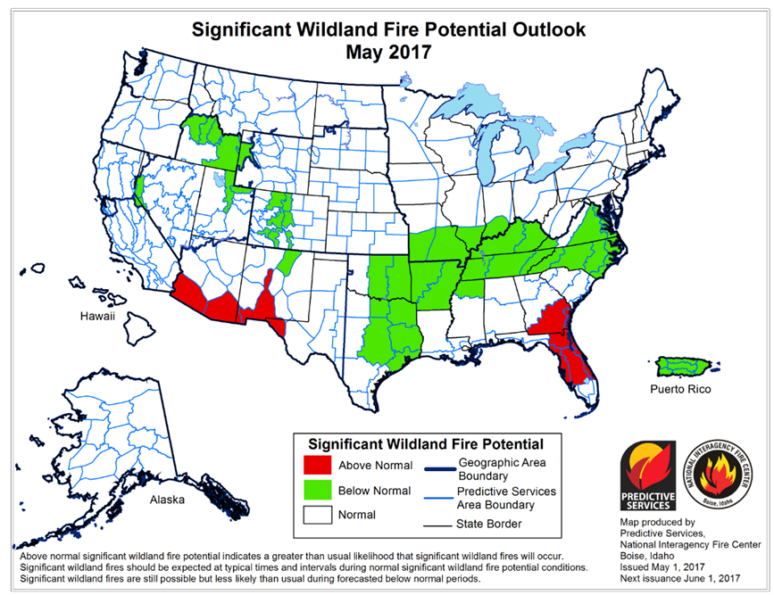
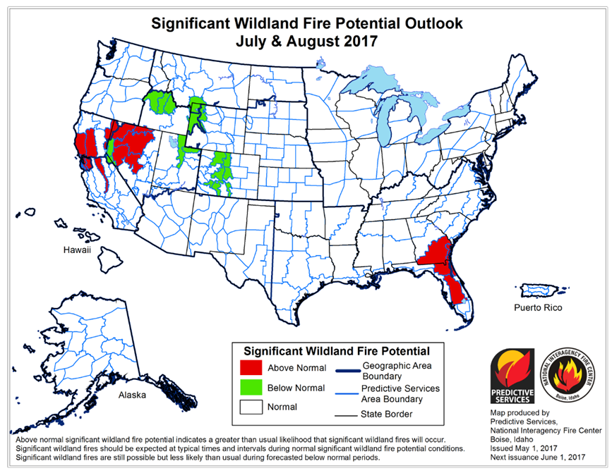
Update with May 1st 3 month outlook

Slide 6
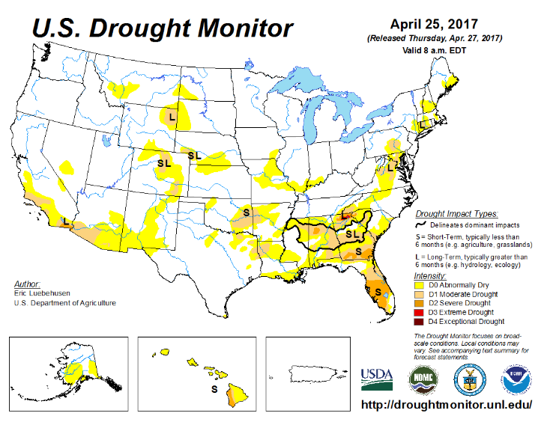
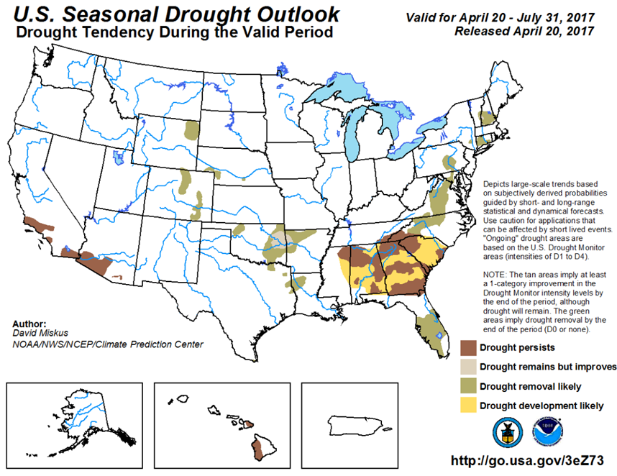
Update with May 1st 3 month outlook
Notes:
Drought area are primarily lower elevation areas outside of CA

Slide 7
Currency and Trainees (Hope Spriggs)
Currency requirements
5 years from date of last assignment
Update experience record with IQCS Manager each fall
Trainees – remote trainee assignments, how many assignments
Important to fill out evaluation record(s) completely
NWCG Taskbook
Taskbook good for 3 years from date of first assignment
NEW Taskbook Location: https://www.nwcg.gov/publications/position-taskbooks
RT-130 Annual Fire Refresher - regional requirement only
Taskbook Evaluations: Example on next slide:
Notes:
You are current for 5 years from date of last assignment, after that you revert to trainee status.
There is no required # of assignments, it depends on the evaluating IRIN.
PTB is good for 3 years from date of your first assignment.

Slide 8
Notes:
For more Taskbook information and guidance: See the PMS 310-1 Page 10 (October 2015 version)

Slide 9
Website Address Changes
NIROPS and Active Fire Maps (AFM)
NIROPS: https://fsapps.nwcg.gov/nirops
AFM: https://fsapps.nwcg.gov/afm
Download KMLs/KMZs again
NIROPS CDE
MODIS and VIIRS
Don’t presently work with Google Earth Chrome
Notes:
Google Earth Chrome is a new web browser-based version of Google Earth. Nothing is installed on your device. Only works in Chrome, not in other web browsers.

Slide 10
Online Scanner Order Page (Jan Johnson)
2017 Updates
General User Updates
NIROPS website was moved to new server at EROS Data Center in early December 2016.
Overall the website is nominal but we are still picking up glitches.
Still sharing the server with Active Fire Maps (AFM) and BAER.
Looking at options for load balancing to improve performance during high demand.
Reminder message about Current Orders
Auto-fill average incident elevation field
Modification log

Slide 11
Current Orders Reminder

Slide 12
Average Incident Elevation
The average incident elevation field will auto-fill based on the elevation data in Google Maps.
If there is more than one box in the scan order, the elevation is the average of all the boxes.
Notes:
This was requested by the IR tech’s to aid in their mission planning.

Slide 13
IR Order Modification Log
The modification log will allow us to keep track of everyone who touches the IR request during the day.
The email link allows us to contact the individual if questions come up about the change(s) in the IR request.

Slide 14
Flight Time Critical Check Box
If the incident requests an IR flight at a specific time, the box can be checked on, and the reason for the request can be explained in the User Comments.
This is primarily for early and late season fires.

Slide 15
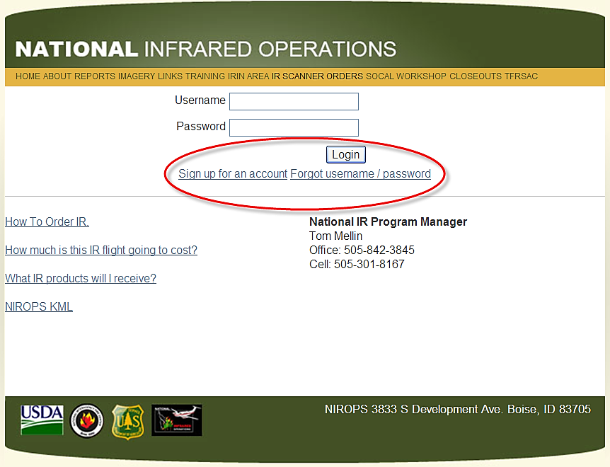
Reminders From 2016
“Forgot Username/Password” link
“Sign up for an account” link
Automatic notification email to the GACC IR Liaison
“NIROPS Account Accepted” with user contact info
Auto notification if order is UTF
Need valid email for incident
Forest Service email users
Check your “Junk E-Mail” folder
Time lag in FS email
Cache of FS PCs can be “sticky”
<Ctrl> + F5 helps to clear the cache
Notes:
Default domains are the same as the WFDSS default domains: fs.fed.us, blm.gov, nps.gov, bia.gov, fws.gov
State email domains: CalFire, fire.ca.gov, Oregon Department of Forestry (ODF), oregon.gov, Washington DNR, dnr.wa.gov
If you use FS email, legitimate messages can end up in you Junk E-Mail folder;
There is a time lag with messages/responses that go to FS email accounts
Confirm that incident email is valid, AND, entered correctly in email box
Cache on FS PCs tends to be “sticky”, doing <Ctrl> + F5 occasionally helps to clear the cache

Slide 16
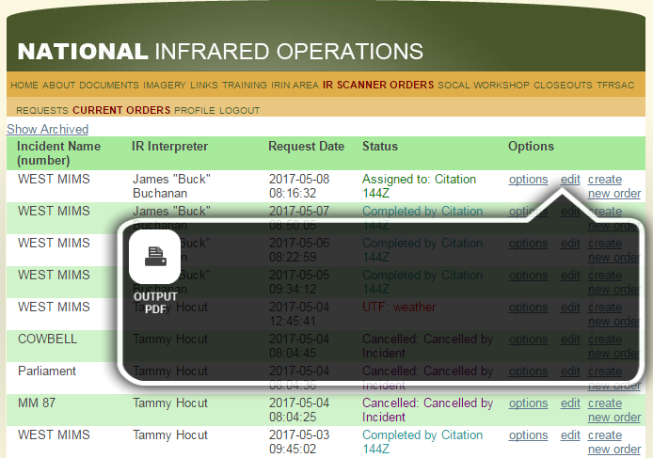
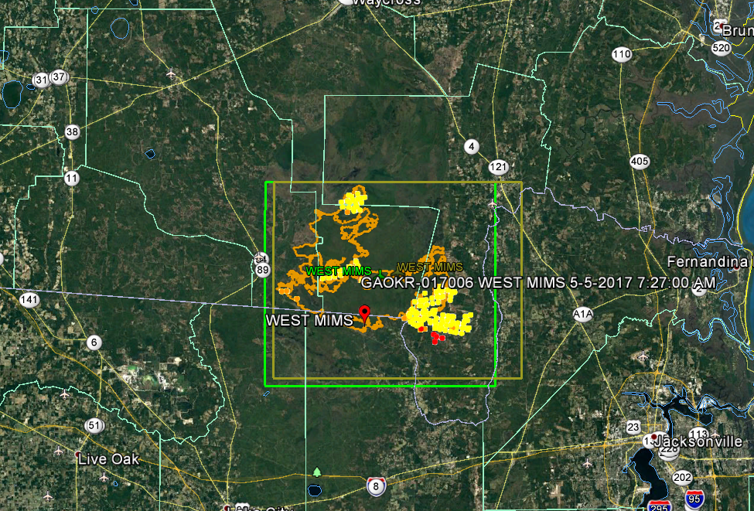
Checking Scan Boxes
Generate a PDF of your order from the Current Orders to check scan box coordinates and other information
Use the NIROPS CDE KML to check scan box size and location

Slide 17
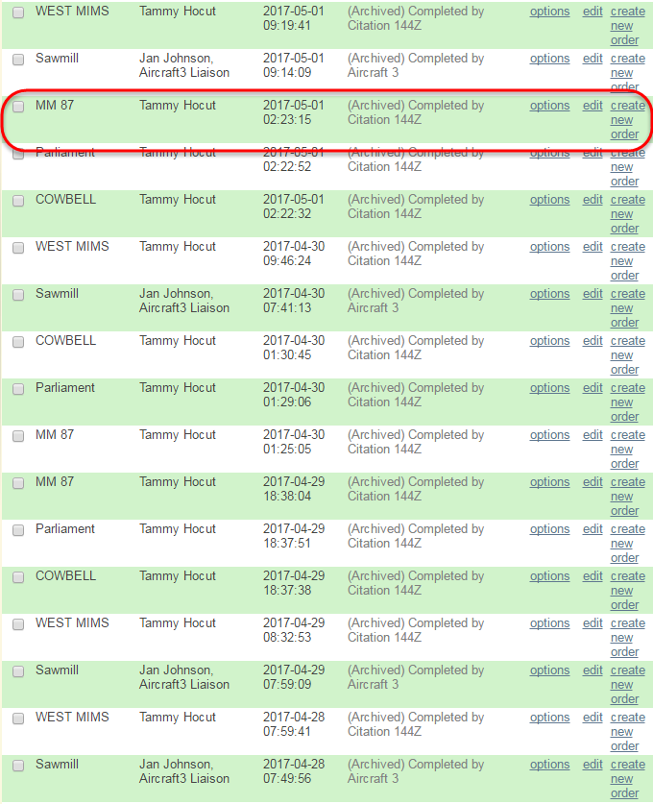
Retrieving Archived Orders
If you need to retrieve and submit an archived order as a new order
Go to “Current Orders”
Click on “Show Archived”
Find your old order
Click “create new order”
Edit order
Click on “Submit as New Request”

Slide 18
Final (?) Items
If you run into an Online Ordering issue
Send me a detailed email, with a screen grab of the error if you can, OR,
Call me, however,
Support is NOT 24/7
Updates were pushed to the server in late March
There will be some glitches, so as always, be patient.
Notes:
Don’t wait until the fall closeout to bring up a problem that has been occurring since the beginning of the season

Slide 19
Data Sources (Jim Grace)
For local copies of background data
NIFC FTP site: /base_info/topo_maps (new geotiffs)
NRCS Data Gateway
USGS topo, Lidar hillshade, interactive map much like RDDS
https://gdg.sc.egov.usda.gov/GDGOrder.aspx
Export from ArcGIS Servers (FS, APFO)
USGS HDDS or EarthExplorer
RDDS no longer exists
Disadvantage is these are not seamless
Incident GISS
Rocky Mountain teams have hard drives
T: drive
Notes:
RDDS Rapid Data Delivery/Distribution? System
HDDS Hazards Data Distribution System
NRCS Data is by county
Location of the new topo geotiffs /base_info/topo_maps folder on the ftp site
7_5MinuteQuadIndex_GDB_layerfile.zip is posted at the root level of the ftp site and covers the entire US

Slide 20
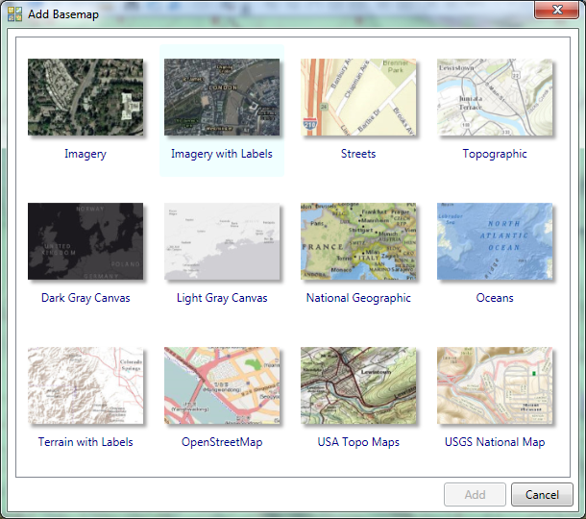
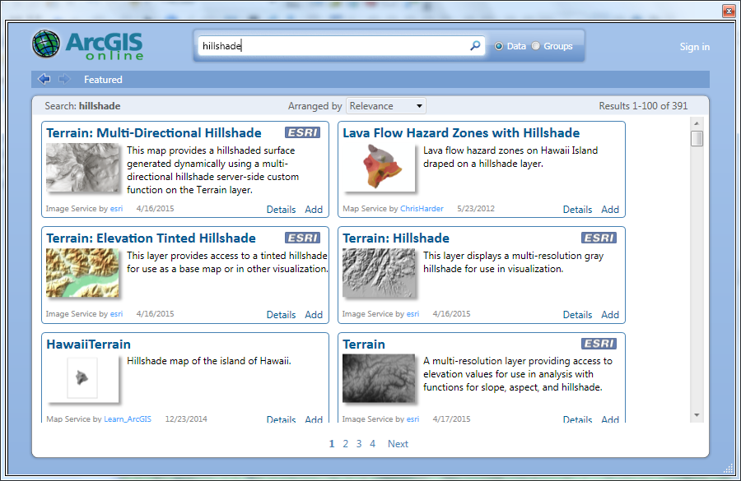
Data Sources
Several Map Services available
In ArcGIS under Add Data
Add Basemap Add from ArcGIS Online
Notes:
This is data only available if the service is up and running, it’s pretty stable but what if the server goes down?? Do you have a local copy of DRG’s to continue mapping and on schedule?? The Image server for FS and BLM is also available but I wanted to stick with the options open for anybody. There’s most likely other map services published out there

Slide 21
Data Sources
Several Map Services available
In ArcGIS under Add Data; Add ArcGIS Server
USFS 166.2.126.54 (Raster Data Warehouse)
NAIP (current and archive)
Terrain
https://goo.gl/eY4pyy 2017 RDW tutorial
APFO gis.apfo.usda.gov
NAIP
Open to all users
EVWHS Enhanced View Web Hosting Service
Digital Globe’s Government access to high resolution satellite images
Visitor Maps
Resource imagery
Notes:
This is data only available if the service is up and running, it’s pretty stable but what if the server goes down?? Do you have a local copy of DRG’s to continue mapping and on schedule?? The Image server for FS and BLM is also available but I wanted to stick with the options open for anybody. There’s most likely other map services published out there
2017 tutorial on how to access USFS RDW (Raster Data Warehouse) http://fsweb.geotraining.fs.fed.us/www/content/lessons/621/Image%20Services%20and%20RDW%20-%20Storyline%20output/story.html

Slide 22
Scan Boxes
Ensuring accurate scan box is a duty of the IRIN
Regardless of who submits order
General rule – round out to the next full minute (approx. 1 km) outside perimeter
Crew will always fly the whole fire
If box is enlarged to capture possible starts, mention this in comments
Make use of the NIROPS CDE kml
Compare new to previous scan box and MODIS detects
Excess scan lines waste resources and can reduce coverage of actual fires
Notes:
Interpreters need to check the scan boxes that are being submitted and ensure that they are up to date and not too large. Ideally, the IRINs would be the ones submitting the orders and they should push for this. Many SITLs are trainees and so they want to submit the order since it is one of the tasks that they need to get signed off on. If that is the case, the IRIN should still be checking the box and adjusting it if need be. SITLs and dispatchers frequently just draw a box without making sure it covers all the fire but not too much. Boxes that are too large aren’t a big deal when there is not a lot of activity but at PL 4 and 5 we need to be as efficient as possible. The NIROPS CDE kml is a great tool for checking the box size relative to your most recent kml and MODIS hits.

Slide 23
Logs
General comments on imagery only
Communicate details to techs or IRCN
Interpreted acres and growth
State what perimeter you started with
Any issues that could impact acres/growth
Fires previously mapped separately that merge
Fires added or removed from complex
Acres removed or added based on other data source
Growth due to interior islands burning out
Complexes get messy, do your best, communicate
Notes:
IRCN needs to now if there are alignment issues to identify trends
Fires previously mapped separately that merge, fires added or removed from complex

Slide 24
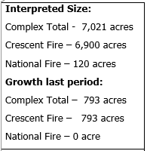
Logs - examples
Notes:
Detailed info on imagery offset or quality is not necessary in the log – techs don’t see it

Slide 25
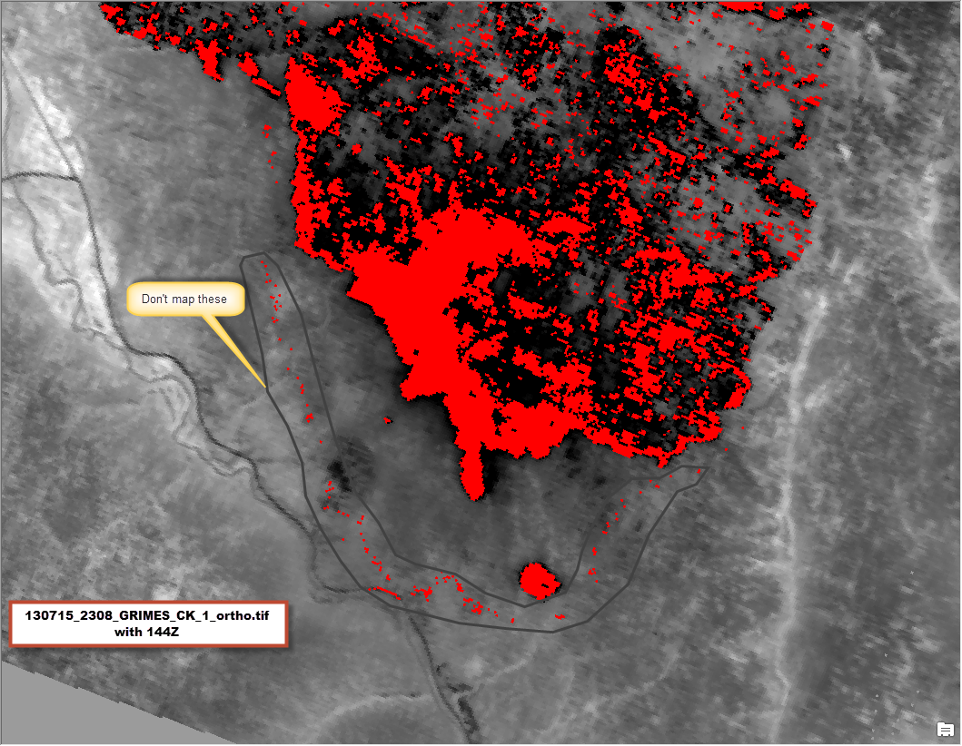
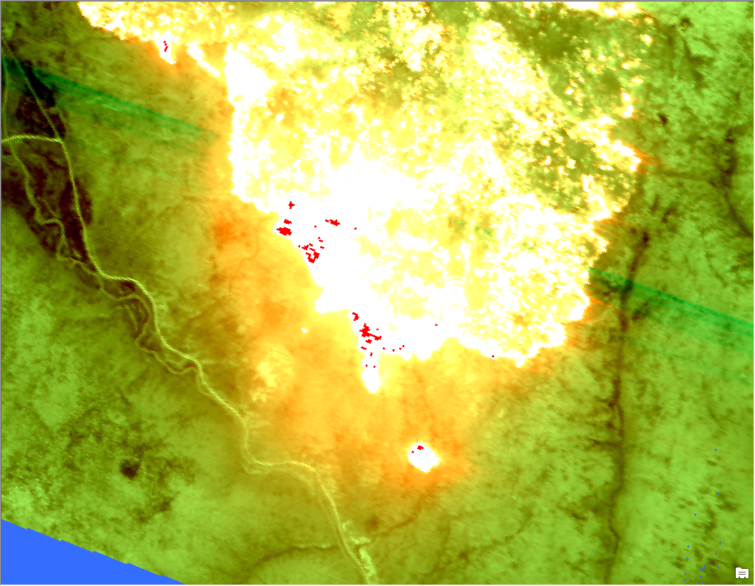
Halo issue
Recognize halo effect pixels by location, spatial arrangement, absence in color .tif
Utilize color .tif to distinguish halo pixels from valid heat sources
Remember that halo pixels will be included in Raw Heat Data and should not be mapped

Slide 26
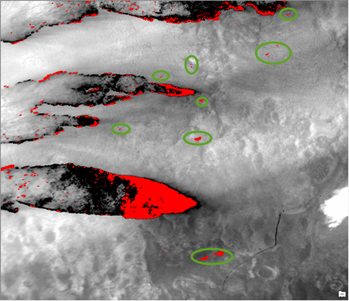
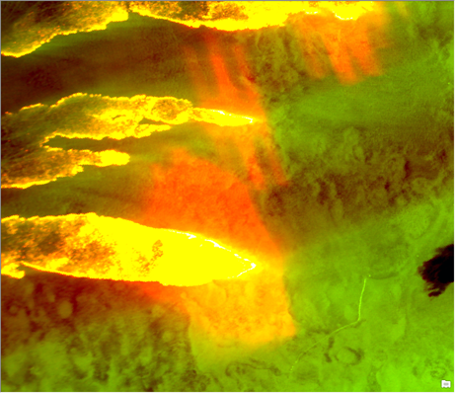
Halo issue
May no longer appear as a “halo” or “ring”
170424_1844_WEST_MIMS_2
Notes:
Tweaks to the processing algorithm have reduced the appearance of rings but some artifacts will still be present where fire is very hot.

Slide 27
NIFC FTP Site
Same set up as last year
All users need NAP/Ross accounts for upload access and must use a secure ftp client
IRIN user group includes access to the 2017_Fires folder in NIROPS as well as write access to Incident_Specific_Data folders for all GACCs
But all products (maps, shapefiles etc.) can be accessed without passwords via http://ftp.nifc.gov
Phoenix imagery must be accessed via secure ftp client
See NIFC FTP Site Change Management Document for more info
Notes:
NAP = NESS Application Portal
NESS = National Enterprise Support Service

Slide 28
Remember….
Rules regarding ROSS/NAP passwords apply
Renew password every 60 days
Reminder 10 days prior to expiration from donotreply@nwcg.gov
After 90 days account is disabled
IIA helpdesk is 866-224-7677
Secure FTP client required for uploading and accessing restricted folders
WinSCP, FileZilla, SmartFTP, and many others
Log in to FTP not working?
Login to ROSS/NAP, password may have expired
Check with other IRINs to see if they have same problem
Be patient, FTP client can take a minute to come up
Set Server Response Timeout higher
Notes:
Email sent 10 days before expiration of password at 60 days, no other email sent, no email sent for account being disabled
Email comes from donotreply@nwcg.gov, may go to junk email
Between 60 and 90 days you should be able to reset password on your own, after that you need to call the helpdesk
IIA = Interagency Incident Applications
Helpdesk will want to know your IP address, agency and what time you were trying to access

Slide 29
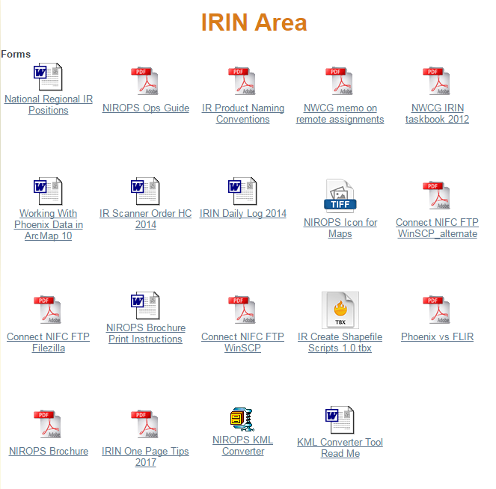
IRIN Area Documents
New IRIN One Page Tips
New NIROPS_KML tool
Follow instructions in KML Converter Tool ReadMe doc
Now handles Web Mercator Auxiliary Sphere
Date on shapefiles must be in YYYYMMDD format
Phoenix vs FLIR document

Slide 30
Phoenix vs FLIR document
“The information below discusses trade-offs and issues with the Phoenix system versus other IR systems when the fire moves into mop-up stage. The intent is to provide IRINs information to engage in a discussion with SITLs or other staff. It is not intended, and should not be used, for posting as a standard disclaimer (which nobody reads anyway).”
Discusses issues such as:
Detection capability of Phoenix vs FLIR
When FLIR might be more effective
Effect of time of day on detection

Slide 31
Projections and Sticky Tolerance
Work in projection the incident is using
Default to UTM if no info available
Beware of Web Mercator Auxiliary Sphere (WMAS)
Not good for calculating acres
Create IR Shapefile tool handles reprojection
Set Sticky Tolerance
Editor toolbar → Options, General tab, Sticky move tolerance
Set to 20+ to avoid inadvertently moving features

Slide 32
Safety
Work/Rest Ratio
Sleep
Situational Awareness
Entering and leaving office
Notify building manager or others
Drive Safely
Notes:
Working remotely presents a number of challenges
Not just a “fire” thing.
If security or dispatch is open 24 hours, make them aware that you are in the building, building manager – for AC

Slide 33
Get Ready
Make sure you are listed correctly as an IRIN or IRIN(t) in IQCS, ROSS, and on your red card
Maintain contact with your GACC IR liaison – contact info, availability
Make sure you have all necessary passwords
To get into scanner form and IRIN Area on website
Base data, AFF, etc.
NAP user account with IRIN group
Track fire activity through Active Fire Mapping (https://fsapps.nwcg.gov/afm/)
Track IR activity through the scanner order page
Track planes thru AFF or FlightAware (XCN44, XCN49)
Notes:
Courtesy text/email to your GACC IR liaison when you take an assignment – keeps them in the loop and better idea of who is still available

Slide 34
Get Ready
Be prepared
Refresher materials on ftp site - /nirops/S443_Denver_2017
Local base data, local license for ArcGIS (if possible)
Good internet connection
Be available, meaning…..
Showing in ROSS as available
Have approval & understanding of your supervisor
Assume full 14 day assignment
Update scanner form as soon as you take an assignment with your contact info
Contact incident to discuss communication & coordination, projection, product delivery, etc.
Make sure you have an email for the incident
Notes:
Refresher is the recent S443 session (March 2017). A number of the exercises have the halo issue.
Email is a good backup method for delivering products.

Slide 35
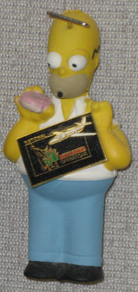
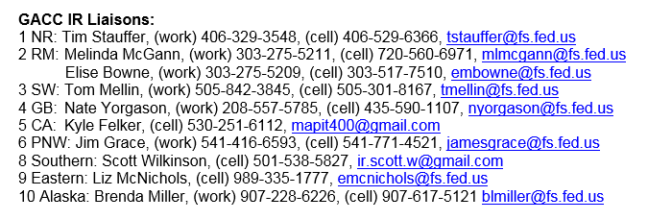
Questions?
Notes:
GACC IR liaison should be your first contact. Liz McNichols moved to Southern Area but will continue as Eastern Area liaison
Nate Yorgason (Caribou Targhee NF – Idaho Falls) has taken over for Hope Spriggs as Great Basin liaison. Hope has served since 2010
Melinda McGann will retire after this fire season and Elise Bowne will take over as GACC IR liaison
Newest version of 1 page tips is posted on website in IRIN Area.

