Slide 1
A day In the Life
Of an IRIN

Slide 2
Introduction: Unit Objectives
By the end of this unit, the students will be able to:
Explain what is expected of an IRIN
Explain the IRIN work cycle on an assignment
List the steps necessary to become available for assignment as an IRIN

Slide 3
What Does an Infrared Interpreter Do?
An IRIN is an overhead resource who works for the SITL (Situation Unit Leader)
Situation Unit -
Functional unit within the planning section responsible for the collection, organization and analysis of incident status information, and for analysis of the situation as it progresses. Reports to the planning section chief.
Notes:
For a Type 3 team, a short Type 2 team, or a NIMO team there may not be a SITL. In those cases you will work for the Plans Section Chief (PSC)

Slide 4
What Does an Infrared Interpreter Do?
An IRIN can work under two different scenarios
As a single resource working remotely from their home office.
Almost always
As part of a “pod” of IRINs at a centralized location
Used during periods of high fire activity in a given locale

Slide 5
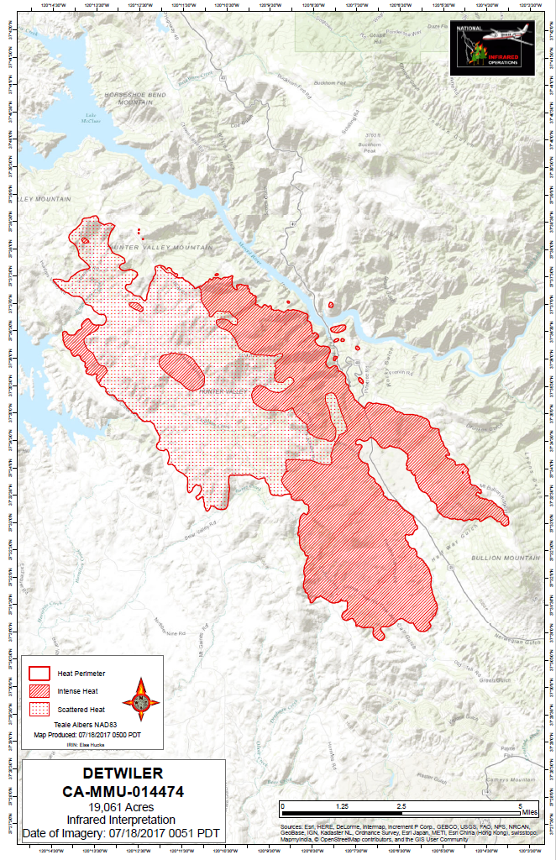
What Does an Infrared Interpreter Do?
The primary duty of the IRIN is to “Interpret imagery and post findings on .. maps”.
A base map with interpretation overlay is the primary product.
This has evolved from a hardcopy map with mylar overlay to a digital or paper map produced in GIS.

Slide 6
Roles and Responsibilities of the Infrared Interpreter
Primary Objectives:
Quality Control of thermal imagery
Determine heat perimeter
Identify areas of heat and isolated heat sources
Calculate acreage of the perimeter
Produce shapefiles, summary map(s), kmz and log
Notes:
The infrared interpreters have four primary objectives. This is really the core of what is taught in the Infrared Interpreter training class. They determine a fire boundary, identify isolated heat sources, calculate the acreage burned, and produce summary maps. Then the IRIN gets to work. Using highly honed interpretive skills, the IRIN (and trainee) locate the fire perimeter to a base map. When time allows, the acreage is calculated. The maps are delivered to the situation unit leader. The IRIN briefs the incident command on what he or she saw in the imagery if requested by the SITL.

Slide 7
The Work Cycle of an IRIN:
Scanner Request Submitted
By SITL or IRIN using
Online Ordering
IRIN Determines
w/ SITL
Additional Flight
Go to bed
(ROSS A# assigned)
Accurate Shapefiles / Maps/Log/KMZ
Delivered to IMT Before
Morning Briefing
ZZZZZZZZZZZ
Interpretation:
Create Products
Wake up
Check on flight
Eat, get ready
FLIGHT
Expanded dispatch,
AFF, IRCN, IRCR
Imagery Delivered:
Upload to FTP site
Your schedule will change nightly.
Notes:
The work cycle makes it problematic for anyone to do IRIN work (given our standard period of operations) in addition to daytime work whether it be GIS, aerial detection and mapping, etc.
Your schedule will change nightly.

Slide 8
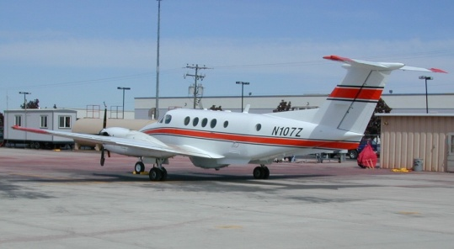
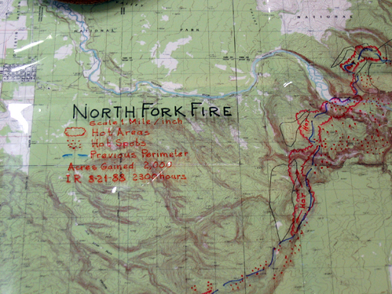
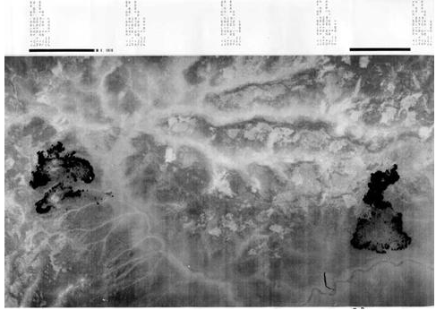
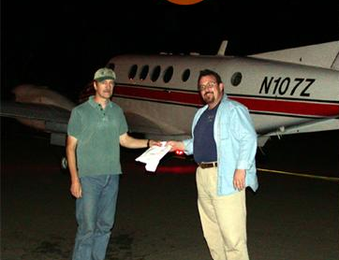
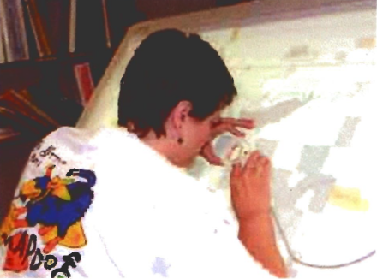
Old School: One IRIN, One Fire
Map Product
Acquisition
Interpretation
Morning
Briefing
Delivery
Digital Product
Notes:
Until the Phoenix system was introduced in 2003, one co-located IRIN, one fire was the traditional role. You may still be assigned to one fire, but you may work other fires; you may meet the plane for your imagery plus other imagery that needs to be uploaded to the ftp site. Assume you will be multi-tasking.

Slide 9
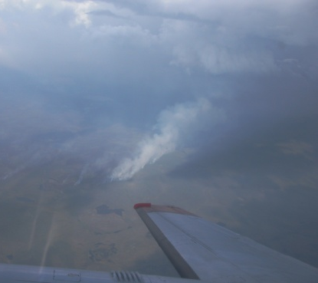
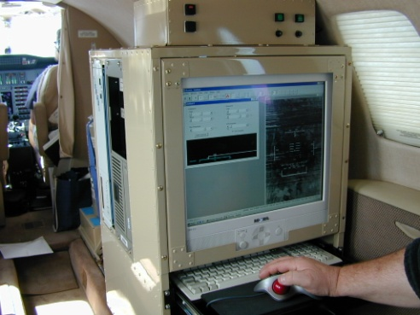
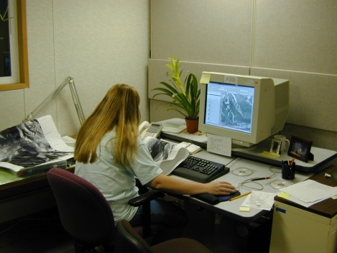
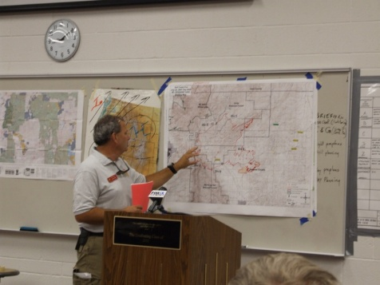
Remote IRIN Support: One IRIN, Multiple Fires
Interpreter(s) located at
home office
Phoenix data
in WinZip archive
Phoenix data
in WinZip/FreeArc archive
Shapefiles, PDFs, and log
ftp.nifc.gov/
NIROPS
Incident
ftp.nifc.gov/
Incident Spec Data/
IR
Notes:
Phoenix plus FTP and AirCell downlink have made it common for IRINs to support more than one fire.

Slide 10
IRIN work – before getting imagery
AM – brief SITL and submit order for next night
Get end of day briefing from SITL
Areas of concern/perimeter growth
Acquire additional base imagery?
Arrange to get most recent perimeter
Track plane and techs twitter feed to know when/what to expect
Inform incident of general flight time
Fire not flown, # and orientation of runs
Prepare new shapefiles/folders using naming conventions
Blank for intense/scattered/isolated heat
Copy previous perimeter into new perimeter shapefile
Set/copy projections, leave time/date as xxxx
Or use Create IR shapefile tool
Get map layout ready to go

Slide 11
IRIN work – after getting imagery
Enter correct date/time stamp for shapefile names and map legend
Bring in *ortho.tifs to *.mxd and check for coverage, image quality, alignment with base imagery – every night, every run
Color.tifs are created from ortho tifs so if ortho tif lines up, the color will as well
Get overall sense of how much heat there is to map and what your timeframe is
If time is tight, digitize priority areas/products first
Raw heat data shapefile useful for
Ensuring you’ve covered everything especially outside perimeter
When done digitizing - clear all selections, calculate acres, turn off layers not needed in map
Produce pdf file, kmz, fill out log, zip shapefiles and post to NIFC ftp site

Slide 12
Communication with SITL
Exchange contact info, best times/way to get a hold of them (text message, email, phone)
What/how to deliver products
Additional products as time permits
Zoomed maps, smaller handouts, KMZs
Stress the time imagery was collected
Be accessible – PM briefing if possible, provide cell #
Make sure you contact info is on scanner order
Notes:
Communication can be much more difficult with remote interpreting – a major drawback, lots of time waiting for phone to pick up.
Other products (zoomed maps, small handouts for field personnel etc.) should be negotiated as time permits. Can quickly become expected products.
PM briefing good for finding out what the fire did while you were asleep, new areas of concern, any new issues with that night’s flights.

Slide 13
Communication with SITL
Remember – The IRIN works for the SITL!
Do not distribute digital or hardcopy products without the approval of the SITL
Once data is posted to NIFC ftp site it becomes responsibility of the incident

Slide 14
Coordination with GISS
Good source of base imagery, intel and updates
Exchange contact info (w/ SITL approval)
Agree on projections, data exchange protocol (posting of new perimeter)
Set up schedule or communication protocol
Notes:
Be sensitive to crunch times for GISS – they can be a great help but their job is not to make life easier for you – be as self-sufficient as possible.
Less important for base imagery that in the past.

Slide 15
IR Team Coordination
Notes:
The IRIN is part of the Plans Section on an incident and reports to the Situation Unit Leader, or SITL or PSC if no SITL. The also frequently talk directly with the GISS on an incident.

Slide 16
Data Delivery
NIFC ftp site
ftp://ftp.nifc.gov
Secure ftp client to upload data
Need to be part of IRIN user group to access imagery
Can e-mail products if problems with NIFC ftp site access
Notes:
Anyone can download data from Incident folders, need password to upload data. Set up an email account on yahoo or gmail.

Slide 17
NIFC FTP Site
All users need NAP/ROSS accounts for upload access and must use a secure ftp client
IRIN user group includes read/write access to the 2019_Fires folder in NIROPS as well as write access to Incident_Specific_Data folders for all GACCs
But all products can be accessed without passwords via https://ftp.nifc.gov

Slide 18
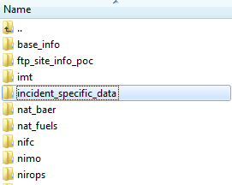
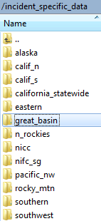
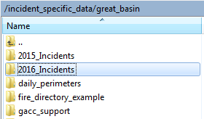
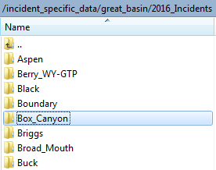
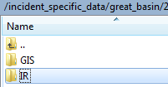
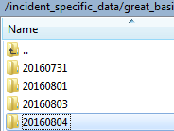
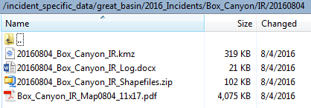
NIFC ftp file structure (NIROPS products)
IR folder is outside GIS folder

Slide 19
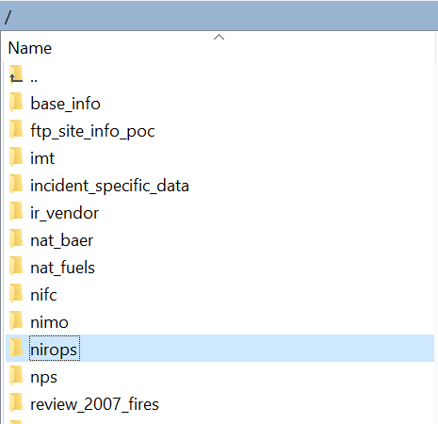
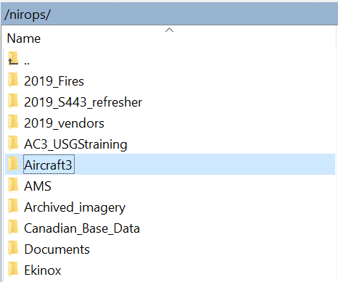
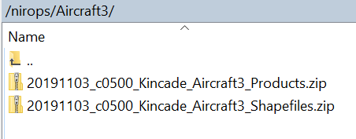
NIFC ftp file structure (Aircraft 3 products)

Slide 20
Questions?

