Slide 1
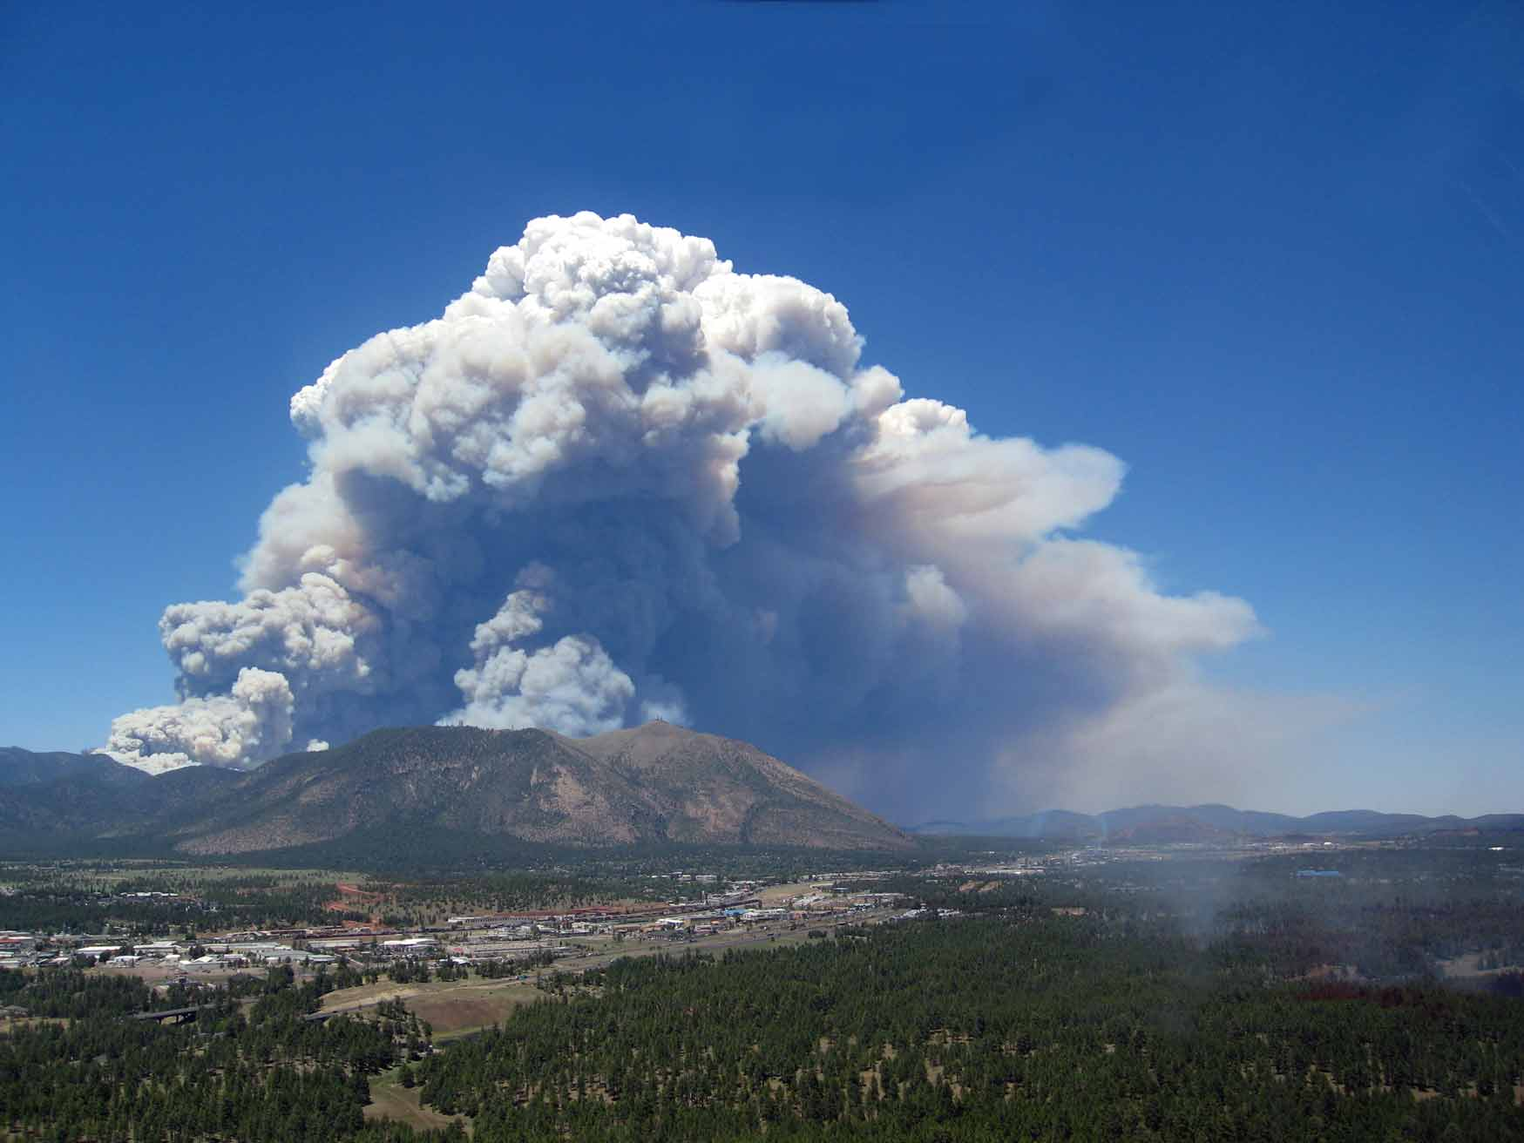
Deliverables
Notes:
Schultz Fire – Flagstaff, AZ 2010

Slide 2
Unit Objectives
List the IR products delivered to the incident
Discuss the mode of delivery
Identify key communication route

Slide 3
Outline
Products
Maps/Logs/KMZs
Communication/coordination with SITL and GISS
Product delivery and timing
Briefing/Documentation/Feedback

Slide 4
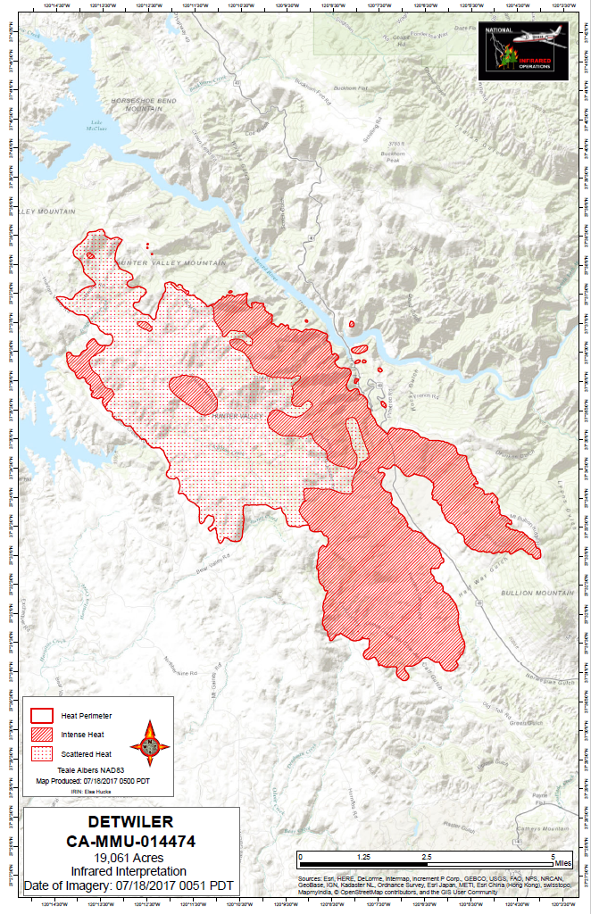
Deliverables
The primary duty of the IRIN is to “Interpret imagery and post findings on .. maps”.
A base map with interpretation overlay is the primary product.
This has evolved from a hardcopy map with mylar overlay to a digital map produced in GIS.

Slide 5
IR Products
In time for morning briefing
IR GIS layers - shapefiles
Map(s) – GeoPDFs
IR log
KMZ file for viewing in Google Earth

Slide 6
IR GIS Shapefiles
Heat Perimeter (polygon)
Isolated Heat Sources (points)
Intense Heat (polygon)
Scattered Heat (polygon)
Notes:
Every data layer will be produced, if applicable, regardless of what is requested by an individual SITL.

Slide 7
IR GIS Products
Shapefiles
Work in all versions of ArcGIS and many other applications
One set of products for all users and situations (incl. Type 3/4 teams, local units, no GIS support, etc.)
Various products easily separated

Slide 8
IR GIS Products
Some layers will not always be applicable (e.g. no intense heat during mop up)…
..but every applicable layer should be produced (e.g. heat perimeter even if no change).
Need consistency for documentation and changes in SITLs.

Slide 9
File names
Examples:
20060925_2025_PigeonMtn_IsolatedHeatSources.shp
20060925_2025_PigeonMtn_HeatPerimeter.shp
20060925_2025_PigeonMtn_ScatteredHeat.shp
20060925_2025_PigeonMtn_IntenseHeat.shp
Collection date
Incident name
Data type
Collection time*
*Follow Aircraft 3 directions for times on files, example here is for Phoenix data
Notes:
Do all naming and renaming in ArcCatalog so that it applies to all the associate files for a given data layer. Make sure there is a .prj file. Time should be listed in local time at incident location

Slide 10
Files and directories
Managing directories and files takes time – do prior to receiving imagery
Standardizing directory/file names and structure saves time, reduces stress, and simplifies communication and handoffs to other IRINs/SITLs/GISSs
Details will be covered in Aircraft 3 software specific training
Notes:
Part of work early in shift before imagery is received.
With geodatabases beware of version compatibility issues

Slide 11
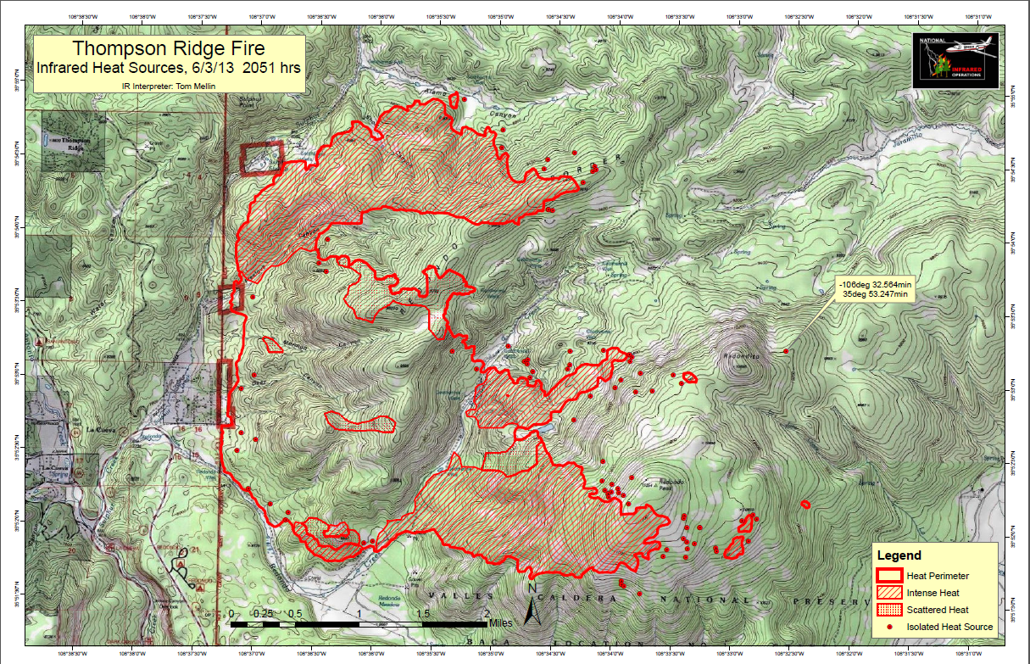
The Map – Remember…
STAND(GL)
Scale/Scale Bar
Title
Author
North Arrow
Date/Time*
Grid/Graticule
Legend
*Of the imagery, not the map
Notes:
NIROPS logo should be added

Slide 12
The Map – Remote Interpretation
Deliver products as early as possible as the Incident GISS may have to incorporate data into their maps, or print copies of your maps
Always produce a GeoPDF of the map for documentation and a “quick look” that doesn’t require ArcGIS. This can also be used in mobile devices
Map size of layout – standard is 11x17
Notes:
Good to have GISS’s cell phone or contact info so you can let them know when it is up on the ftp site.
PDF is important so that SITL and others can get a quick look without firing up ArcMap.
Quick looks can be printed for other interested parties as long as not for release.

Slide 13
IR Log
Important communication to the incident
Will be in a different format for Aircraft 3 products
The IR log acts as a briefing – issues with imagery, fire activity, trigger points, etc.
Where possible relate comments to ground features on the map.

Slide 14
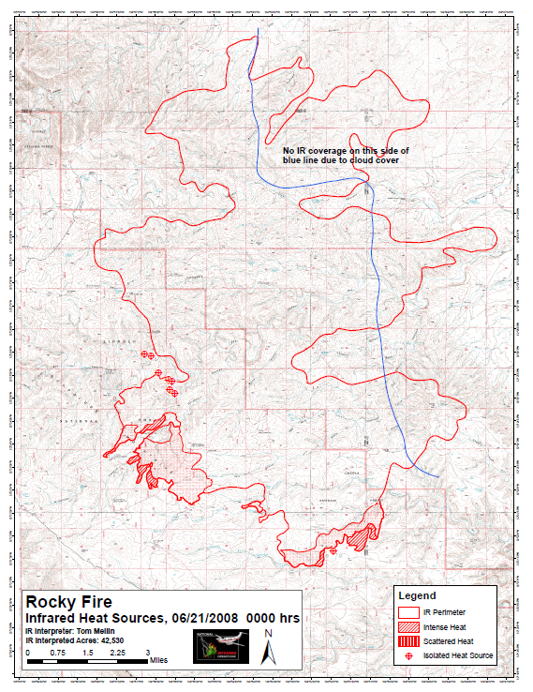
Partial coverage
Complete coverage of fire is assumed
If not, need to explicitly show that on the map and state it in the daily log
Cloud cover, not flown, problems w/ imagery, etc.
Notes:
Big difference between not showing heat and not getting coverage. Southeast edge of this fire was very active the previous night.

Slide 15
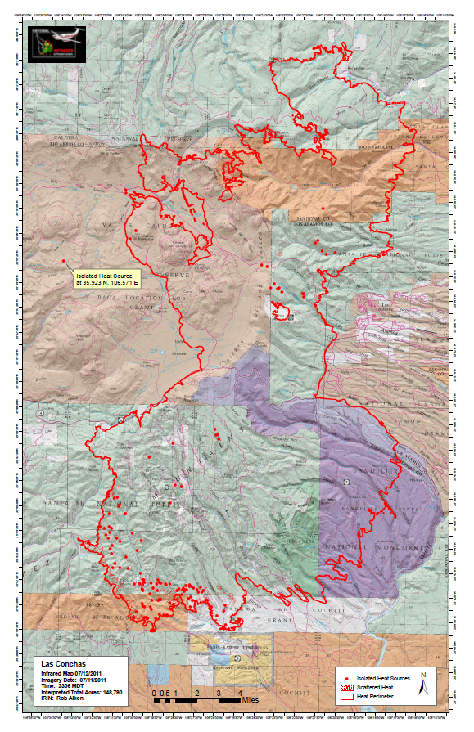
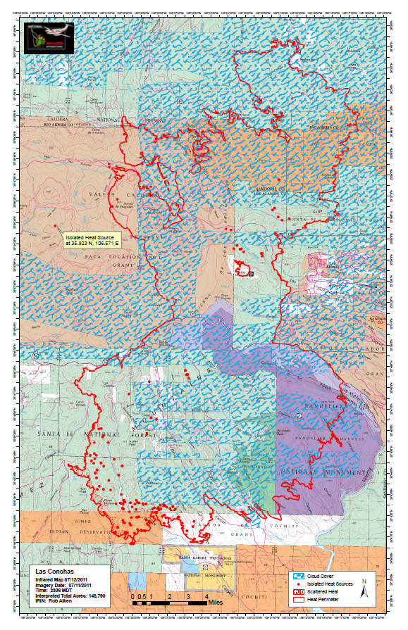
Partial Coverage – another example
Notes:
Approx 70% of the flight area was covered by clouds. Failure to include this in the map could lead to erroneous conclusions about fire activity. Note that is some cases there are heat sources hot enough to trigger the sensor thru the cloud cover depending on the amount of heat and the thickness of the clouds.

Slide 16
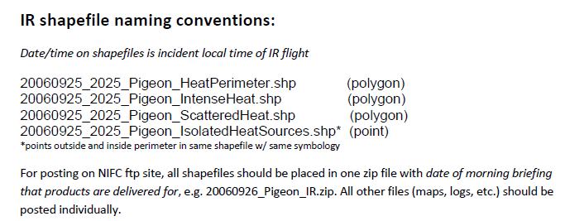
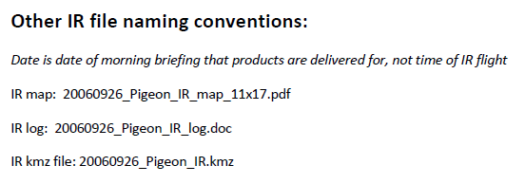
Naming conventions for Aircraft 3 shapefiles differ slightly – this will be covered in the next training.
Notes:
Zip file should contain just the shapefiles. PDF should be separate

Slide 17
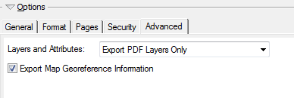
PDFs
Should be able to keep under 10MB
300 dpi and normal quality is usually sufficient
Reduced pdfs can be created if you have full Adobe license
Geocoded pdfs are the default in ArcGIS export
Notes:
Connection speeds at ICP can be very slow so you don’t want the pdfs to be too big.

Slide 18
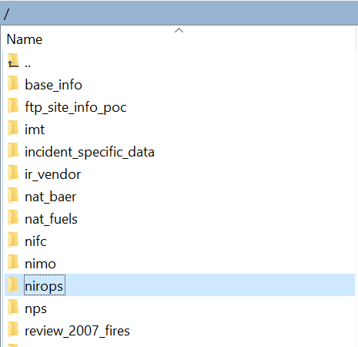
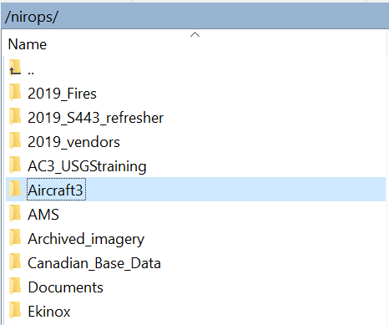
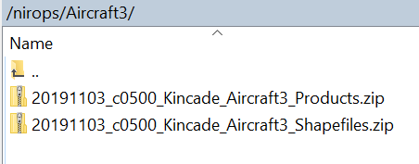
NIFC ftp file structure (Aircraft 3 products)

Slide 19
Communication with SITL/Incident
Takes place through Jan Johnson. No direct communication to the SITL or incident is allowed between Aircraft 3 analysts and the fire personnel.
Notes:
Communication can be much more difficult with remote interpreting – a major drawback, lots of time waiting for phone to pick up.
Other products (zoomed maps, small handouts for field personnel etc.) should be negotiated as time permits. Can quickly become expected products.
PM briefing good for finding out what the fire did while you were asleep, new areas of concern, any new issues with that night’s flights.

Slide 20
Communication with SITL
Remember – The IRIN works for the SITL, but Jan Johnson is the go-between!
Do not distribute digital or hardcopy products without the approval of the SITL
Once data is posted to NIFC ftp site it becomes responsibility of the incident

Slide 21
Data Delivery
NIFC ftp site
ftp://ftp.nifc.gov
Secure ftp client to upload data
Can e-mail products to Jan Johnson if problems with NIFC ftp site access
Notes:
Anyone can download data from Incident folders, need password to upload data. Set up an email account on yahoo or gmail.

Slide 22
NIFC FTP Site
Will be covered in subsequent training
All users need NAP/ROSS accounts for upload access and must use a secure ftp client
Products are posted to: ftp://ftp.nifc.gov/nirops/Aircraft3
But all products can be accessed without passwords via https://ftp.nifc.gov

Slide 23
Documentation
Products posted to NIFC ftp site and archived by incident
Keep copies of your work

Slide 24
Unit Objectives - Review
List the IR products delivered to the incident
Discuss the mode of delivery
Identify key communication route

Slide 25
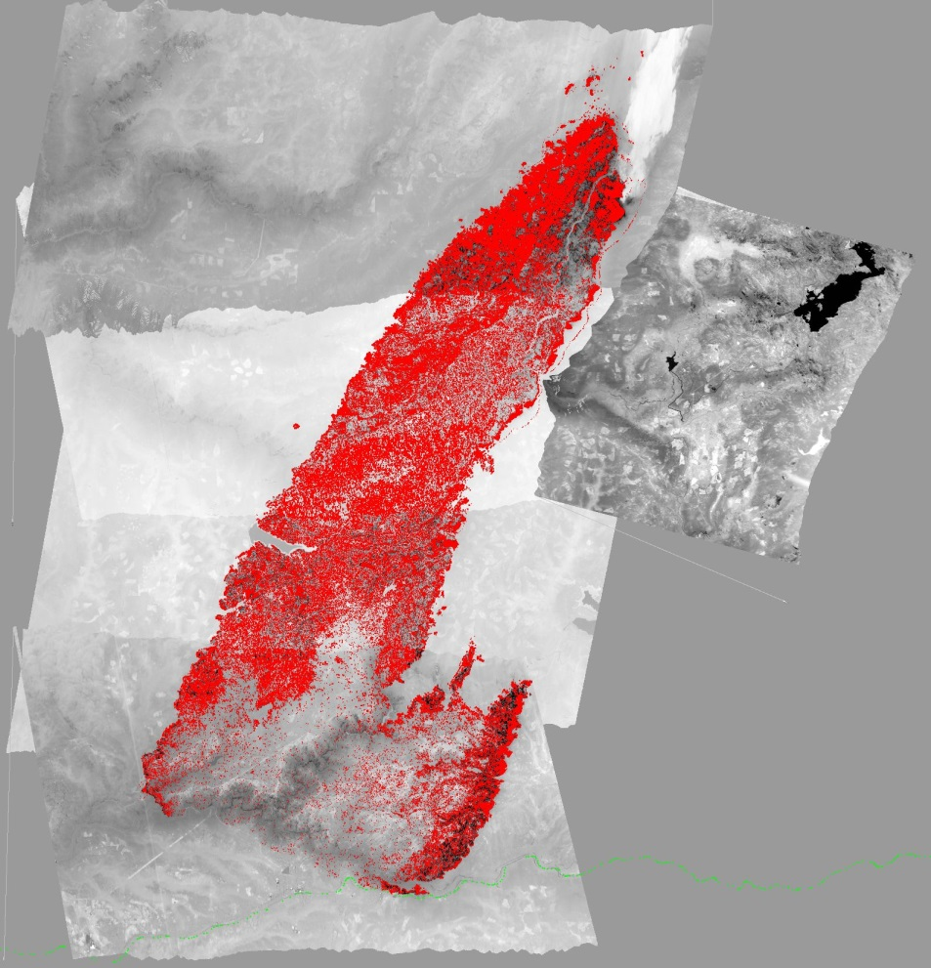
Questions?
Notes:
King Fire – Eldorado NF, CA 2014
On Sept 17 grew by 50,000+ acres making a 13 mile run to the northeast and nearly tripling in size, final size of 97,717 acres.

