Slide 1
GTAC Aircraft3/Firehawk Support to NIROPS
S443 “Lite” Course
March 25 – 26, 2020
Denver Federal Center
Lakewood, CO

Slide 2
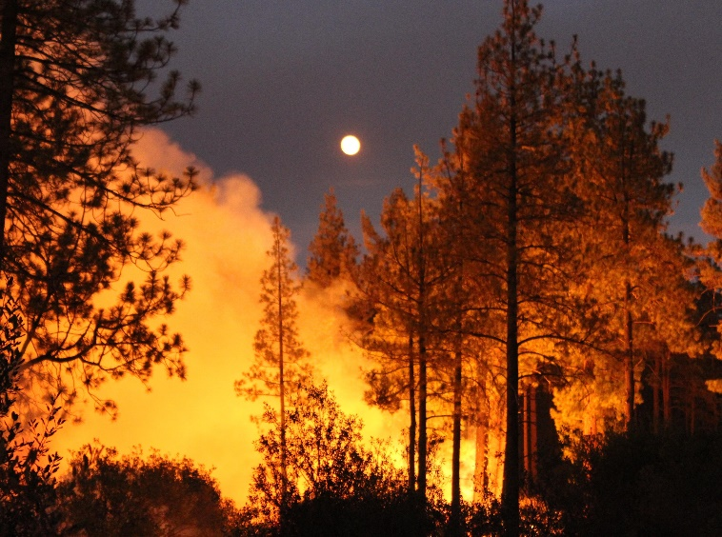
Presentation Outline
Overview of Aircraft3/Firehawk Support
Liaison: Making the Incident Support Process Work
Cranston Fire
Inciweb

Slide 3
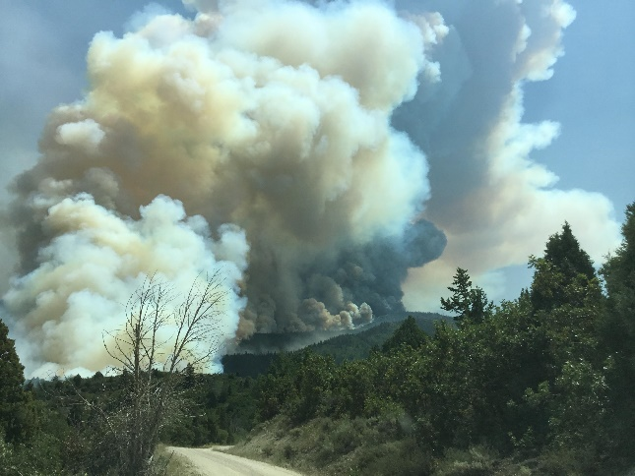
GTAC Aircraft3/Firehawk Support
Initial fire mapping collaboration began in early 1990s on prescribed fires.
Project Red Sky; proof of concept work
First operational fire mapping was the Tyee Creek Fire (WA) in 1994.
Initially used as a “gap filler” at PL 4, 5.
Several factors have lead to increased use of Aircraft3 support.
Expansion of the “fire season”.
Geographic distribution of fires on the landscape.
Changes in how fires are managed.
Coal Hollow Fire
Inciweb

Slide 4
Aircraft3/Firehawk Derived Products
Intended to have the same “look and feel” as products from NIROPS.
Current Products
ArcGIS format shapefiles, decimal degree, WGS84
“Read me” file (2008) with analysts’ observations of fire activity.
Time Stamp (2009) in UTC (“Zulu”) time.
Data acquisition window of ± 30 minutes.
KML/KMZ of shapefiles (2011).
“No data” and “cloud cover” shapefiles (2013).

Slide 5
GTAC Aircraft3/Firehawk Support
Initial Coordination with NIFC IR aircraft occurs at NIFC/NICC – National IR Program Manager/Coordinator.
Coordination the same as with NIROPS aircraft.
NIROPS and Aircraft3 provide similar information. This is why coordination is needed for the two programs.
GTAC acts as a liaison between Aircraft3 and NIFC/NICC for use of these assets.

Slide 6
Aircraft3 2018 Summary
Very limited analyst support
Limited support to incidents with Type 1 or Type 2 teams assigned.
Incident support started on April 16
Bluewater, Diener Canyon, NM
Rattlesnake, AZ
Incident support ended on October 2
Ryan and Silver Creek Fires, CO
57 days of continuous support from July 2 – August 31.
Eastern Area (EA) and Alaska GACCs did not request support.
Additional support provided by the NCAC-Denver (USGS).
USFS and USGS personnel
12 % of the CONUS IR requests (299 of 2,705) were assigned to Aircraft3
82 % of the assigned requests were completed by Aircraft3
Notes:
Agencies supported: FS, CalFire, NPS,

Slide 7
Extended Support to Incidents
Ferguson (CA) – 27 nights
Coal Hollow (UT) – 12 nights
Avian Complex (FL) – 11 nights
County (CA) – 9 nights
Lake Christine (CO) – 9 nights
Watson Creek (OR) – 9 nights
Badger Creek (WY) – 7 nights
Holy (CA) – 7 nights
Cranston (CA) – 6 nights

Slide 8
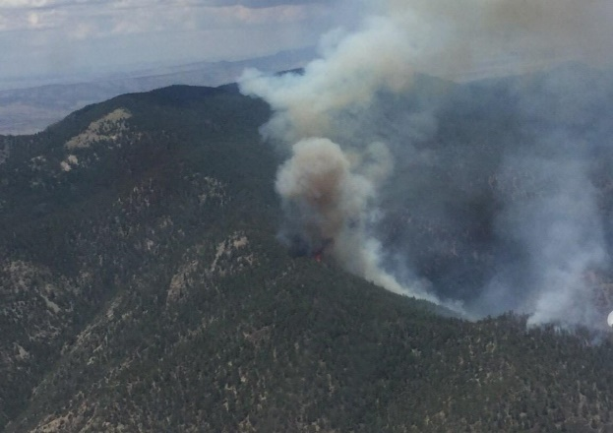
Aircraft3 2019 Summary
Overall it was a very quiet support season.
Incident support started on July 16
Roberts Fire, NM
Latest support request since 2009
Incident support ended on November 4
Maria Fire, CA
13 days of continuous support from August 19 – August 31.
Support requests came from Alaska, Southwest, North and South Ops GACCs.
6.1 % of the IR requests (40 of 655) were assigned to Aircraft3
75 % of the assigned requests were completed
by Aircraft3
Roberts Fire
Inciweb
Notes:
Agencies supported: FS, CalFire, USFWS, AK Dept. of Forestry

Slide 9
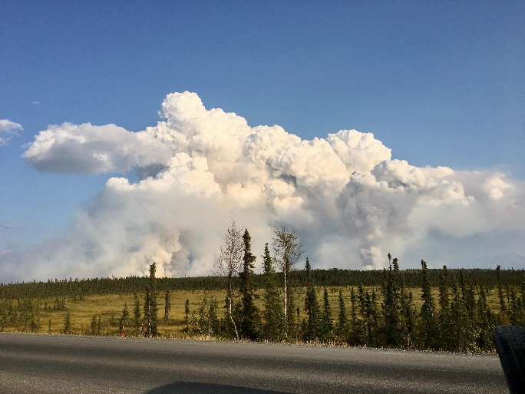
Extended Support to Incidents
Swan Lake (AK) – 19 nights
Kincade (CA) – 4 nights
Cellar (AZ) – 3 nights
Roberts (NM) – 3 nights
Swan Lake Fire
Inciweb

Slide 10
Liaison: Making the Support Process Work
Nat’l IR Program Manager
AOH/AOHW
USGS
Data post for
0600 brief
Data post for
0600 brief
Aircraft3
FTP Folder
NIFC
Nat’l IR Coord.
Data pull for
0600 brief
Data pull for
0600 brief
Incident(s)
SITL/GISS

Slide 11
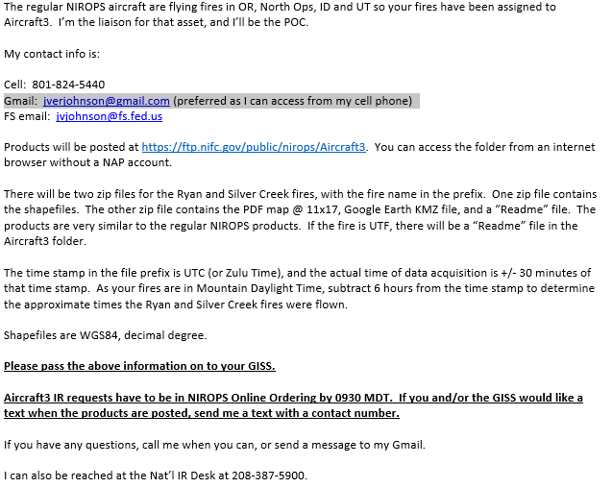
Contact the Incident(s)

Slide 12
Interacting With The Incident(s)
Questions for the incidents
How did the products look?
Did the mapped fire activity reflect intel from the field?
Predicted fire behavior?
Weather?
Updated perimeter? When will it be available?
Questions from the incidents
What is being used to fly the fire?
“Secret squirrel”
Why can’t we talk to the analyst directly?

Slide 13
Interacting With AOH/AOHW
Fire priority list for next night.
New fires/fires being dropped.
Changes in scan boxes.
Updates to incident perimeters.
NIROPS aircraft status (weekly).
Post edited updated perimeters to the Aircraft3 folder (https://ftp.nifc.gov/public/nirops/Aircraft3) and/or email.
Deleting extraneous attribute fields from perimeters

Slide 14
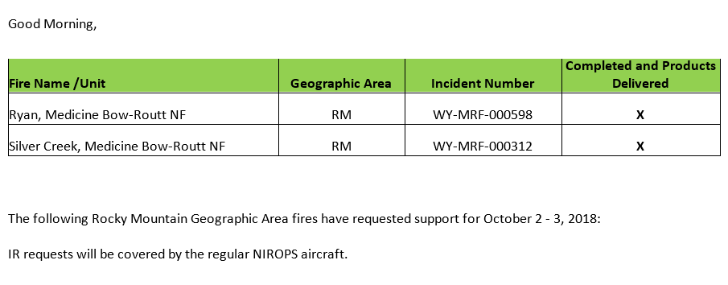
Other Liaison
Daily summary email to CAC, FS WO-ENG, GTAC, NICC, NIFC.
Email to NRO contact list of fires to be supported for the next night.

Slide 15
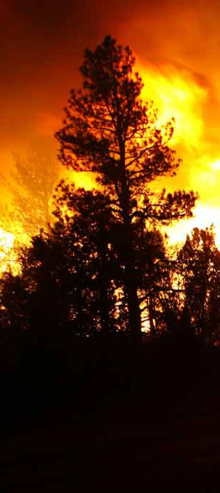
Thanks
Comments/Questions?

