Slide 1
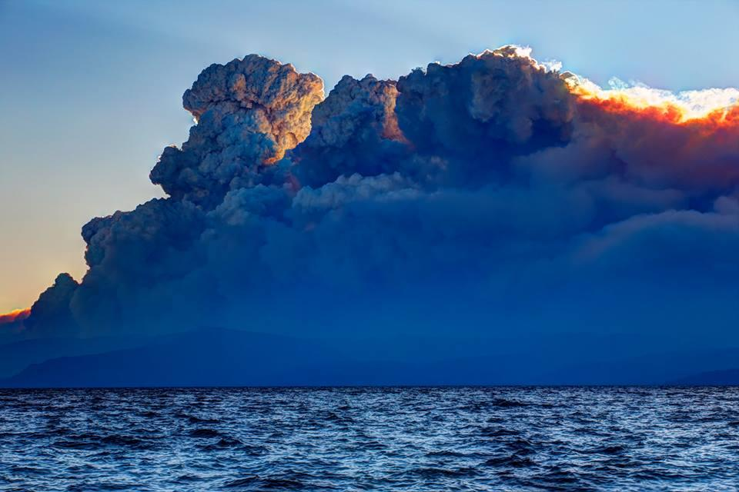
ICS Organization
King Fire CA

Slide 2
Contents
Objectives
Incident Command System

Slide 3
Objectives:
Describe the ICS organization and the relationship of the Infrared Interpreter (IRIN) to other positions
Identify the primary consumer of NIROPS and/or Aircraft3/Firehawk products

Slide 4
National Interagency Coordination Center (NICC)
The focal point for coordinating the mobilization of resources for wildland fire and other incidents throughout the United States.
Intelligence and Predictive Services related-products designed to be used by the internal wildland fire community for wildland fire and incident management decision-making.
NICC coordinates between the 10 GACCs who mobilize and coordinate resources within those regions.

Slide 5
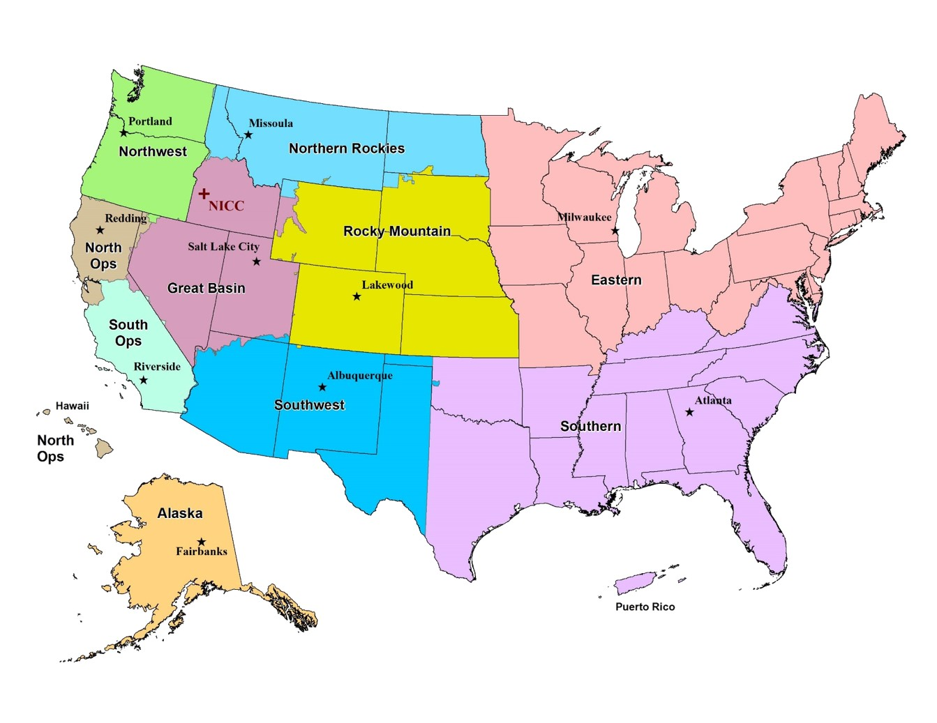
The US is divided into Geographic Area Coordination Centers (GACCs).
GACCs coordinate resources within their regions
When resources are exhausted within a GACC NICC coordinates with other GACCs to supply those resources.
GACCs are divided into zones
Notes:
The United States is divided into 10 Geographic Areas for the purpose of incident management and mobilization of resources (people, aircraft, ground equipment) While the primary mission of the GACC is logistical coordination, the Center also has support program in Predictive Services, Intelligence, and in several Center’s Fire Information.

Slide 6
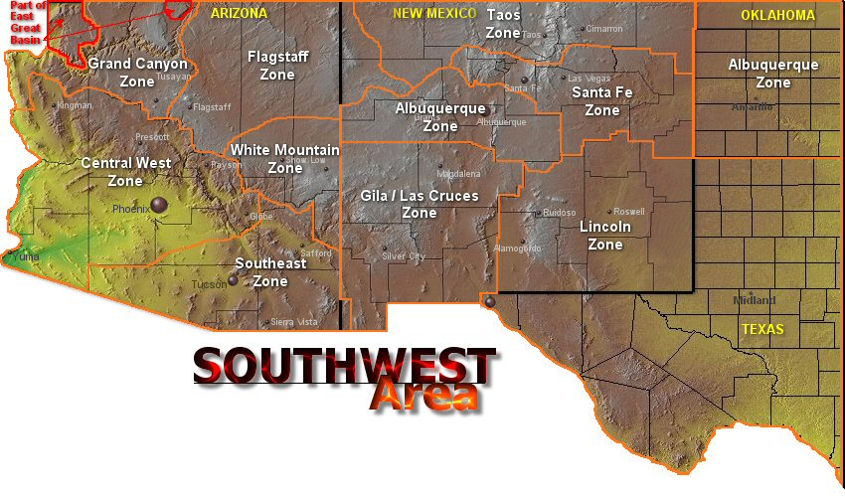
GACCs are divided into zones
Dispatch Centers coordinates initial attack within these zones. Fires not contained in the Initial Attack (IA) are coordinated through the GACC as the fire’s complexity increases.
Notes:
Except for dispatch of air tankers and lead planes based outside the dispatch center responsibility where the fire is located in, the GACC does not have initial-attack dispatch responsibilities. Within each zone there is a dispatch center the is responsible for initial-attack dispatch responsibilities and the mobilization of local resources.

Slide 7
Fire Complexity Levels
Initial Attack
Type 5 Incidents
Local Dispatch
(The Zones)
Initial Attack
Type 4 Incidents
Extended Attack
Regional Dispatch
(The GACCs)
Type 3 Incidents
Incidents that typically request
NIROPS support
Type 2 Incidents
National Dispatch
(NICC)
Type 1 Incidents
NIMO
Notes:
Forests and ranger districts will also request NIROPS support
NIMO, National Incident Management Organization

Slide 8

So where does NIROPS fit into this organization?

Slide 9
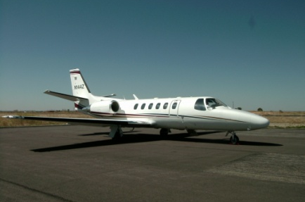
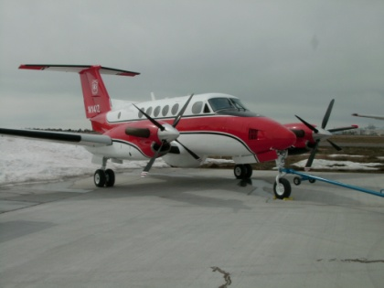
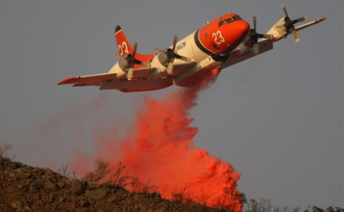
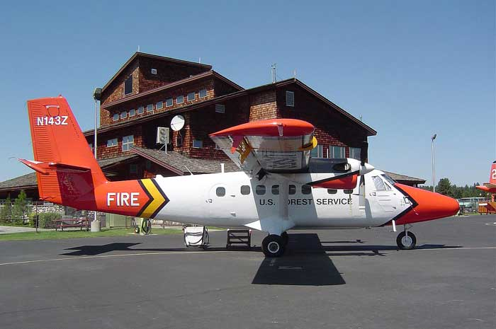
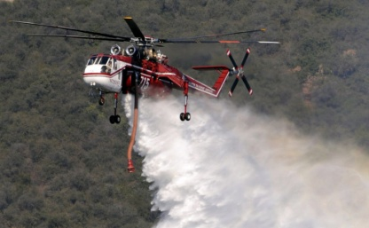
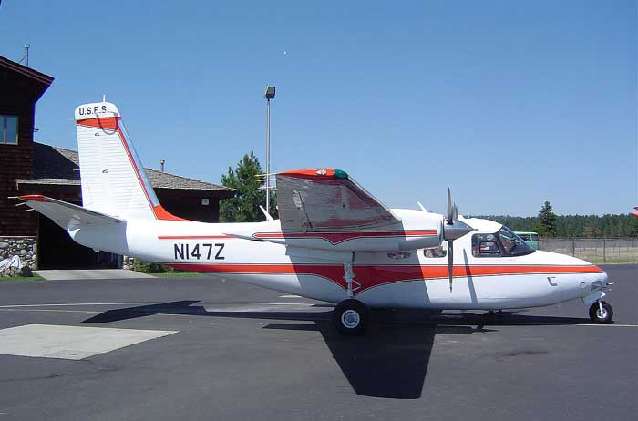
National Level Resources
NIROPS aircraft are considered national resources and are dispatched from the Aircraft Desk at the National Interagency Coordination Center (NICC) at NIFC.
National resources are those which have national utilization, high demand, limited availability, and unique status reporting requirements
Notes:
National resource aircraft include:
Smokejumper Aircraft ,Type 1 & 2 Helicopters ,Air Tankers ,Infrared Aircraft ,Lead Planes ,Large Transport Aircraft (737)
Air Nat’l Guard Modular Airborne Firefighting Systems (MAFFS-2)

Slide 10
Incident Command System (ICS)
Used to
  Manage an emergency incident
  Manage a non-emergency events
Has
  Considerable internal flexibility
  Grows and shrinks to needs
  Cost effective and efficient
  Applies to emergency & non-emergencies
Notes:
The ICS concept dates back to the 1970s. A series of Wildland Urban Interface (WUI) fires in Calif. Resulted in millions of dollars in property damage and loss of life. The after action reviews pointed out issues with coordination, common terms, multi-agency roles between responding agencies. ICS is an attempt to streamline emergency and non-emergency response.

Slide 11
Five Primary ICS Management Functions
Operations
Logistics
Command
Planning
Finance/
Administration

Slide 12
Incident Command System – Functional Responsibilities
Function
Responsibility
Command
Overall responsibility
Operations
Direct tactical actions
Planning
Prepare action plan (IAP) -- maintain resource & situation status
Logistics
Provide support
Finance/Administration
Cost accounting & procurement

Slide 13
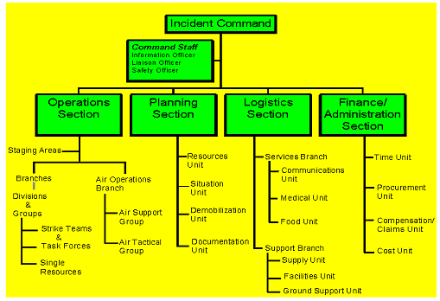
Typical Incident Management Team Structure

Slide 14
Planning Section-Responsibilities
Collect, evaluate and display info
Develop IAP
Maintain Resource status info on equipment and personnel
Maintain Incident Documents

Slide 15
Aircraft vs. IRINs
NIROPS aircraft are a national resource that can support multiple fires in multiple GACCs
  NOT assigned to the fire
  Fires receive the service
IRINs are a single resource (overhead) that can support one or more fires
  Can be assigned to a Fire
  OR can be assigned to a GACC or Area Command to support multiple fires (usually as a member of a POD)
Notes:
An A# and charge code are need to get the service of an IR aircraft. An overhead resource order is needed to get an IRIN.
N114Z, Citation Bravo, $1123/hr + per diem; N149Z, King Air B200, $1125/hr + per diem

Slide 16
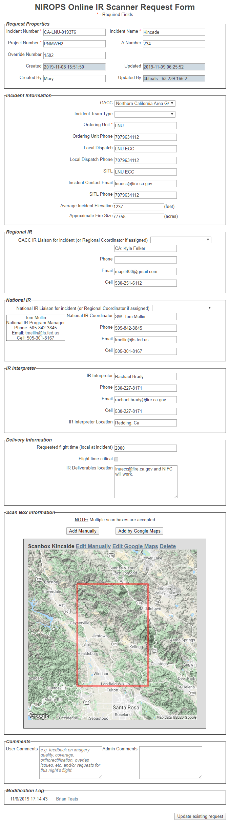
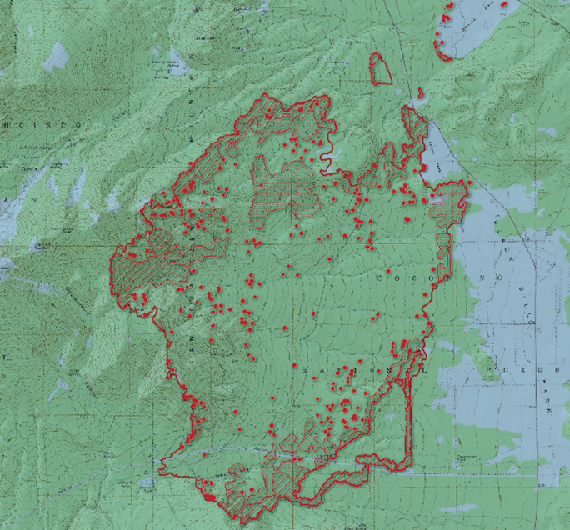
Scanner order + IRIN = Fire Products
+
Notes:
Each incident MUST submit a scanner order that goes to expanded dispatch, then to the geographic area aviation coordinator and finally to NICC in Boise. Each incident MUST order an IRIN through an overhead resource order for the duration of the incident or for as long as the incident requires infrared imagery.

Slide 17
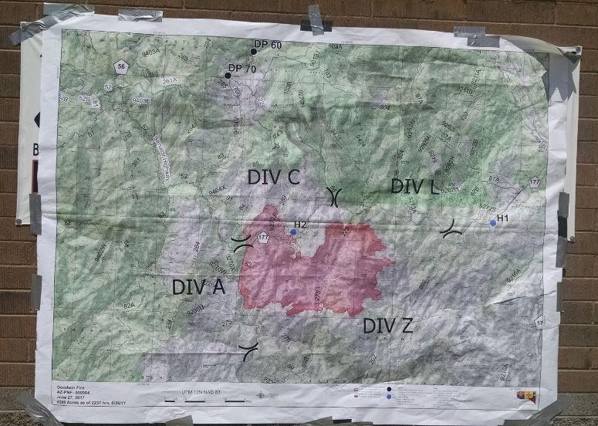
NIROPS and Aircraft3/Firehawk products are delivered the Situation Unit Leader (SITL) the IRIN assigned to the incident reports to the SITL.
Credit:
Wildfire Today

Slide 18
Review of Objectives:
Describe the ICS organization and the relationship of the Infrared Interpreter (IRIN) to other positions
Identify the primary consumer of NIROPS and/or Aircraft3/Firehawk products

Slide 19
Questions?

