Slide 1
National Infrared Operations (NIROPS) Organization

Slide 2
Outline
Background
NIROPS Mission
History
Aircraft
Equipment

Slide 3
“… forest fire detection is not a simple thermal mapping job. To be effective, this system must find the fire targets when they are very small and distributed over vast land areas. The fire targets must be precisely located to be of any use to fire suppression forces.”
Airborne Infrared Forest Fire Detection System: Final Report, 1971.
Notes:
One of the final statements that came out of the 1971 Final Report is an explanation of what they needed, and this is that “fire detection is not a simple thermal mapping job. To be effective, this system must find the fire targets when they are very small and distributed over vast land areas. The fire targets must be precisely located to be of any use to fire suppression forces.”
The important point of this is that there is a distinction between thermal mapping and fire detection. In Phoenix, fire detection is achieved by the comparison of data from the two thermal bands, and this has been developed over many years of analysis and use within the Forest Service. Thermal mapping is typically achieved with the use of such systems as FLIRs.

Slide 4
Background
Wildland fire detection and mapping takes advantage of airborne and space-borne remote sensing, airborne GPS flights, airborne and ground observations, and incorporates fire behavior modeling, fuel modeling, and local knowledge.
Notes:
Fire mapping does not happen by itself. It is an integration of hardware, software, and imagery with the skills and knowledge of individuals.

Slide 5
Background
What remote sensing provides wildland fire mapping
Fire perimeter and active fire fronts
Problem areas – hot spots outside line
Where the fire has been
Lines of containment
Effectiveness of backfire operations
Hot-spots during the mop-up phase
Post-fire burn severity

Slide 6
Forest Service and IR
First project, FireScan began in 1962
Continuous operational deployment since 1967
Development of Mouse Trap FLIR 1984
Numerous papers, and technical reports
Continuous evaluation of commercial, scientific, and military systems
Notes:
The forest service has been a leader in the development of infrared technology for wildland fire detection.
With the support of NASA, US Army Aviation and Missile Command, and private industry we have continuous developed and evaluated infrared technology since 1962.

Slide 7
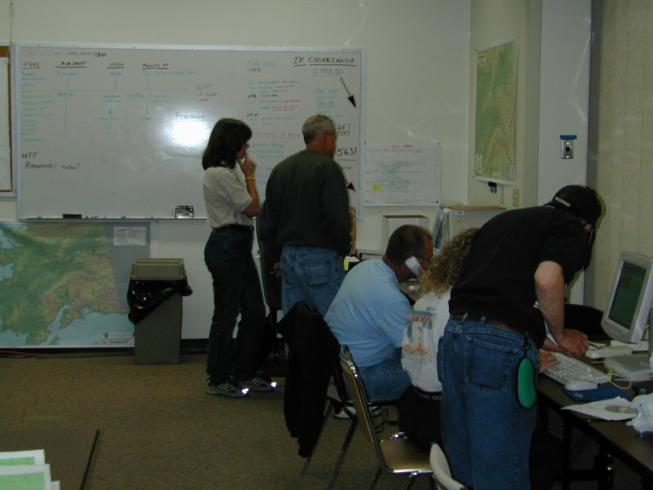
The NIFC National Infrared Program strives to provide the best possible imagery for the widest applications
The aircraft platforms and sensors are suited for rapid transit times between incidents and rapidly collecting data over them
NIROPS has a full cadre of dedicated personnel to coordinate, collect, interpret and deliver infrared intelligence.
Notes:
There are two key components to the National IR Program: 1) the aircraft, crew, scanner, and technician and 2) the infrared interpreter and incident support.
The flying component consists of three planes, two King Air and a Citation jet. These are flown by Forest Service and BLM crew. On board is the line scanner, either the Firefly or Phoenix systems run by highly trained and skilled technicians.
To get these folks into the air over your fire requires two things: an Infrared Aircraft Scanner Order and an infrared interpreter.

Slide 8
NIROPS “Organization”
Research &
Development
Operations
IRINs:
Tom Mellin
National IR Program Manager
Pilots:
Dan Johnson
IR Techs:
Charles ‘Kaz’ Kazimir
Michael Mann
FS FAM:
Beth Lund
Assistant Director of
Operations
(Geospatial Technology and Applications Center)
NIFC: NIICD
R4: Intermountain
Region

Slide 9
National Program Manager
Tom Mellin
IRNC
IRRC R1
IRRC R2
IRRC R3
IRRC R4
IRRC R5
IRRC R5 South
IRRC R6
IRRC R8
IRRC R9
IRRC R10
IRNC: Infrared National
Coordinator: Work with the
Coordinator on Duty (NICC)
and the respective GACCs to determine mission priorities for the use of IR aircraft.
Tom Mellin is the National Program Manager for NIROPs. His responsibilities include the coordination of S-443, appointing the IRRC, and IRNCs when needed.
Work with the GACCs, ICTs and MAC Groups to determine mission priorities for the use of IR aircraft within the GACC, and to help IR aircraft crews to prepare daily mission plans. Maintain lists of qualified IRINs in their region.
S-443 Training Cadre: The National Coordinator and the
IRRC make up the core of the training cadre. RSAC has been tasked to coordinate the development of the student workbook and online refresher course.

Slide 10
Infrared Interpreters (IRINS)
Approximately 150 IRINS nationally
The Infrared Interpreter (IRIN) works under the direction of the Situation Unit Leader within the Planning Section and is assigned when infrared line scanner imagery is needed on an incident. The IRIN directs infrared mapping operations in an advisory capacity.

Slide 11
Infrared Technicians
Duties include maintaining and updating line scanners. Operating line scanner during infrared missions.
Dave Chamberland: AMRDEC is contracted to write the software for the Phoenix system.

Slide 12
Aircraft: Exclusive IR use from April-November
144Z: Cessna Citation Bravo II
Used for tanker inspections/VIP transport in off season
149Z Beechcraft 200 Super King Air
Used for tanker inspections/Cargo in off season

Slide 13
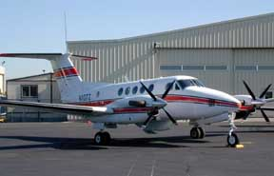
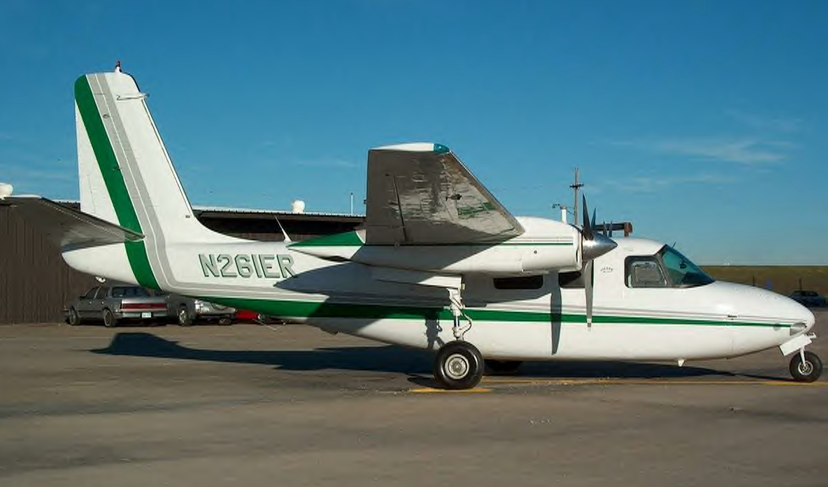
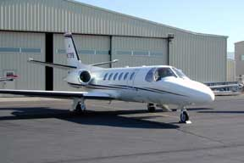
Beechcraft King Air B-200
Cessna Citation Brovo II
Notes:
Many things have changed since 1962.
The evolution of aircraft used during the history of this program has included:
A Beechcraft AT-11
An Aero Commander 500B
A Convair T-29
A Beechcraft B-90 that was just taken out of service last year
A Swearengen Merlin
And
A Beechcraft B-200 and a Citation Brovo II that are currently dedicated to the National Infrared Operations Program.

Slide 14
NIROPs Line scanners
There are a total of 4 line scanners.
2 are Phoenix systems based upon the RS-25 scan head.
2 are Daedalus systems based upon the ABS3500 scan head.
 | Phoenix | Daedalus
Thermal Bands | 2 | 2
IFOV | 1.25 mRad | 1.25 mRad
FOV | 120° | 86°
Swath Width | 6.5 miles | 3.5 miles

Slide 15
Outline
Background
NIROPS Mission
History
Aircraft
Equipment

