Slide 1
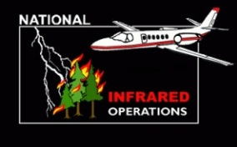
Phoenix Thermal Infrared System

Slide 2
WHY IR LINE SCANNERS?
Cover extremely large areas in a very short period of time
Line scanners are extremely accurate (depending on processing system +/- 1 meter)
Can detect very small fires
(While simultaneously)
Mapping very large areas
Timely delivery
Notes:
Line scanner technology for fire mapping dates back to the mid-1960s, however, for large area coverage, it is still the most capable airborne system currently available.
For example, the AMS used by NASA for the Ikhana UAS missions in 2007-2008 is a modified 12-channel Daedalus line scanner.

Slide 3
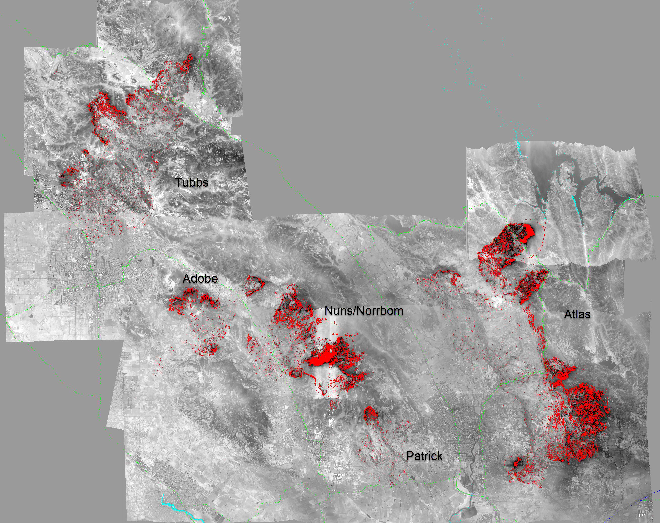
Phoenix imagery
Sonoma and Napa Co. fires (CA) Oct 10, 2017, 2044 hrs PDT
Notes:
Sonoma and Napa Co fires Oct 10 2044 hrs local
6 mile wide swaths gives the ability to cover large areas.

Slide 4
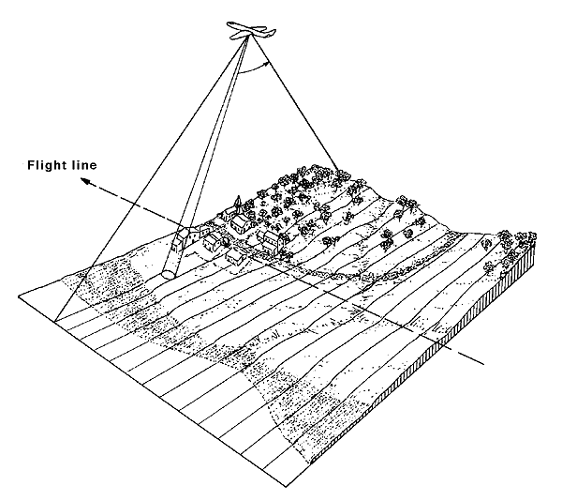
PHOENIX System Specifications
Two channel thermal IR line scanner
3-5 μm band for intense heat
8-12 μm band for background terrain
1.25 milliradian IFOV – 3.8 meter (12.5 Feet) pixel at nadir, 10,000 feet AGL
120⁰ FOV – 6.55 mile swath at 10,000 feet AGL (with at least 2 mile overlap between runs)
256 gray scale (256th pixel is colored red)
1680 pixels per scan line
200 scan lines per second
Time listed on imagery is ALWAYS Mountain (Boise).

Slide 5
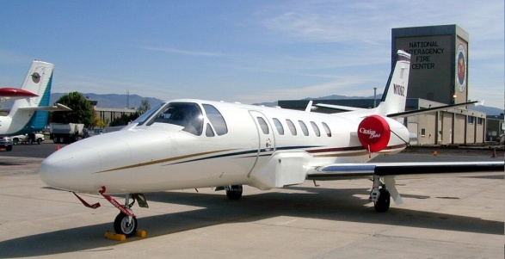
PHOENIX System Installation – N144Z

Slide 6
NIROPS History
1964 – Research begins with DoD, Civil Air Patrol, NASA, USFS
1969 – First full system deployment
Deliverable Products:
1969-1972 – “stitched” Polaroids
1972-1993 – 5” continuous dry silver film
1993-2005 – 8½” continuous thermal paper
2004-present – orthorectified imagery in GeoTiff format
Delivery Methods:
1969 - 2005 – hand delivered/drop tubes
1996 - 2003 – hand delivered imagery/drop tubes
2004 – 2005 - ground ortho processing
2006 - 2008 – Ortho files uploaded to ftp site (“land and upload”)
2009-present – AirCell to ftp site

Slide 7
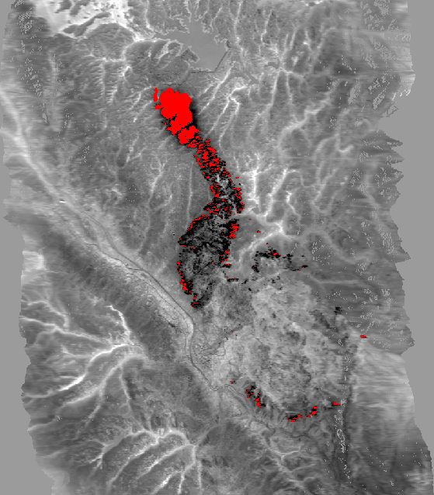
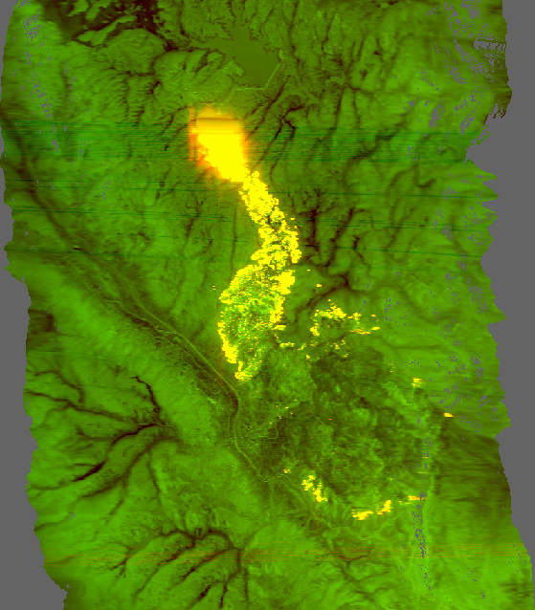
IR Data delivered from plane
“raw” tiff
Orthocorrected tiff w/ fire detects
Orthocorrected color tiff
Waldo Canyon Fire June 25, 2012, 2253 hrs
Notes:
Phoenix imagery is “black hot” (as well as red) the 256th pixel (value of 255)
Lighter areas are cooler – drainages, areas without forest cover
In black and white tiff, all background information is from channel B (8-12) and A is used for fire detects (shown red)
In color tiff, Channel B “background” (8-12) is displayed in green (the lighter the green, the warmer the area) and Channel A “heat detection” (3-5) is displayed in red so that as heat from fire increases, the image becomes more orange and eventually yellow.
Raw tiffs, un-orthocorrected, are NOT part of the delivery packet to the interpreter.

Slide 8
Grey Scale Ortho
Phoenix imagery is “black hot” (pixel value of 255 is red)
Lighter areas are cooler – drainages, areas without forest cover
In black and white tiff, all background information is from channel B (8-12) and A is used for fire detects (shown red)

Slide 9
Color Ortho
Channel B “background” (8-12) is displayed in green (the lighter the green, the warmer the area) and Channel A “heat detection” (3-5) is displayed in red so that as heat from fire increases, the image becomes more orange and eventually yellow.
Cool areas (drainages, no forest cover, etc.) are black.

Slide 10
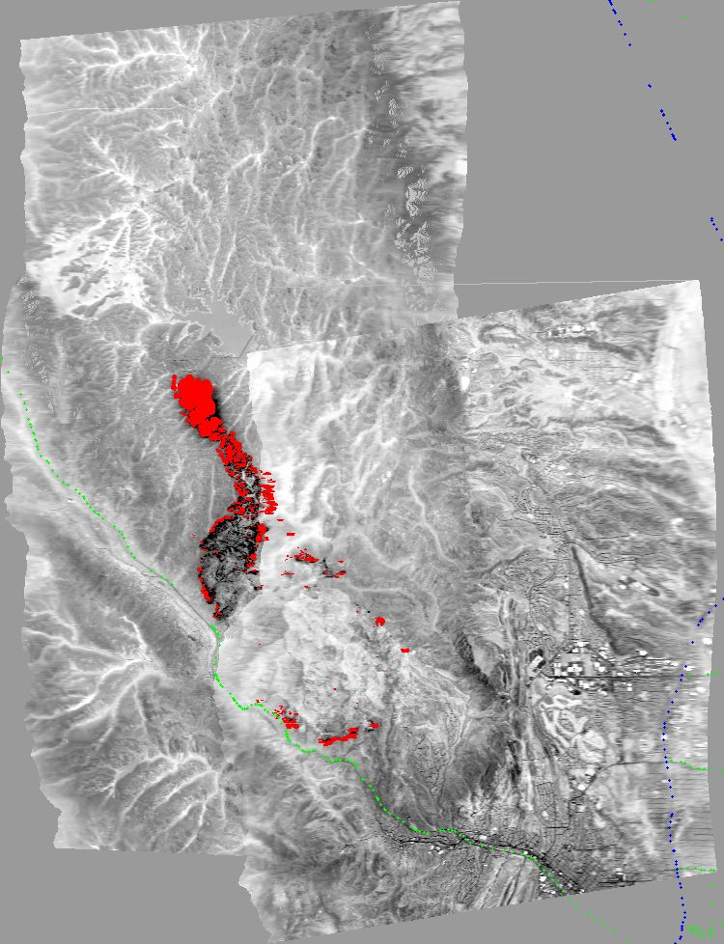
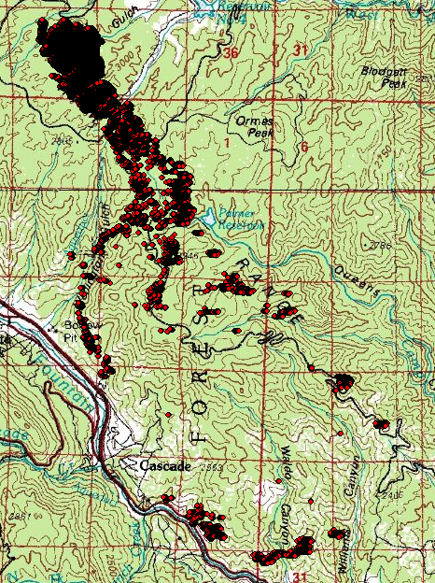
IR Data delivered from plane (con’t)
“dumb” reduced resolution JPEG mosaic of all runs
Raw heat detect point shapefile
Waldo Canyon Fire June 25, 2012, 2253 hrs
Notes:
Dumb means no geo coordinates, reduced resolution

Slide 11
Some Points To Remember About Phoenix Imagery
What is captured in the imagery is the relative variation in heat across the fire area
No one-to-one correspondence between pixel values and ground temperature
The technician can adjust the heat “threshold” value during runs across the fire area.
Doesn’t allow for automated extraction of heat areas
There is more heat in the imagery than just the red (DN = 255) pixels!
Requires an Infrared Interpreter (IRIN) to derive products

Slide 12
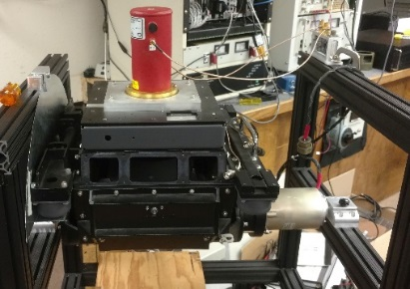
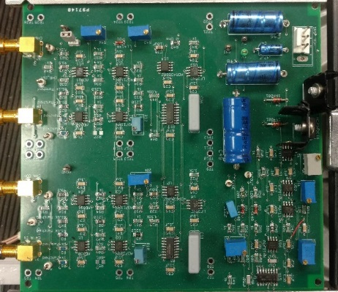
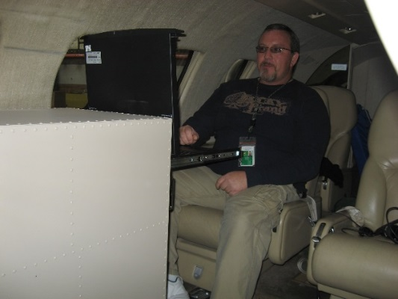
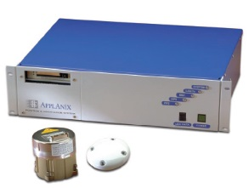
Phoenix Line Scanner Ops Diagram
COLLECTION
(linescanner, detector, preamps)
SIGNAL CONDITIONING
(sample & hold circuit, filters, cabling)
PROCESSING
(A/D conversion, software, fire detection, image processing)
DELIVERABLES
(ortho tiff, color tiff, ortho’d mosaic, .shp files)
NAVIGATION
(Applanix or Ekinox GPS attitude correction control)

Slide 13
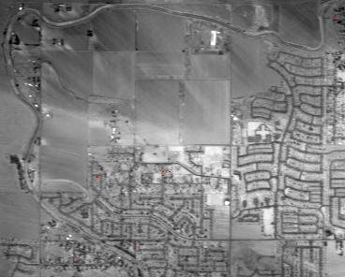
N149Z Phoenix Sensitivity Tests 2015
Test Flight over 6”, 9”, 12” Targets
Test Results at:
8,000 Ft AGL: 9” – 12”
10,000 Ft AGL: 6” - 9” - 12”
12,000 Ft AGL: 6” - 9” - 12”
14,000 Ft AGL: 6” – 9” – 12”
16,000 Ft AGL: 9” – 12”
18,000 Ft AGL: 9” – 12”
Similar testing has been done with Phoenix on N144Z.
Actual results may vary.
Notes:
Tests were done over open, flat ground

Slide 14
Phoenix Line Scanner
Near term updates (CY 2019/2020)
Upgrade of DSP/ADC boards and software to 64-bit processing.
DSP – Digital Signal Processing
ADC – Analog to Digital Converter
Switch to 10-meter DEMs for ortho-rectification.
Integration of Ekinox-S INS/IMU
INS – Inertial Navigation System
IMU – Inertial Measurement Unit
New mirrors

Slide 15
Phoenix Line Scanner
Long term updates (proposed)
Replace the AirCell system
Replace current LN2-cooled detectors with cryo-cooled detectors.
Add detectors in the SWIR bands, 2.2 µm and 2.6 µm.
Physically shrinking the system

Slide 16
Questions?

Slide 17
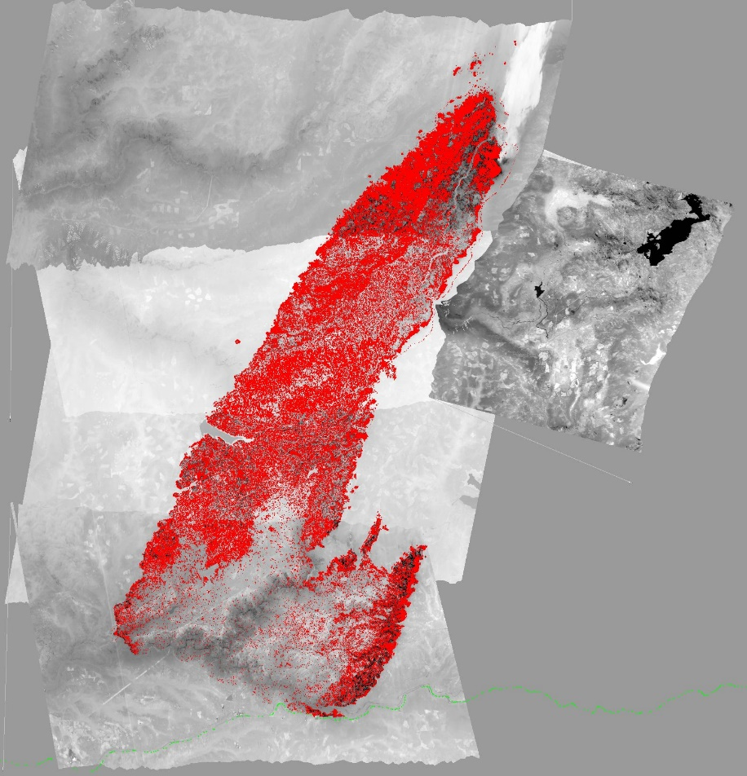
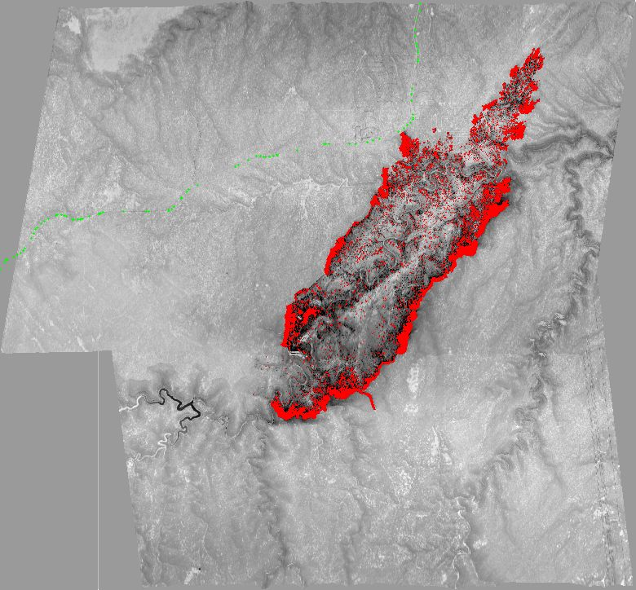
Phoenix Imagery Examples
King Fire – CA 2014
On Sept 17 grew by 50,000+ acres making a 13 mile run to the northeast and nearly tripling in size, final size of 97,717 acres
Tinder Fire, AZ 2018
Started April 30th grew to 8,600 ac
Topo and NAIP base provided for reference
Notes:
King Fire was on the Eldorado NF, started Sept 13
Tinder Fire was on the Coconino NF, flown at 1am

