Slide 1
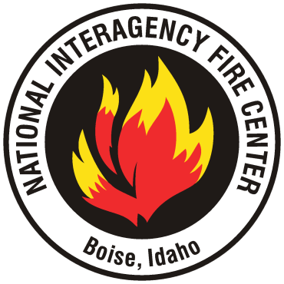
One Place
One Mission

Slide 2
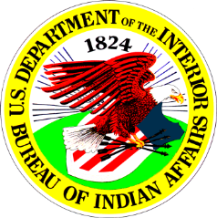
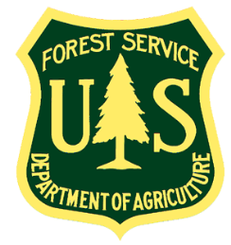
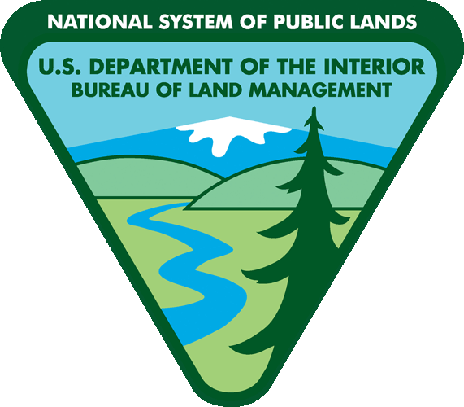
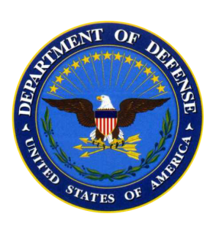
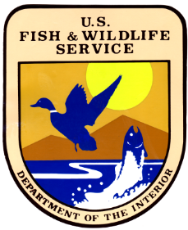
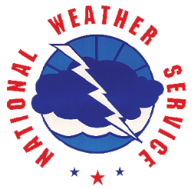
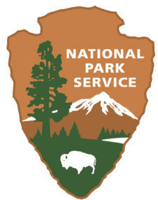
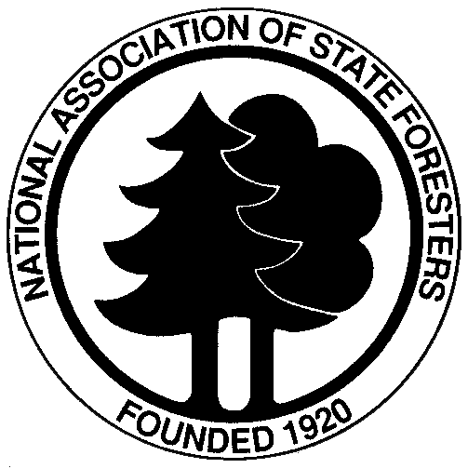
One
Mission
Notes:
NIFC was established in 1963 to reduce duplication of services, cut costs, and coordinate national fire planning and operations among federal government agencies with roles and responsibilities in managing wildland fire.
Today, representatives of nine different federal, state, and local government agencies and organizations work together here at NIFC.
NIFC is located on a 55-acre site administered by the Bureau of Land Management. Operating costs and responsibilities are shared by the principal cooperating agencies.
Boise was initially chosen as the location for NIFC because it’s centrally located to support wildfire suppression activity in the West and because it provides excellent air transportation and other amenities.
About 630 employees, all told, work at NIFC for the various agencies.

Slide 3
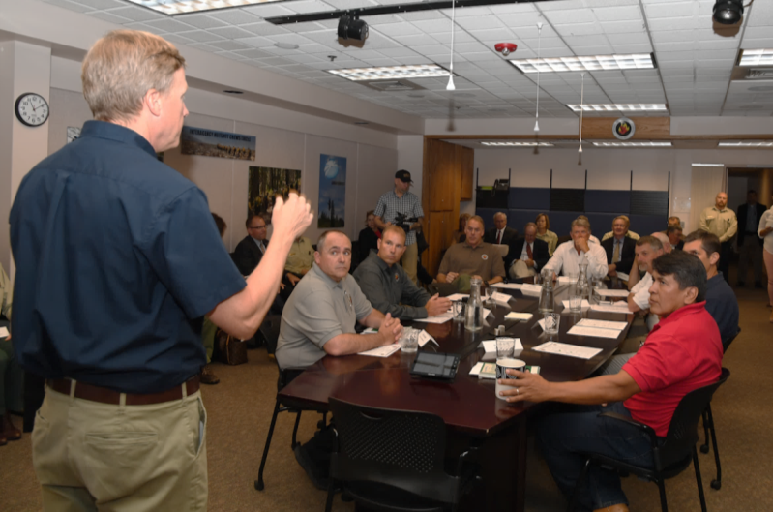
Our Expertise
Coordinating wildland fire and all-hazard response nationally on an interagency and intergovernmental basis.

Slide 4
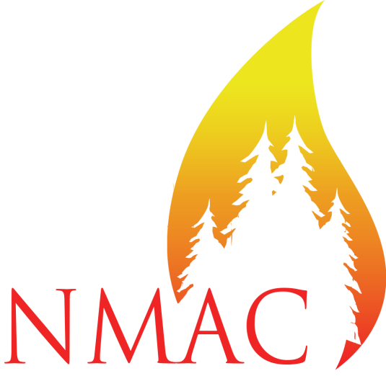
National Multi-Agency Coordinating Group (representatives from seven agencies at NIFC)
Establish national priorities
Direct and allocate firefighting resources
Determine National Preparedness Levels
Preposition firefighting resources
Resolve firefighting policy issues
Notes:
As we mentioned earlier, during periods of peak fire activity, there are often not enough firefighters, aircraft, and other firefighting equipment to go around and there is competition for resources.
Through resource allocation and other responsibilities, the National Multi-Agency Coordinating Group, or NMAC as we call it around here, provides an essential management mechanism for national level strategic coordination to ensure that firefighting resources are efficiently and appropriately managed in a cost-effective manner.
It is up to NMAC to establish national priorities among Geographic Areas and to direct, allocate, and reallocate firefighting resources to meet them.
NMAC is based here at NIFC and you’re going to get a chance to meet with some of the members this afternoon.

Slide 5
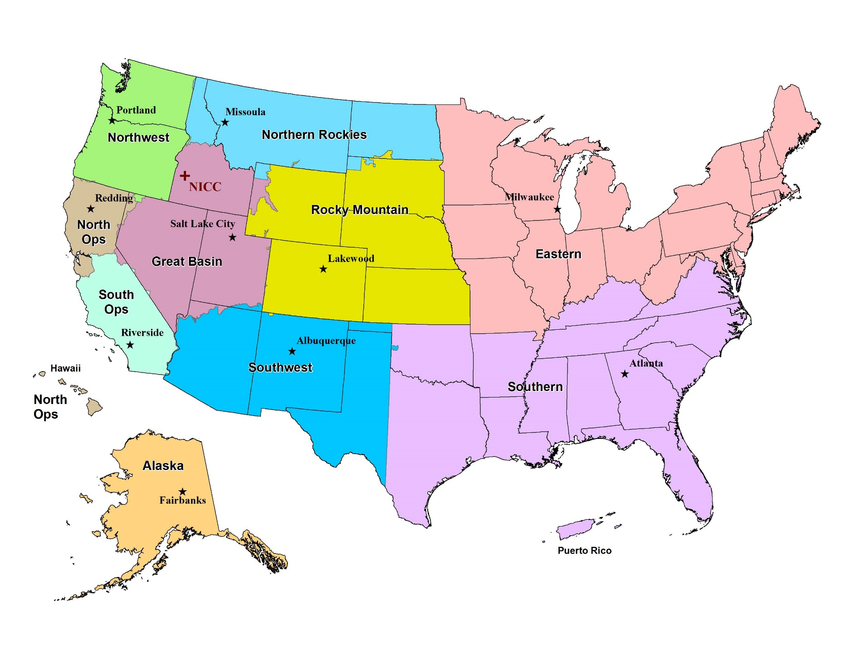
10 Geographic Areas
Notes:
The United States is divided into 10 GACCs. Each GACC supports many local, state, and federal units.

Slide 6
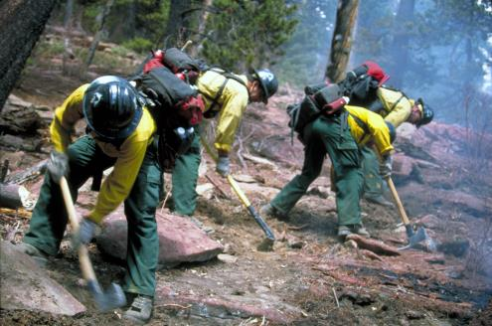
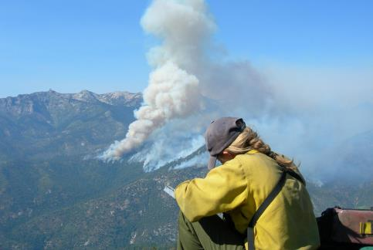
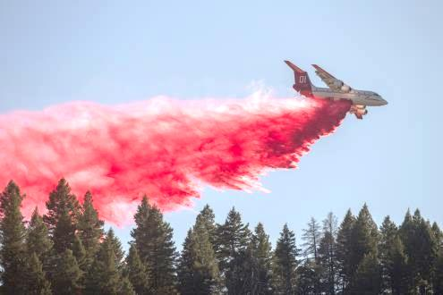
3-Tier Response
Local Area
1
1
Initial response to incident by local firefighting resources
Geographic Area
2
Mobilizes additional crews, equipment, and aircraft from within geographic region.
National
3
NICC dispatches the closest, most cost-efficient resources across geographic areas.
Notes:
Wildland fires are initially reported to a local agency dispatch office, which responds by sending firefighters, equipment and supplies to the fire.
If the fire grows beyond the capability of the local agency, the nearest of 10 Geographic Area Coordination Centers, or GACC, is contacted. The GACC then locates and dispatches additional resources.
When fires in a geographic area strain GACC personnel and equipment, the National Interagency Coordination Center, located here at NIFC, is called.

Slide 7
Annual Number of Fires in U.S.
5-Year Average: 63,717
10-Year Average: 69,020
Number of Fires
2006
2009
2018
Year
Notes:
As you can see, the number of wildfires in the U.S. varies quite a bit each year, but even in “slow” years, there’s still a lot of fires.

Slide 8
Annual Number of Acres in U.S.
5-Year Average: 6.72M
10-Year Average: 6.63M
Number of Acres Burned (in millions)
2006
2009
2018
Year
Notes:
The number of acres burned by wildfires in the U.S. varies quite a bit each year.

