Slide 1
GTAC Aircraft3/Firehawk Support to NIROPS
NGA-AOH Meeting
June 12-13, 2019
National Interagency Fire Center (NIFC)
Boise, ID

Slide 2
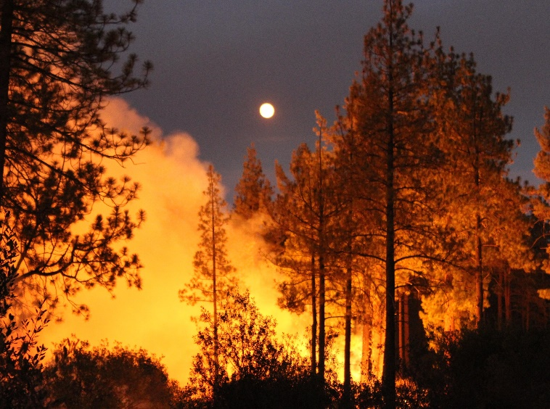
Presentation Outline
Overview of Aircraft3/Firehawk Support
Liaison: Making the Incident Support Process Work
Cranston Fire
Inciweb

Slide 3
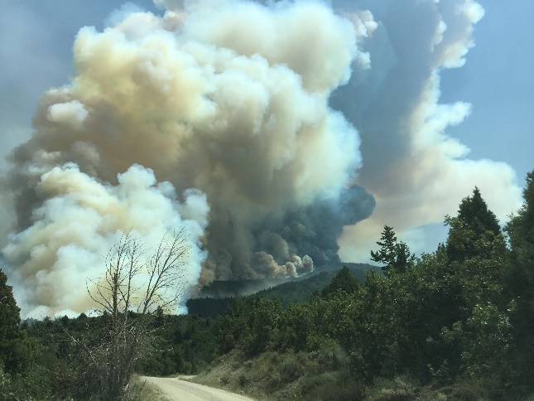
GTAC Aircraft3/Firehawk Support
Initial fire mapping collaboration began in early 1990s on prescribed fires.
Project Red Sky; proof of concept work
First operational fire mapping was the Tyee Creek Fire (WA) in 1994.
Initially used as a “gap filler” at PL 4, 5.
Several factors have lead to increased use of Aircraft3 support.
Expansion of the “fire season”.
Geographic distribution of fires on the landscape.
Changes in how fires are managed.
Coal Hollow Fire
Inciweb

Slide 4
Aircraft3 2018 Summary
Very limited analyst support
Limited support to incidents with Type 1 or Type 2 teams assigned.
Persistent issue with late data delivery to the analysts.
Incident support started on April 16
Bluewater, Diener Canyon, NM
Rattlesnake, AZ
Incident support ended on October 2
Ryan and Silver Creek Fires, CO
57 days of continuous support from July 2 – August 31.
Eastern Area (EA) and Alaska GACCs did not request support.
Additional support provided by the NCAC-Denver (USGS).
USFS and USGS personnel

Slide 5
Extended Support to Incidents
Ferguson (CA) – 27 nights
Coal Hollow (UT) – 12 nights
Avian Complex (FL) – 11 nights
County (CA) – 9 nights
Lake Christine (CO) – 9 nights
Watson Creek (OR) – 9 nights
Badger Creek (WY) – 7 nights
Holy (CA) – 7 nights
Cranston (CA) – 6 nights

Slide 6
Liaison: Making the Support Process Work
Nat’l IR Program Manager
GTAC
IWG-RRRB
Data post for
0600 brief
Data post for
0600 brief
AC3/Firehawk
FTP Folder
GTAC
NIFC
Nat’l IR Coord.
Data pull for
0600 brief
Data pull for
0600 brief
Incident(s)
SITL/GISS

Slide 7
Aircraft3/Firehawk Derived Products
Intended to have the same “look and feel” as products from NIROPS.
Current Products
ArcGIS format shapefiles, geographic coordinates, WGS84
“Read me” file (2008) with analysts’ observations of fire activity.
Time Stamp (2009) in UTC (“Zulu”) time.
Data acquisition window of ± 30-45 minutes.
KML/KMZ of shapefiles (2011).
“No data” and “cloud cover” shapefiles (2013).

Slide 8
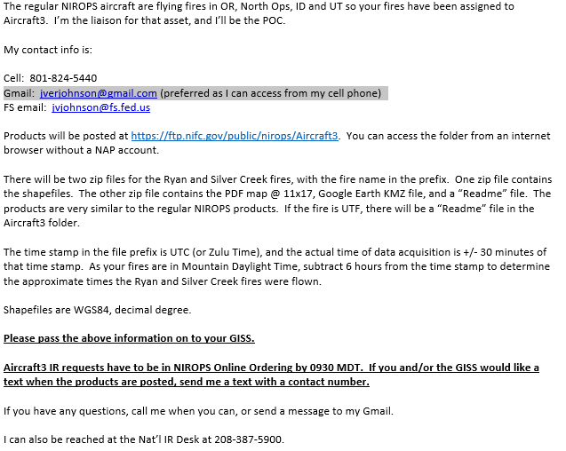
Contact the Incident(s)

Slide 9
Interacting With The Incident(s)
Questions for the incidents
How did the products look?
Did the mapped fire activity reflect intel from the field?
Predicted fire behavior?
Weather?
Updated perimeter? When will it be available?
Questions from the incidents
What is being used to fly the fire?
“Secret squirrel”
Why can’t we talk to the analyst directly?

Slide 10
Interacting With IWG-RRRB
Fire priority list for next night.
New fires/fires being dropped.
Changes in scan boxes.
Updates to incident perimeters.
NIROPS aircraft status (weekly).

Slide 11
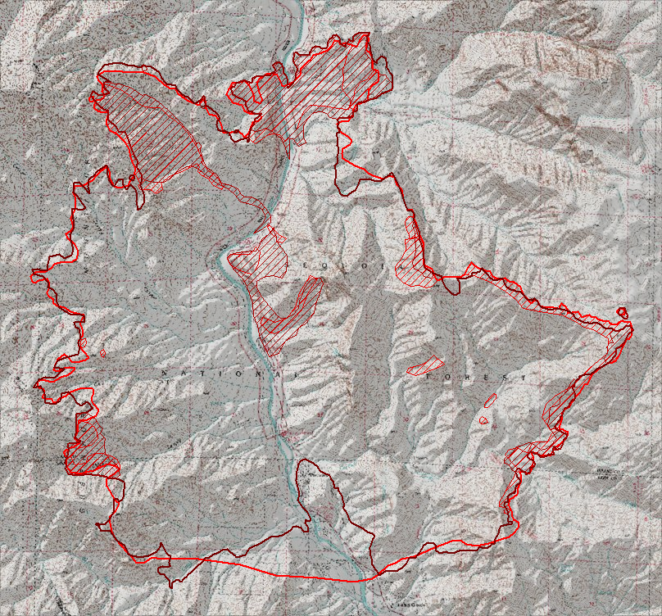
AC3/Firehawk Product Example: Bull Fire, Kernville, CA, 2010
Phoenix –derived perimeter
Firehawk –derived perimeter
Time difference between Firehawk and Phoenix: Approx. 3 hours

Slide 12
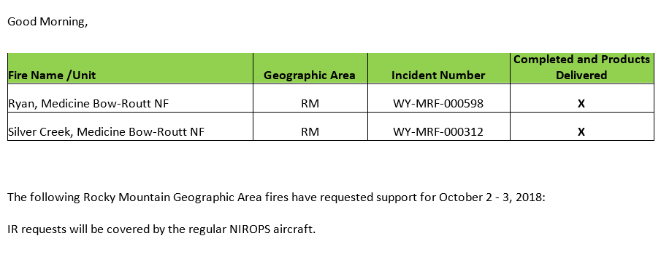
Other Liaison
Daily summary email to CAC, NGA, FS WO-ENG, GTAC, NICC, NIFC.
Email to NRO with list of fires to be supported for the next night.

Slide 13
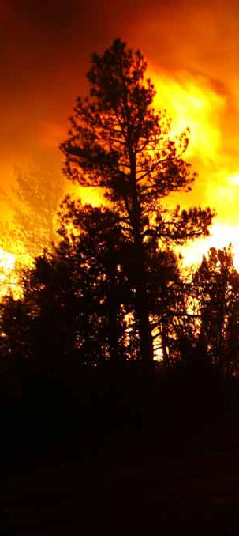
Thanks
Comments/Questions?

