Slide 1
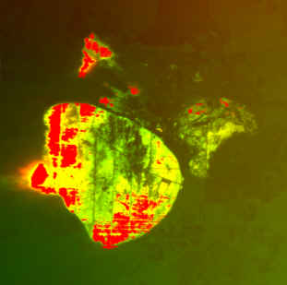
NIROPS
Update:
2011

Slide 2

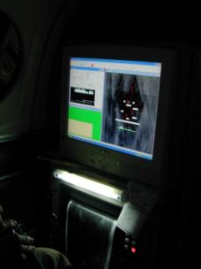
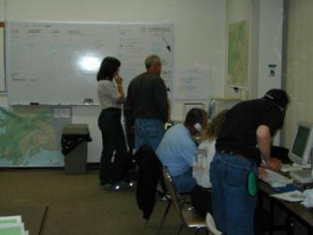
The NIFC National Infrared Program strives to provide the best possible imagery for the widest applications
The aircraft platforms and sensors are suited for rapid transit times between incidents and rapidly collecting data over them
NIROPS has a full cadre of dedicated personnel to coordinate, collect, interpret and deliver infrared intelligence.
Notes:
There are two key components to the National IR Program: 1) the aircraft, crew, scanner, and technician and 2) the infrared interpreter and incident support.
The flying component consists of three planes, two King Air and a Citation jet. These are flown by Forest Service and BLM crew. On board is the line scanner run by highly trained and skilled technicians.
To get these folks into the air over your fire requires two things: an Infrared Aircraft Scanner Order and an infrared interpreter.

Slide 3





NIROPS “Organization”
Research &
Development
Operations
IRINs:
Tom Mellin
National IR Program Manager
Pilots:
Dan Johnson
IR Techs:
Woody Smith
Charles ‘Kaz’ Kazimir
Karyn Woods
Assistant Director
Operations
R4: Intermountain
Region

Slide 4
National IR
Program Manager
Tom Mellin
IRCN
IRCR
Northern
IRCR
Rocky Mtn.
IRCR
Southwest
IRCR
Great Basin
IRCR
North Ops
South Ops
IRCR
Northwest
IRCR
Southern
IRCR
Eastern
IRCR
Alaska
IRCN: Infrared National Coordinator:
Works with the Coordinator on Duty (NICC) and the respective GACCs to determine mission priorities for the use of IR aircraft. This is a NICC - assigned position
National IR Program Manager for NIROPS
Responsibilities include the coordination of S-443, appointing the IRCR, and IRCN’s when needed. Conduct information presentations about the IR program to other agency and interagency groups, e.g., Incident Commanders, Operation Chief, Dispatchers, Aviation, etc.
GACC IR Liaison
Maintain and update the list of qualified or trainee, active or inactive Infrared Interpreters (IRIN) in their GACC. Submit updated list to NICC, GACC, IRCN and each IRIN on the list.
Conduct information presentations about the IR program to other agency groups, e.g., Incident Commanders, Operation Chief, Dispatchers, Aviation, etc.
IRCR: Infrared Regional Coordinator
In the event of multiple incidents in the region, the IRRC may act as lead for IRINs assigned to the incidents. The IRRC could possibly assist with the flight scheduling of the IR aircraft. This is a NICC-assigned position.
S-443 Training Cadre:
The National IR Program Manager and the GACC IR Liaisons make up the core of the training cadre.
RSAC has been tasked to coordinate the development of the student workbook and online course pre-work.

Slide 5
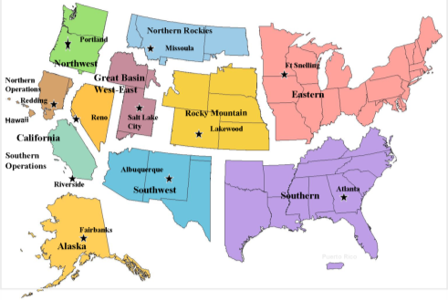
GACC IR Liaisons
Northern: Lee Werth
Rocky Mtn: Melinda McGann
Bob Malcolm
Southwest: Tom Mellin
Great Basin: Hope Spriggs
CA N/S: Kyle Felker
Northwest: Randy Herrin
Southern: Scott Wilkinson
Eastern: Liz McNichols
Alaska: Hilary Rigby

Slide 6
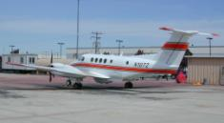
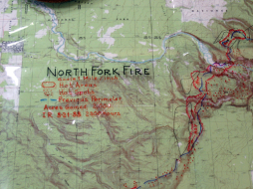
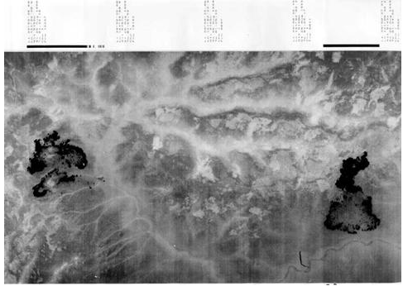
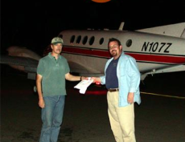

Traditional Role: One IRIN, One Fire
Map Product
Acquisition
Interpretation
Morning
Briefing
Delivery
Digital Product
Notes:
Until the Phoenix system was introduced in 2003, one co-located IRIN, one fire was the traditional role. You may still be assigned to one fire, but you may work other fires; you may meet the plane for your imagery plus other imagery that needs to be uploaded to the ftp site. Assume you will be multi-tasking.

Slide 7
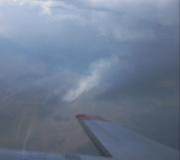
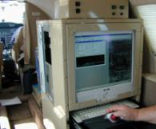

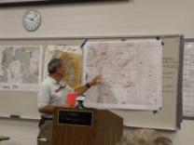
Pod and Remote IRIN Support: One IRIN, Multiple Fires
Interpreter(s) located at
RO, SO, RD, hotel,
home
Phoenix data
in WinZip archive
Phoenix data
in WinZip archive
Shapefiles, PDFs
in WinZip archive
ftp.nifc.gov/
NIROPS
Incident
ftp.nifc.gov/
Incident Spec Data/
IR
Notes:
Phoenix plus FTP (and soon AirCell downlink) have made the one fire, one co-located IRIN much less common.

Slide 8
IRIN “Pods”
Multiple IRINs at a single location central to multiple incidents
If working in a pod
  A lead IRIN is assigned
  Each interpreter will be responsible for at least one fire, possibly more, depending on size and complexity
  Interpreter may work fires not in the local area
  Usually 14 day assignments

Slide 9
Remote (Virtual) IRINs
Support one or more incidents from home office
  May be individual incidents, or supporting a pod remotely
  Variable time length*
  IRINs are responsible for communicating with the incident
  *Focused effort to keep remote interpretation for short (1-3 day), infrequent, or “gap-filling” assignments
Notes:
Because of remote interpretation, there has not been an IR flight request UTF’d because of IRIN unavailability for the last few years.
Especially with remote assignments, communication is critical but can be challenging.
The concept of remote interpreting is new to some teams, always ask if it is acceptable.

Slide 10
Aircraft vs. IRINs
NIROPS aircraft are a national resource that can support multiple fires in multiple GACCs
  NOT assigned to the fire
  Fires receive the service
IRINs are a single resource (overhead) that can support one or more fires
  Can be assigned to a Fire
  OR can be assigned to a GACC or Area Command to support multiple fires (usually as a member of a “pod”)
Notes:
The IRINs fall under the Incident Command System (ICS) organizational chart, the aircraft do not.
Aircraft can cover multiple fires in multiple states/GACCs in one night. Can map 500,000 acres/hr.

Slide 11
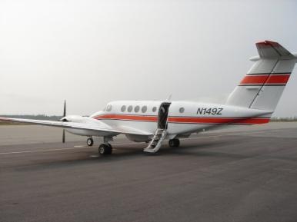

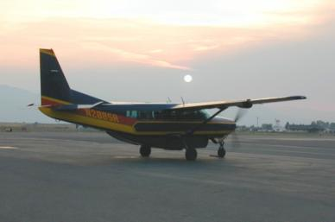
Scheduling
149Z
King Air 200B
144Z
Citation Bravo
National Coordinator position activated at PL4
Once FS assets have been exhausted, the National Coordinator can utilize contract assets.
Contract IR Aircraft
Firehawk
Notes:
Once the scanner order is received at NICC and an IRIN is assigned, one of the planes will be scheduled to fly the mission. These flights take place at night to maximize contrast in radiant heat signatures, minimize fire activity, and avoid other air traffic over the fire. As fire activity increases the National Coordinator position is activated. The NC assist the NIC aircraft coordination desk with dispatching and scheduling NIROPS aircraft. If the fire activity becomes too heavy for the NIROPS aircraft to fill all the requests, the NC can recommend activating one of the contractors on the infrared vendor list to assist the NIROPS aircraft. These additional infrared assets are assigned to fires by the NC to maximize their utility.

Slide 12
Commercial Infrared Vendors
Infrared Field Users’ Guide and Vendor Listings
  Field Users’ Guide is Thermal RS 101 and Typing Scheme
  Vendor Listings include capabilities and contact information
  http://nirops.fs.fed.us/reports
Notes:
IFUVGL available on NIROPS website under Reports. IR Guide and Vendor Listing now separate documents.

Slide 13

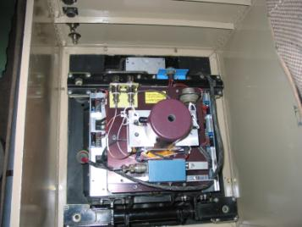
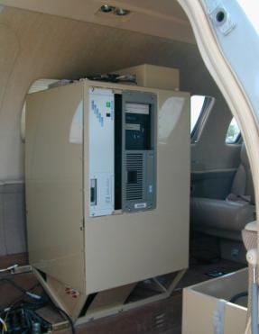
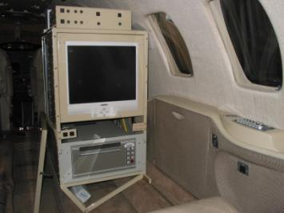
PHOENIX System Installation – N144Z

Slide 15
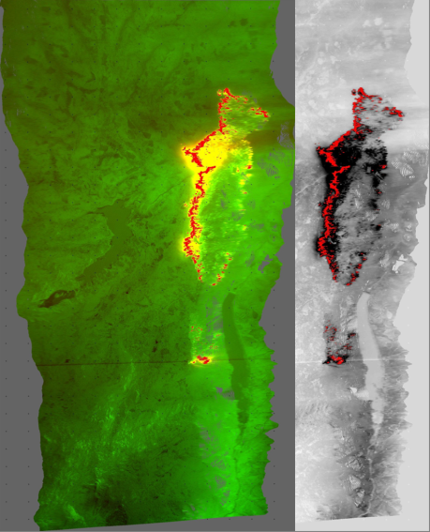
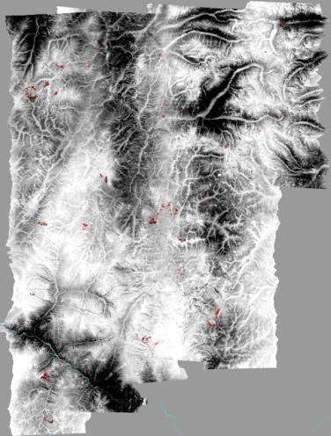
Phoenix Data Products
Heat detect Shape files.
GeoTiffs
  Color
  Grayscale
  Fire Layer
JPEGS
Mosaics

Slide 16
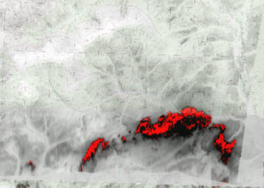
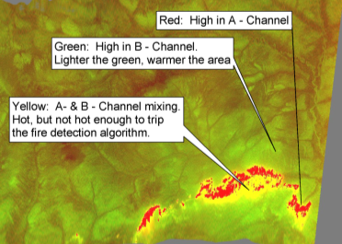
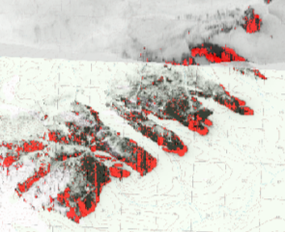
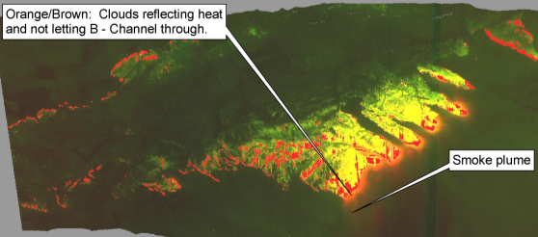
KA – B Detection Output From Phoenix System
Notes:
Output products from Phoenix. A qualified IRIN needs to use each product to accurately locate the heat source.

Slide 17

AIRCELL Equipment
ftp.nifc.gov /
NIROPS
Notes:
Unlike satellite links that use very expensive tracking style antenna, AirCell uses a ground based system and only requires simple fixed antennas on the bottom of the aircraft. Minimum seamless CONUS coverage begins at 10,000 feet AGL.
An Inmarsat antenna would have required approx. 3 feet of space on either 144Z or 149Z (antenna plus buffer space)

Slide 18
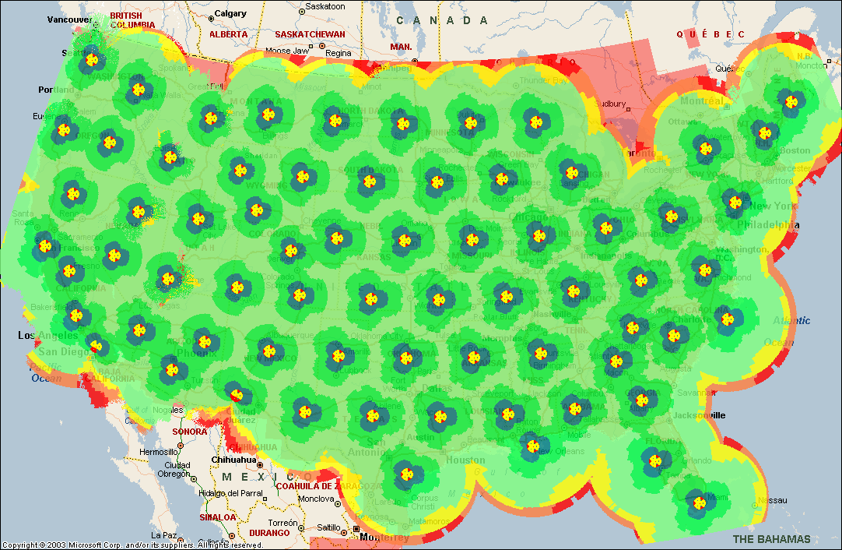
AirCell System
Direct download of imagery to NIFC ftp site
Utilizes existing network of cell phone towers
Seamless coverage above 10,000 ft. AGL in CONUS
More efficient, timely delivery of data
Improved safety – fewer landings/takeoffs, less driving
Notes:
18

Slide 19
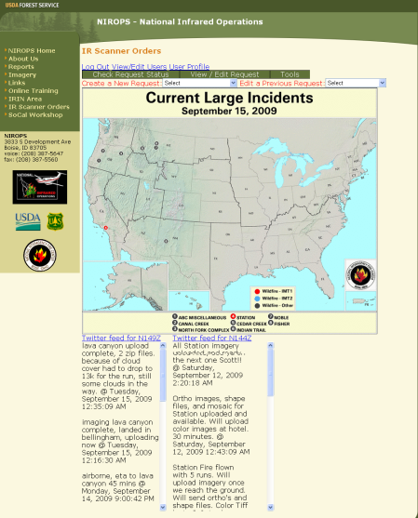
Getting Started
Summer 2009
  Installment of AirCell system on both planes
  First operational delivery of data
  Twitter accounts and feeds from both aircraft
  Identification of issues to address for 2010
Notes:
Twitter feeds allow IR techs to notify IRINs when data is ready for download from the NIFC ftp site.

Slide 20
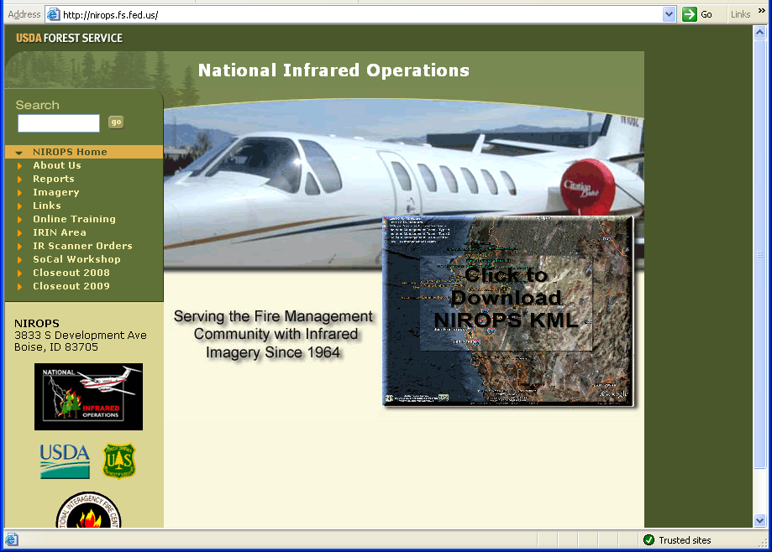

Slide 21
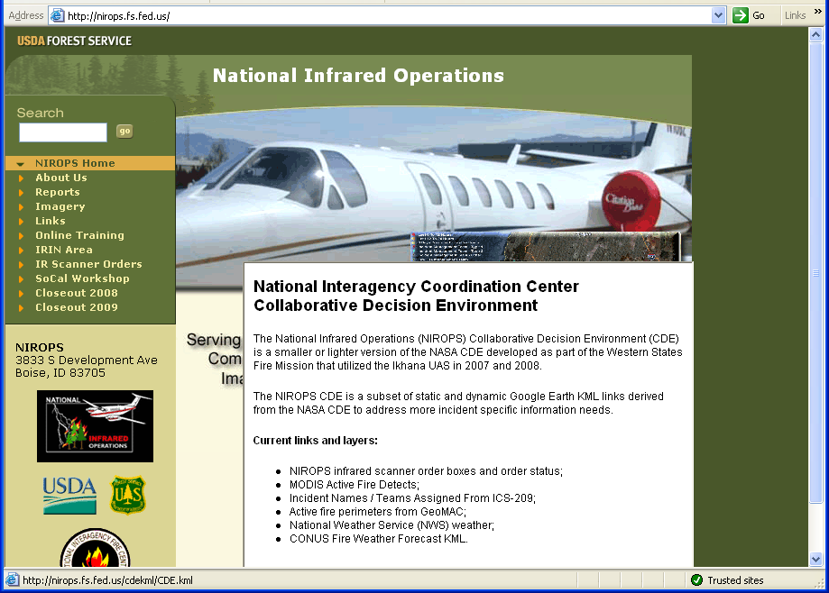

Slide 22
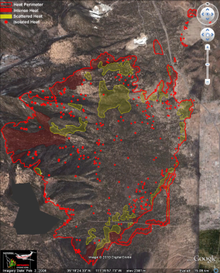
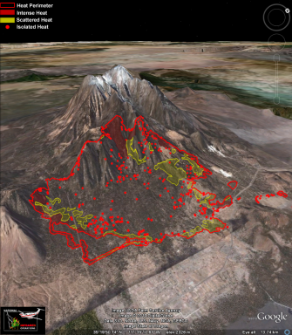
NIROPS KMZ Tool
Developing a tool to generate GE KMZs from standard NIROPS datasets
  Heat Perimeter
  Intense Heat
  Scattered Heat
  Isolated Heat
Address issues with administrative access on BLM computers
Tool will be available from NIROPS website
Notes:
Tool is currently under development (alpha stage)
Anticipate completion later this fall

Slide 23
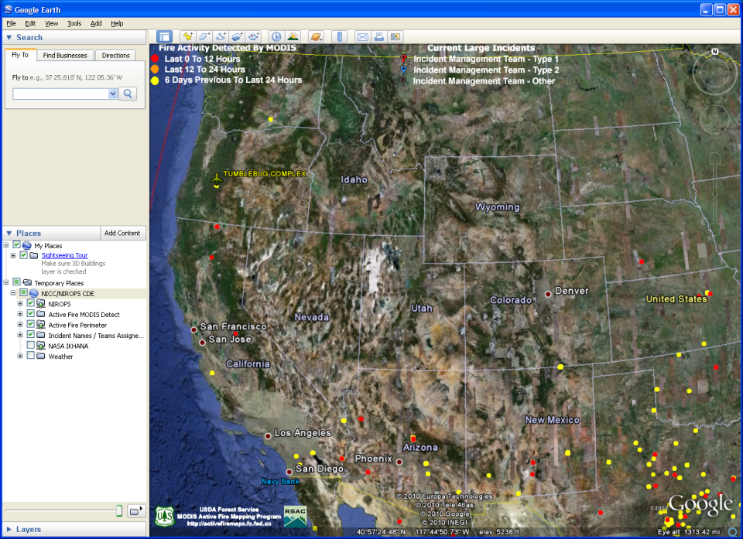

Slide 24
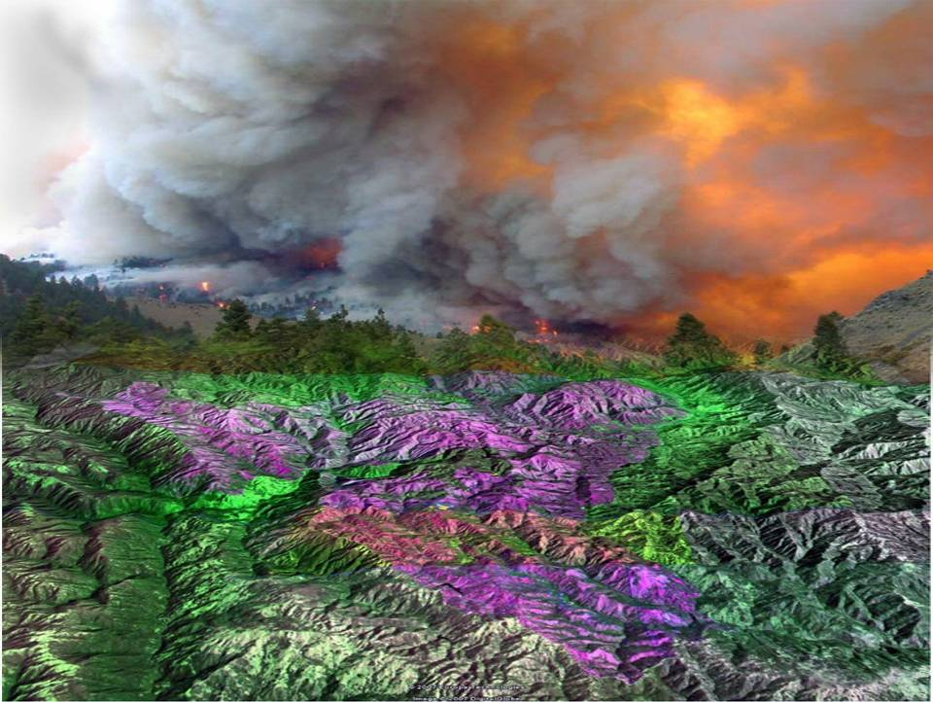
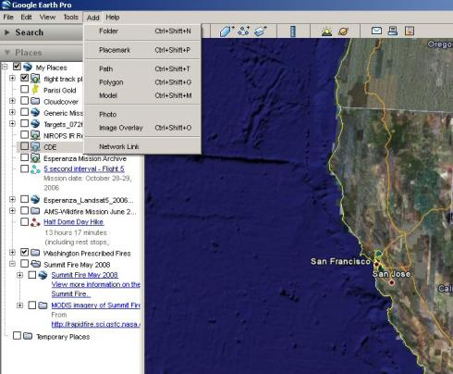
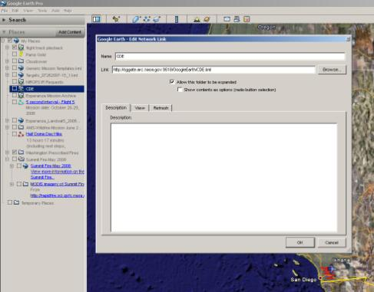
Accessing the Wildfire CDE
Step 1: Add Network Link
Step 2: Enter URL: http://sggate.arc.nasa.gov:9518/GoogleEarth/CDE.kml

Slide 25
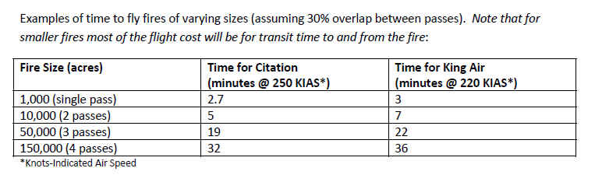
What will it cost? (2012 rates)
Getting the plane there:
OGD-Ogden, UT to Destination | Direct Distance | 144z ($1760/hr x Time) | 149Z ($900/hr x Time)
FAI-Fairbanks, AK | 1900 miles | $1760 x 6 hrs = $10,560 | $900 x 8 hrs = $7,200
JAX-Jacksonville, FL | 1600 miles | $1760 x 5.5 hrs = $9,680 | $900 x 7.5 hrs = $6,750
ELO-Ely, MN | 950 miles | $1760 x 3 hrs = $5,280 | $900 x 4 hrs =$3,600
SAN-San Diego, CA | 570 miles | $1760 x 1.75 hrs = $3,080 | $900 x 2.5 hrs = $2,250
Over the fire:

Slide 26
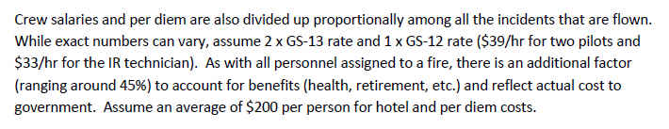
What will it cost?
Air Crew:
IRIN:
Similar to Air Crew cost if assigned to fire. If remote there is no per idem costs.

Slide 27
Feedback Needed!
Is NIROPS meeting your needs?
When you have problems let us know immediately
Lots of new technology what will help?
What are your requirements?
  Spatial
  Temporal
  Spectral
  Data Products / Display
  Platform

Slide 28
Primary Contacts
NIROPS Program Manager – Tom Mellin
  505-842-3845 Work
  505-301-8167 Cell
CALFIRE – Buddy Bloxham
  831-236-5659 Cell

Slide 29
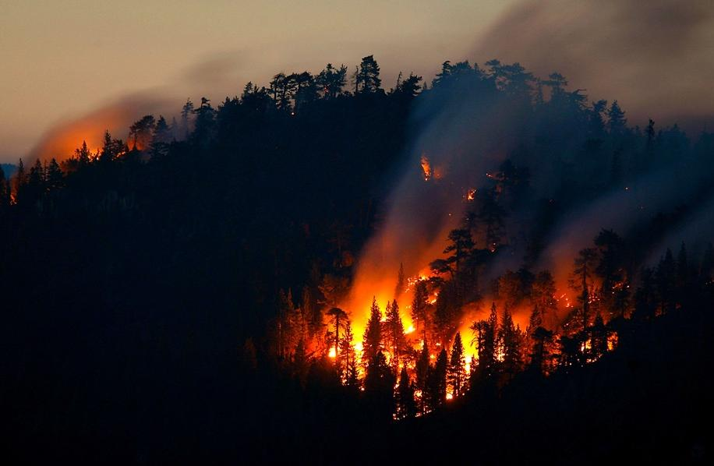
Questions?
  Tom Mellin – National IR Program Manager and SW GACC Liaison
  (505) 842-3845 Work
  (505) 301-8167 Cell
  tmellin@fs.fed.us
  Tom Zajkowski – Remote Sensing Analyist
  (801) 975-3758 Work
  (801) 520-8648 Cell
  tzajkowski@fs.fed.us

