Slide 1
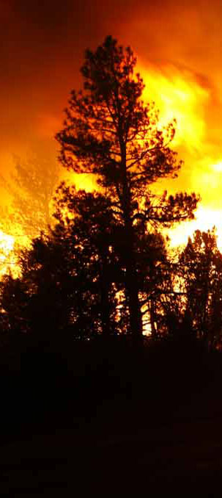
2016 NIROPS National Summary
Tom Mellin,
National Infrared Program Manager
Original Presentation November 2, 2016
NIROPS Closeout, NIFC, Boise
Some slides updated with Southern Area data, 1/5/17 and 2/1/17

Slide 2
2016 NIROPS National Summary for Southern Grop of State Foresters GIS Committee
February 7, 2017
Melinda McGann
IRCN, IRCR, and IRIN
FS Rocky Mountain Region

Slide 3





Our NIROPS “Organization”
Research &
Development
Operations
IR Interpreters:
Tom Mellin
National IR Program Manager
Pilots:
Dan Johnson
IR Techs:
Woody Smith
Charles ‘Kaz’ Kazimir
Larry Sutton
NIFC - Director of
Operations
GTAC
USFS (Region 4 ) - Ogden, UT
USFS (W.O.) - Boise , ID

Slide 4
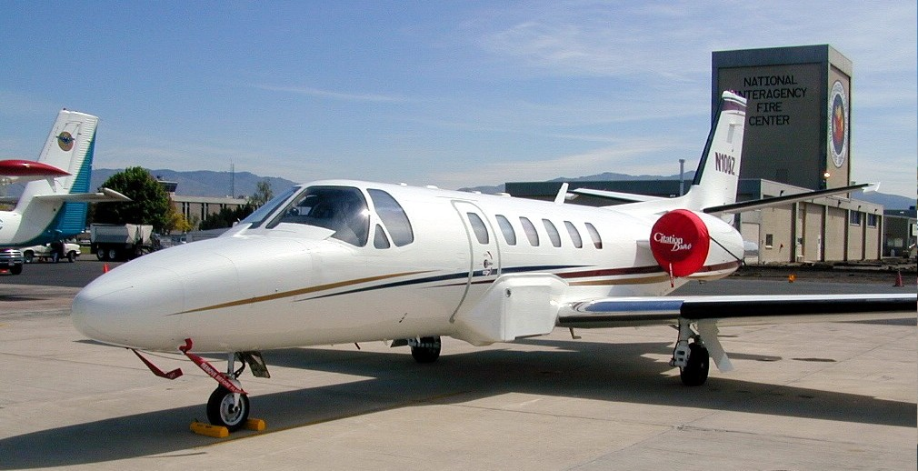
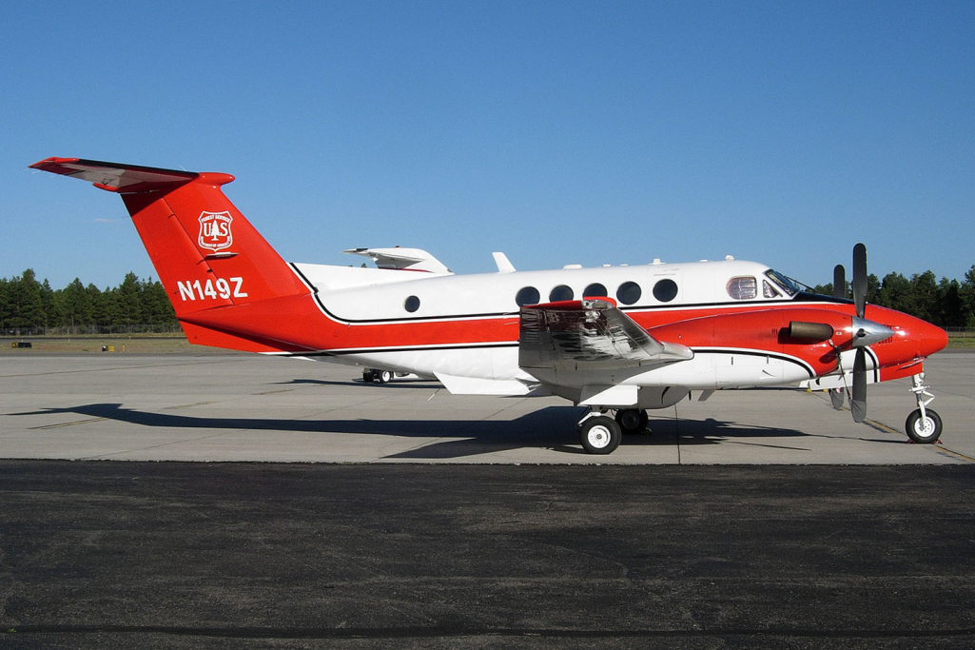
Aircraft: Dedicated to IR use from April-November
144Z - Cessna Citation Bravo
These aircraft are a National resource. They can cover multiple incidents in multiple states in a single night.
Can map 300,000 acres in an hour
Ordered at fsapps.nwcg.gov/nirops
149Z - Beechcraft 200 Super King Air
Notes:
Aircraft are based in Ogden, the techs are based in Boise
Can map 300,000 acres in an hour
Planes not assigned to a particular incident, NICC/IRCN establishes priorities
Once the scanner order is received at NICC and an IRIN is assigned, one of the planes will be scheduled to fly the mission. These flights take place at night to maximize contrast in radiant heat signatures, minimize fire activity, and avoid other air traffic over the fire. As fire activity increases the National Coordinator position is activated. The NC assist the NIC aircraft coordination desk with dispatching and scheduling NIROPS aircraft.

Slide 5
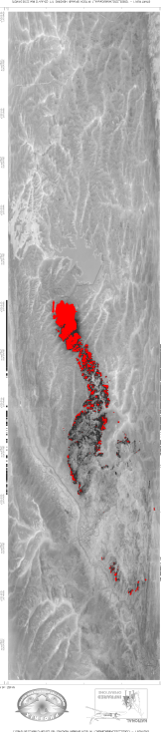
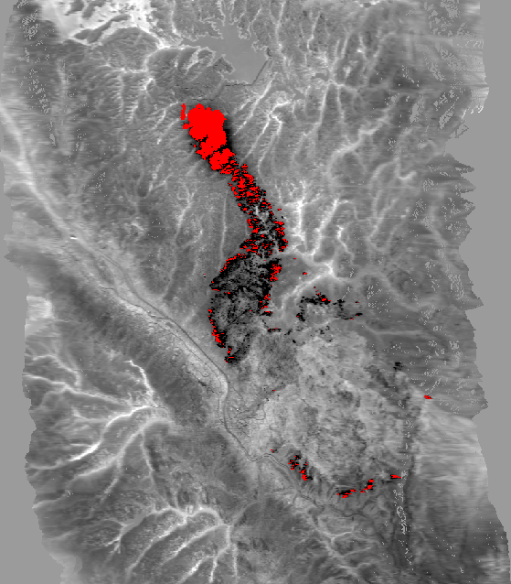
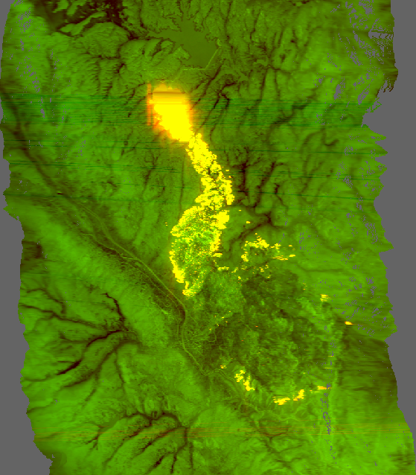
IR Data delivered to IRIN
“raw” tiff
Orthocorrected tiff w/ fire detects
Orthocorrected color tiff
Waldo Canyon Fire June 25, 2012, 2253 hrs
Notes:
Phoenix imagery is “black hot” (as well as red) the 256th pixel (value of 255)
Lighter areas are cooler – drainages, areas without forest cover
In black and white tiff, all background information is from channel B (8-12) and A is used for fire detects (shown red)
In color tiff, Channel B “background” (8-12) is displayed in green (the lighter the green,the warmer the area) and Channel A “heat detection” (3-5) is displayed in red so that as heat from fire increases, the image becomes more orange and eventually yellow.

Slide 6
Roles and Responsibilities of the Infrared Interpreter
Primary Objectives:
  Quality Control of thermal imagery
  Determine heat perimeter
  Identify areas of heat and isolated heat sources
  Calculate acreage of the perimeter
  Produce shapefiles, summary map(s) and log to ftp.nifc.gov
Notes:
Quality control – check orthorectification, look for coverage gaps, sensor saturation, electrical interference, cloud cover issues

Slide 7
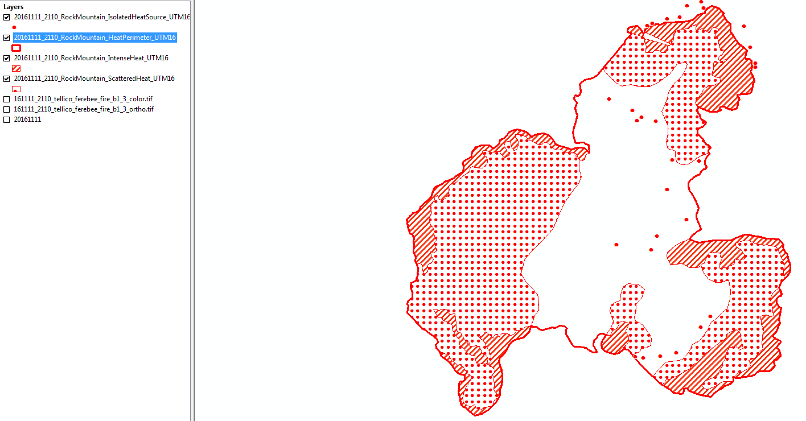
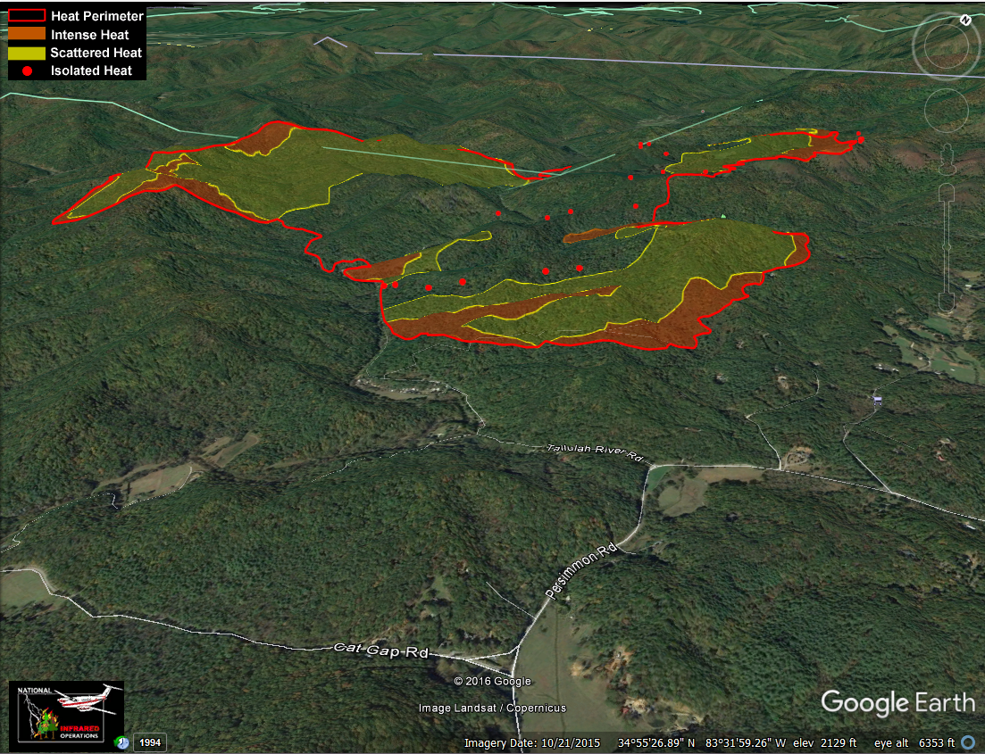
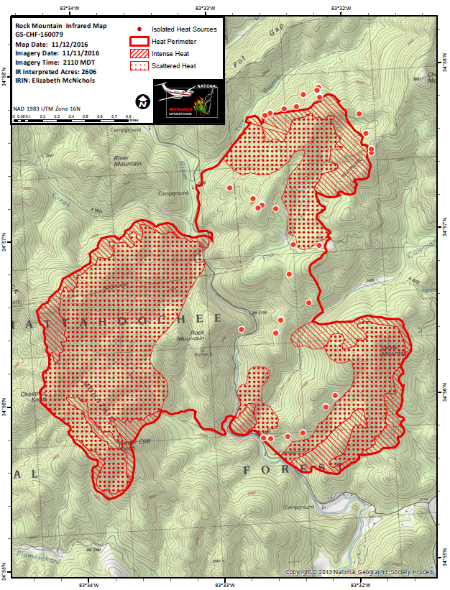
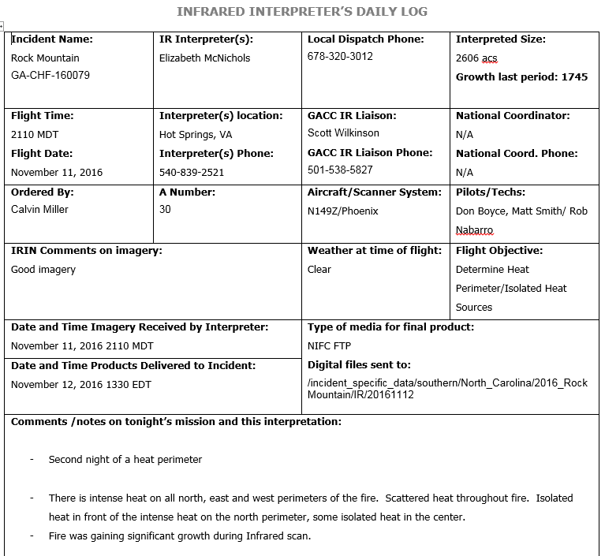
Products:

Slide 8
2016 –
5.4 million acres, 77% of the ten year average (2006-2015)
Slow start to the season
Late season (Nov) in Southern Area
More IR requests in CO, NM, AZ and WY than previous few years
Updated 1/5/17
Notes:
Based on IMSR 12/30/16
2015 – 10.1 million acres

Slide 9
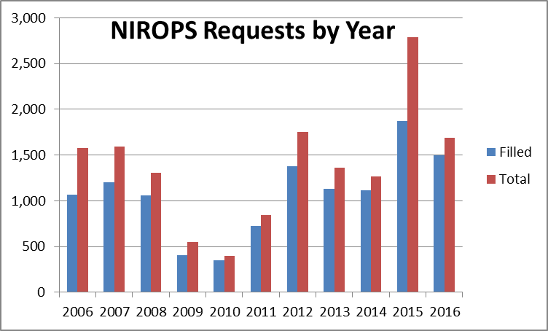
2016 NIROPS Requests
1,692 total requests with 1,495 filled
10 yr avg (2006-2015) 1,343 requests and 1,030 filled
10% UTF rate
Aircraft 3 filled
3% of missions
none in SA
(28% in 2015)
Updated 1/5/17
Notes:
Numbers are for all of 2016 including SA November missions.
2015 - 33% UTF (26% non-weather)
2015 was record year for requests and missions.

Slide 10
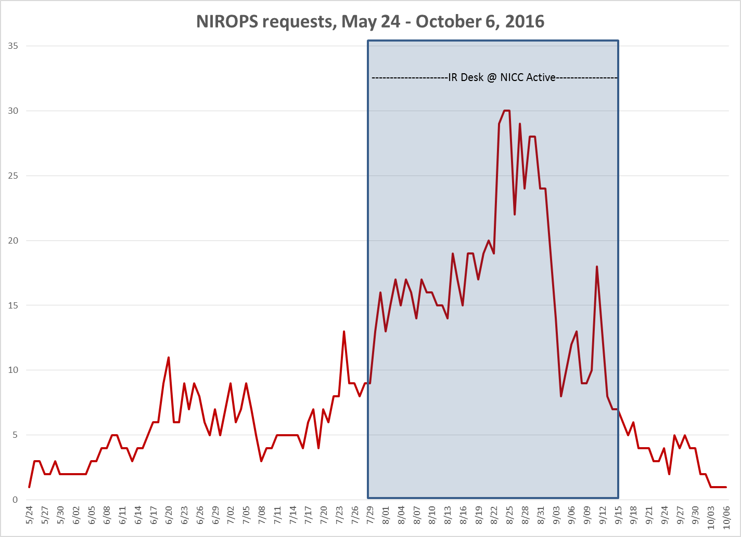
Notes:
IR desk staffed from 7/29 thru 9/15
PL4 from 8/20 thru 9/2
Down to PL2 by 9/7

Slide 11
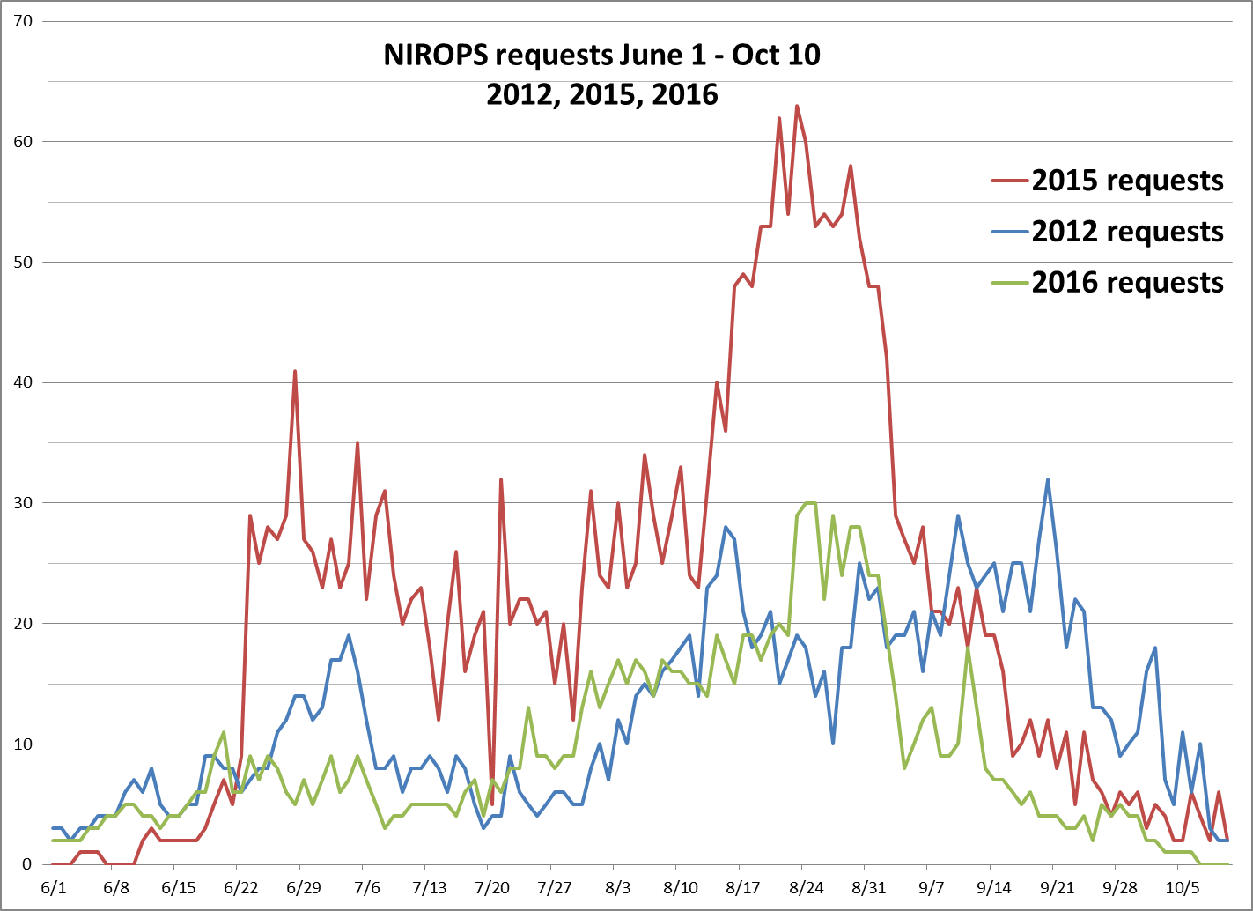
Notes:
2012 and 2015 included for comparison as most active seasons for NIROPS ordering

Slide 12
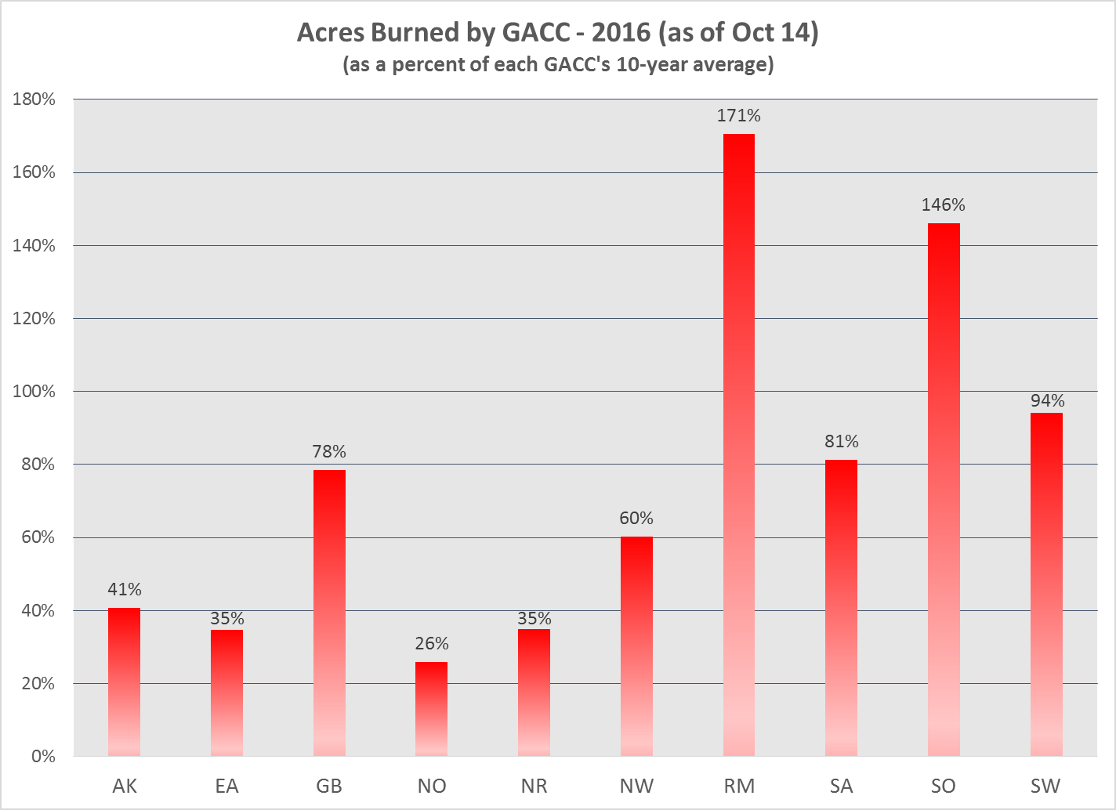
Fire Activity by GACC
Notes:
Acres as of 10/14/16

Slide 13
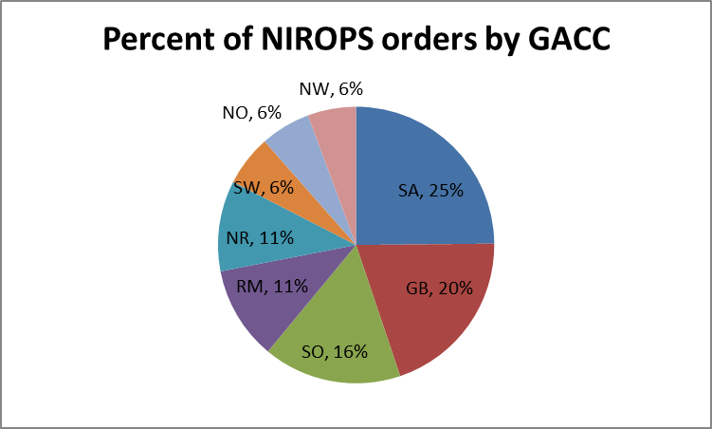
2016 – Orders by GACC
Compare to 2015
Updated 2/1/17
Notes:
2015 – NW 28%, AK 23%, NR 22%, NO 16%, GB 6%, SO 5% SW had 14 requests, RM had 4, EA had 1

Slide 14
Busiest Night 2016 – August 30, 26 Fires
N149Z (15 fires)
  Porcupine (UT)
  Box Canyon (UT)
  Peterson Hollow (UT)
  Willow Creek (UT)
  Berry (WY)
  Tatanka Complex (WY)
  Maple (WY)
  Pioneer (ID)
  Tie (ID)
  Elk Ridge (ID)
  Cedar (ID)
  Sixtytwo (ID)
  Moose (ID)
  Freeman (ID)
  Roaring (ID)
N144Z (11 fires)
  Pony (CA)
  Tully (CA)
  Chimney (CA)
  Rey (CA)
  Cedar (CA)
  Gap (CA)
  Soberanes (CA)
  Bogart (CA)
  Rail (OR)
  John Doe (ID)
  Copper King (MT)
2015 Busiest night was 8/19 with 47 fires flown, 26 by 144Z, 16 by 149Z, 5 by AC3
Notes:
There were 28 orders with 2 UTFs – one for weather (Roaring Lion (MT) and one for duty day Beaver Creek (CO)
2015 – 53 requests, 47 fires flown on August 19 – 144Z 26 fires, 149Z 16 fires, Aircraft 3 5 fires

Slide 15
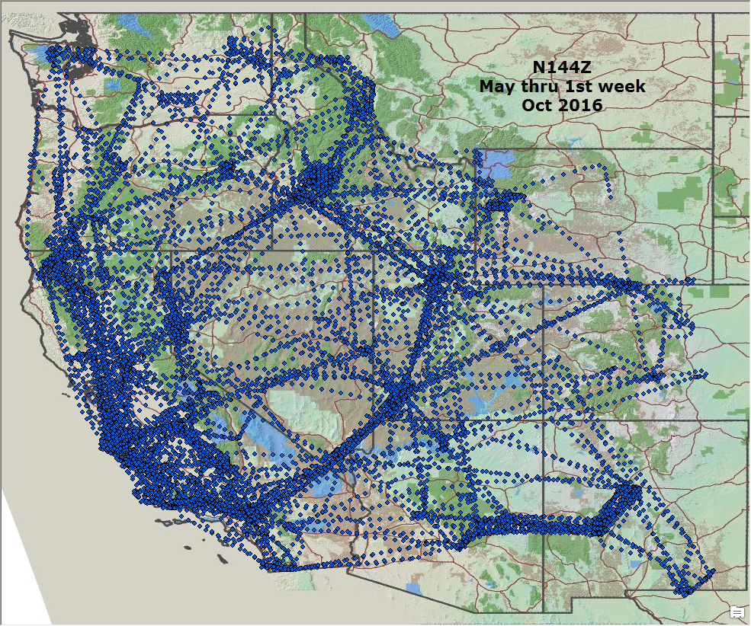
N144Z – 593 requests filled

Slide 16
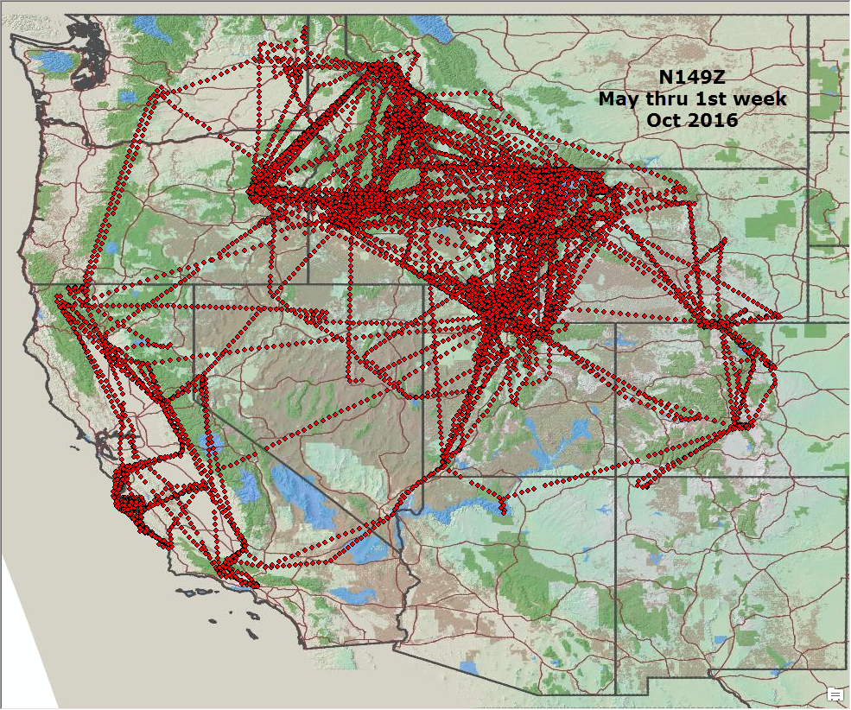
N149Z – 448 requests filled

Slide 17
Aircraft Comparison
N144Z (Citation Jet) is faster (370 kts vs 240 kts) and covers the west coast and farther flung fires
N149Z has greater endurance (4 hrs vs 3 hrs)
Notes:
Early season fires in NM and AZ covered by 144 since 149 was undergoing landing gear replacement
Had to have a replacement part machined since plane is 23 or 27 years old

Slide 18
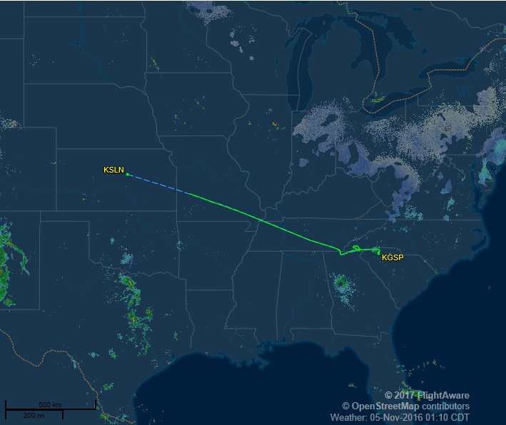
November 4, 2016

Slide 19
Busiest night at SACC:
November 18, 22 orders, 5 states
Chestnut Knob, NC
Maple Spring, NC
Cathy Gap, NC
Boteler, NC
Tellico, NC
Party Rock, NC
Moses Creek, NC
May Branch, NC
Muskrat/Knob, NC
Cliffside/Jones Gap, NC
Pinnacle Mountain, SC
Rough Ridge, GA
Rock Mountain, GA
Tatum Gulf, GA
Timber Ridge, GA
Cave Cove, TN
East Miller Cove, TN
White Oak Circle, TN
Cool Branch Road, TN
Old Mountain Road, TN
Big Poplar, TN
Raven Rock, VA
Updated 2/1/17

Slide 20
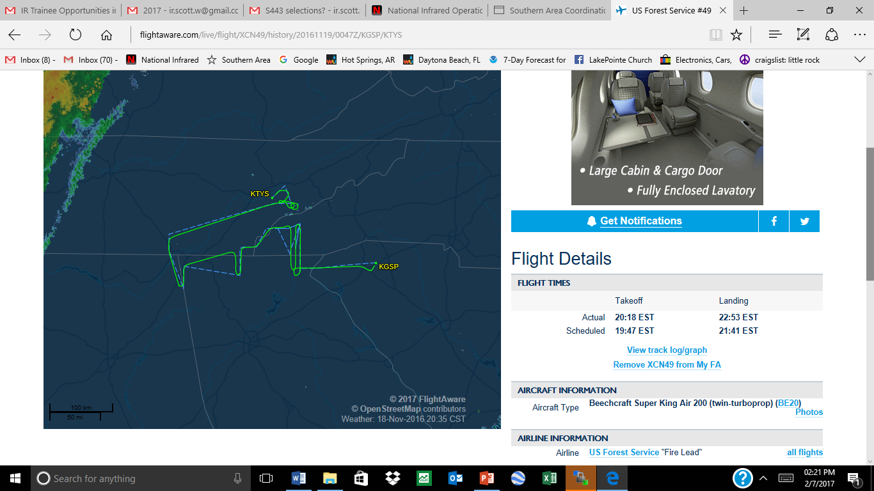
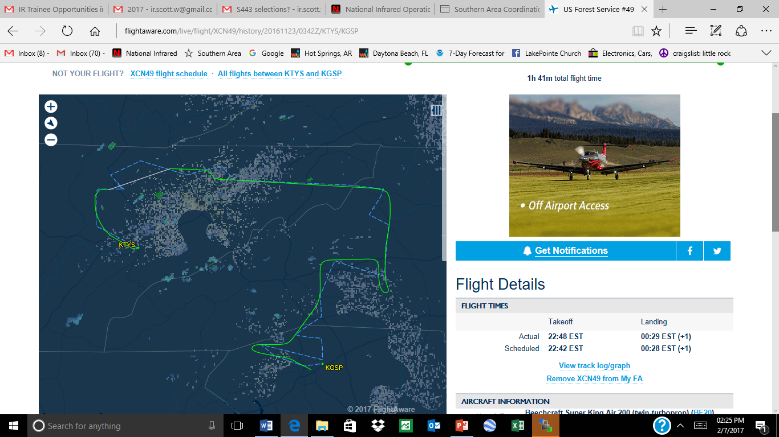

Slide 21
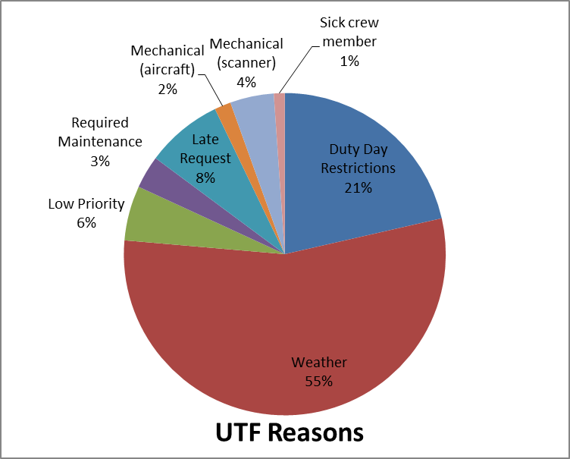

UTFs (Unable to Fill)
182 total UTFs (NIROPS only)
UTF rate drops from 10% to 4% when weather UTFs are not counted
UTF for Aircraft 3 - 17% (10% non-weather)
Notes:
NIROPS only (182 UTFs)
14 UTFs for late orders
No UTFs for Mandatory days off this year (compare to last year
208 orders went submitted after 1530 cutoff, 31 orders after 1600, only 12 UTFs for late request

Slide 22
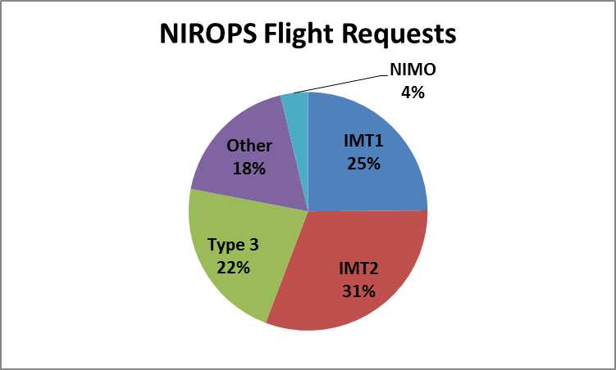
Who is Requesting?
50 orders did not provide this information
All NIMO orders were for Beaver Creek (CO)
Notes:
2015 – IMT1 21%, IMT2 38%, IMT3 17%, Other 24%, NIMO <1%

Slide 23
Prioritization of fires for IR (not in any order)
Type of team assigned – Type 1, 2, 3, etc.
Values at risk, WUI, evacuations
Priority listings in National IMSR
GACC priority listings
Geographic location and grouping of fires
Activity during the day
  Satellite fire detections – MODIS, VIIRS
  Plume activity – visible satellite
Consultation with NICC or GACC COD
Heat detected from NIROPS flights
Expected weather over incident
Feedback from IRINs

Slide 24
Extended Support to numerous incidents
Soberanes (CA) – 75 flights
Pioneer (ID) – 61 flights
Beaver Creek (CO) – 50 flights*
Cedar (CA) – 35 flights
North (NM) – 32 flights
Saddle (CA) – 31 flights
Rail (OR) – 31 flights
Copper King (MT) – 27 flights
Lava Mountain (WY) – 23 flights
Cliff Creek (WY) – 22 flights
*39 flights by Aircraft 3
Notes:
Increased reliance on IR as more fires are managed with a combined strategy – suppression and monitor/confine
Previous high was Mustang Fire (ID) in 2012 - 54 nights
Soberanes had 7 flights by AC3

Slide 25
It Takes a Team!
IR Techs - 5 person rotation
Pilots – 6 FS fulltime
35 + 9 different IRINs, 3 trainees got assignments and got signed off
National IR desk staffed from 7/29 to 9/15 by 3 different IRCNs
Southern Regional IR Coordination 11/10 – 12/3 staffed by 2 IRCRs
Aircraft 3 (Firehawk) coverage key during maintenance on NIROPS aircraft- AC3 liaison at RSAC and NGA analysts
R4 Aviation maintenance crew
Updated 2/1/17
Notes:
Pilots - Dan Johnson, Don Boyce, Ed Netcher, Jack Lowrey, Kris Nelson, Matt Smith (Sam Ramsey, Dina Elosiebo, others?
Techs - Woody Smith, Kaz Kazimir, Jill Keunzi, Mike Mann, Rob Navarro
Jan Johnson AC3 liaison

Slide 26
Takeaways from 2016
Useful to have desk active at PL 3 (“strong 3”) depending on IR demands
Full pilot staffing is great!
When best to utilize other IR resources
  Small fires, initial attack, early stages
  Fire cooling down, mostly hot spot detection
Other IR resources are complementary to NIROPS

Slide 27
Takeaways from SACC
Regional IR Coordinator assigned as soon as possible
Ordering and delivery process unfamiliar
MMA was a wonderful partner
Fuel type unfamiliar to IRINs
Updated 2/1/17

Slide 28
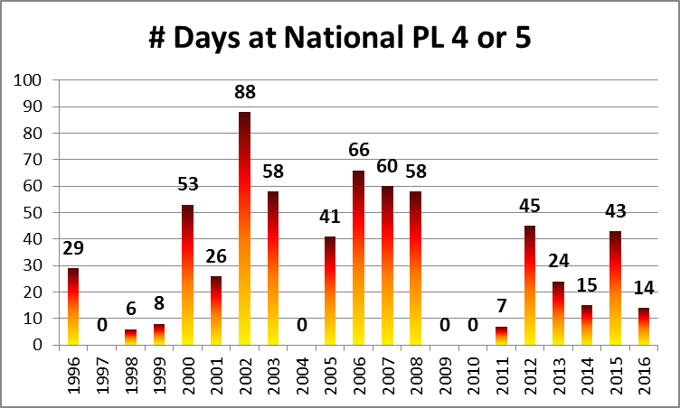
SACC PL5 24 days 11/9 – 12/2
Updated 2/1/17

Slide 29
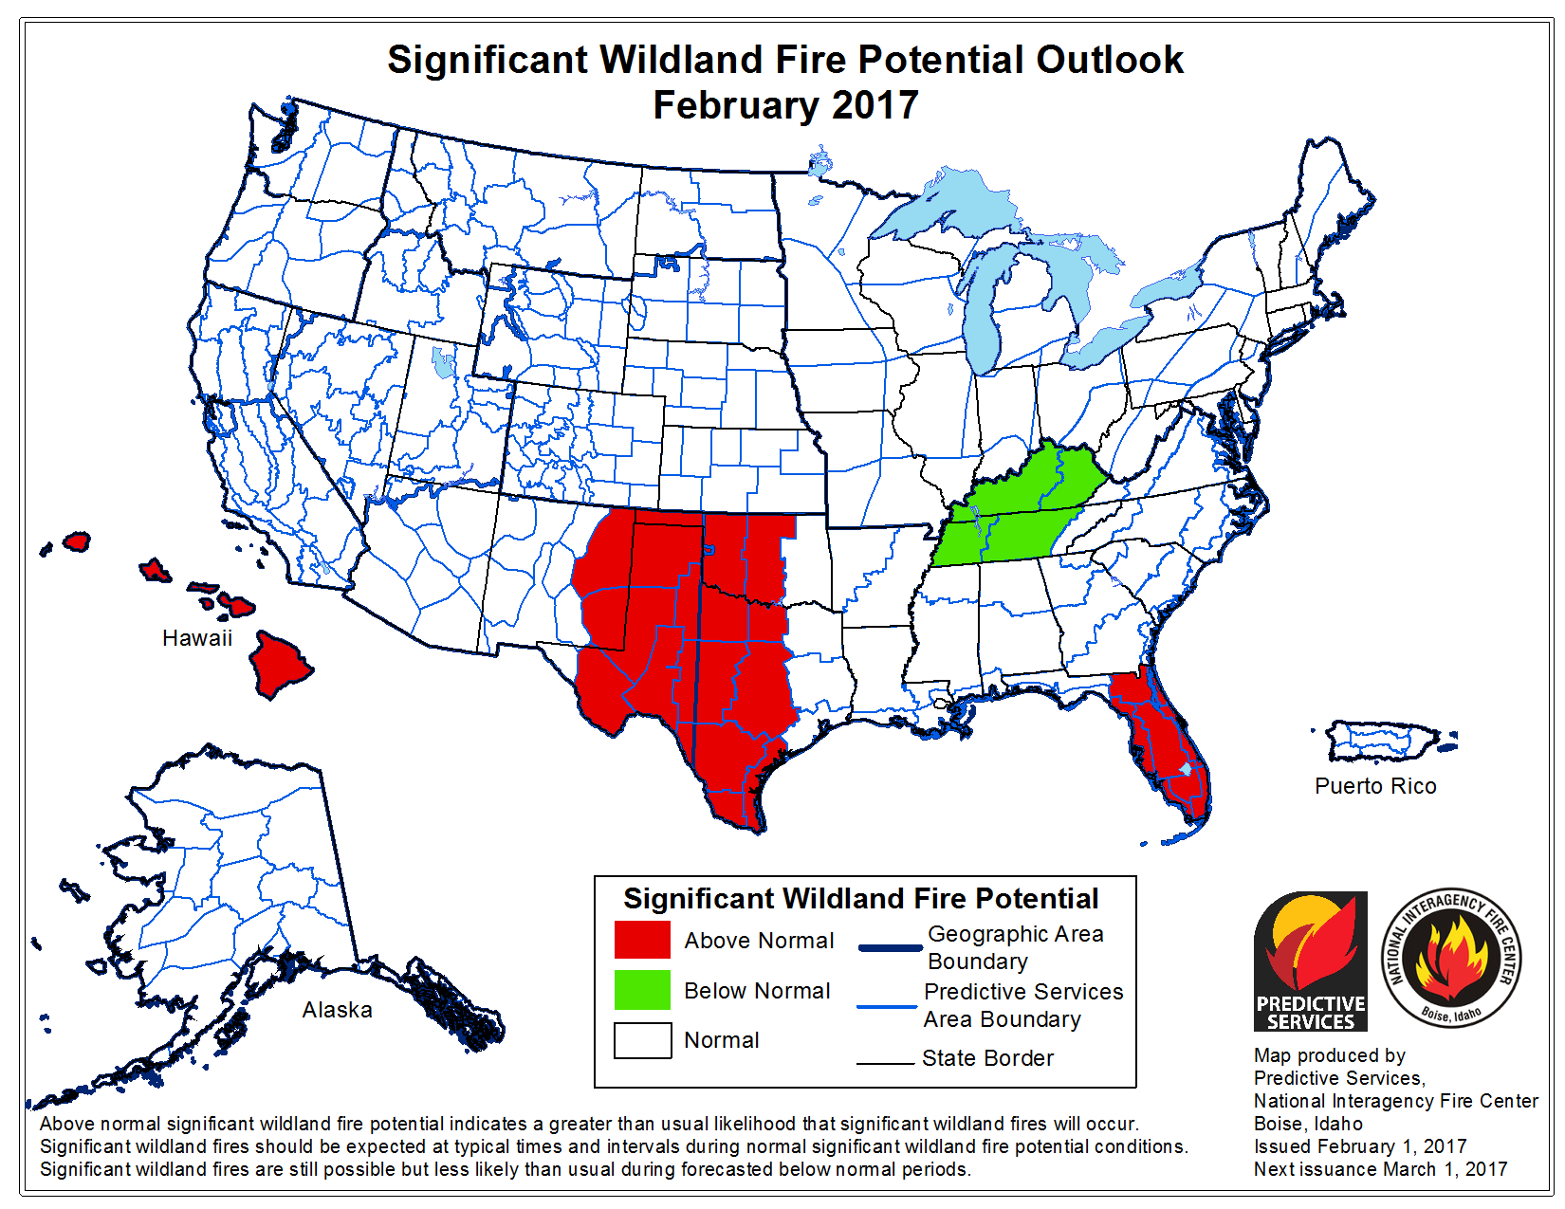
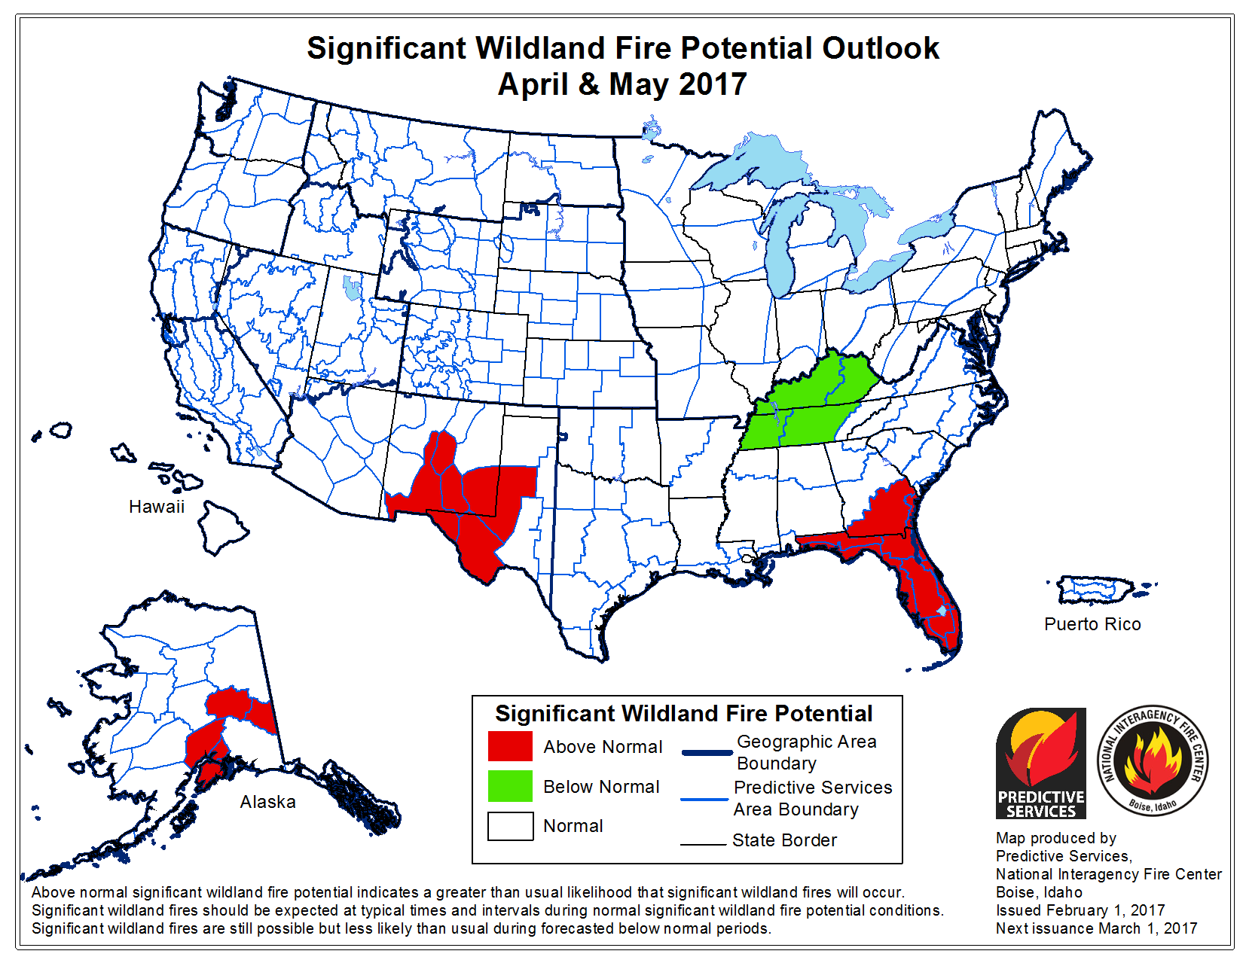
Looking into 2017
Most forecasts call for weak La Niña
Monitor fire activity and try to maintain one system in ready status
Updated 2/1/17

Slide 30
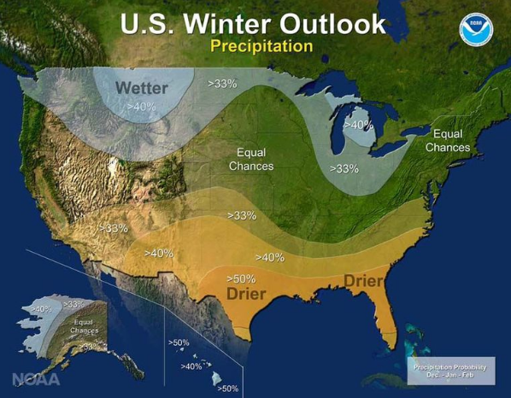

Slide 31
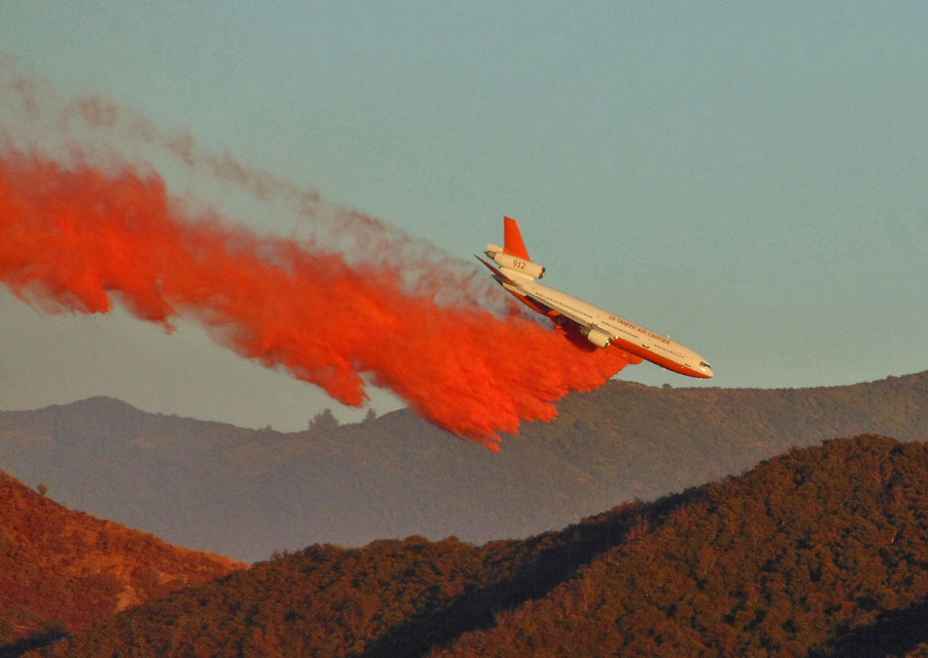
Get ready for next year!
Photo: Initial Attack Fire Media
Notes:
T-912 Silverado Fire – Cleveland NF, Photo by Initial Attack Fire Media

Slide 32
Continued cooperation with other providers
Proposal for a multi mission aircraft is at WO FAM
Pilot scanner operations
AMS testing
https://fsapps.nwcg.gov/nirops
Updated 2/1/17
Notes:
Autonomous Modular Sensor

Slide 33
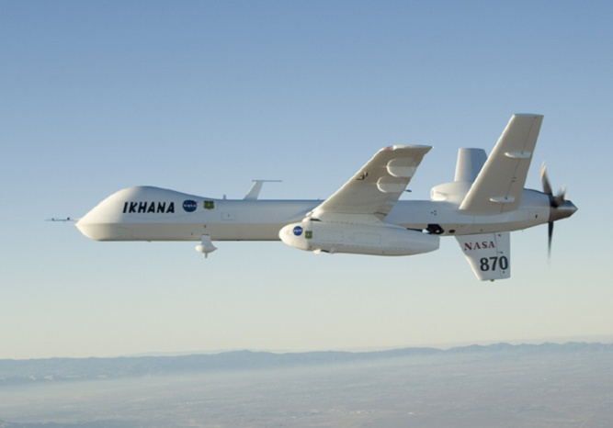
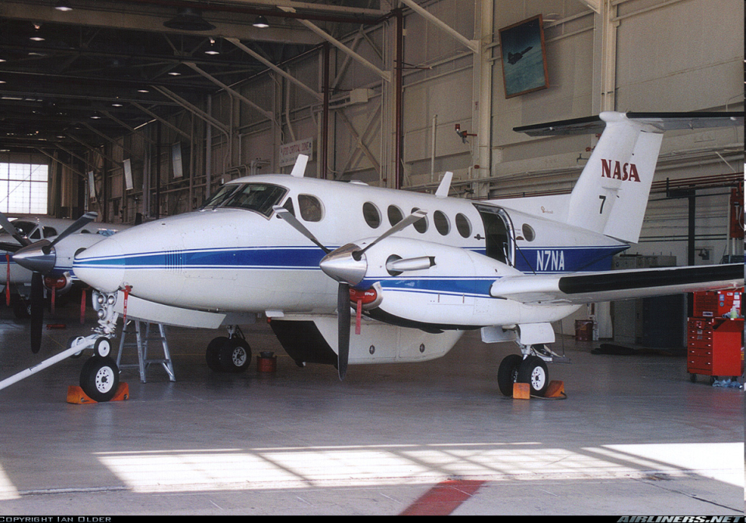
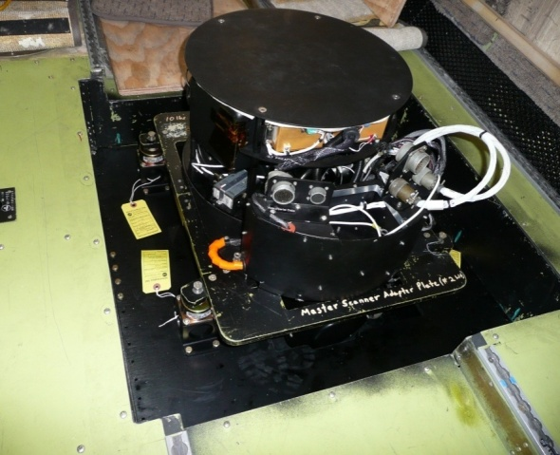
Future developments
Integration of AMS sensor on to USFS plane
  Autonomous Modular Sensor transferred to USFS by NASA – possibly to be installed on a King Air in Atlanta.
Band Wavelength μm
1 0.42- 0.45
2 0.45- 0.52 (TM1)
3 0.52- 0.60 (TM2)
4 0.60- 0.62
5 0.63- 0.69 (TM3)
6 0.69- 0.75
7 0.76- 0.90 (TM4)
8 0.91- 1.05
9 1.55- 1.75 (TM5)
10 2.08- 2.35 (TM7)
11 3.60- 3.79 (VIIRS M12)
12 10.26-11.26 (VIIRS M15)
Notes:
Flown on various cooperative missions with FS and CALFIRE
Modified line scanner
Sensor, integration with IMU for orthorectification, ground station, interface with aircell

