Slide 1
Download and use of the IRIN Template
The template is a zip file containing the folder structure, project and other files for use on incidents is in Tools and Utilities folder in the IRIN_NIROPS Channel of the National IAA Team
Its use is not mandatory but it available as a tool to help IRINs managing incidents
IRIN Tools and Utilities
Steve Penny
USFS Region 4, Remote Sensing Analyst
208-315-3729
stephen.penny@usda.gov

Slide 2
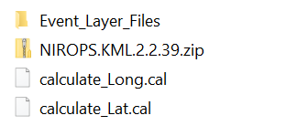
Important topic
Folder Structure
Base data used in map projects
Supporting documentation
Data acquired from the incident
Organized by date
IR images downloaded from the ftp
Location of downloaded mobile geodatabase
Products posted to the ftp and delivered to the incident: pdf map products, shapefiles, file geodatabase, kmz and IR Log
ArcGIS Pro Projects (.aprx files)
Layer files with standard symbology
GTAC tool to create shapefiles and kmz
Tools for lat/lon calculation as well as length and area

Slide 3
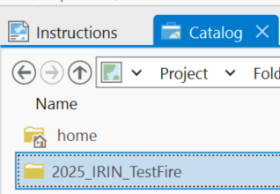
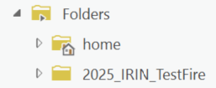
Setting up the incident
Unzip the template 2025_IRIN_Template
Open the 2025_IRIN_template.aprx in the project folder
Open Catalog > View and rename the folder to the fire name 2025_IRIN_FireName
Renamed folder
Open the project and go to the Edit Map tab
Sign in to AGOL

Slide 4
Setting up the incident
The Edit Map has feature layers to quickly identify the Time Zone, UTM Zone, GACC and Dispatch Center
They are in a group called background, uncheck once it is not needed.

Slide 5
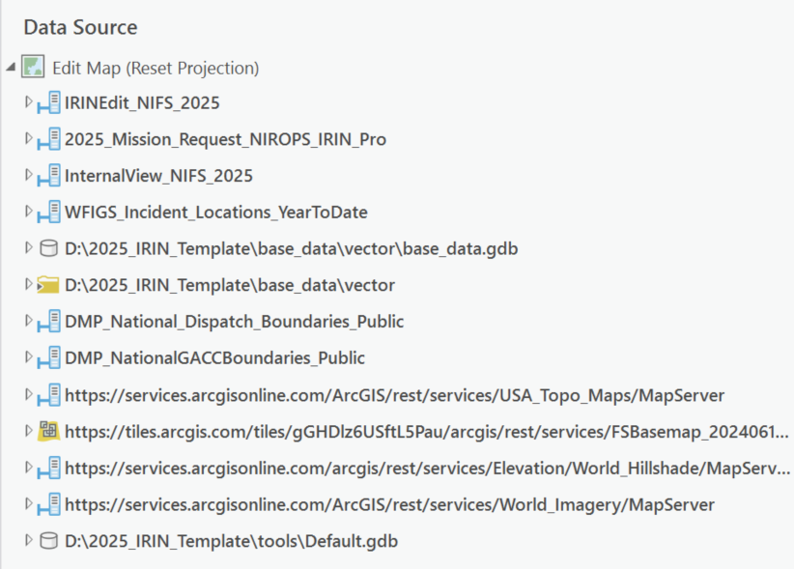
Arc Pro Maps
The Internal view services are loaded
As well as the IRIN Edit Service (NIFS 2025)
And base maps

Slide 6
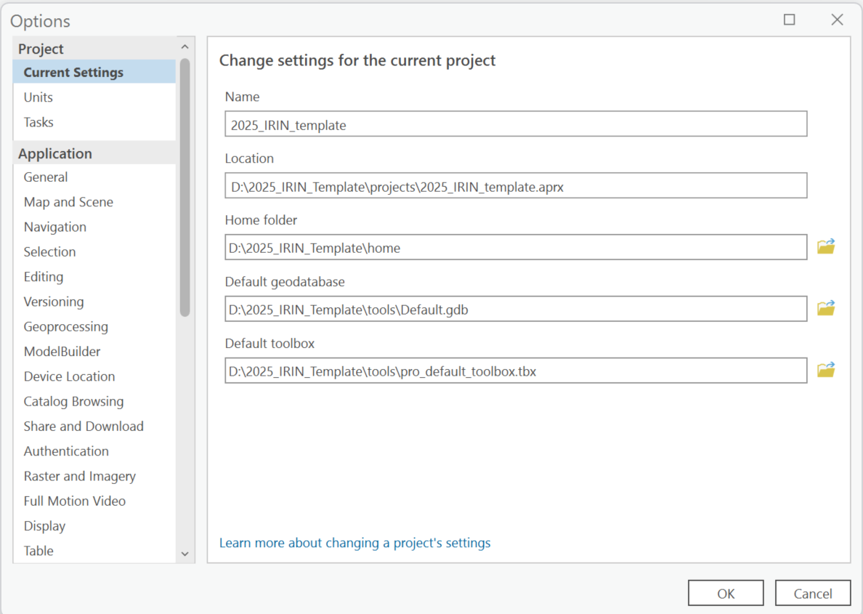
Preparing the project
The Home folder is set to the home folder of the template, this is where the mobile geodatabase will download to

Slide 7
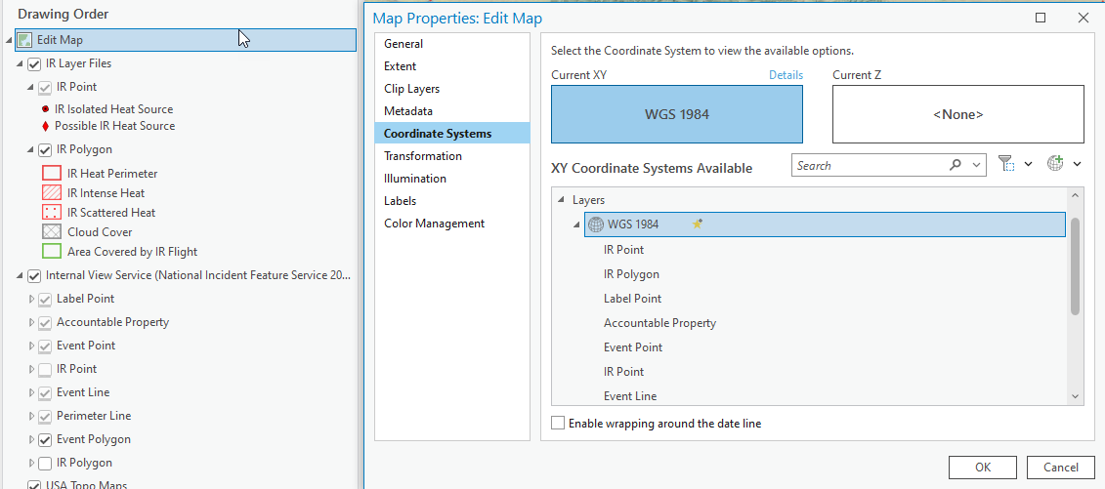
Preparing the project
In the Map Properties, set the coordinate system in both maps to match the incident coordinate system

Slide 8
Preparing the project in the Edit Map
Create the mobile geodatabase – this will be the file used for editing. The process to create the mobile gdb (an offline, syncable version of the NIFS) is with the Download Map tool (creating the mobile geodatabase). Leave “Include basemap & tile layers” unchecked (unless you would like to download a basemap)
The IR data is now sourced to a mobile geodatabase which can be continually sync’d – no need to remove it unless issues are encountered.
Reminder – NEVER EDIT THE LIVE SERVICE, ALL IR DATA CAN ACCIDENTLY BE DELETED

Slide 9
Feature Templates
The first step after adding the data to a map is to create a generic template with your contact and fire information using Manage Templates
Do this in the master template aprx and save it so it will not need to be entered again
https://pro.arcgis.com/en/pro-app/latest/help/editing/create-a-feature-template.htm

Slide 10
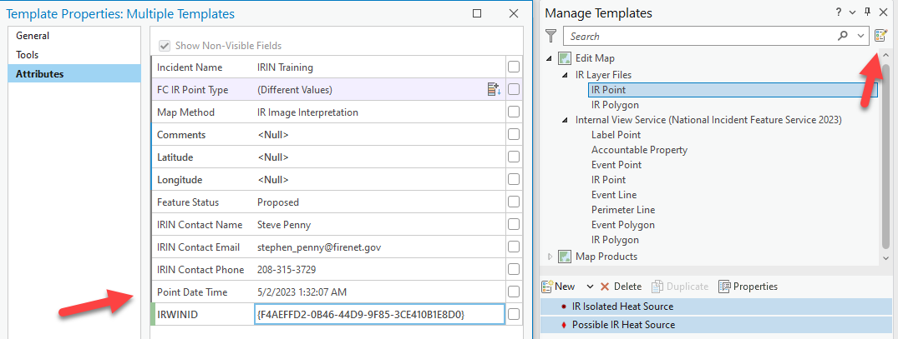
Feature Templates
Go to the Create Features tab – click on the manage templates in upper right-hand corner. Select the point feature class and both symbols in the box below with shift click. Click Properties, fill in the information. Time is in UTC. Click OK. Do the same for the IR_Polygon, IR Heat Perimeter Map Method will generally be IR Image Interpretation except for the IR Heat Perimeter which is defaulted to Mixed Methods unless it is known that it is entirely image interpretation. Feature Status is Proposed. Approved is not used in any IRIN or GISS workflow and a source of confusion. It is a good idea to discuss this with the GISSs and SITL because the GISSS workflow does use this field as a filter in Event Polygon and Event Point and data feeds into other public and non-public products depending on the attribute.

Slide 11
Using the IRIN Template
Enter time Point Date Time
in UTC
Use brackets { } for IRWIN ID
Copy from the Date/Time from the IR Checklist
Spreadsheet into the feature template

Slide 12
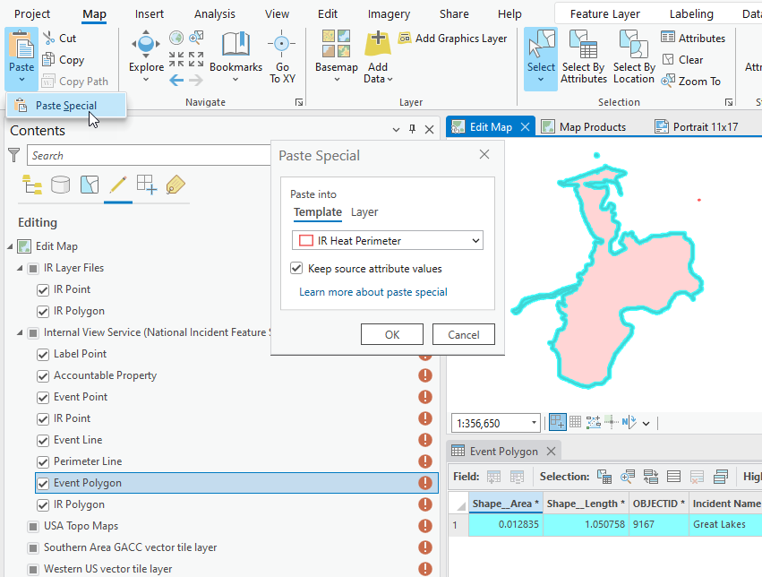
Copy the starting IR perimeter from the latest incident Daily fire Perimeter
Delete previous interpretation features. Ensure the IRIN Edit Service mobile geodatabase is editable and use Copy and Paste Special to replace the incident perimeter as a start for the IR Interpretation. Confirm with the incident that this is perimeter to use.
Copy and paste and the target is the template or layer for the feature. Replace sketch also works in Create Feature, right click on the daily perimeter and choose replace sketch. Complete the interpretation. SYNC mobile gdb

Slide 13
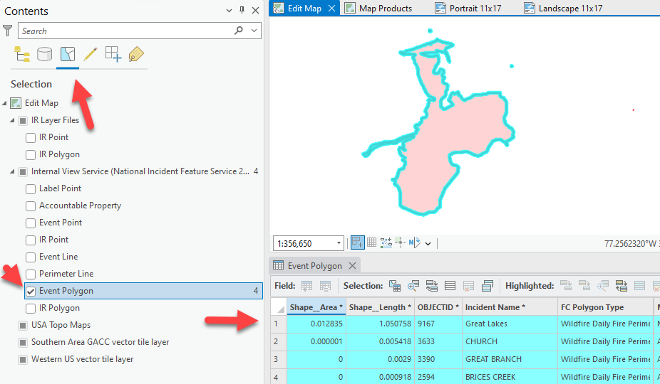
Copy the starting IR perimeter from the latest incident Daily fire Perimeter
To ensure only the incident being interpreted is copied, make the Internal View Service (NIFS 2025) the only selectable layer, use select by polygon and select the fire polygon (or polygons for a complex). Reselect the incident Wildfire Daily Fire Perimeter feature(s) if other incidents are also selected.

Slide 14
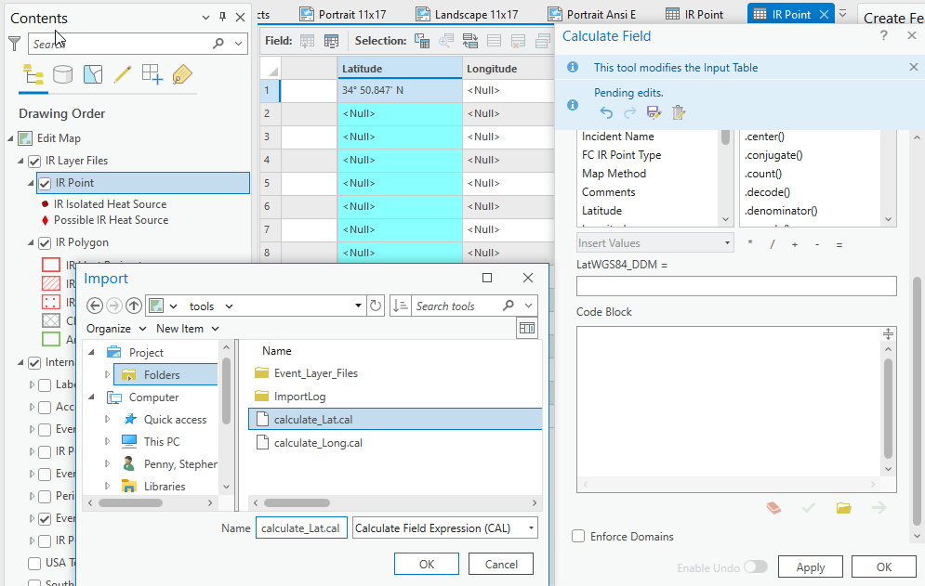
OPTIONAL IF TIME ALLOWS Using the Calculate Lat/Lon Tools
Use Calculate Field and click on the folder at the bottom and navigate to the tools folder
Or use the notebook included in the template. Select only points in your interpretation and run the notebook

Slide 15
Using the IRIN Template
The template has two maps and six layouts
The Edit Map was designed to make any edits to the data. Customize the symbology that is best for editing.
The Map Products Map was designed for the product export. Use a projected coordinate system.

Slide 16
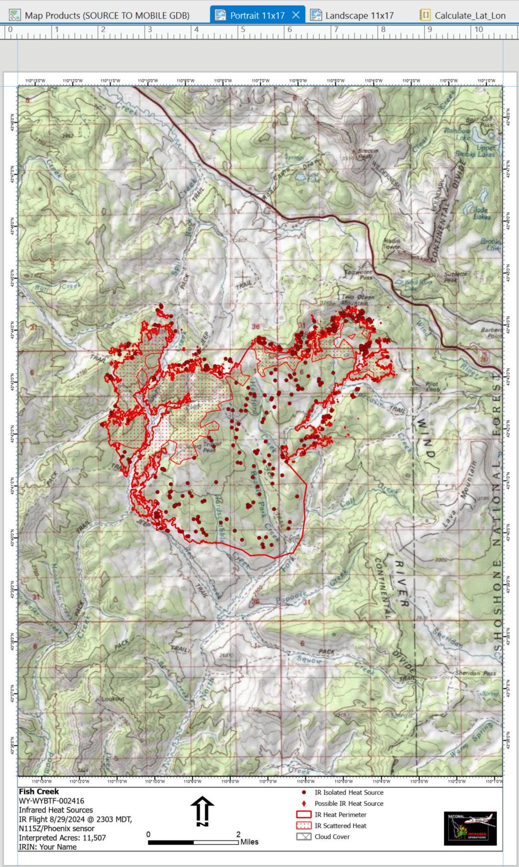
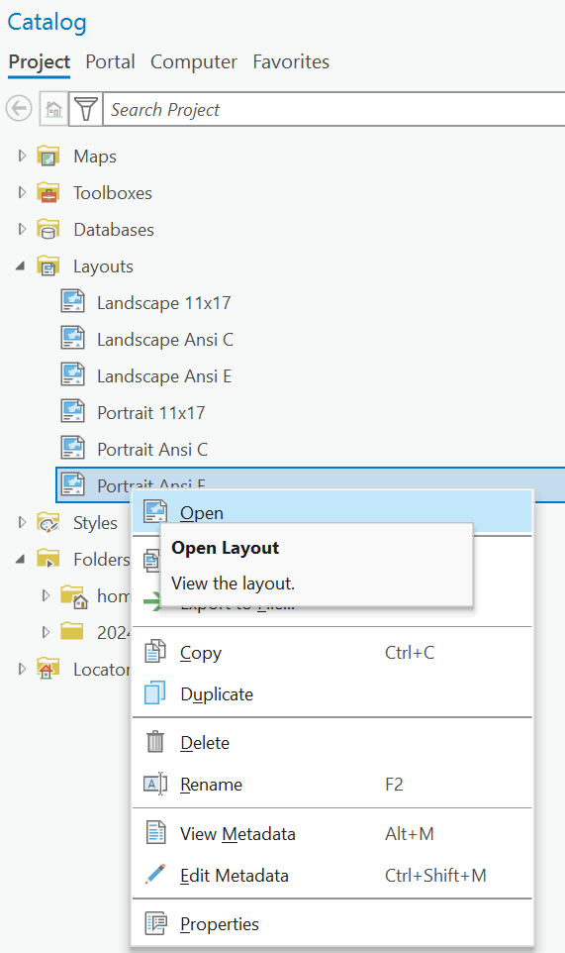
Using the IRIN Template
There are six layouts - 11x17, Ansi C, and Ansi E,
One portrait and one landscape for each size. Use the catalog pane to open an optional map size if desired.

Slide 17
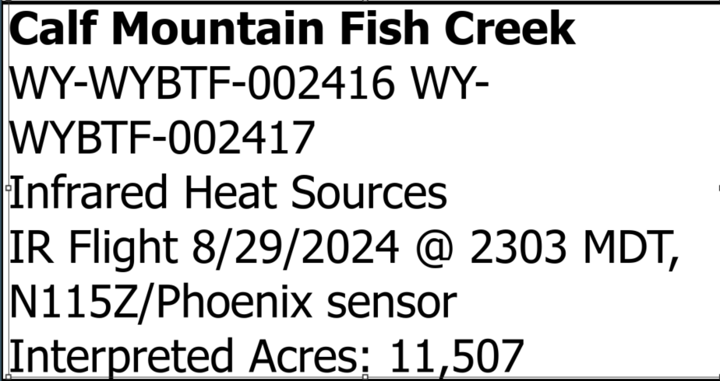
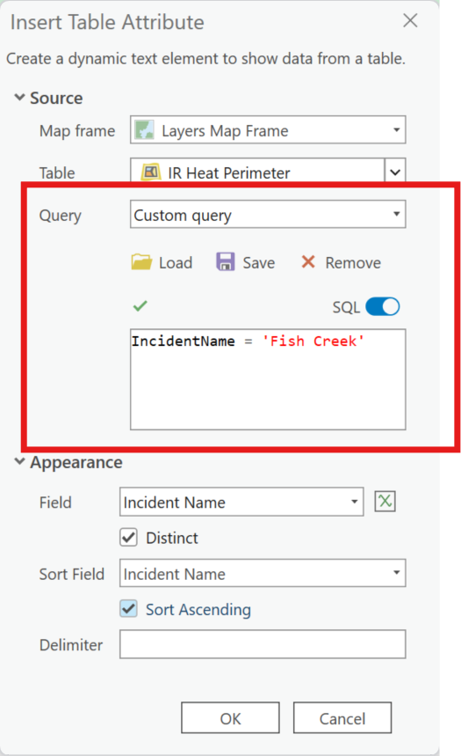
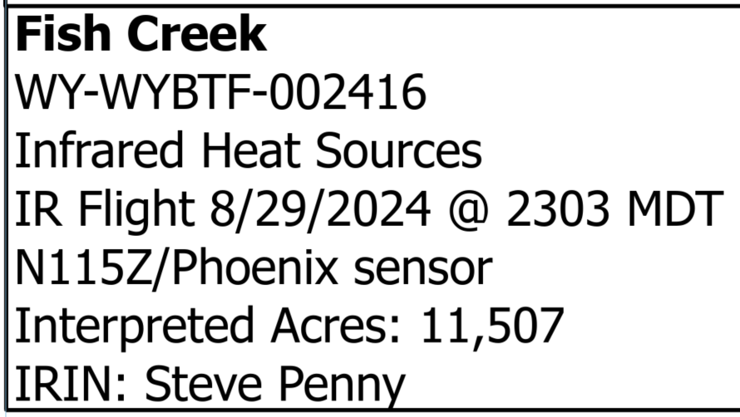
Using the IRIN Template
When interpreting a single fire, edit the dynamic text at the bottom left of the layout. The text is Query is set to Visible rows by default which will populate more than one fire if there are more than one fire in your layout.
Updated Dynamic Text
To correct this, query for the fire you are interpreting

Slide 18
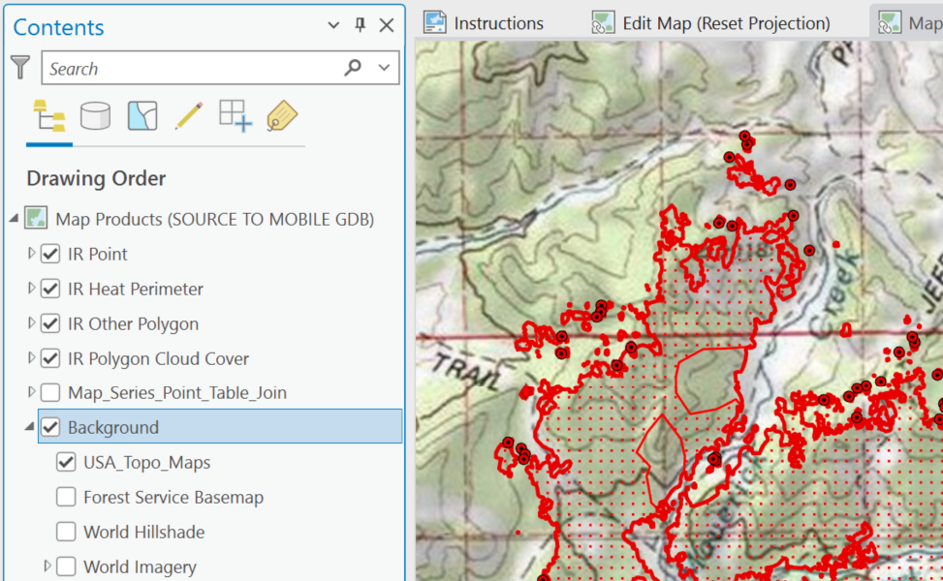
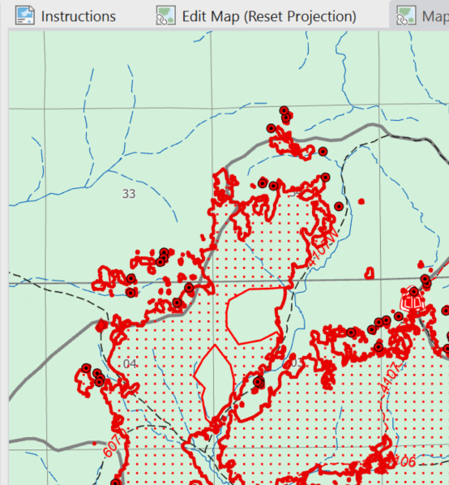
Vector Tile Basemaps
USA_Topo_Maps was the map was commonly used as an IR basemap. With the availability of the Forest Service Basemap, it may be a better option to use depending on the scale. It will be the closest match to the standard incident basemap if the incident is using the recommended basedata download workflow.

Slide 19
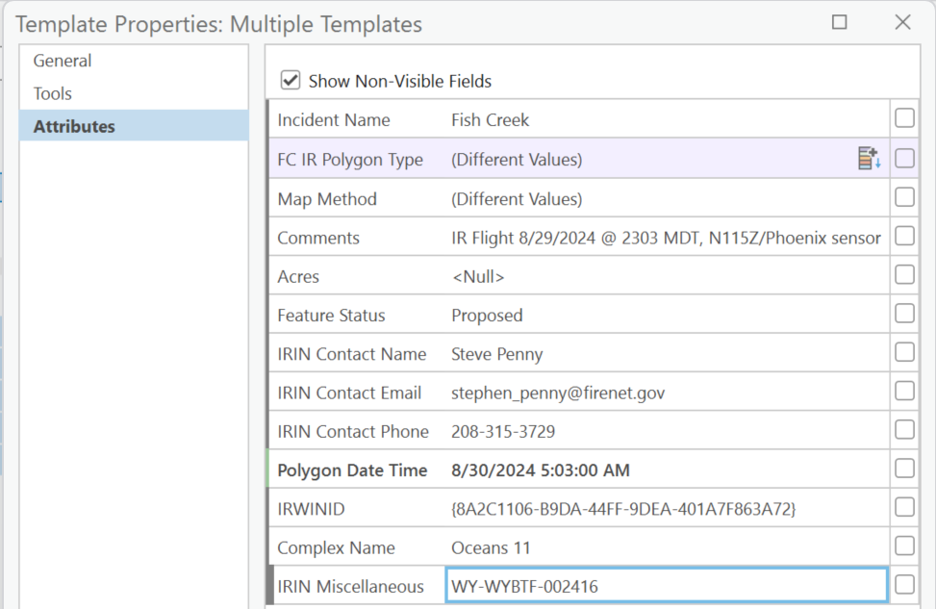
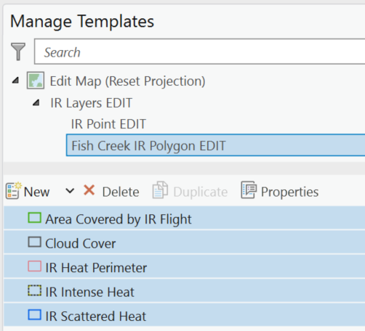
Fire Complexes – Editing in the NIFS
There are several workflows that can be used in a Complex, the key is to find the one that will work most efficiently and quickly.
Managing Feature Templates
Populate the fire attributes and do the interpretation and name the layer with the fire name. Interpret the fire
Copy and past the layer, and edit the feature template

Slide 20
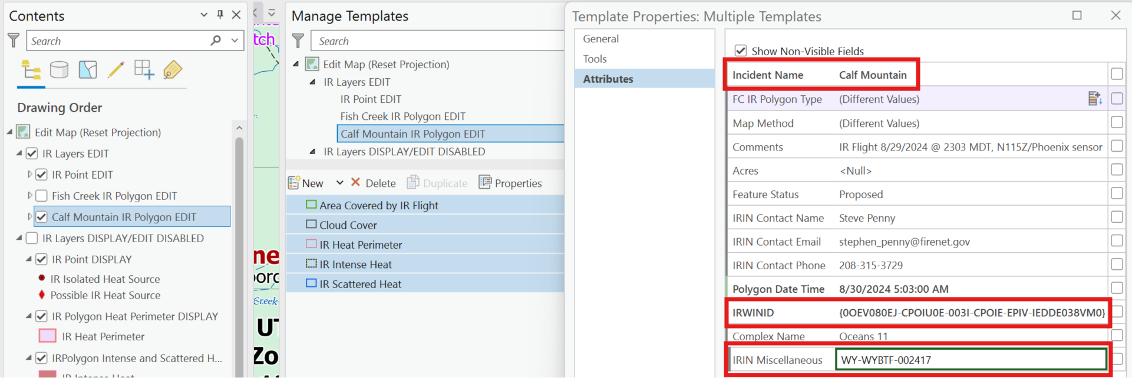
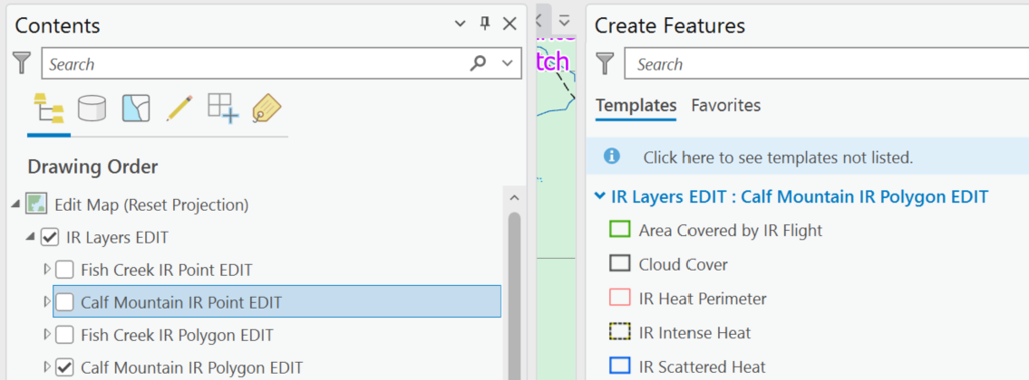
Fire Complexes – Editing in the NIFS
Managing Feature Templates - Continued
Name the copied layer with the additional fire name and populate the template with the fire’s attributes
Non-visible layers are not available in the Create Features pane, which helps with editing
This can be set up ahead of time and the only change to make daily are the Comments and Polygon Date Time fields

Slide 21
Fire Complexes – Map Series and Dynamic Text
See Creating Multiple Map Pages with NIFS IR Polygon_Ver1.pdf in the
Tools and Utility folder in the IRIN_NIROPS Team Channel.
There is also a guide tailored to the IRIN Template in the Tools folder,
Infrared Interpreter Fire Complex Map Series and Dynamic Text Workflows.pdf
And there is direction on the edges of the 11x17 layouts
See these reference materials and reach out to IRINs experienced with Map Series and setting up dynamic text for help if needed.

Slide 22
Questions?

Slide 23
Contacts
USFS Region 4, Remote Sensing
208-315-3729
Steve Penny
stephen.penny@usda.gov

