Slide 1
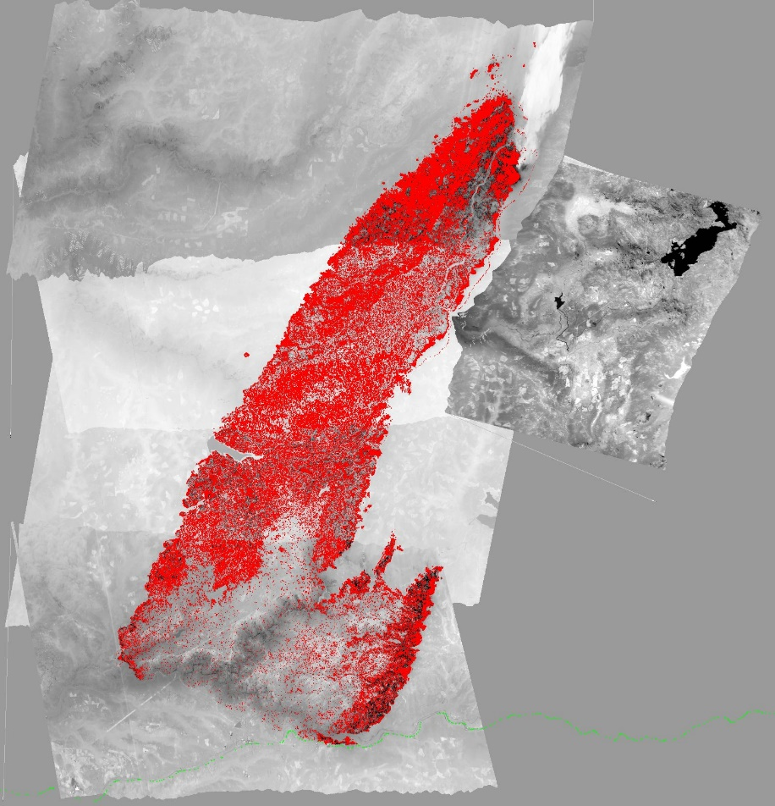
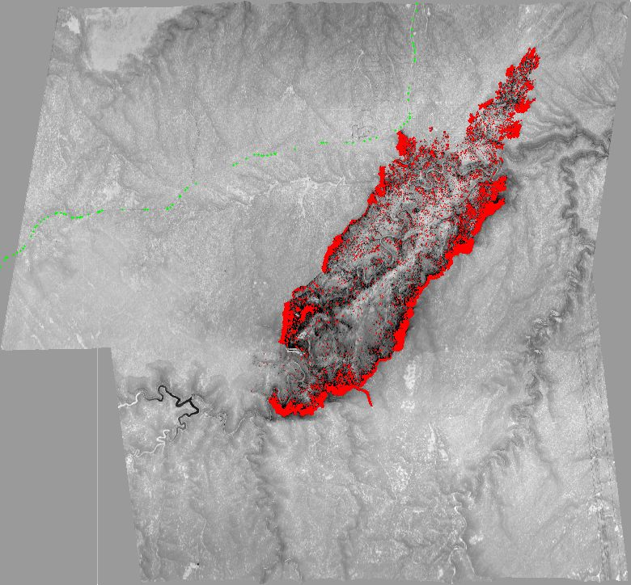
Phoenix Imagery Examples
King Fire – CA 2014
On Sept 17 grew by 50,000+ acres making a 13 mile run to the northeast and nearly tripling in size, final size of 97,717 acres
Tinder Fire, AZ 2018
Started April 30th grew to 8,600 ac
Topo and NAIP base provided for reference
Notes:
King Fire was on the Eldorado NF, started Sept 13
Tinder Fire was on the Coconino NF, flown at 1am

