Slide 1


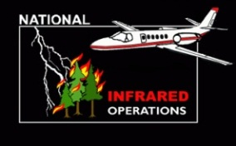

Unit 4 –
Phoenix Thermal Infrared System

Slide 2
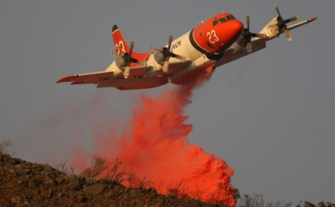
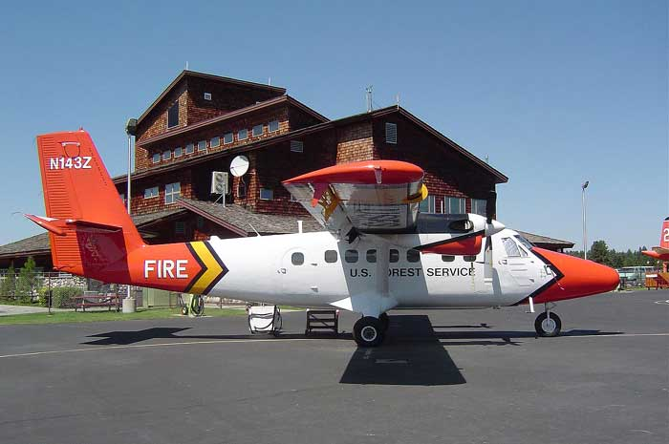
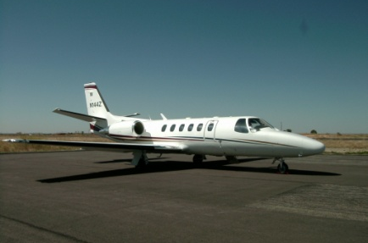
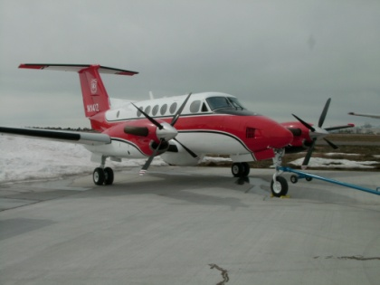
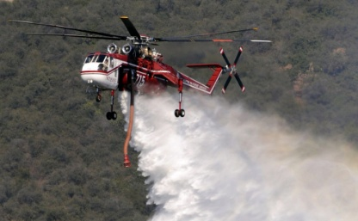
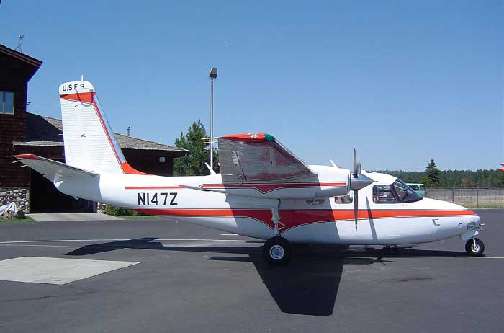
NIROPS aircraft are considered national resources and are dispatched from the Aircraft Desk at NICC
National resources are those which have national utilization, high demand, limited availability, and unique status reporting requirements
Air Tankers
Type 1 & 2 helicopters
Lead Planes
Smokejumpers & Aircraft
ANG MAFFS
Infrared Aircraft
Firehawk Support
Notes:
National resource aircraft include:
Smokejumper Aircraft ,Type 1 & 2 Helicopters ,Air Tankers ,Infrared Aircraft ,Lead Planes ,Large Transport Aircraft (737)
Air Nat’l Guard Modular Airborne Firefighting Systems (MAFFS)

Slide 3
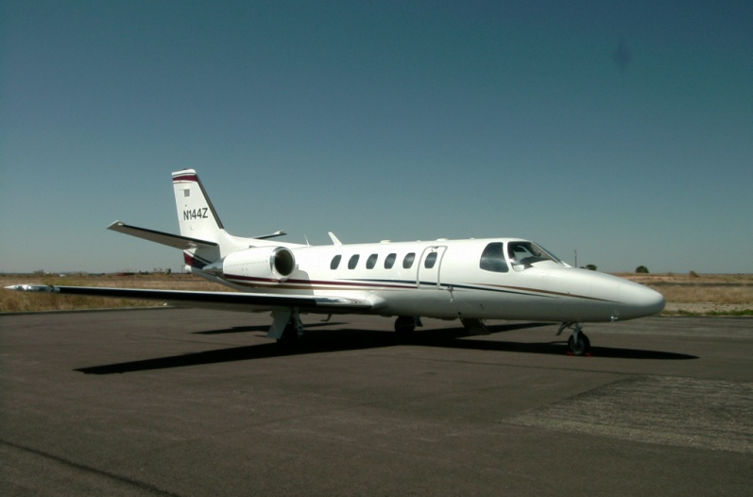

Aircraft: Main function: IR use from April-November
N144Z Cessna Citation Bravo
N149Z Beechcraft 200 Super King Air
Notes:
Both aircraft have similar flight durations of 4.5 hours before refueling and require a minimum 5000 ft. paved and lighted runway.
Aircraft are based in Ogden, the techs are based in Boise. Both used for tanker inspections and personnel transport during the off season.

Slide 4
WHY IR LINE SCANNERS?
Cover extremely large areas in a very short period of time
Line scanners are extremely accurate (depending on processing system +/- 1 meter)
Can detect very small fires
(While simultaneously)
Mapping very large areas
Timely delivery
Notes:
Line scanner technology for fire mapping dates back to the mid-1960s, however, for large area coverage, it is still the most capable airborne system currently available.
For example, the AMS used by NASA for the Ikhana UAS missions in 2007-2008 is a modified 12-channel Daedalus line scanner.

Slide 5
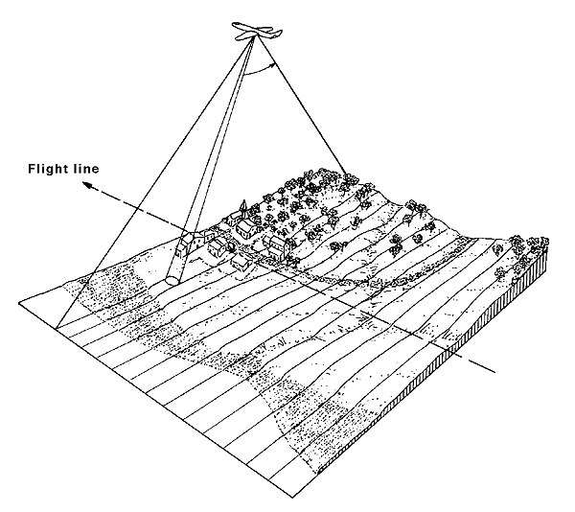
PHOENIX System Specifications
Two channel thermal IR line scanner
  3-5 μm band for intense heat
  8-12 μm band for background terrain
1.25 milliradian IFOV – 3.8 meter (12.5 Feet) pixel at nadir, 10,000 feet AGL
120⁰ FOV – 6.55 mile swath at 10,000 feet AGL (with at least 2 mile overlap between runs)
256 gray scale (256th pixel is colored red)
1680 pixels per scan line
200 scan lines per second
Time listed on imagery is ALWAYS Mountain (Boise).

Slide 6
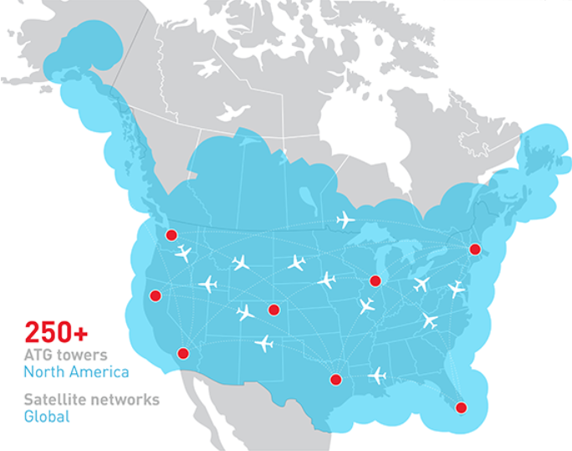

AIRCELL System
  Imagery delivered to NIFC ftp site via AIRCELL system
  AirCell is the company that provides in-flight Internet for commercial airlines (“GoGo”).
  N149Z and N144Z have the business aviation systems; a Wi-Fi hotspot in the sky
  FreeArc compressed archive (.exe)
NIFC ftp site
Notes:
3.1 Mega bits per second (mbps) from the ground to the aircraft
1.8 Mega bits per second (mbps) from the aircraft to the ground
giving an experience similar to a DSL connection at home or small office.
Aircell is the only company in the United States authorized by the Federal Communications Commission (FCC) and Federal Aviation Administration (FAA) to use frequencies in the 800 MHz band for inflight communications. Aircell successfully bid $31.3 million for a 3 MHz air-to-ground spectrum in an FCC auction in June 2006
Cost $85,000 plus $1200-1500 monthly

Slide 7

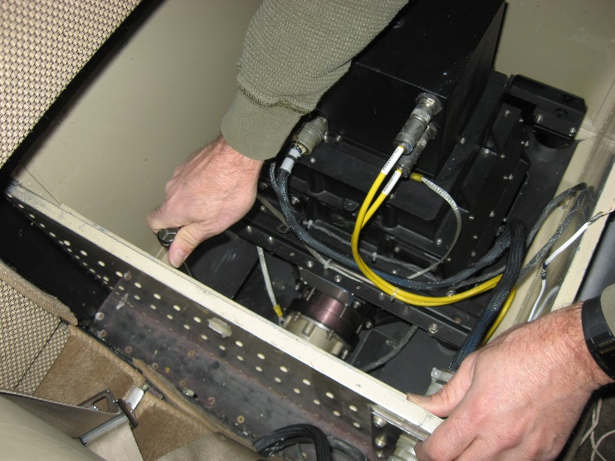
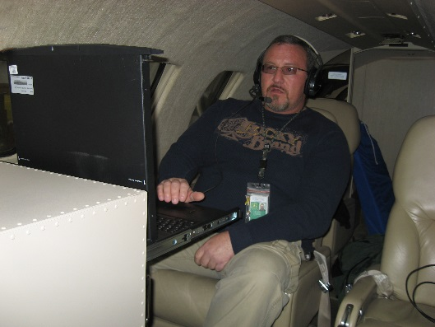
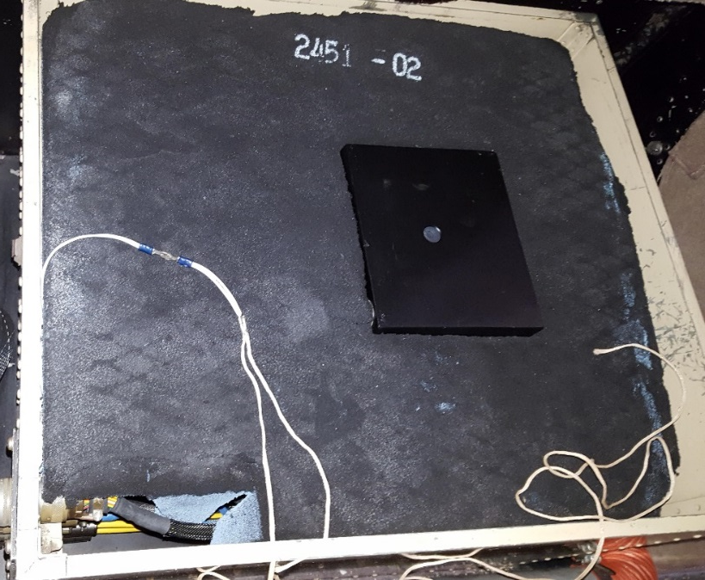
PHOENIX System Installation – N144Z

Slide 8
NIROPS History
1964 – Research begins with DoD, Civil Air Patrol, NASA, USFS
1969 – First full system deployment
Deliverable Products:
1969-1972 – “stitched” Polaroids
1972-1993 – 5” continuous dry silver film
1993-2005 – 8½” continuous thermal paper
2004-present – orthorectified imagery in GeoTiff format
Delivery Methods:
1969 - 2005 – hand delivered/drop tubes
1996 - 2003 – hand delivered imagery/drop tubes
2004 – 2005 - ground ortho processing
2006 - 2008 – Ortho files uploaded to ftp site (“land and upload”)
2009-present – AirCell to ftp site

Slide 9
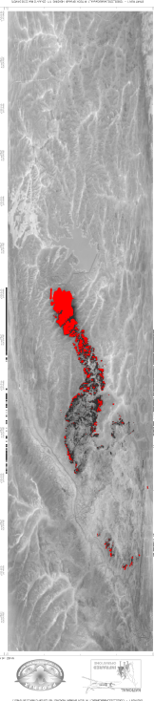
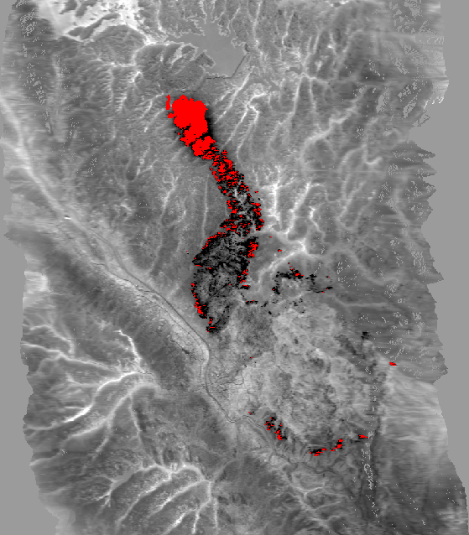
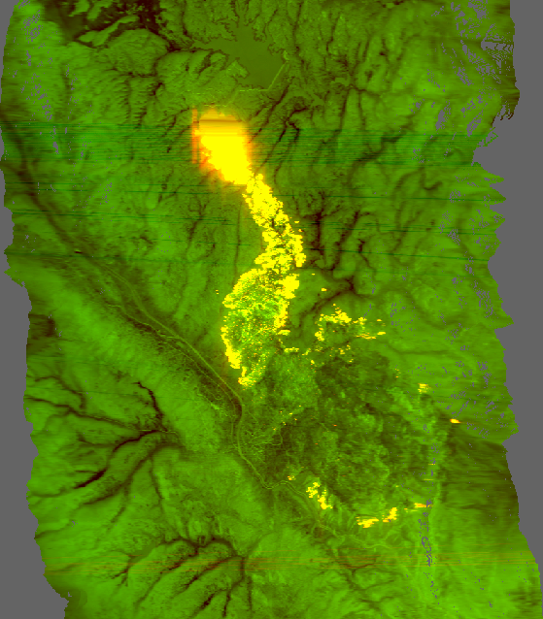
IR Data delivered from plane
“raw” tiff
Orthocorrected tiff w/ fire detects
Orthocorrected color tiff
Waldo Canyon Fire June 25, 2012, 2253 hrs
Notes:
Phoenix imagery is “black hot” (as well as red) the 256th pixel (value of 255)
Lighter areas are cooler – drainages, areas without forest cover
In black and white tiff, all background information is from channel B (8-12) and A is used for fire detects (shown red)
In color tiff, Channel B “background” (8-12) is displayed in green (the lighter the green, the warmer the area) and Channel A “heat detection” (3-5) is displayed in red so that as heat from fire increases, the image becomes more orange and eventually yellow.
Raw tiffs, un-orthocorrected, are NOT part of the delivery packet to the interpreter.

Slide 10
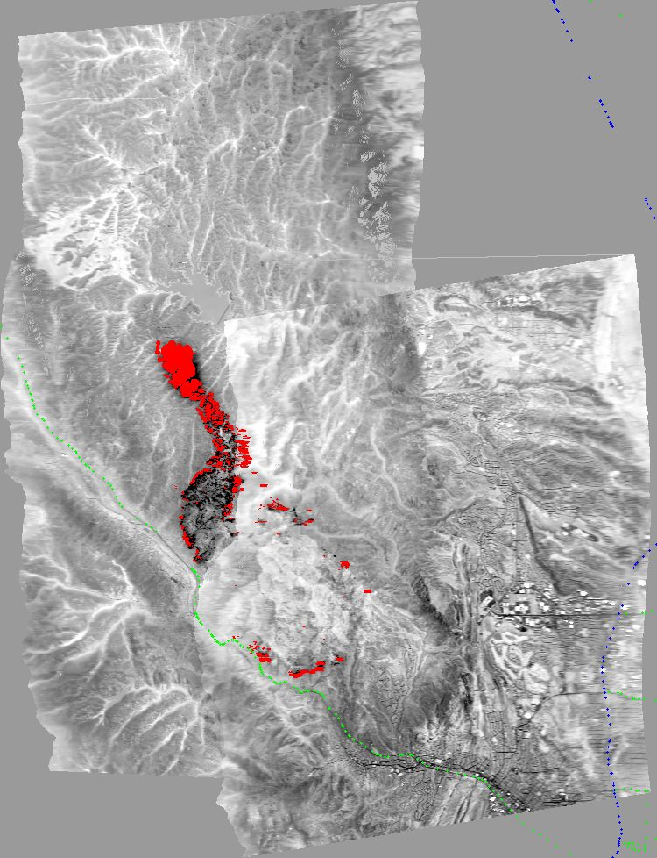
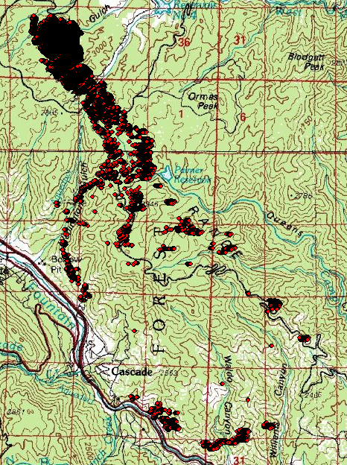
IR Data delivered from plane (con’t)
“dumb” reduced resolution JPEG mosaic of all runs
Raw heat detect point shapefile
Waldo Canyon Fire June 25, 2012, 2253 hrs
Notes:
Dumb means no geo coordinates, reduced resolution

Slide 11
Some Points To Remember About Phoenix Imagery
What is captured in the imagery is the relative variation in heat across the fire area
  No one-to-one correspondence between pixel values and ground temperature
The technician can adjust the heat “threshold” value during runs across the fire area.
  Doesn’t allow for automated extraction of heat areas
There is more heat in the imagery than just the red (DN = 255) pixels!
  Requires an Infrared Interpreter (IRIN) to derive products

Slide 12
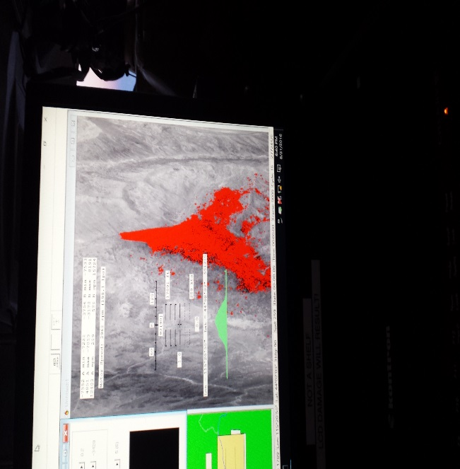
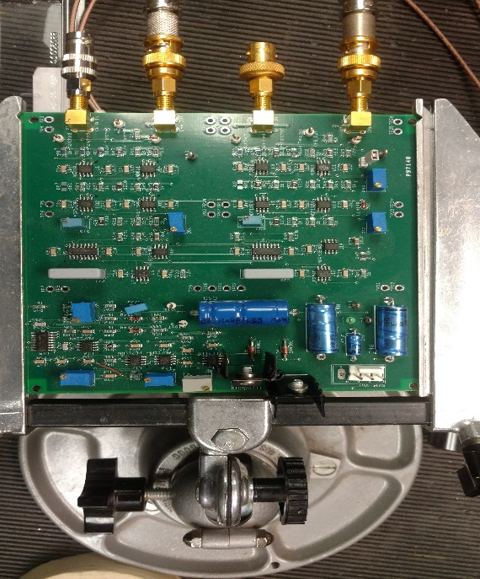
Phoenix Line Scanner
Legacy Technology Made New
  Complete upgrades to:
    Mirrors
    Preamps
    Signal Sample and Hold Circuit
    Navigation System
    Processing Systems
    Operator Interface

Slide 13
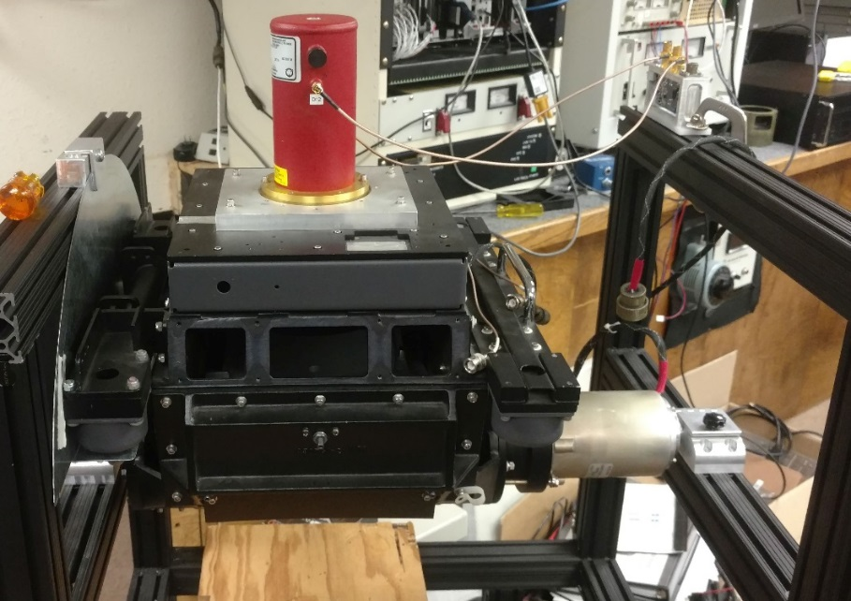
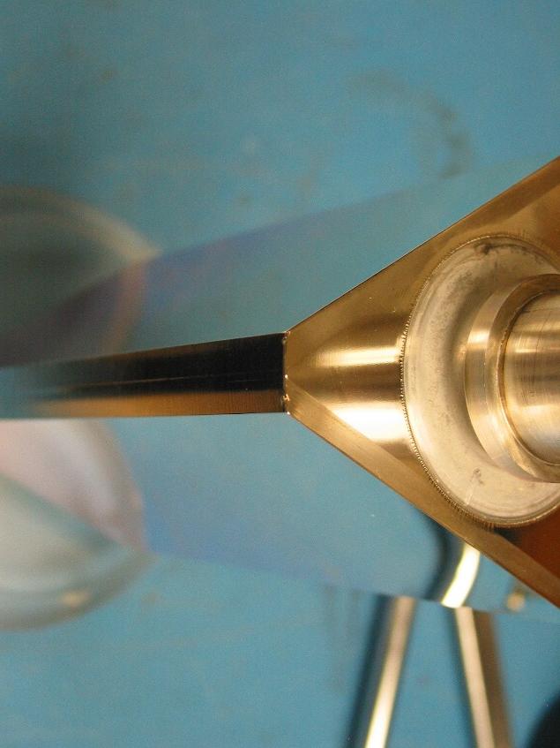
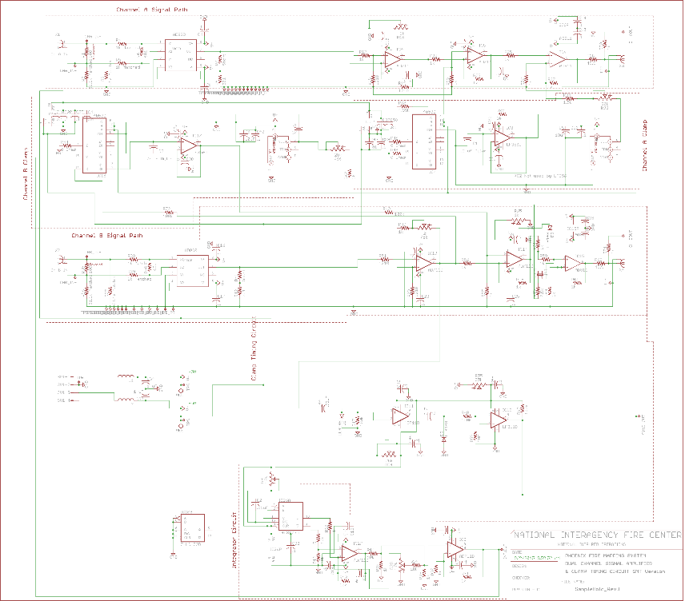
Phoenix Line Scanner (con’t)

Slide 14
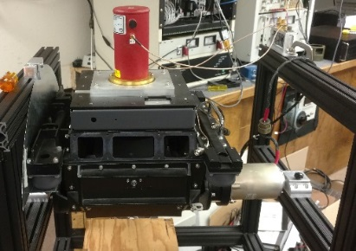
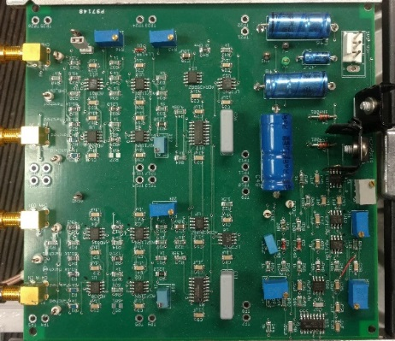
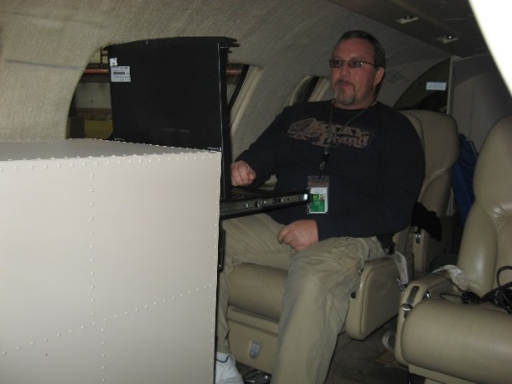
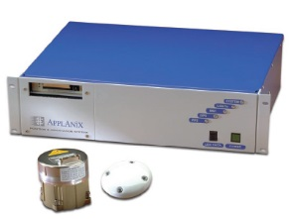
Phoenix Line Scanner Ops Diagram
COLLECTION
(linescanner, detector, preamps)
SIGNAL CONDITIONING
(sample & hold circuit, filters, cabling)
PROCESSING
(A/D conversion, software, fire detection, image processing)
DELIVERABLES
(ortho tiff, color tiff, ortho’d mosaic, .shp files)
NAVIGATION
(Applanix or Ekinox GPS attitude correction control)

Slide 15
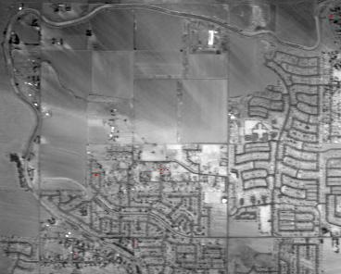
N149Z Phoenix Sensitivity Tests 2015
Test Flight over 6”, 9”, 12” Targets
  Test Results at:
    8,000 Ft AGL: 9” – 12”
    10,000 Ft AGL: 6” - 9” - 12”
    12,000 Ft AGL: 6” - 9” - 12”
    14,000 Ft AGL: 6” – 9” – 12”
    16,000 Ft AGL: 9” – 12”
    18,000 Ft AGL: 9” – 12”
  Similar testing has been done with Phoenix on N144Z.
  Actual results may vary.
Notes:
Tests were done over open, flat ground

Slide 16
Phoenix Line Scanner
Near term updates (CY 2019)
  Upgrade of DSP/ADC boards and software to 64-bit processing.
      DSP – Digital Signal Processing
      ADC – Analog to Digital Converter
    Switch to 10-meter DEMs for ortho-rectification.
  Integration of Ekinox-S INS/IMU
      INS – Inertial Navigation System
      IMU – Inertial Measurement Unit
  New mirrors

Slide 17
Phoenix Line Scanner
Long term updates (proposed)
  Replace the AirCell system
  Replace current LN2-cooled detectors with cryo-cooled detectors.
  Add detectors in the SWIR bands, 2.2 µm and 2.6 µm.
  Physically shrinking the system

Slide 18
Questions?
Notes:
Now lets look at some imagery

Slide 19
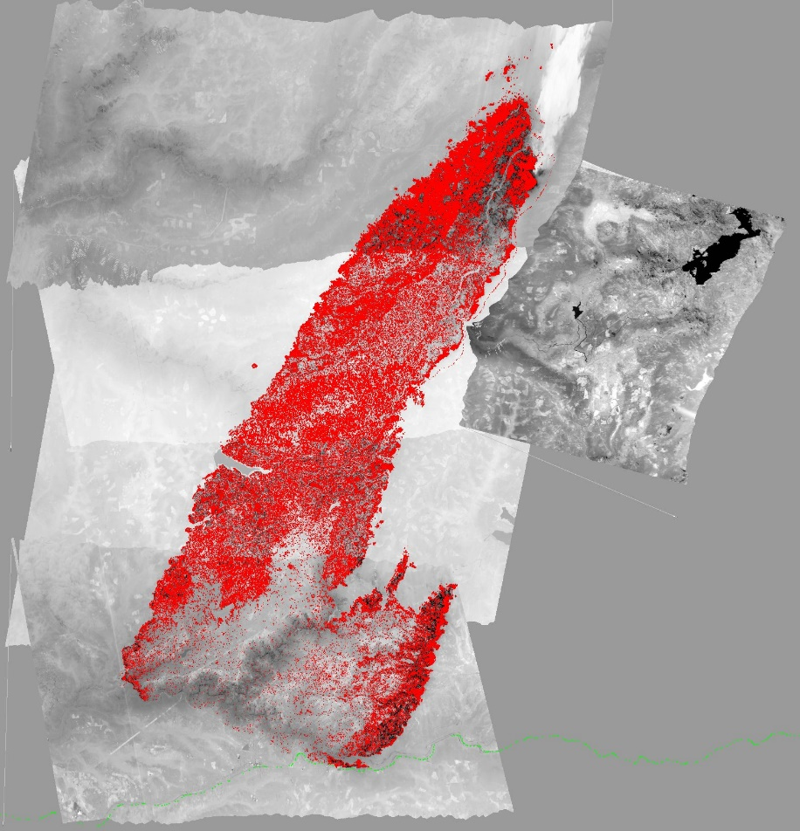
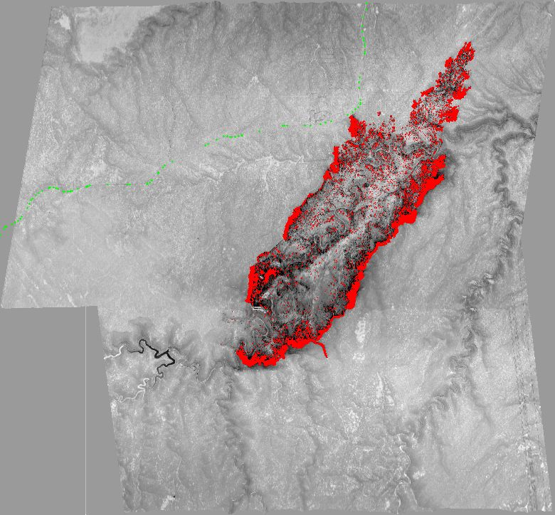
Phoenix Imagery Examples
King Fire – CA 2014
  On Sept 17 grew by 50,000+ acres making a 13 mile run to the northeast and nearly tripling in size, final size of 97,717 acres
Tinder Fire, AZ 2018
  Started April 30th grew to 8,600 ac
  Topo and NAIP base provided for reference
Notes:
King Fire was on the Eldorado NF, started Sept 13
Tinder Fire was on the Coconino NF, flown at 1am

