Slide 1
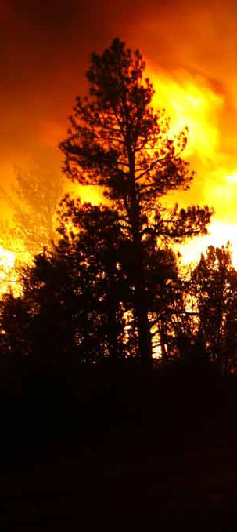
S-443 Infrared Interpretation Unit 5

Slide 2
Objectives
Be able to identify the key points of infrared imagery interpretation,
List the primary map and photo features that are usually identifiable on the infrared imagery,
Be able to list the primary features commonly found on infrared imagery that are related to incident mapping.

Slide 3
Tone is Related to the Amount
of Thermal Energy Emitted
In the NIROPS System:
White is relatively cooler
Black is relatively hotter
Red is extremely hot

Slide 5
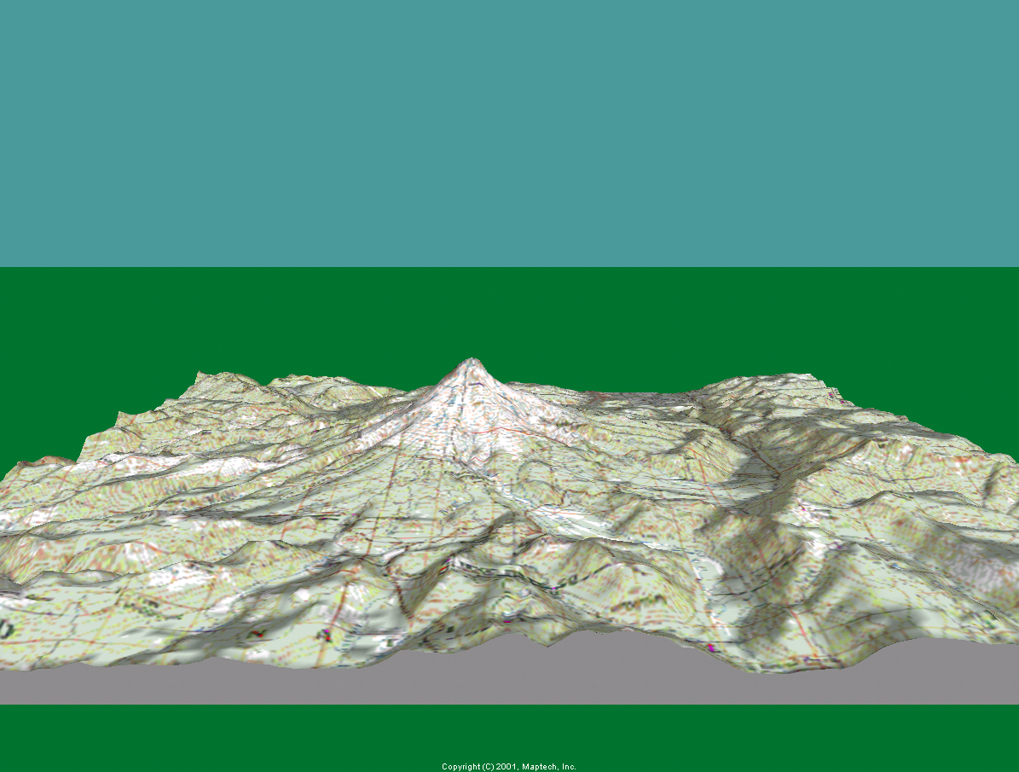
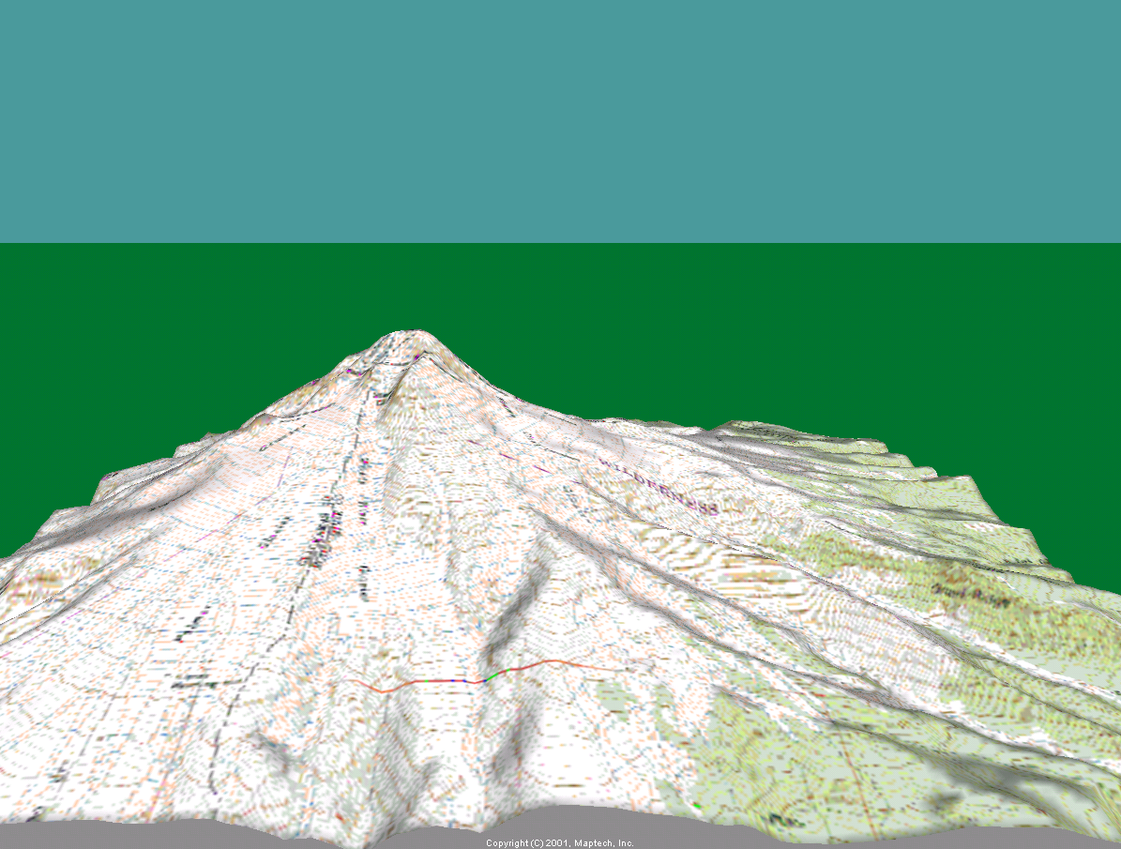
Scale
f AGL
f AGL

Slide 6
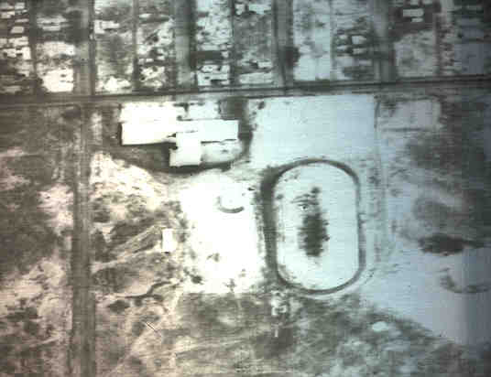
SIZE IS A FUNCTION OF ALTITUDE. COMPARE KNOWN SIZES, SHAPES, and PATTERNS.
Baseball Diamond, 90 feet between bases
Football Field, 100 yards long.
Other Examples?

Slide 7
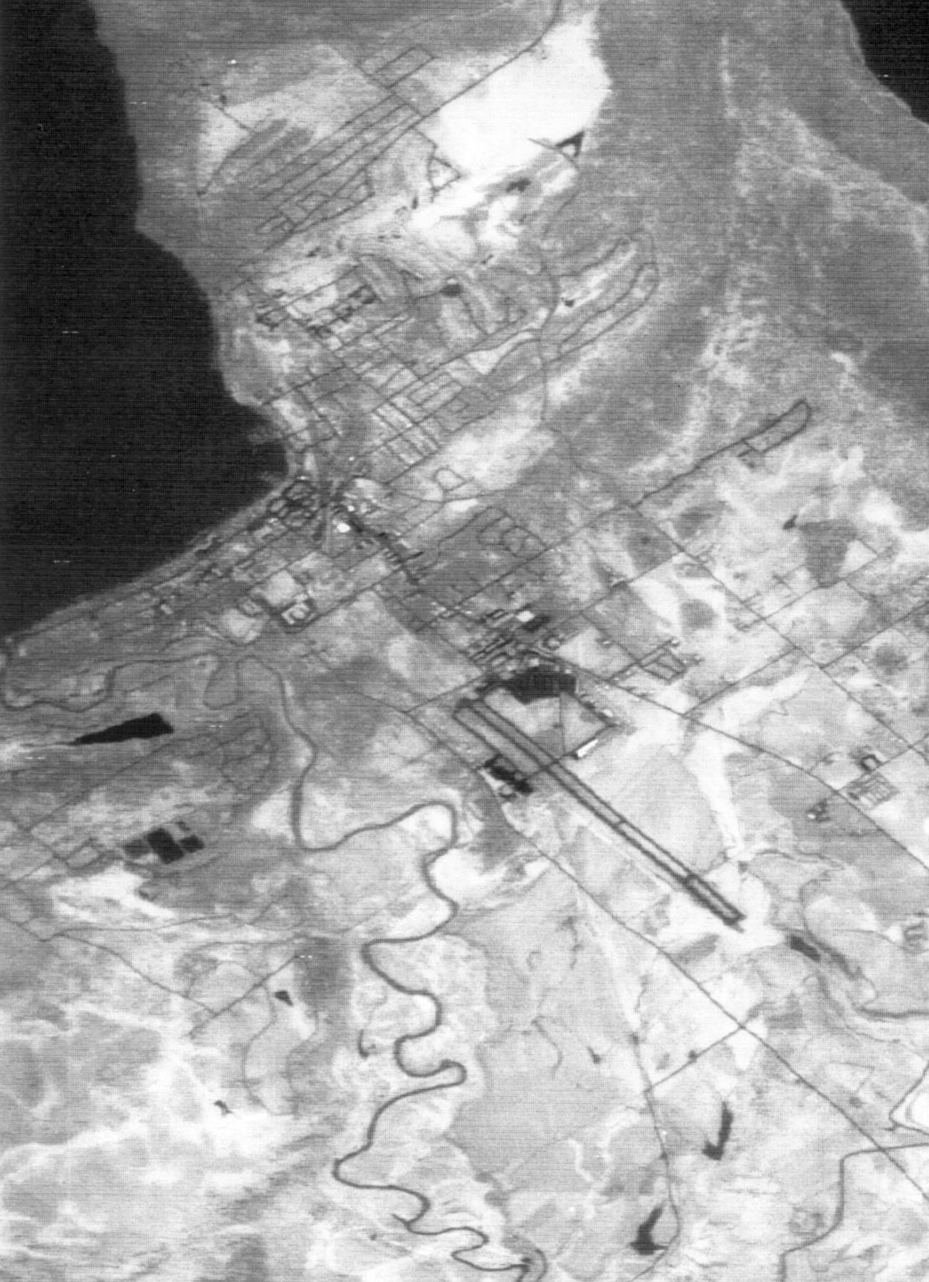
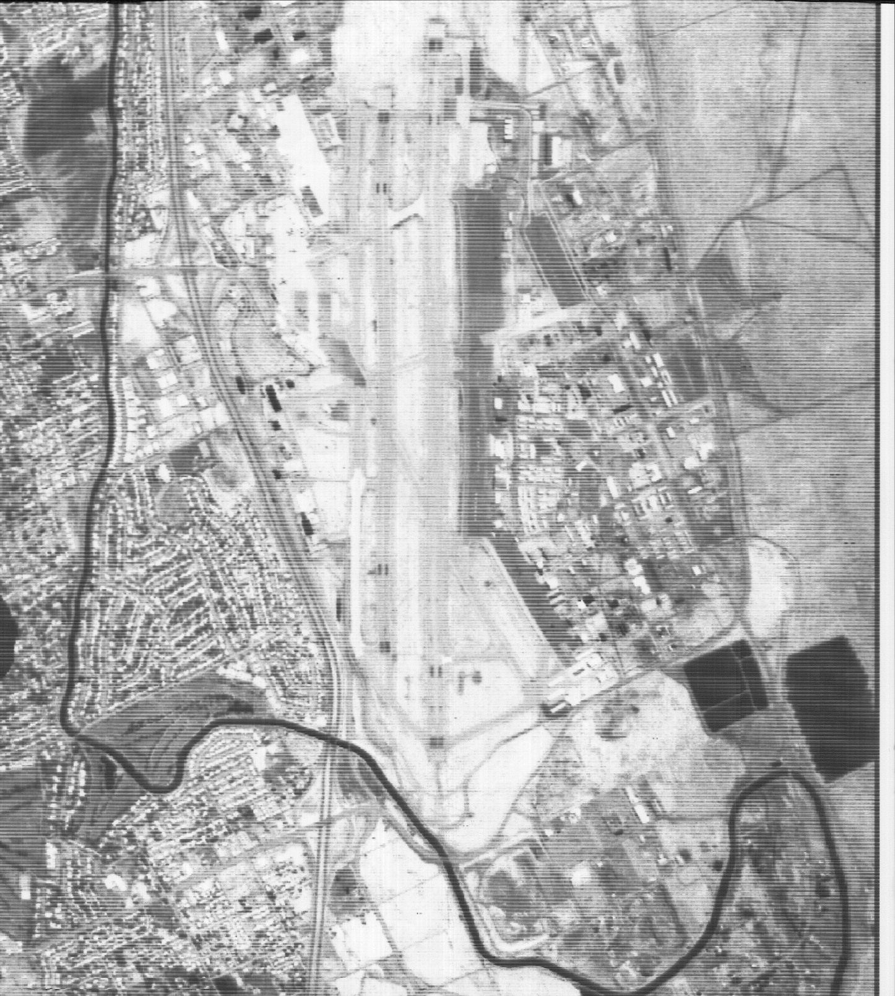
Houses, Right-of-ways, Water ways, Airports

Slide 8
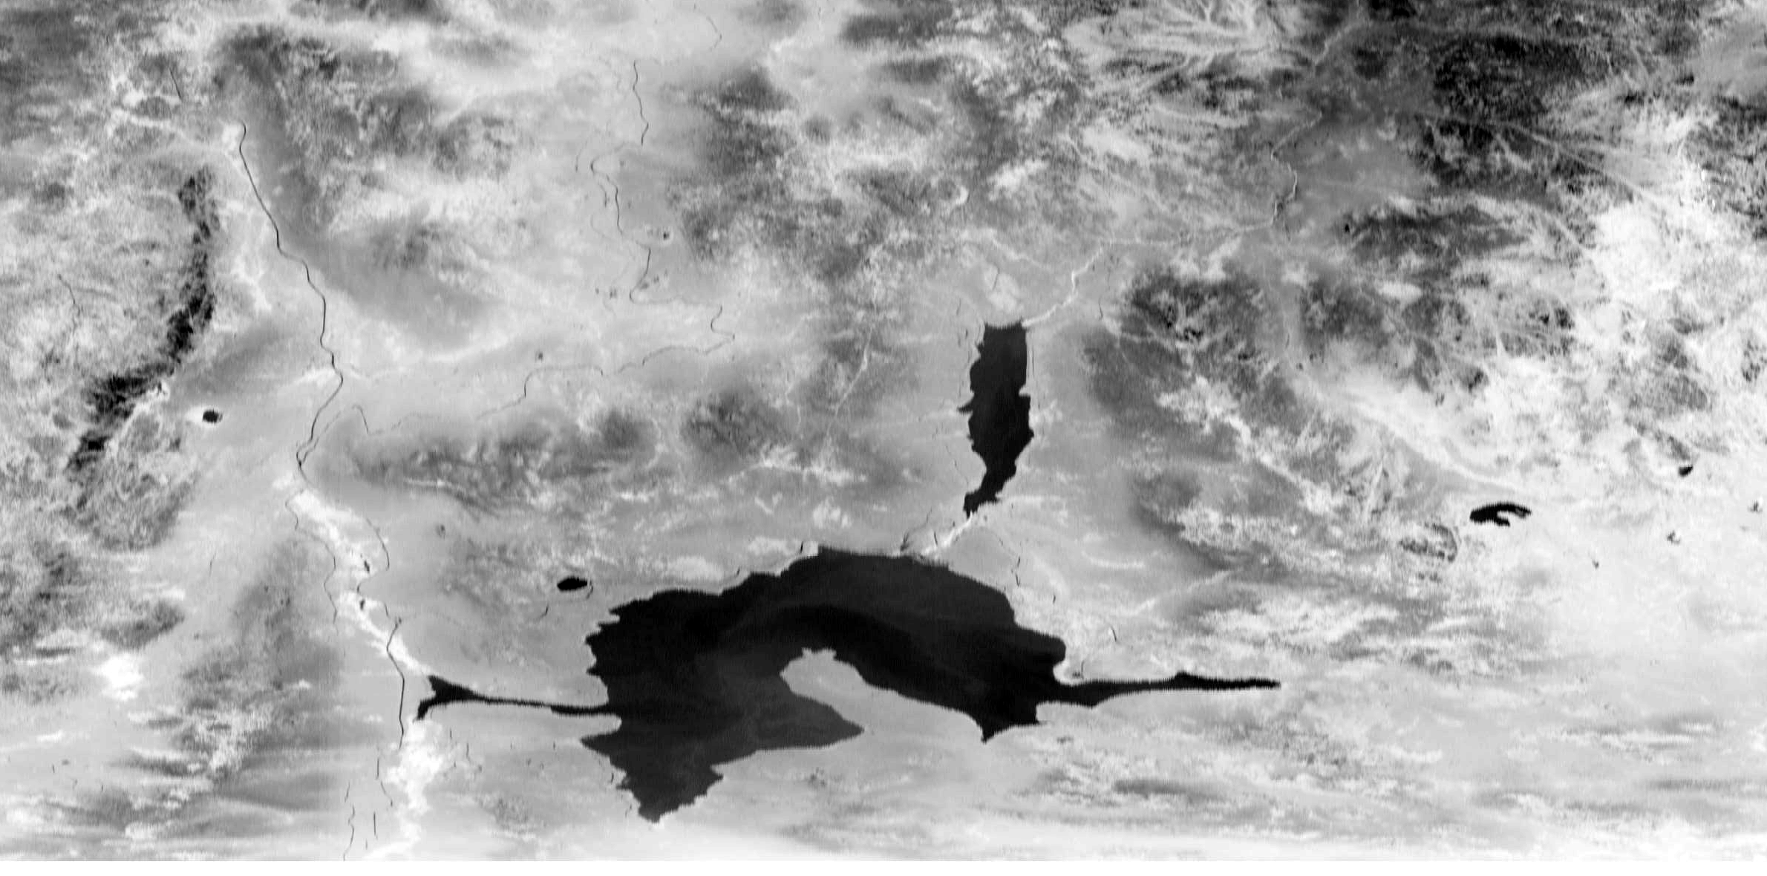
SHAPES

Slide 9
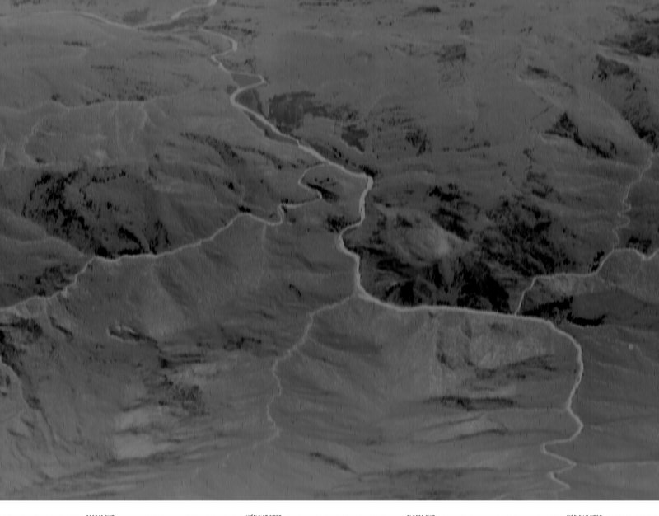
PATTERN

Slide 10
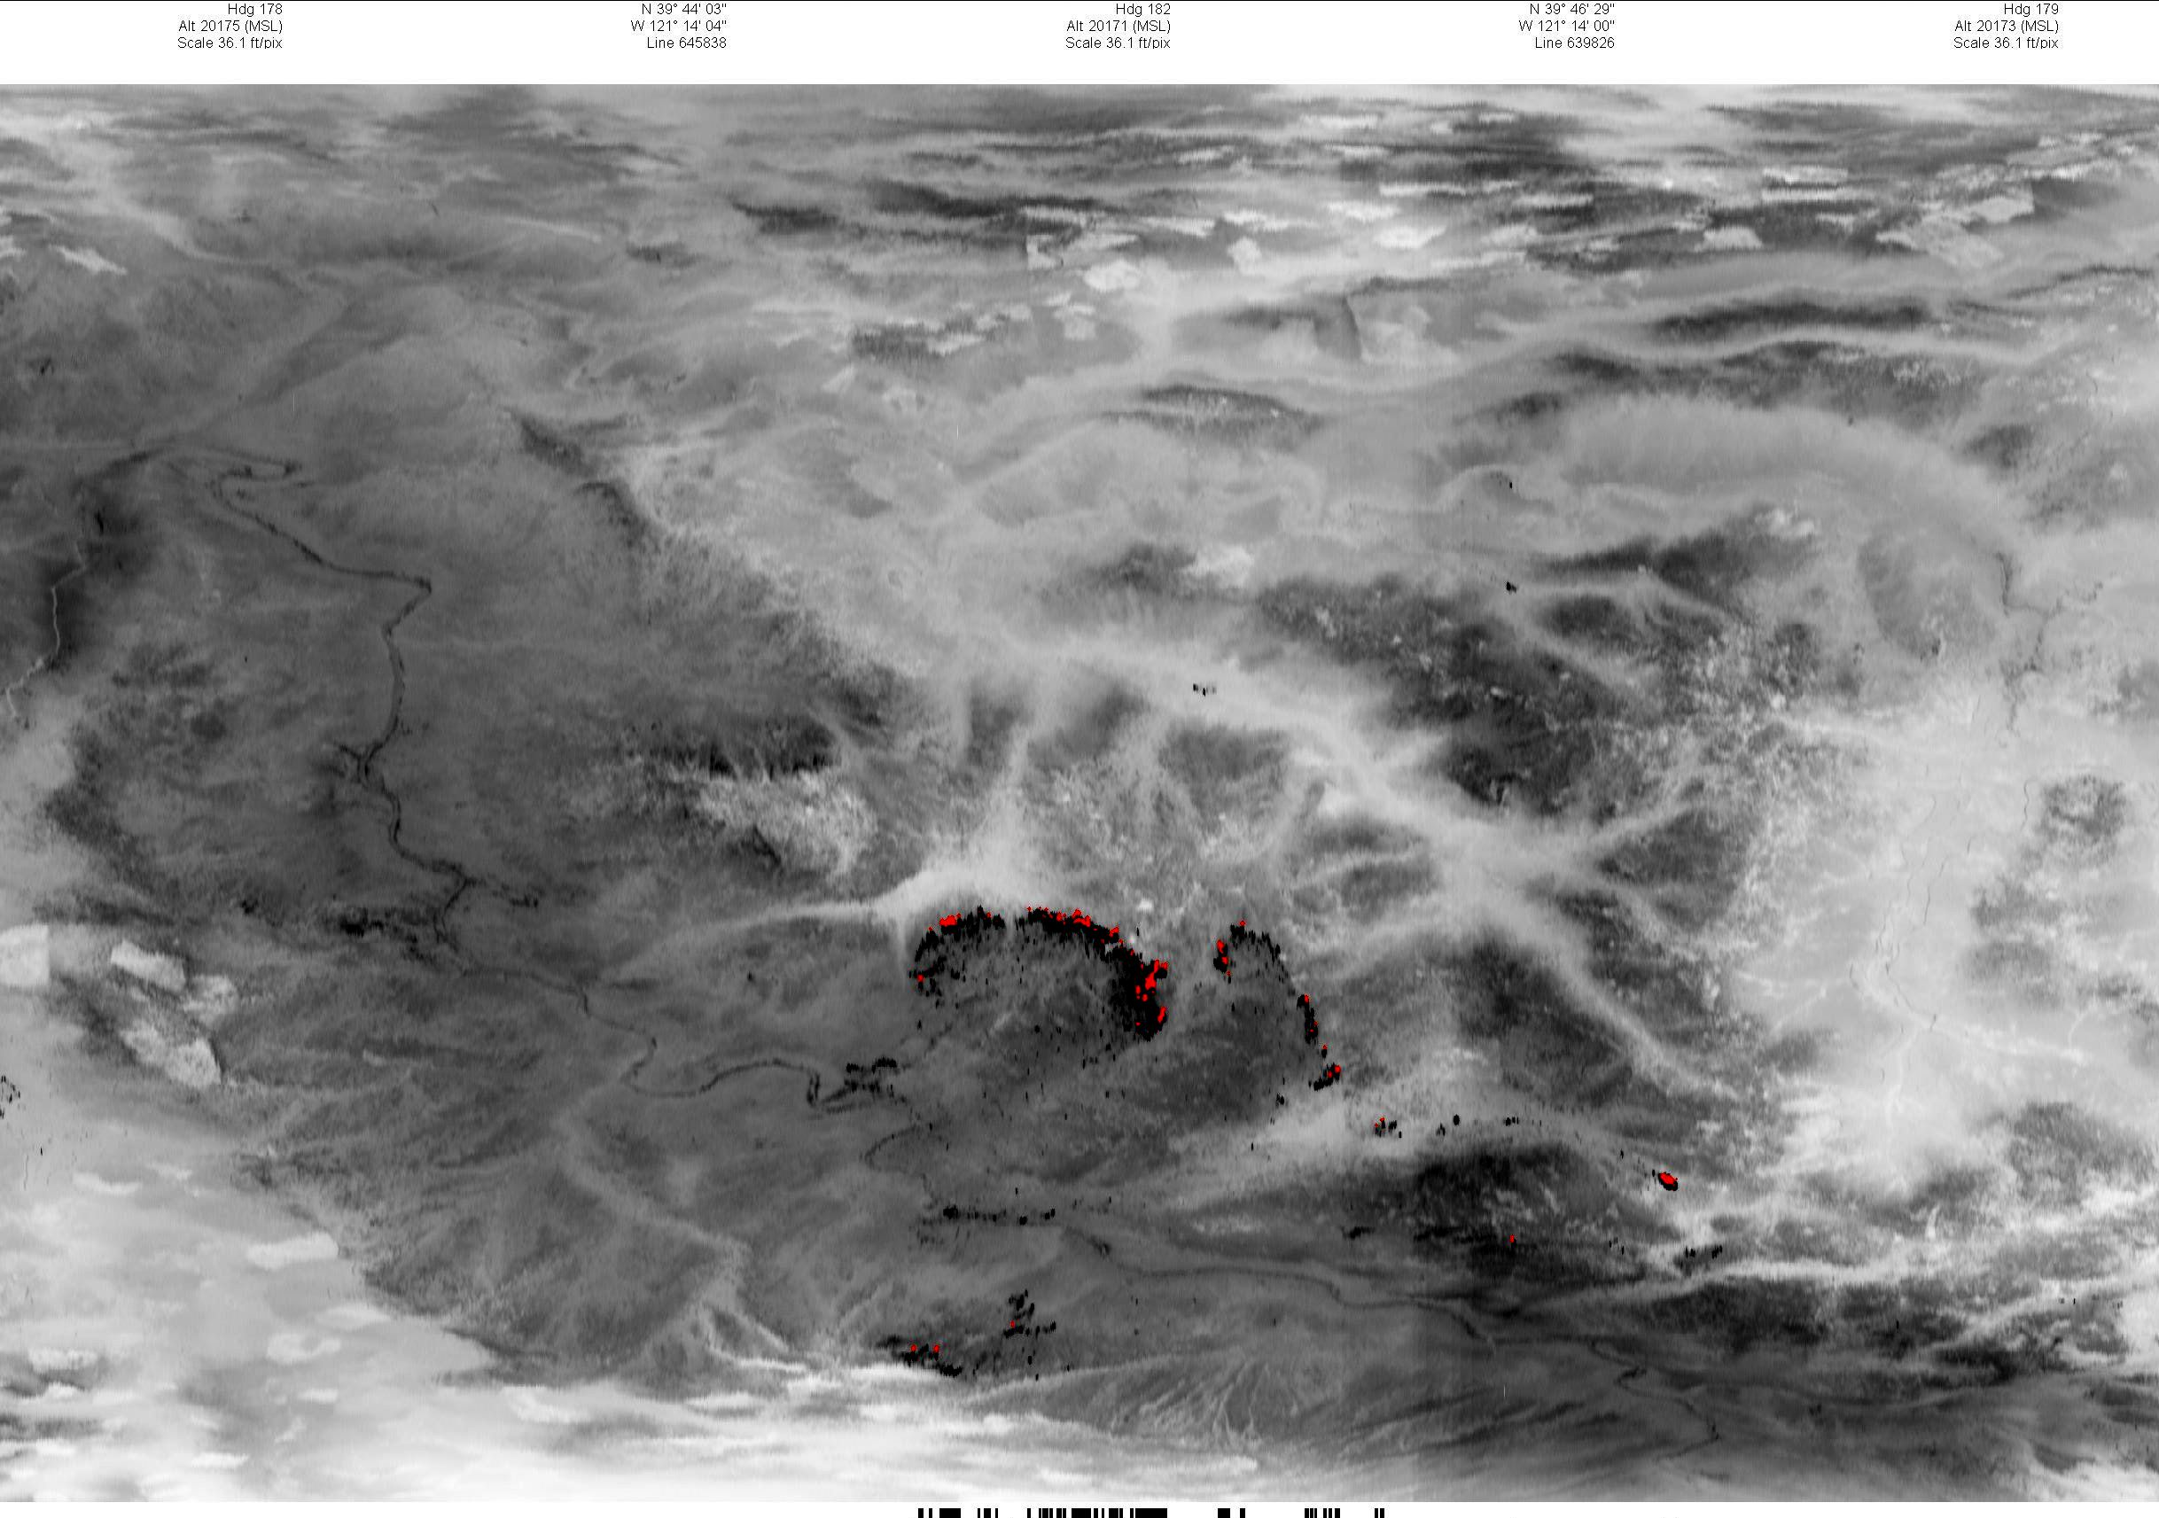
TEXTURE

Slide 11
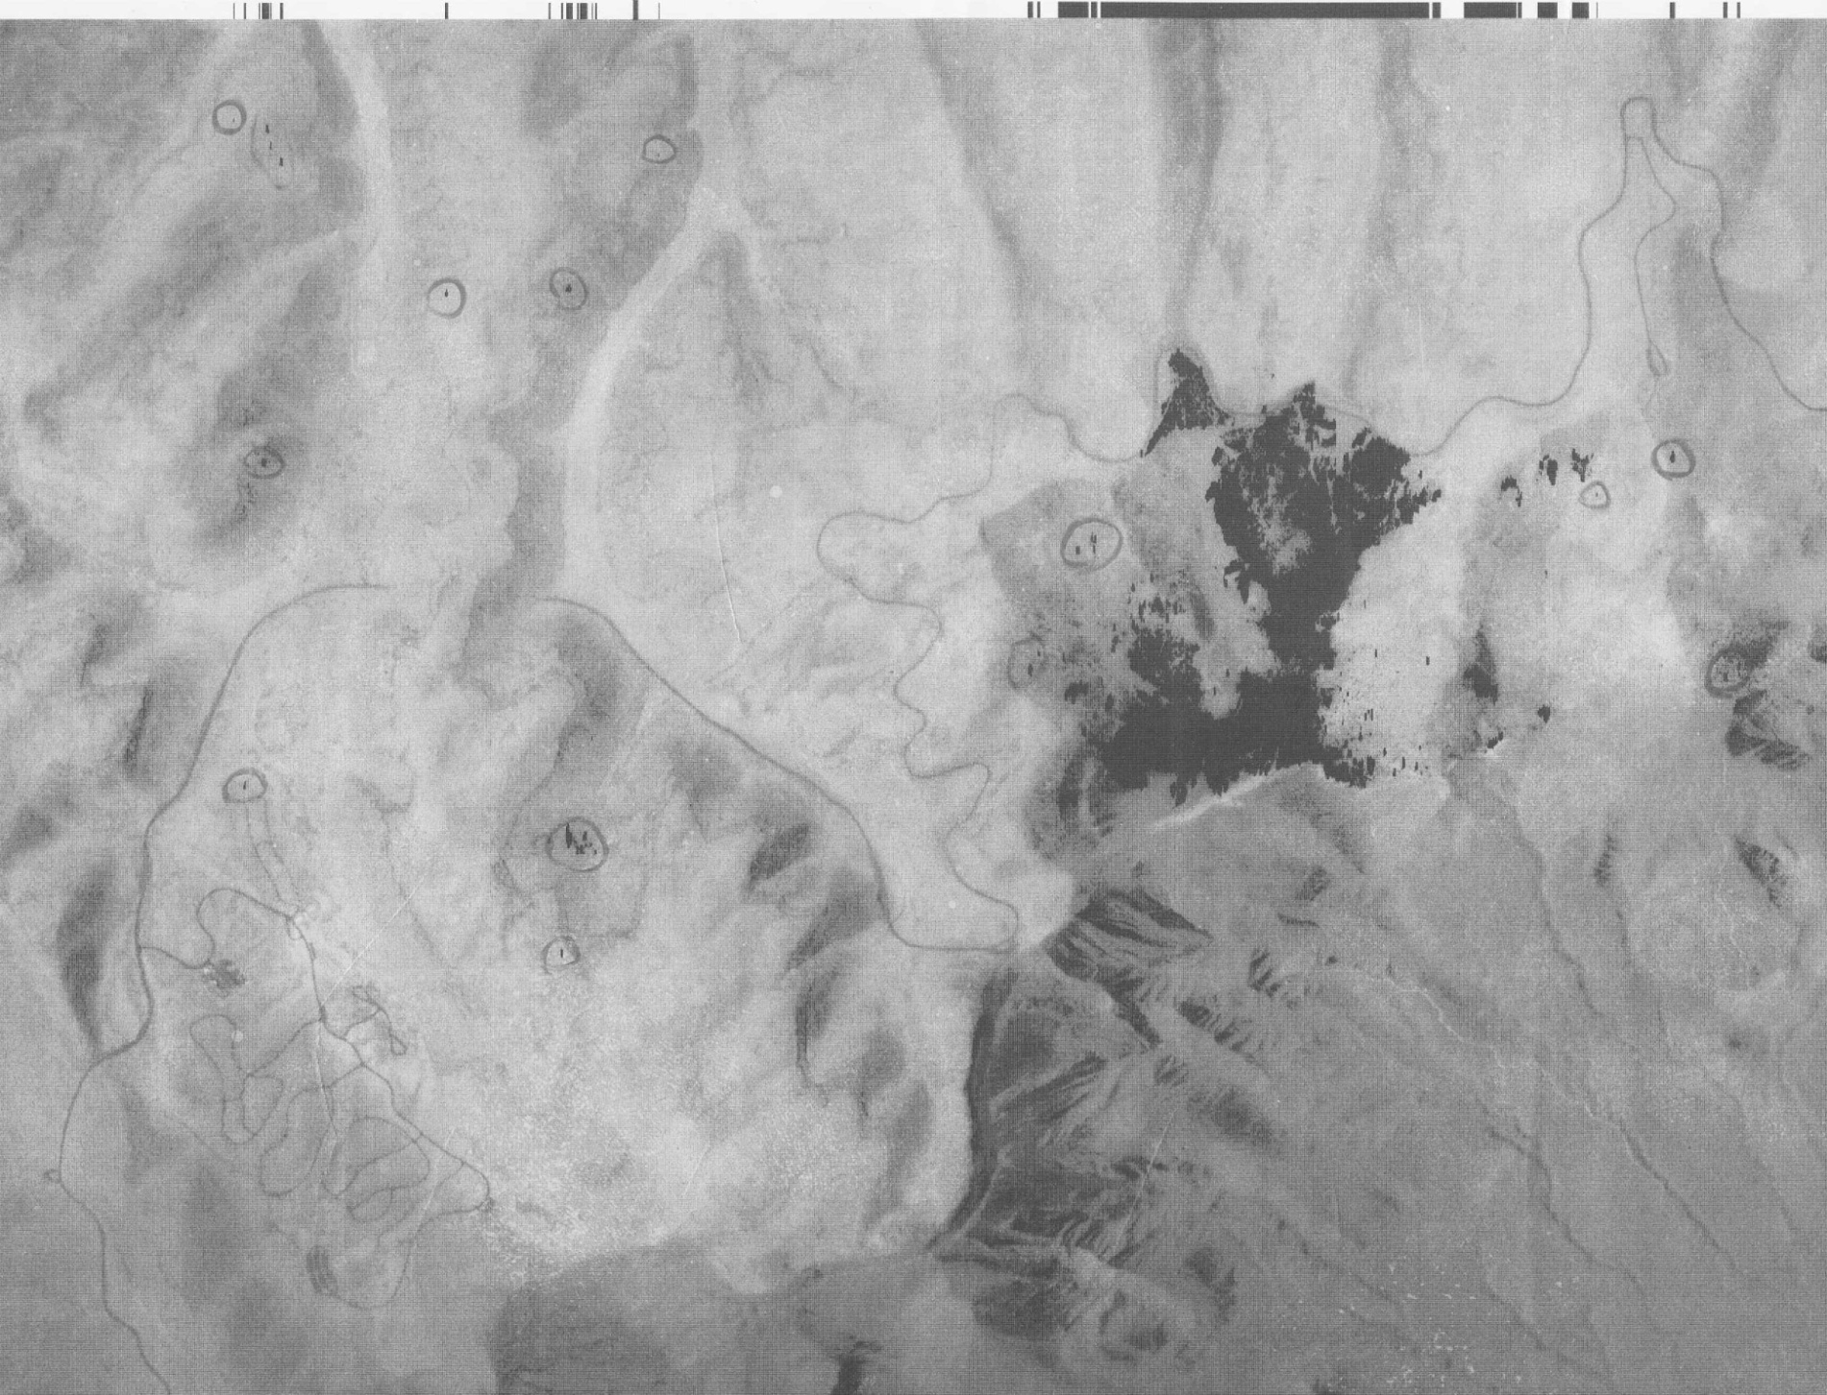
TONE, TEXTURE (ROUGHNESS) & PATTERN

Slide 12
Identifiable Map & Photo Features
Cultural Features
Roads
Turns
Switchbacks
Intersections
Bridges & Tunnels
Airport Runways
Power Corridors
Golf Courses
Ski Runs
Structures
Parks
Fire Control Activities
Irrigation
Geographic Features
Ridges
Drainages
Rivers
Lakes & Ponds
Peaks
Flat Tops/Mesas
Aspects
Rock Outcrops
Lava Flows
Vegetation Patterns
Timber
Meadows
Clearcuts
Partial Tree Removal
Debris Slides
Avalanche Paths

Slide 13
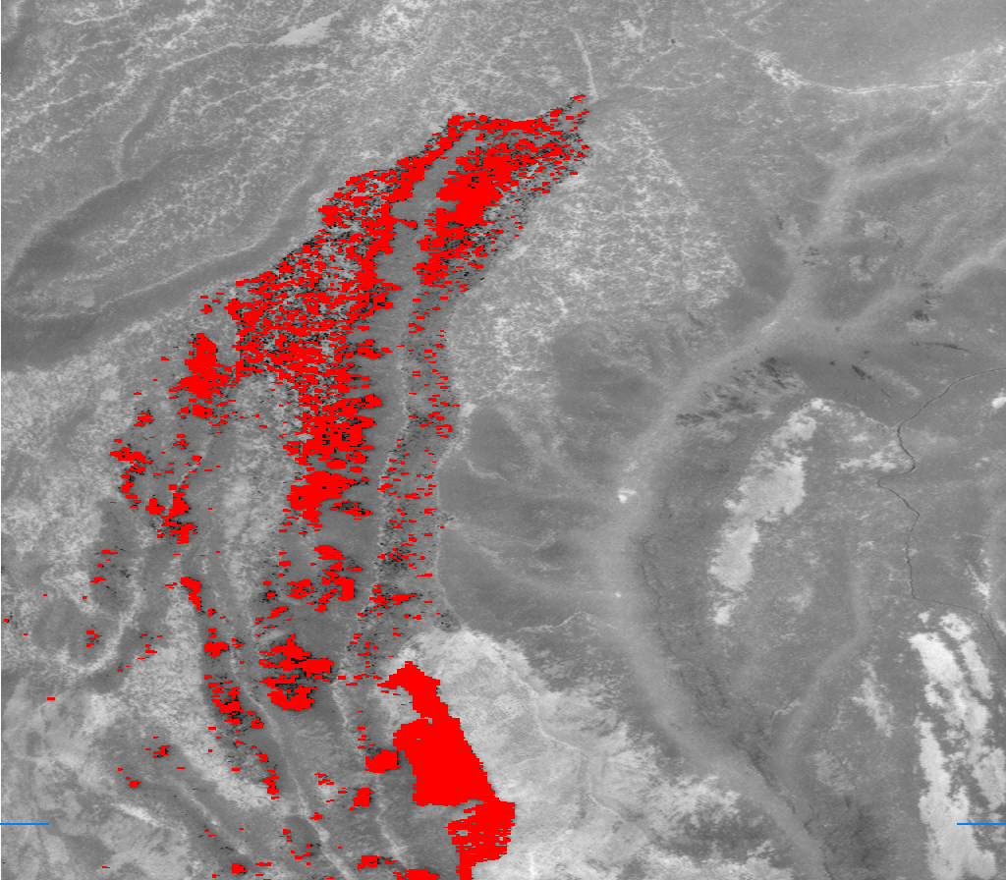
Open Woodland
due to logging
Logging Roads
Steep Canyon
Walls
Rock
Meadows
Surfaced Road?
Cool Draws
Timbered
Stringers
in Meadow

Slide 14
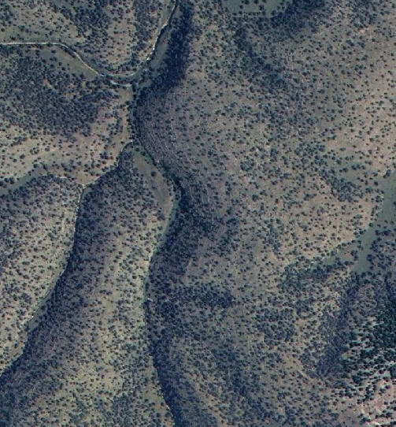
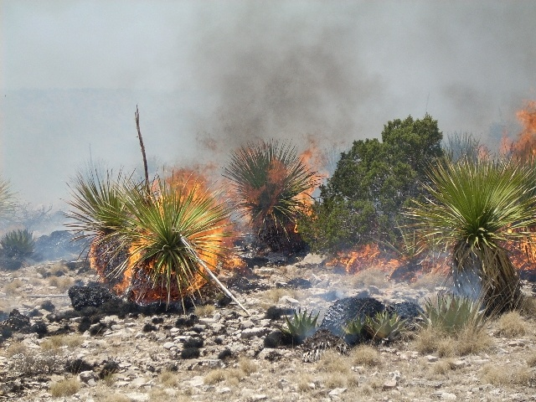
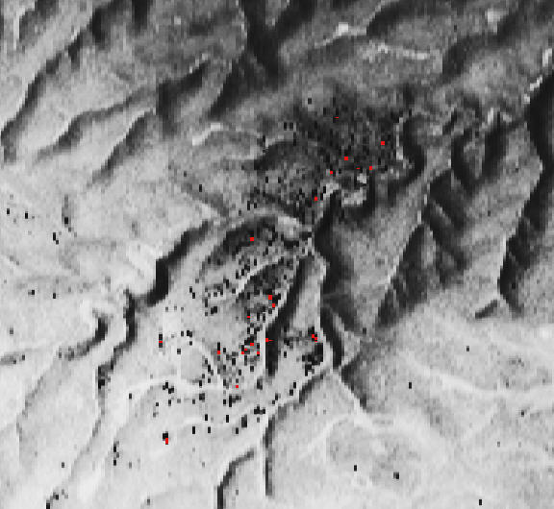
Scattered Fuels
Notes:
14

Slide 15
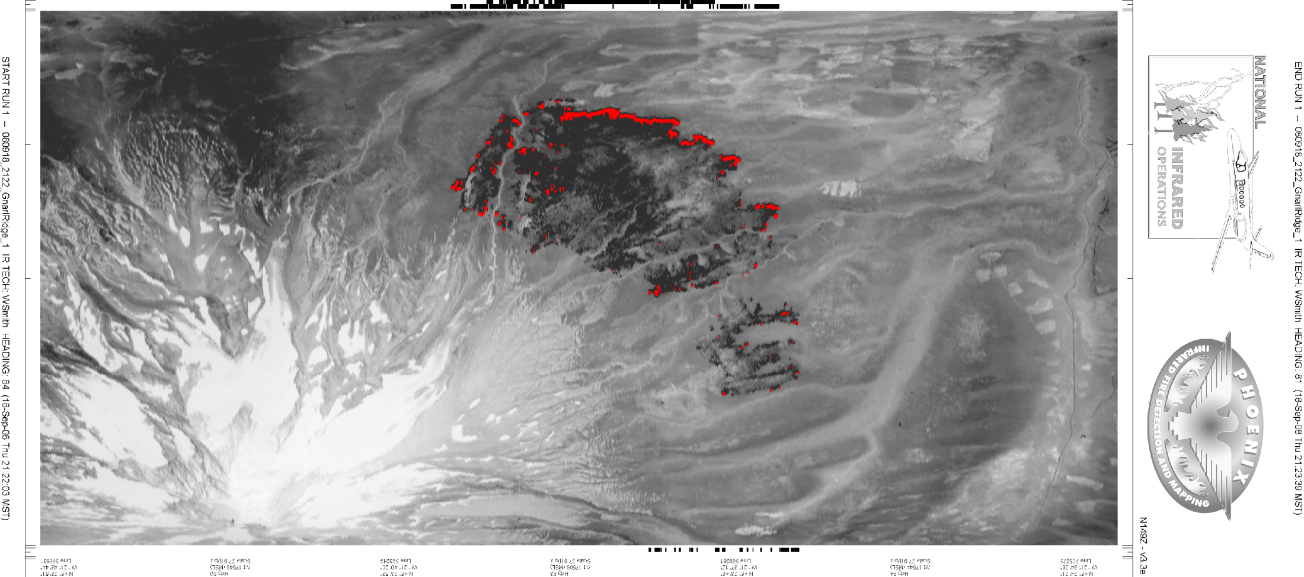
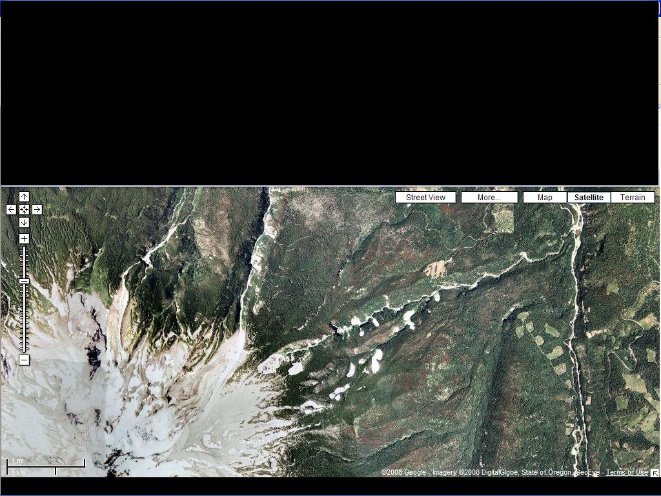
Key Identification Features
Roads
Veg Patterns
Drainages
Glaciers

Slide 16
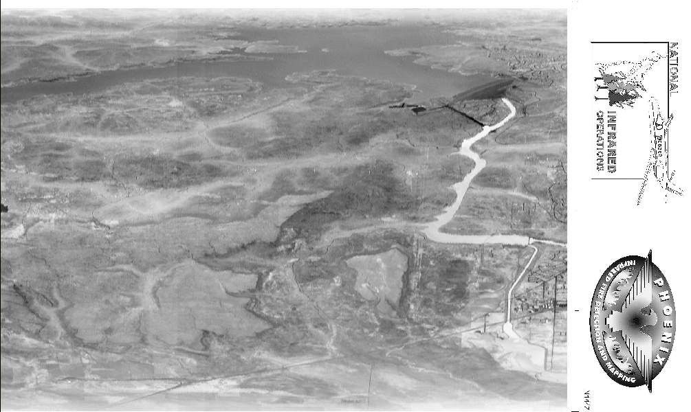

Slide 17
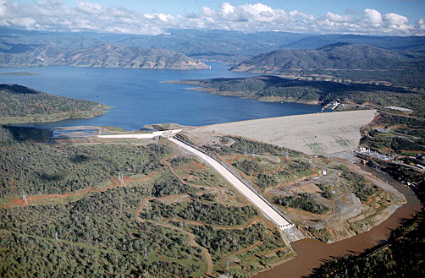
Notes:
Identifying features on both IR imagery and color imagery
Reservoir
Dam
Raceway or Spillway
Roads
River

Slide 18
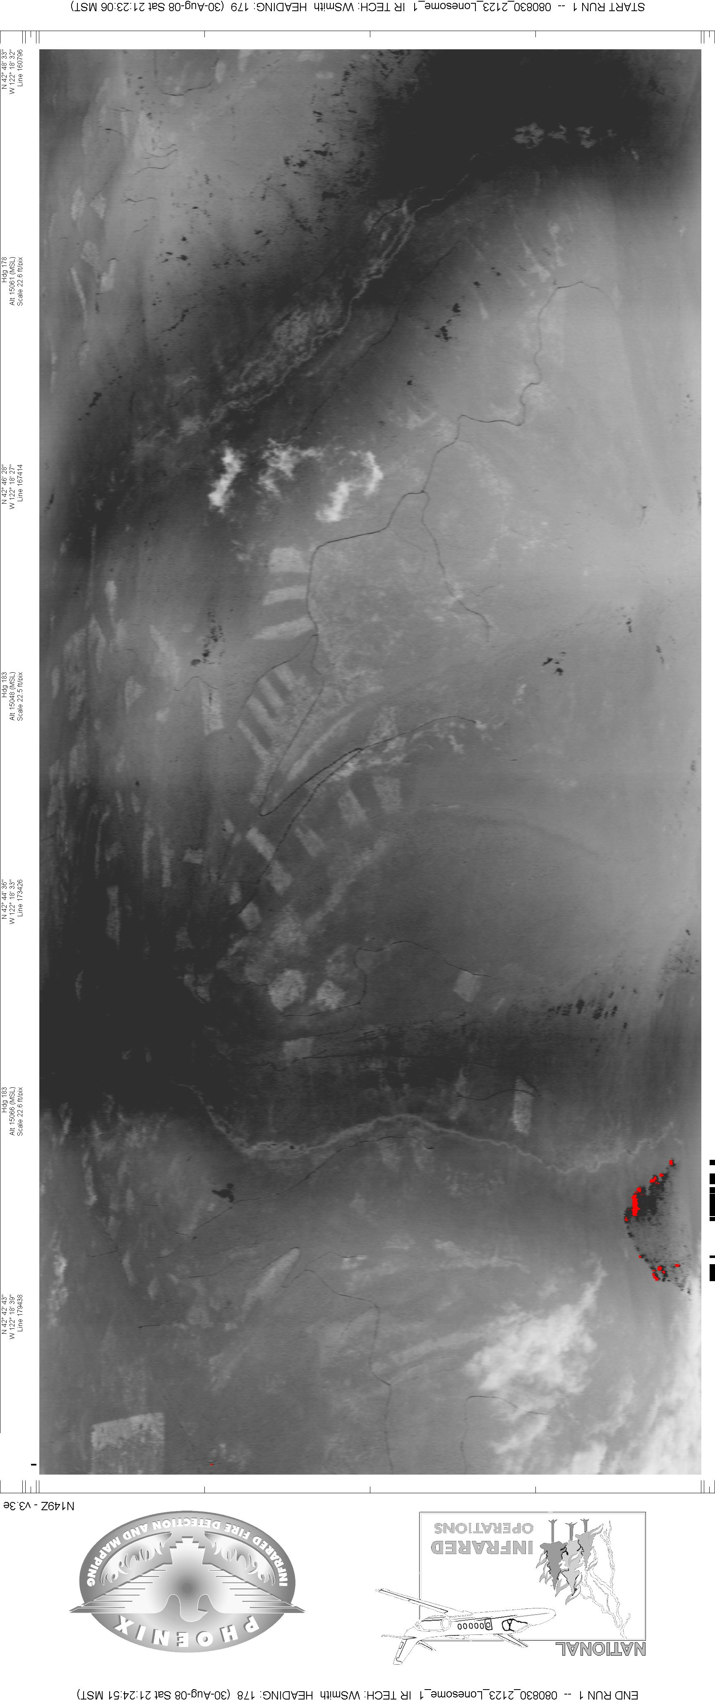
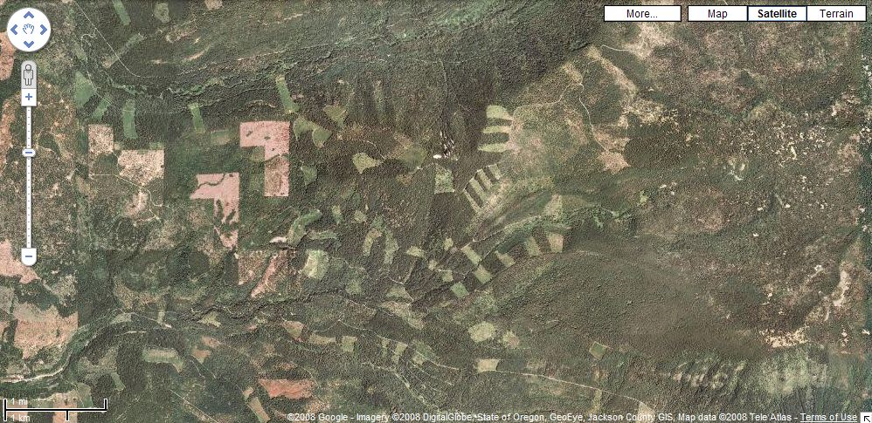
Lonesome Fire Complex, Prospect, Oregon, 2008
Notes:
Lonesome Fire Complex near Prospect in SW Oregon. Compare features visible in both imagery & photo. Ask students about features circled in red, (hot rocks and clouds).

Slide 19
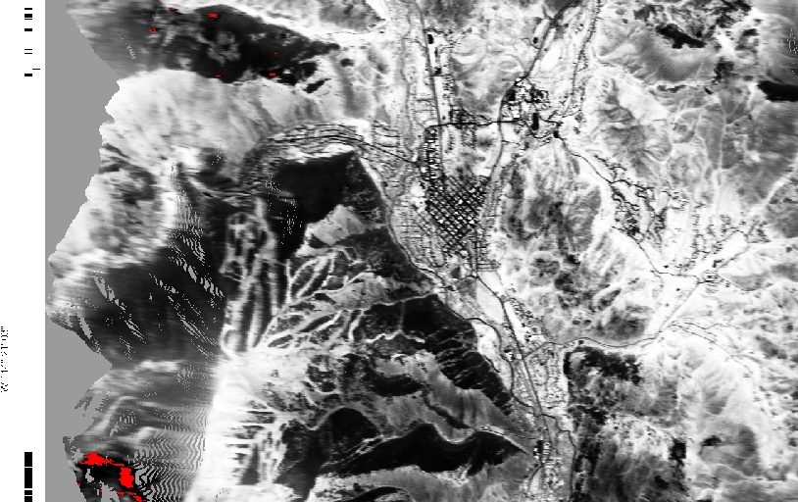
Notes:
Compare features in both imagery and photo. Ski area, urban areas, forested north slopes & grass dominated south slopes, lace on steep topography.

Slide 20
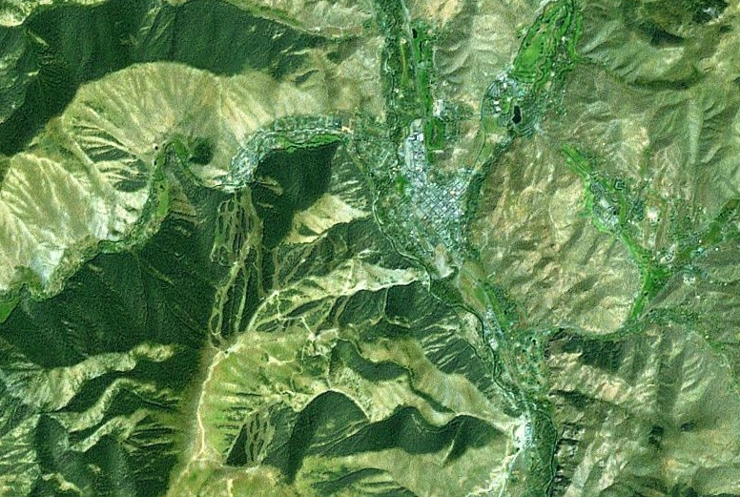

Slide 21
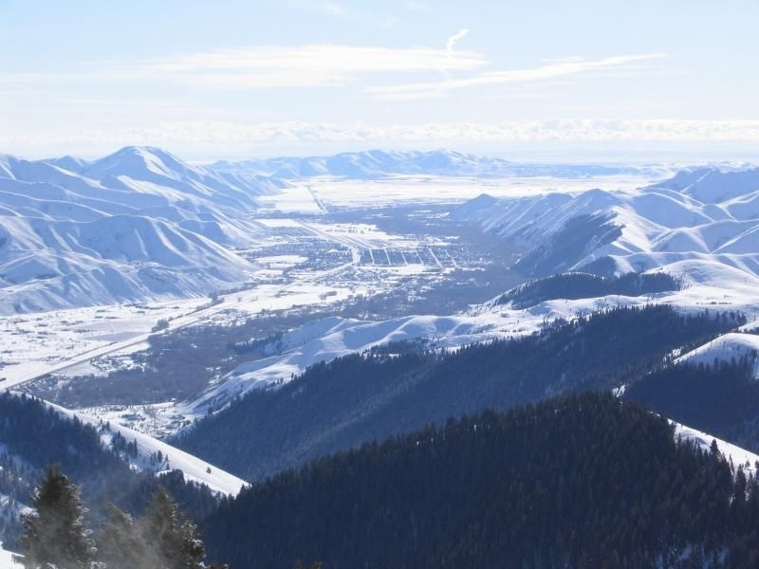

Slide 22
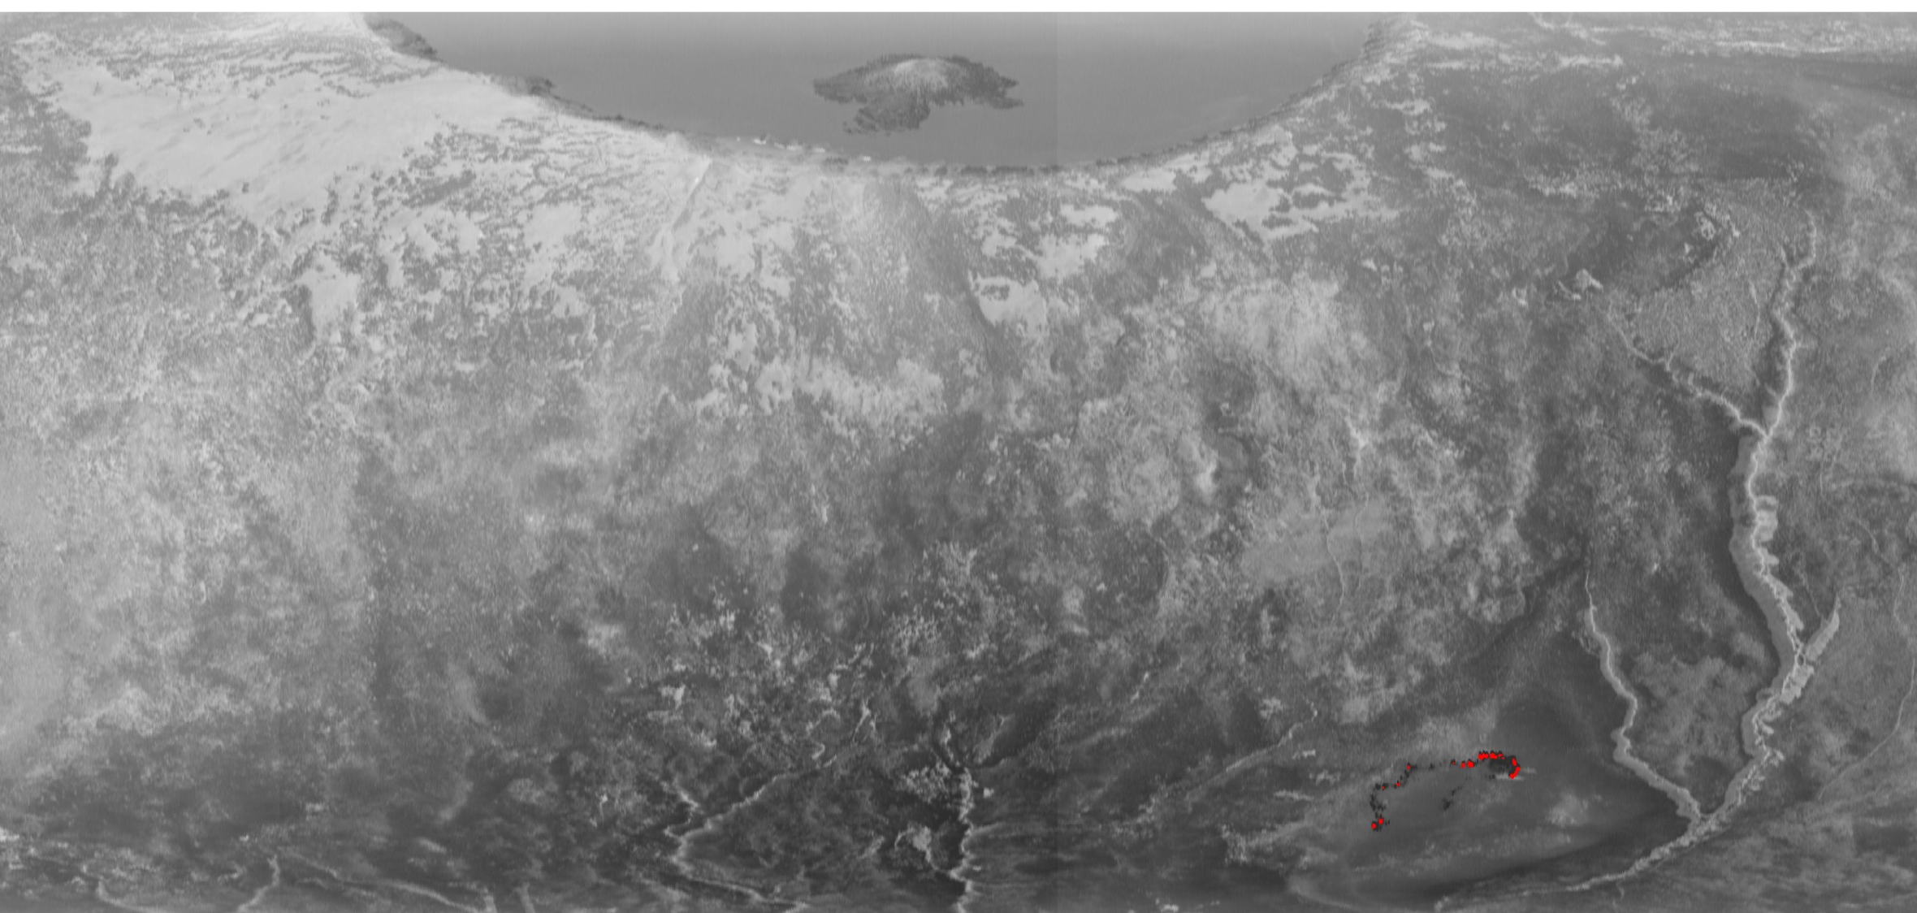

Slide 23
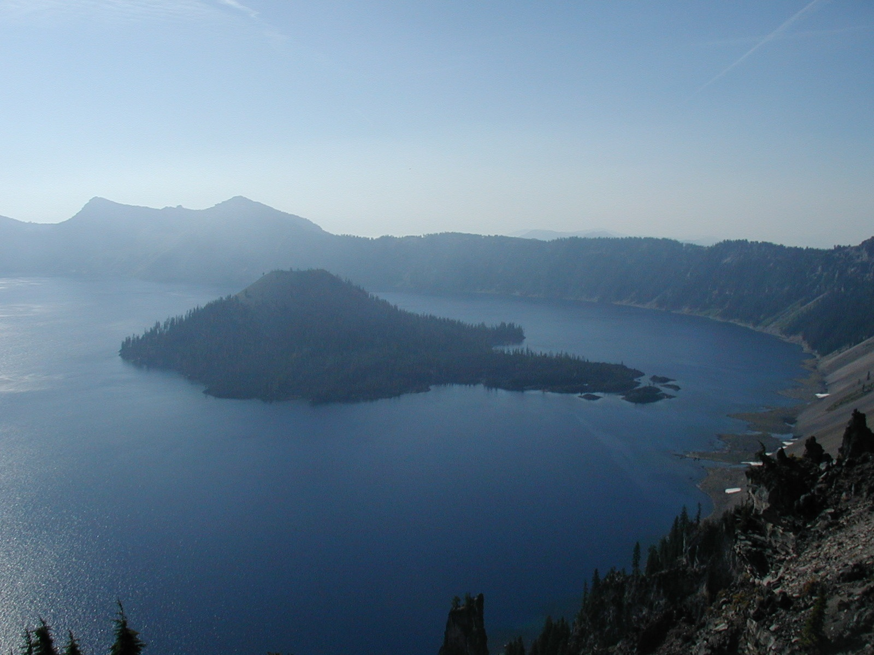

Slide 24
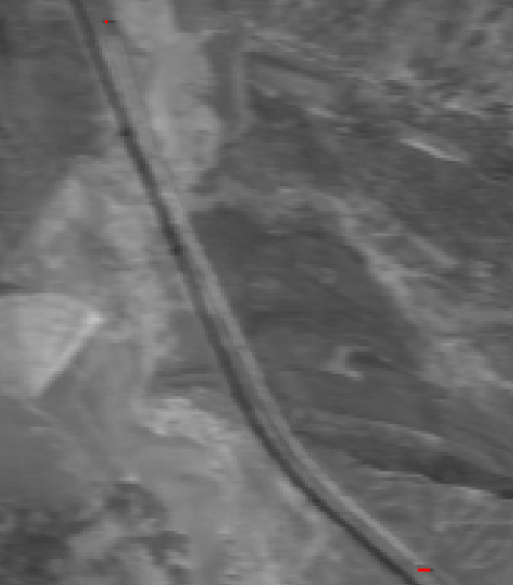
Oil Creek Fire 7/4/12

Slide 25
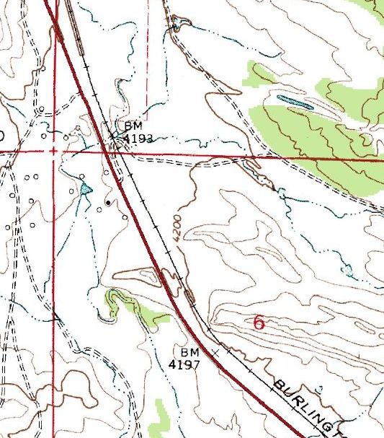
Oil Creek Fire 7/4/12

Slide 26
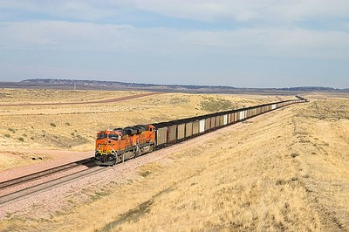

Slide 27
Water
Appearance depends on depth, time of day, etc.
July 27, 0117 July 28, 2205 Aug 4, 1955

Slide 28
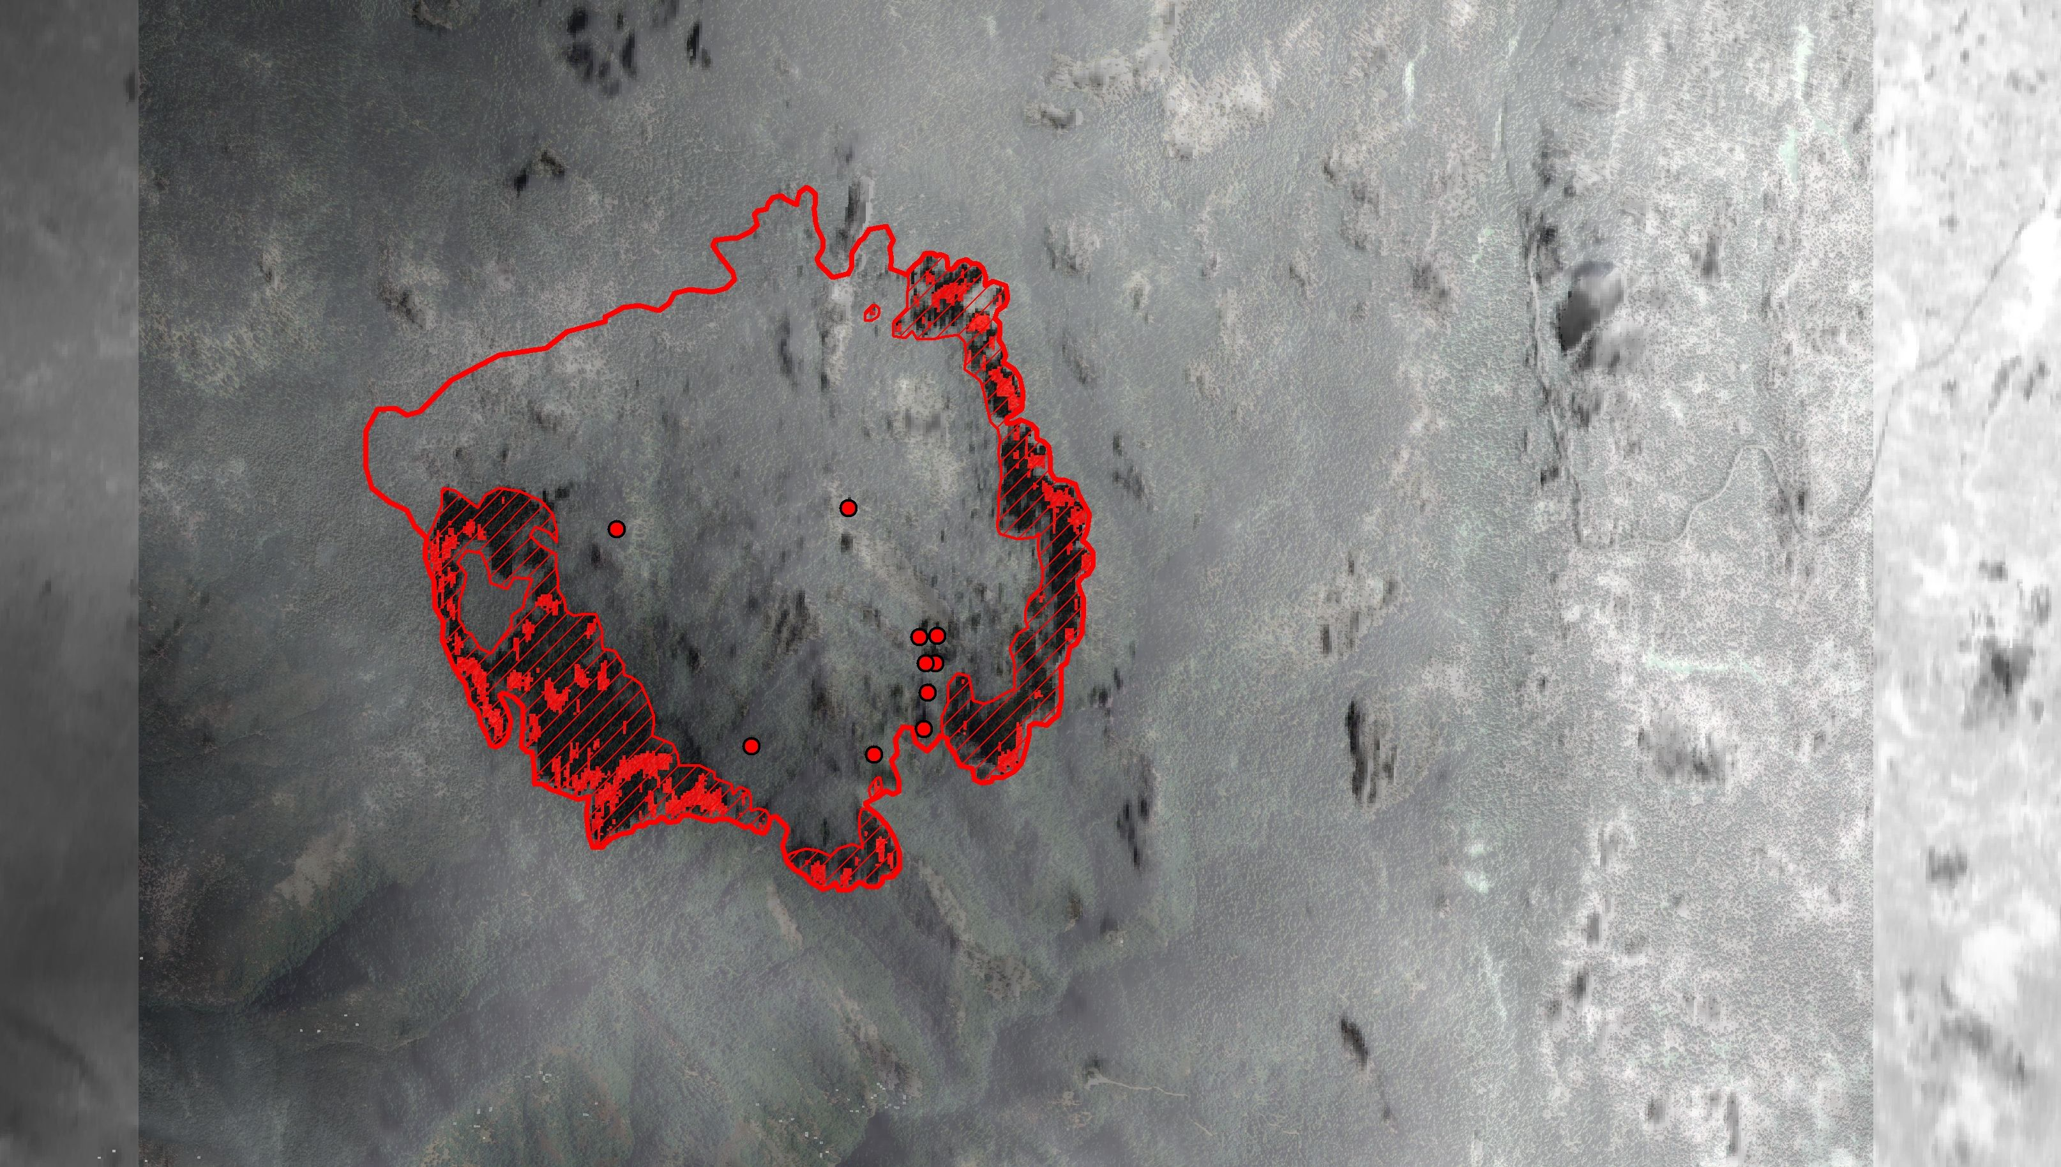
Fire Management – Burnout Operations
September 20
Notes:
First in a series of images showing a management burnout operation lasting several days.
Melinda was IRIN on this fire.

Slide 29
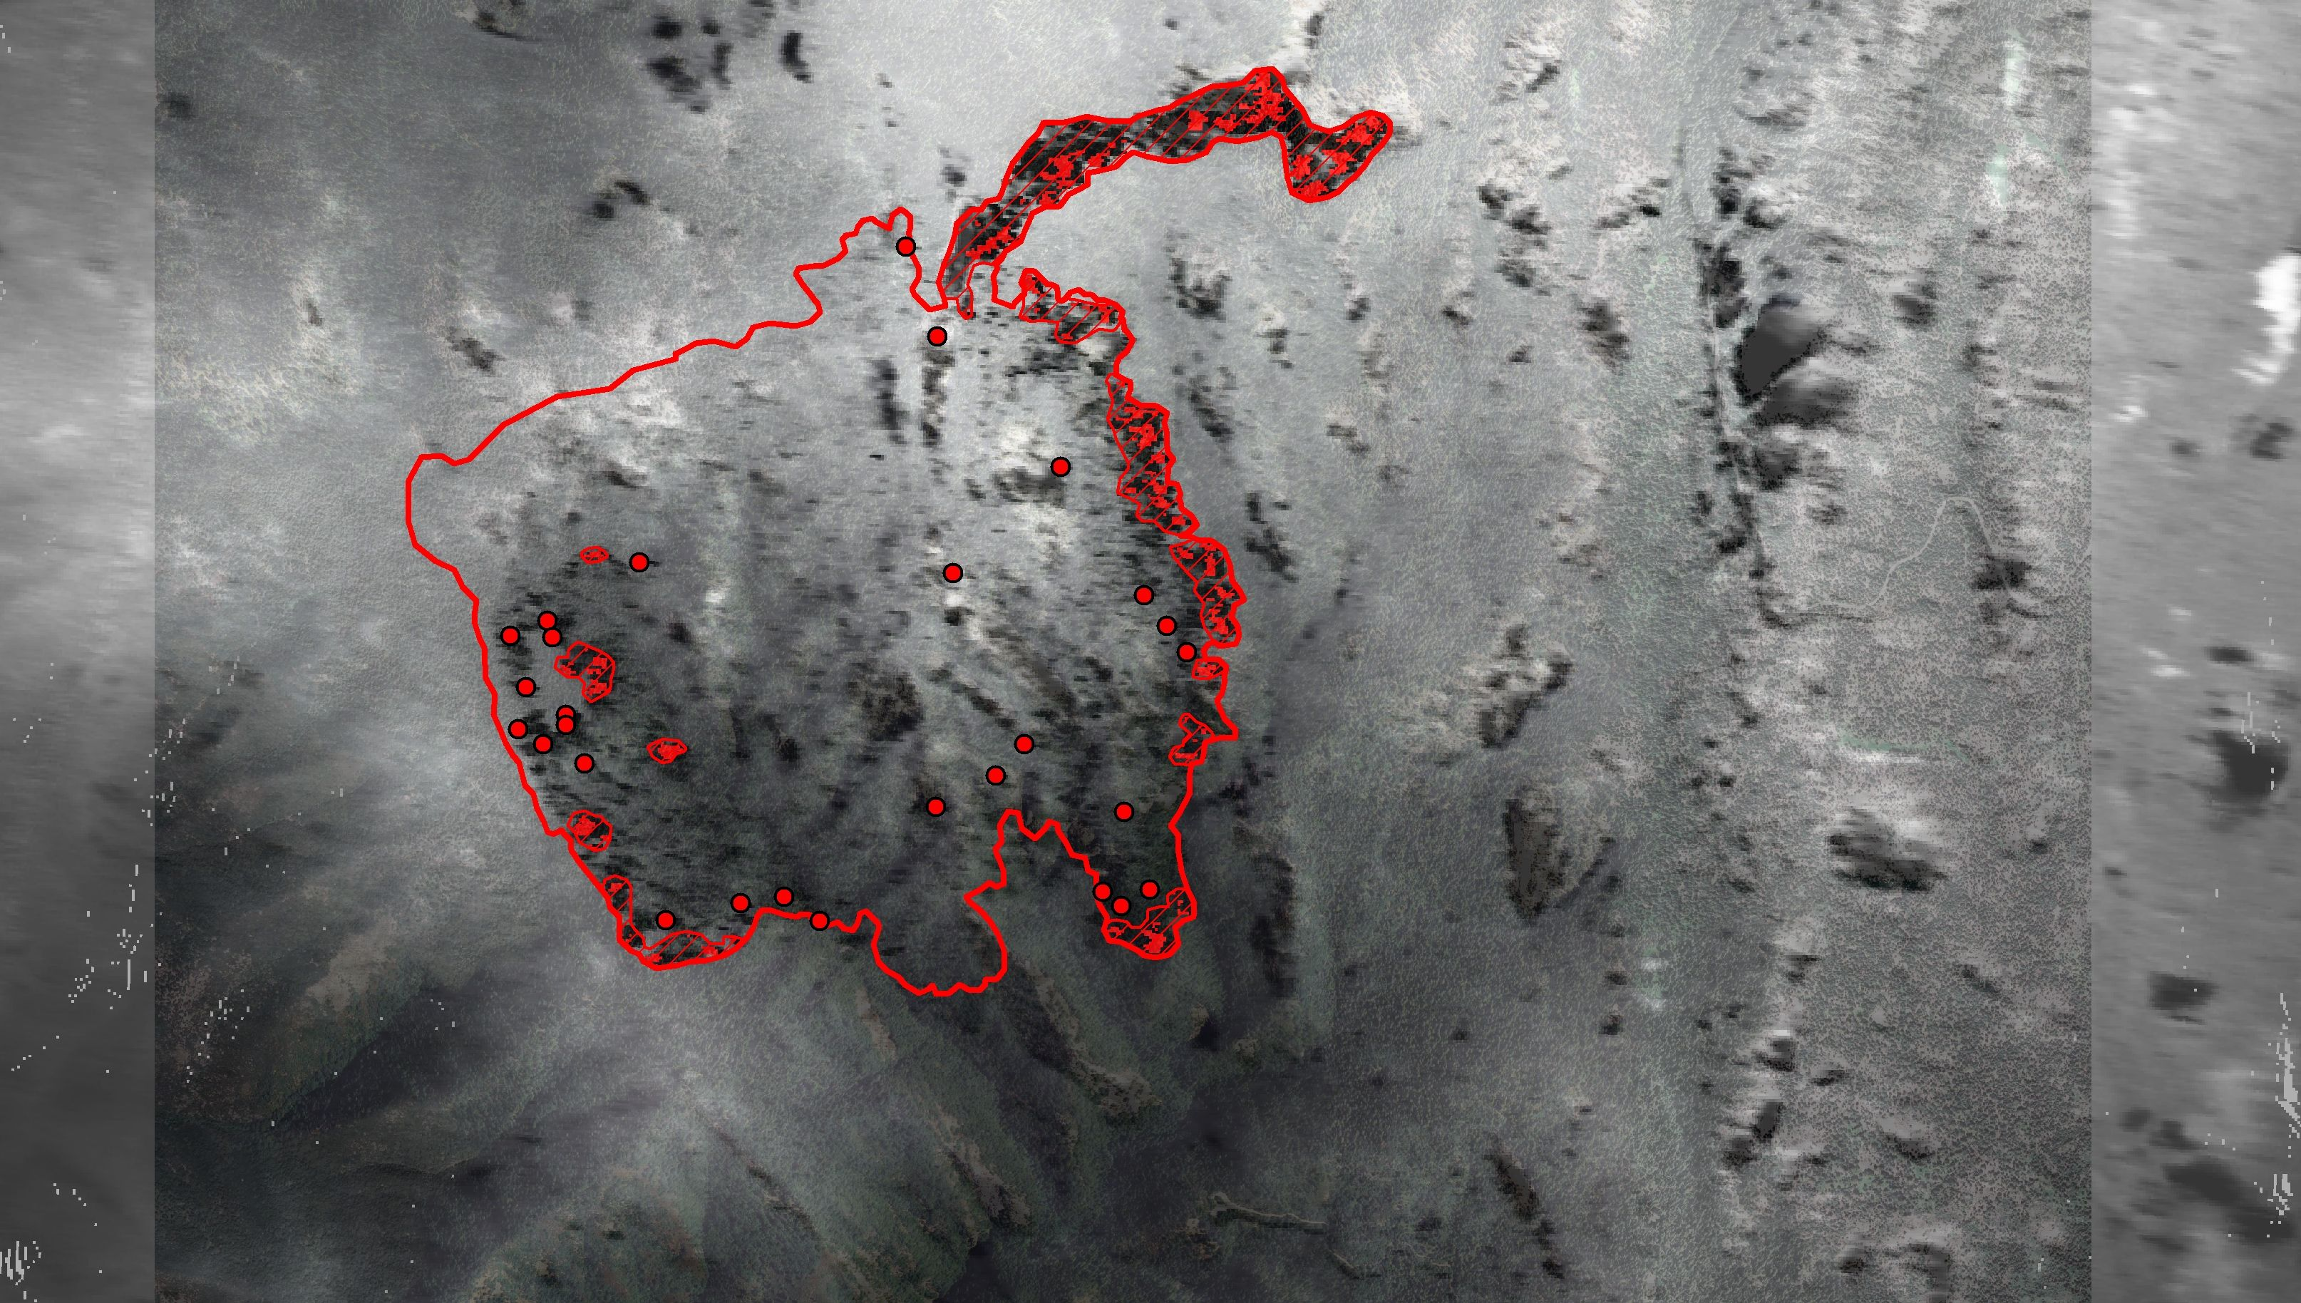
September 21

Slide 30
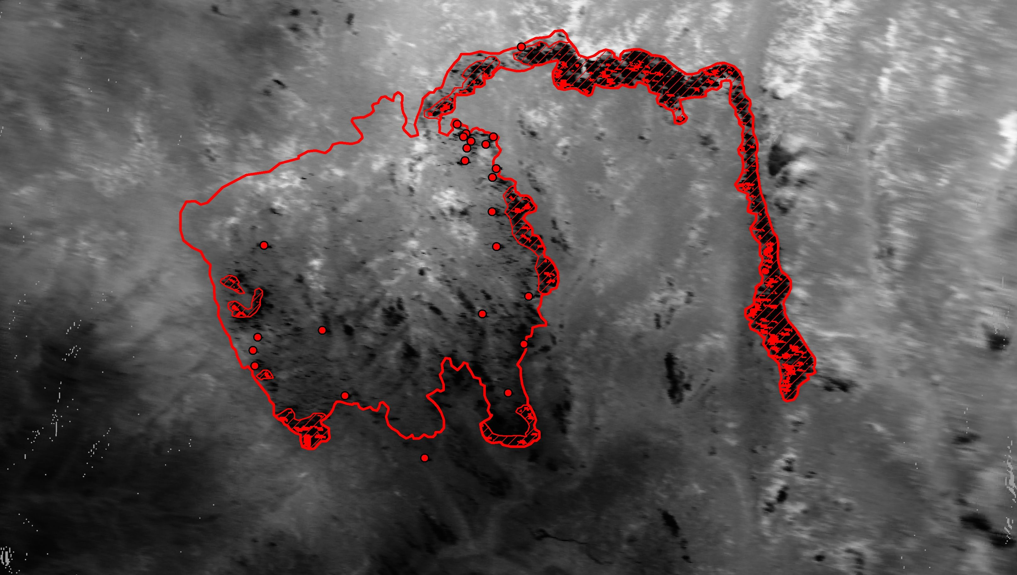
September 22

Slide 31
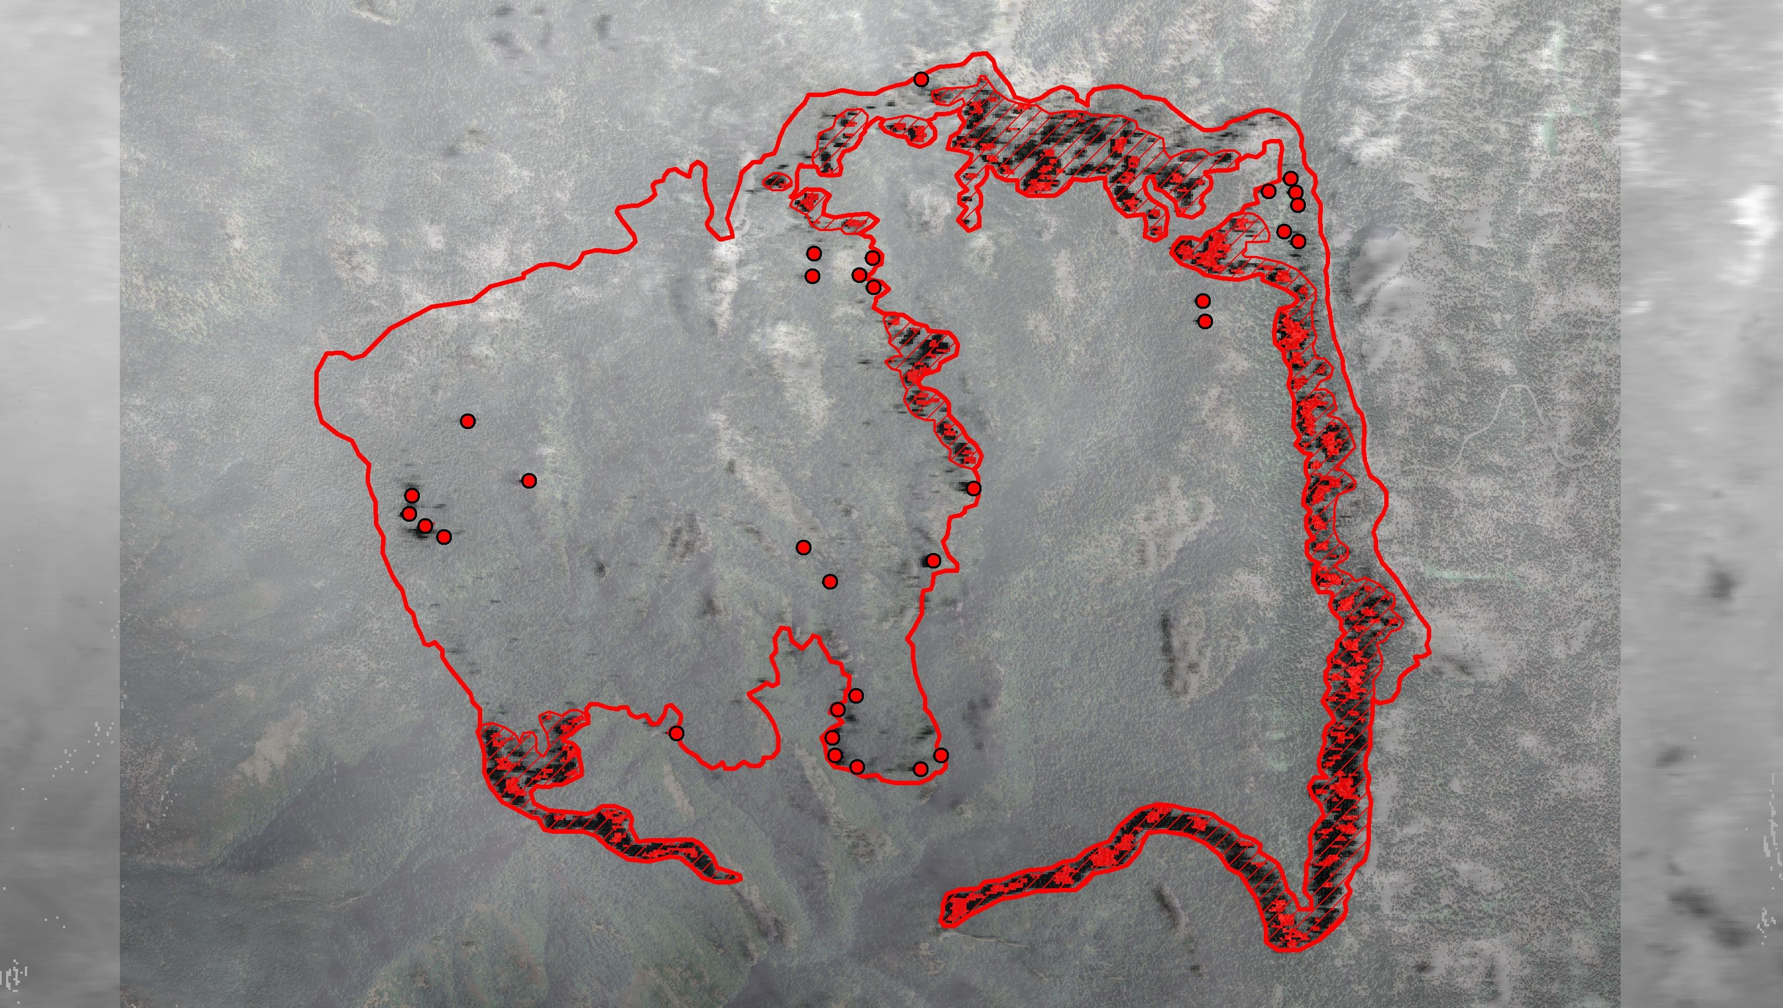
September 23

Slide 32
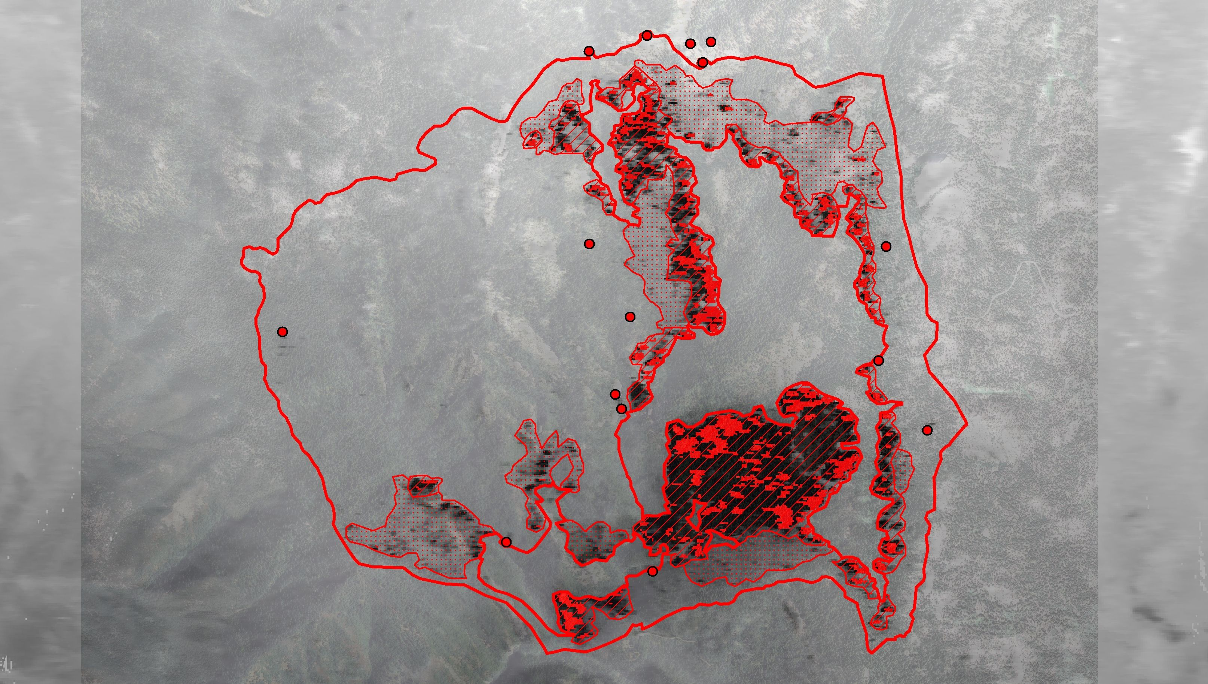
September 25

Slide 33
Notes:
Note heat source way outside of fire perimeter.
Check with Mel – I think it was a marijuana plantation

Slide 34
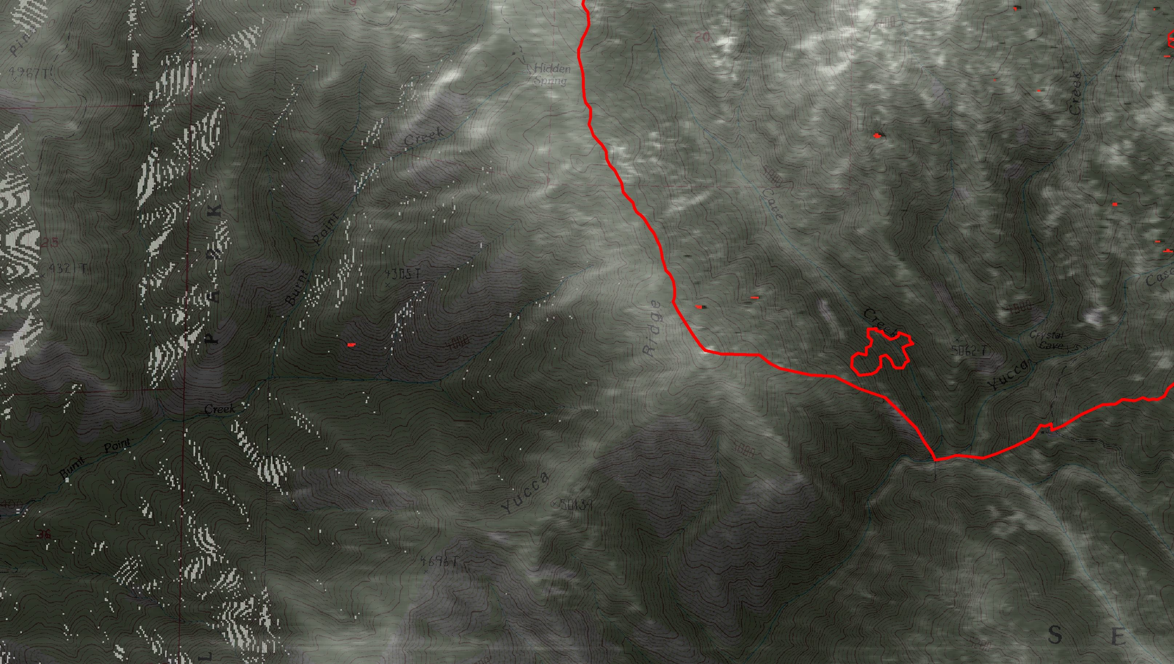

Slide 35
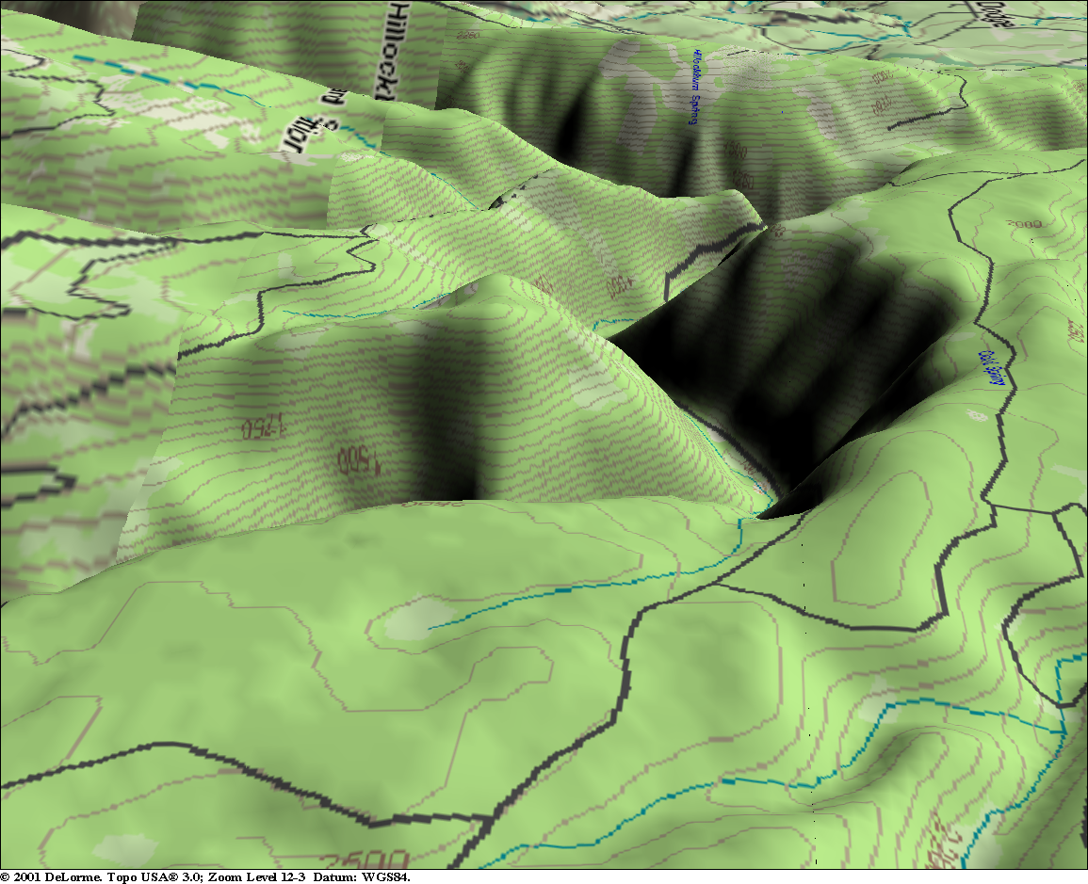
Heat Hidden by Terrain
Bowl Fire, Mt Hood National Forest

Slide 38
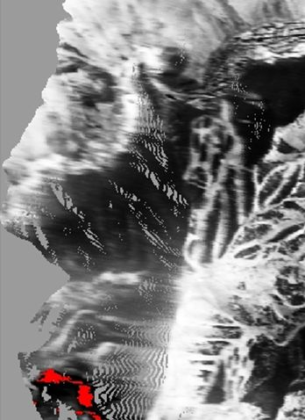
Notes:
Effects of stretch, or lace in steep topography.

Slide 39
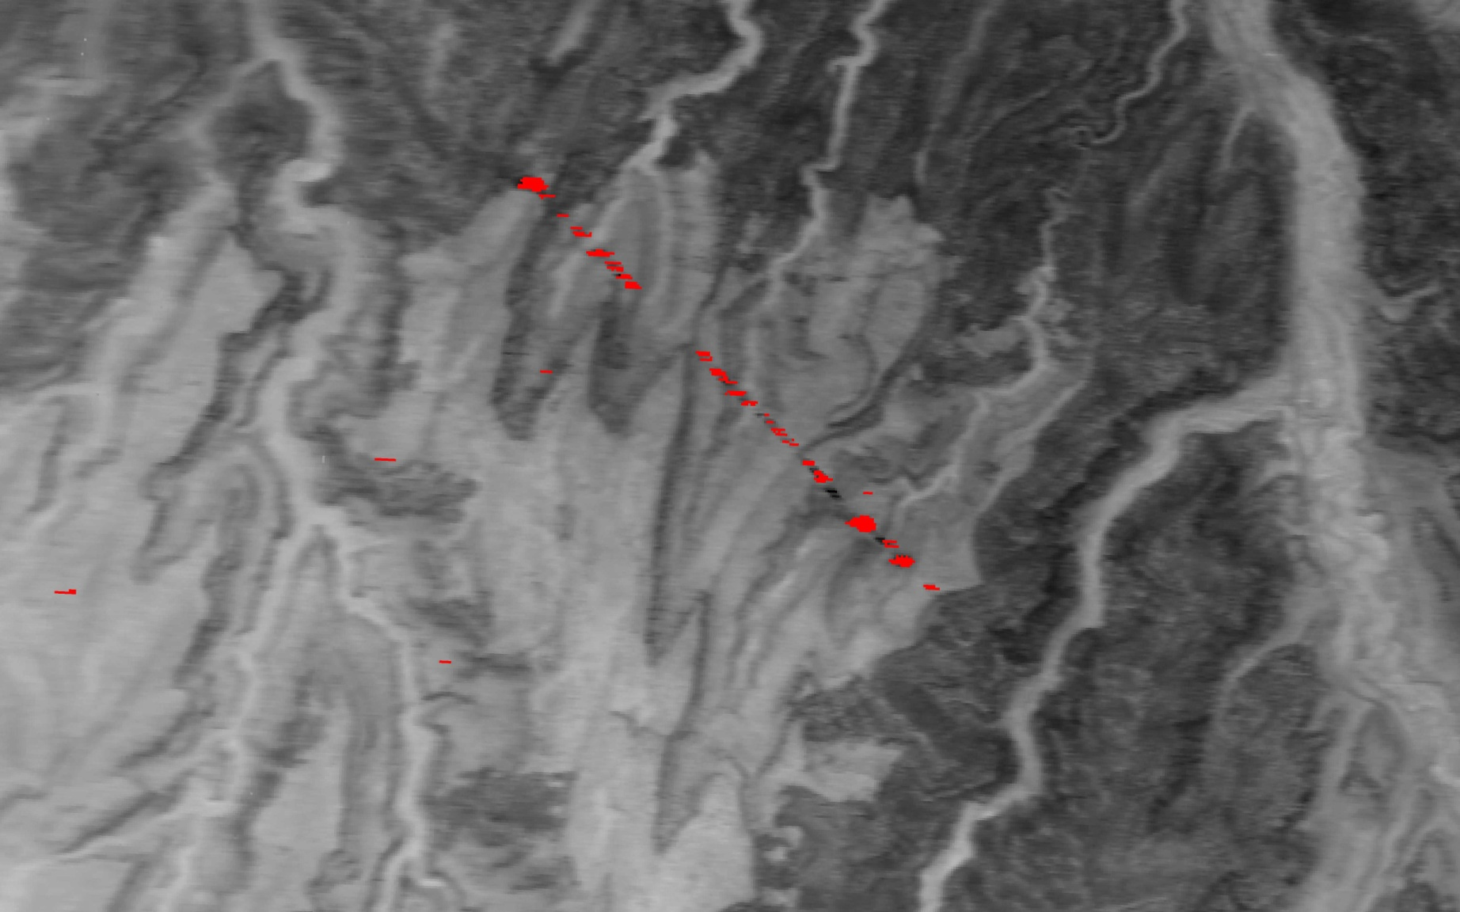

Slide 40
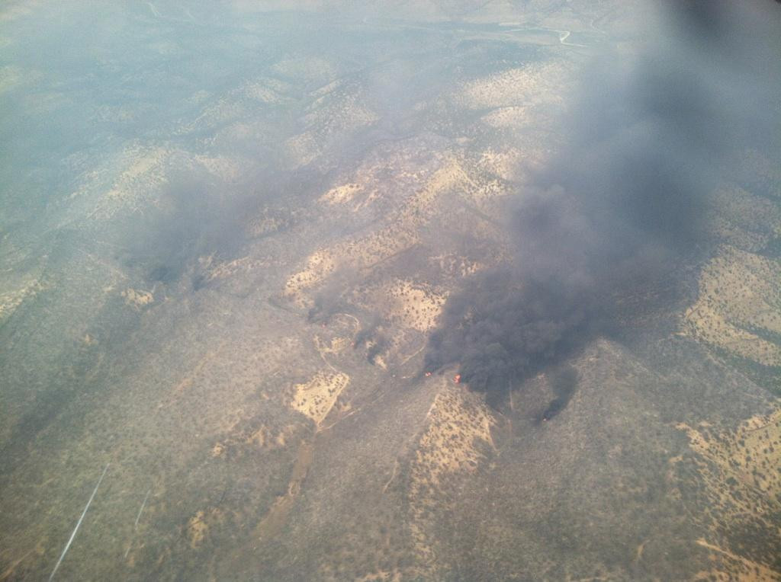

Slide 41
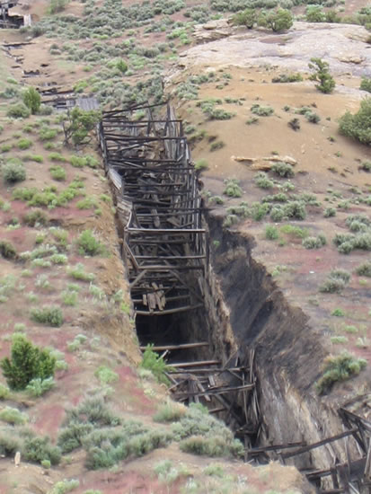
Gilsonite Mine
Notes:
Linear feature cutting across terrain, not along scan line so couldn’t be artifact
Gilsonite – a natural form of asphalt found only in the Uintah Basin

Slide 43
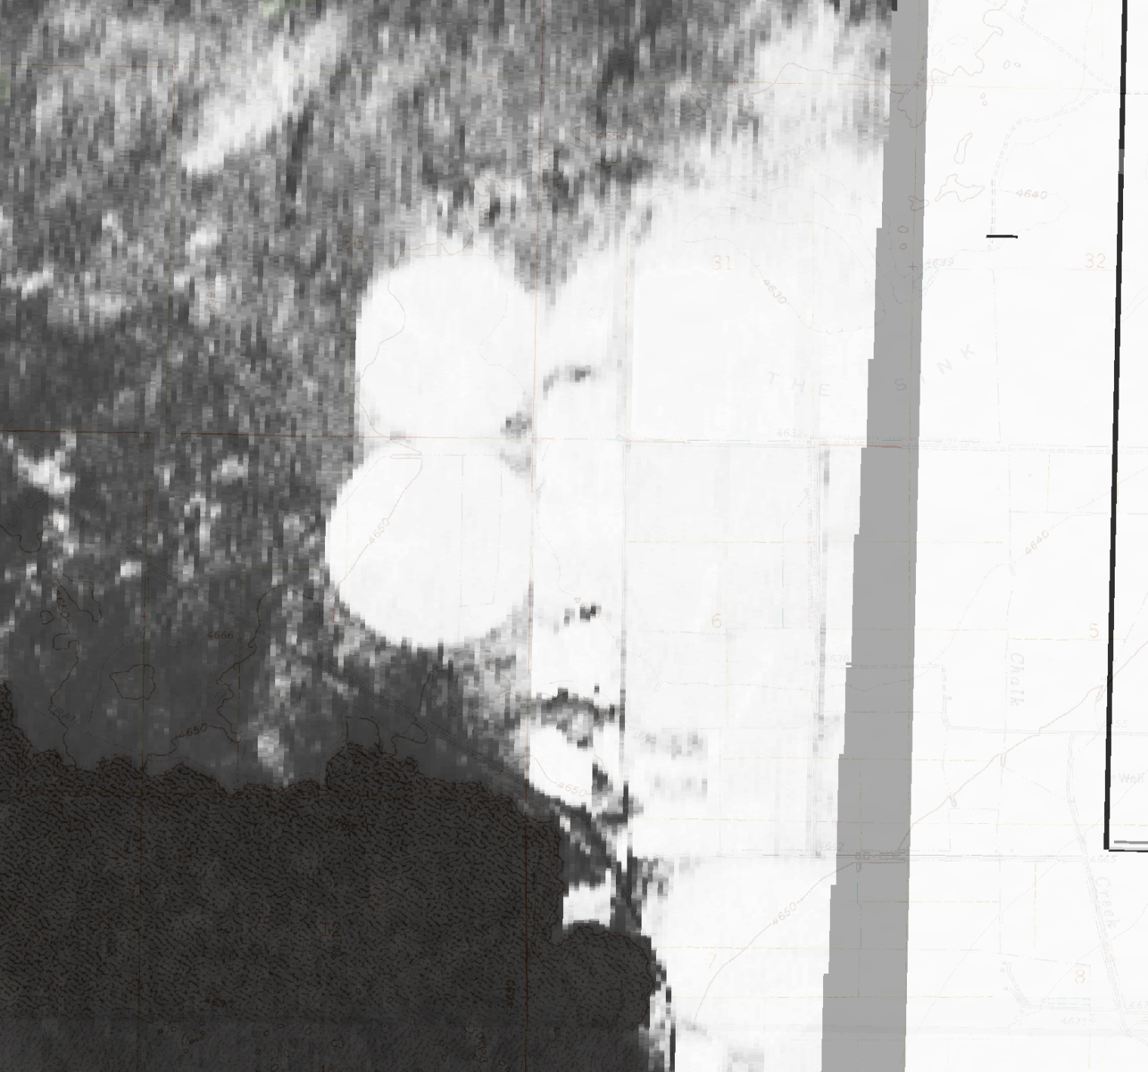

Slide 44
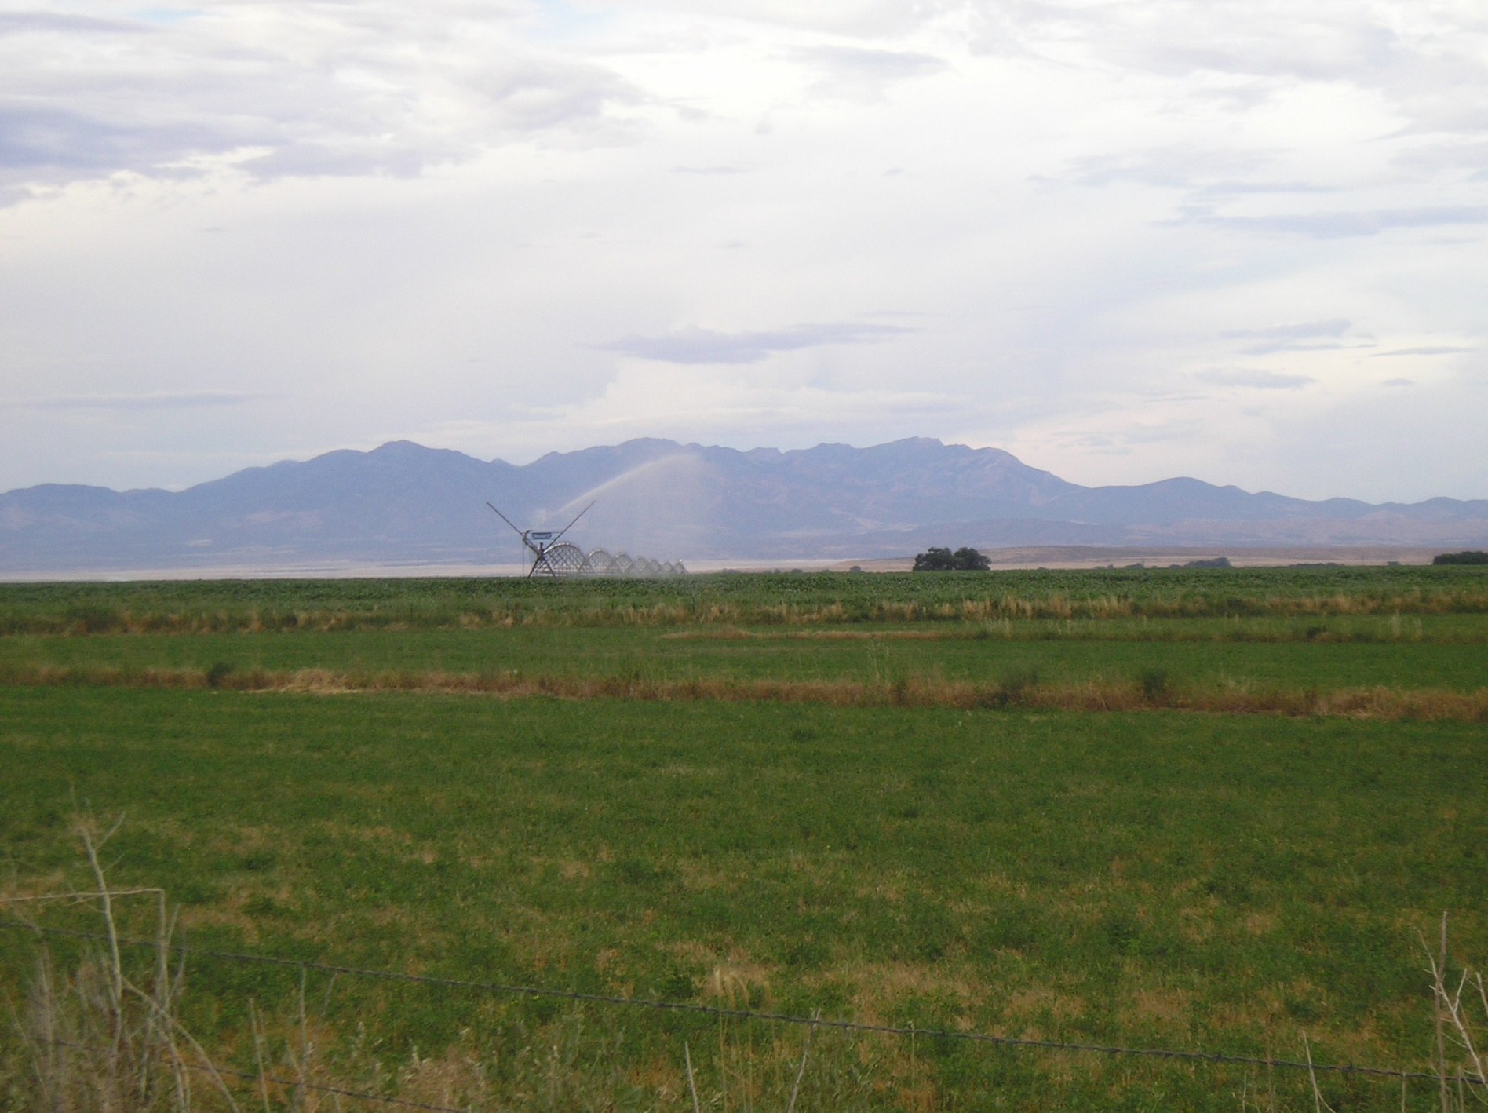

Slide 45
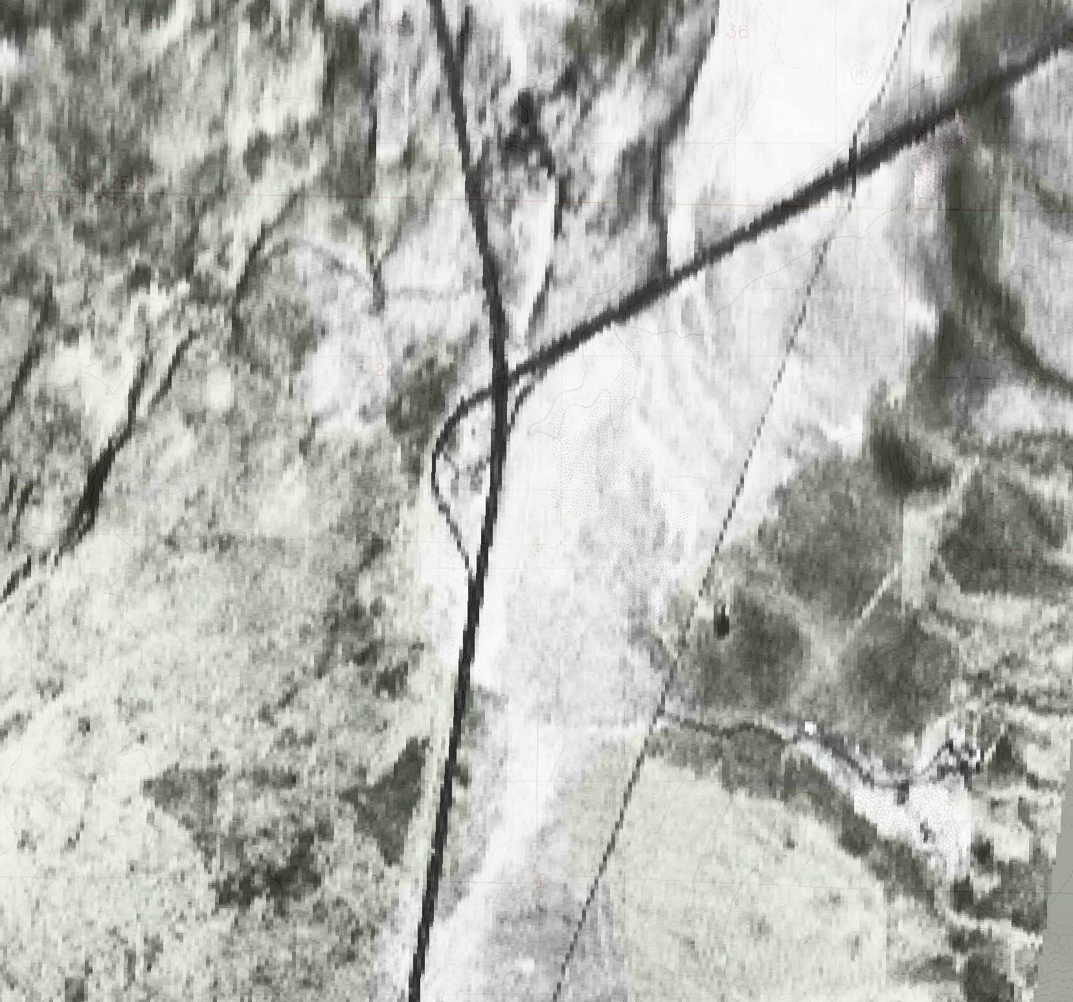

Slide 46
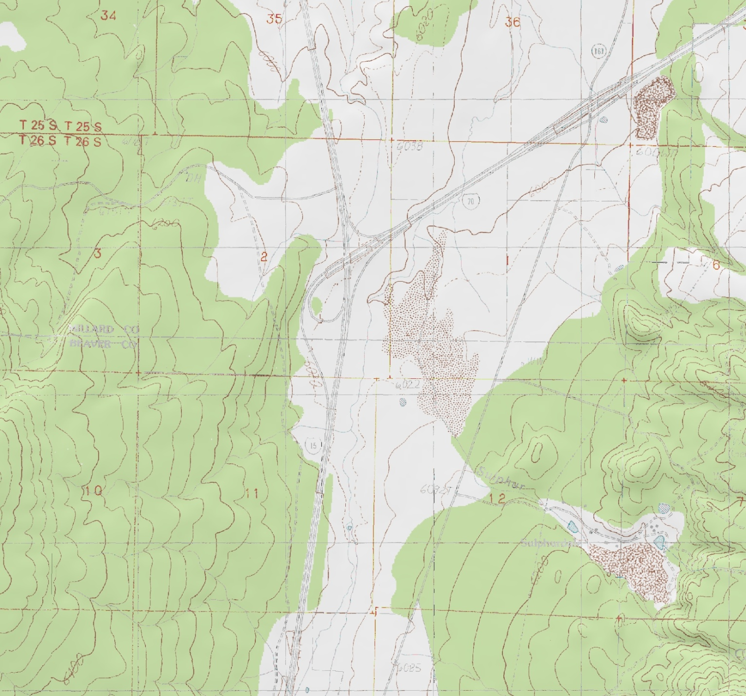

Slide 47
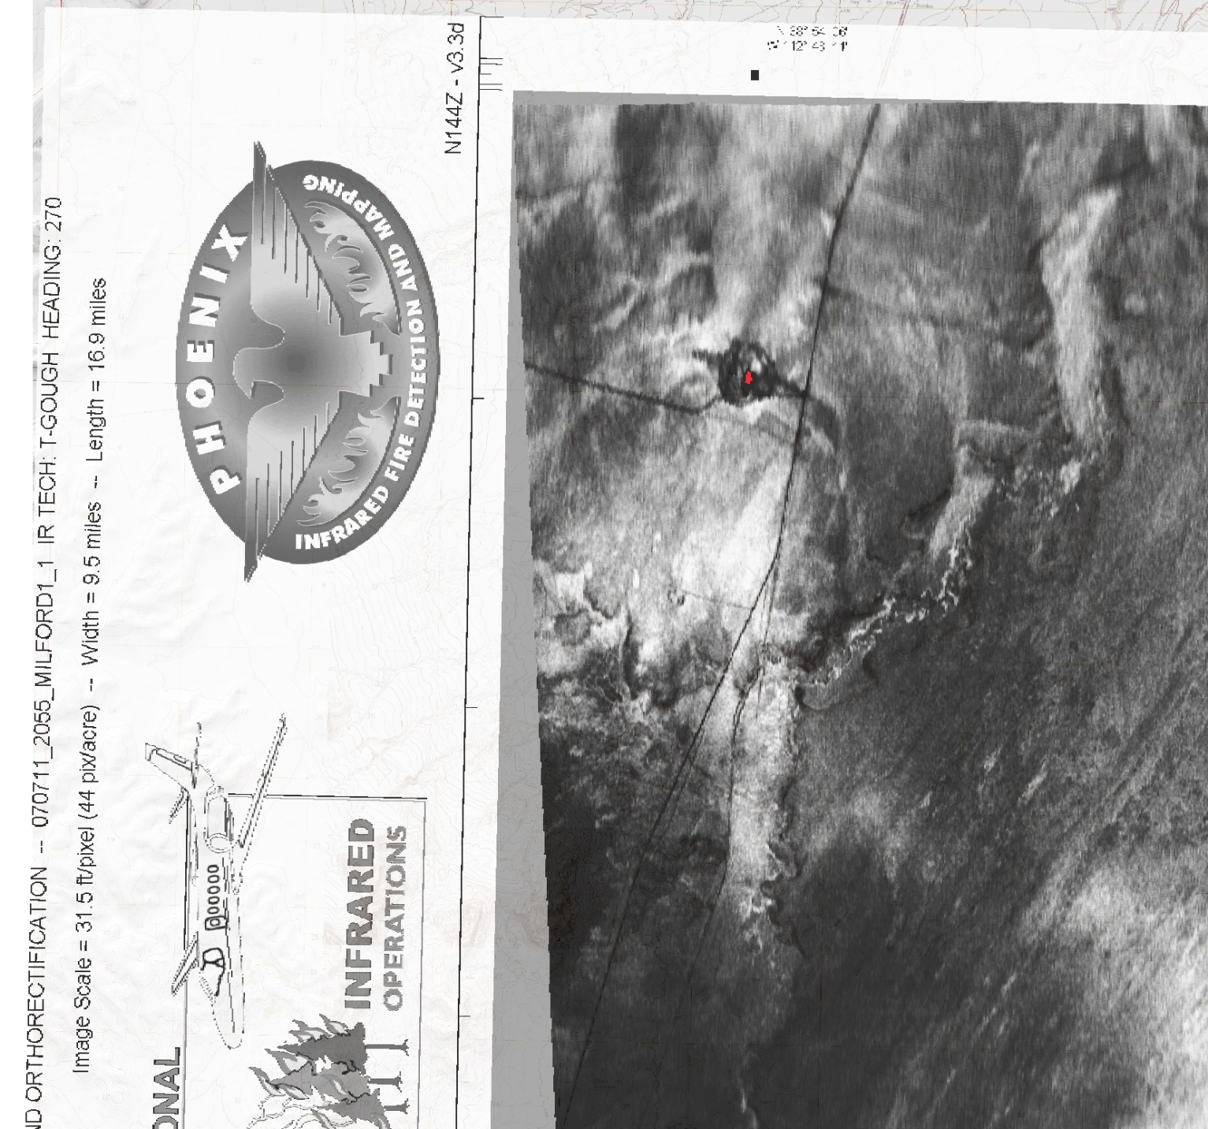

Slide 48
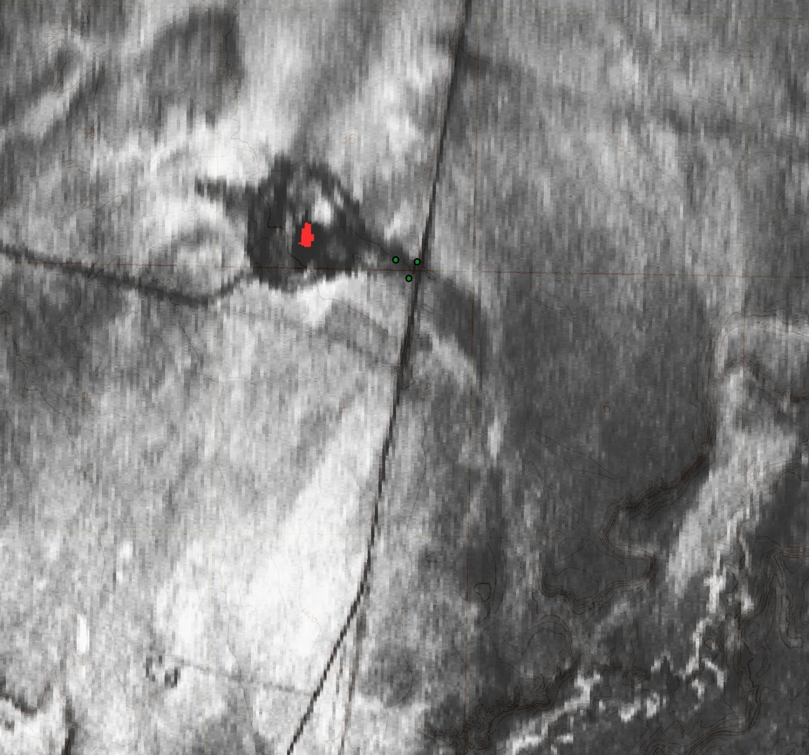

Slide 49
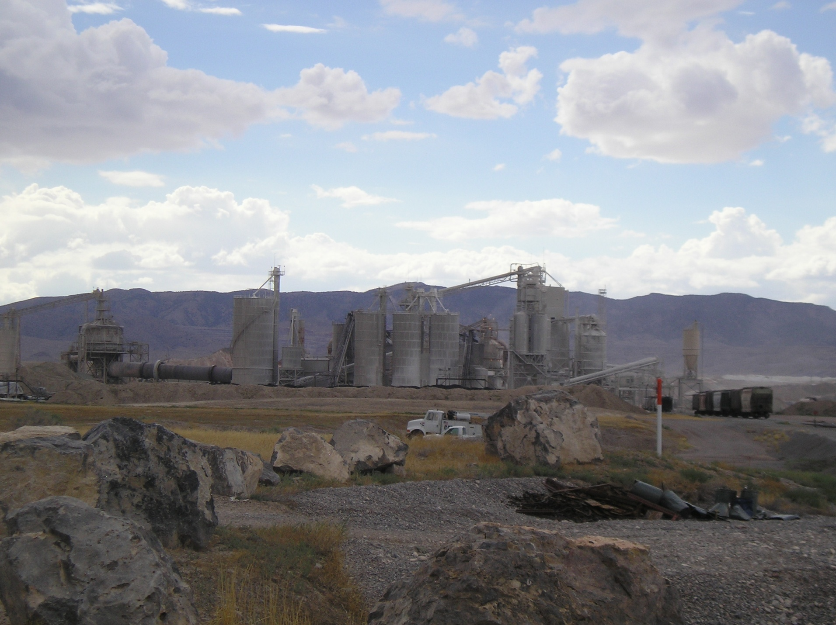

Slide 50
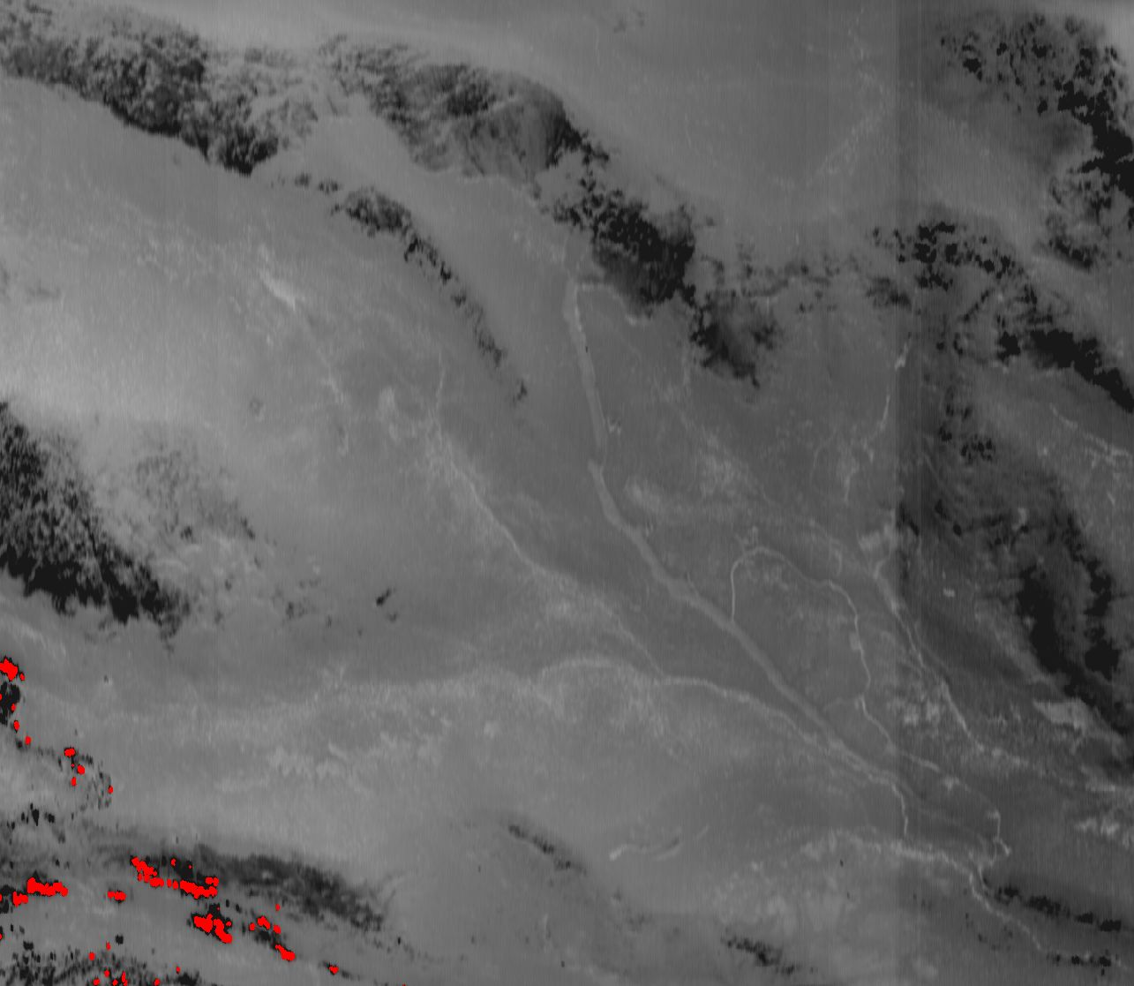

Slide 52
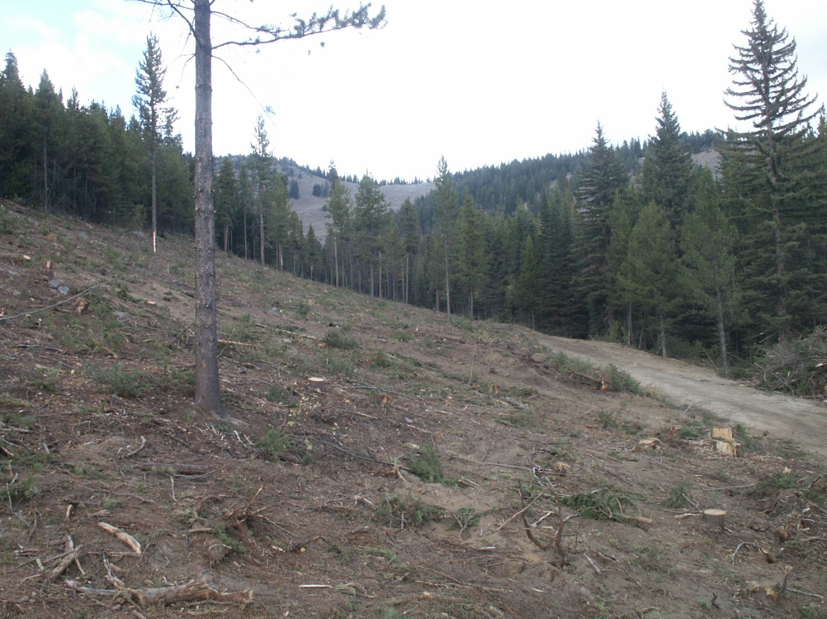

Slide 53
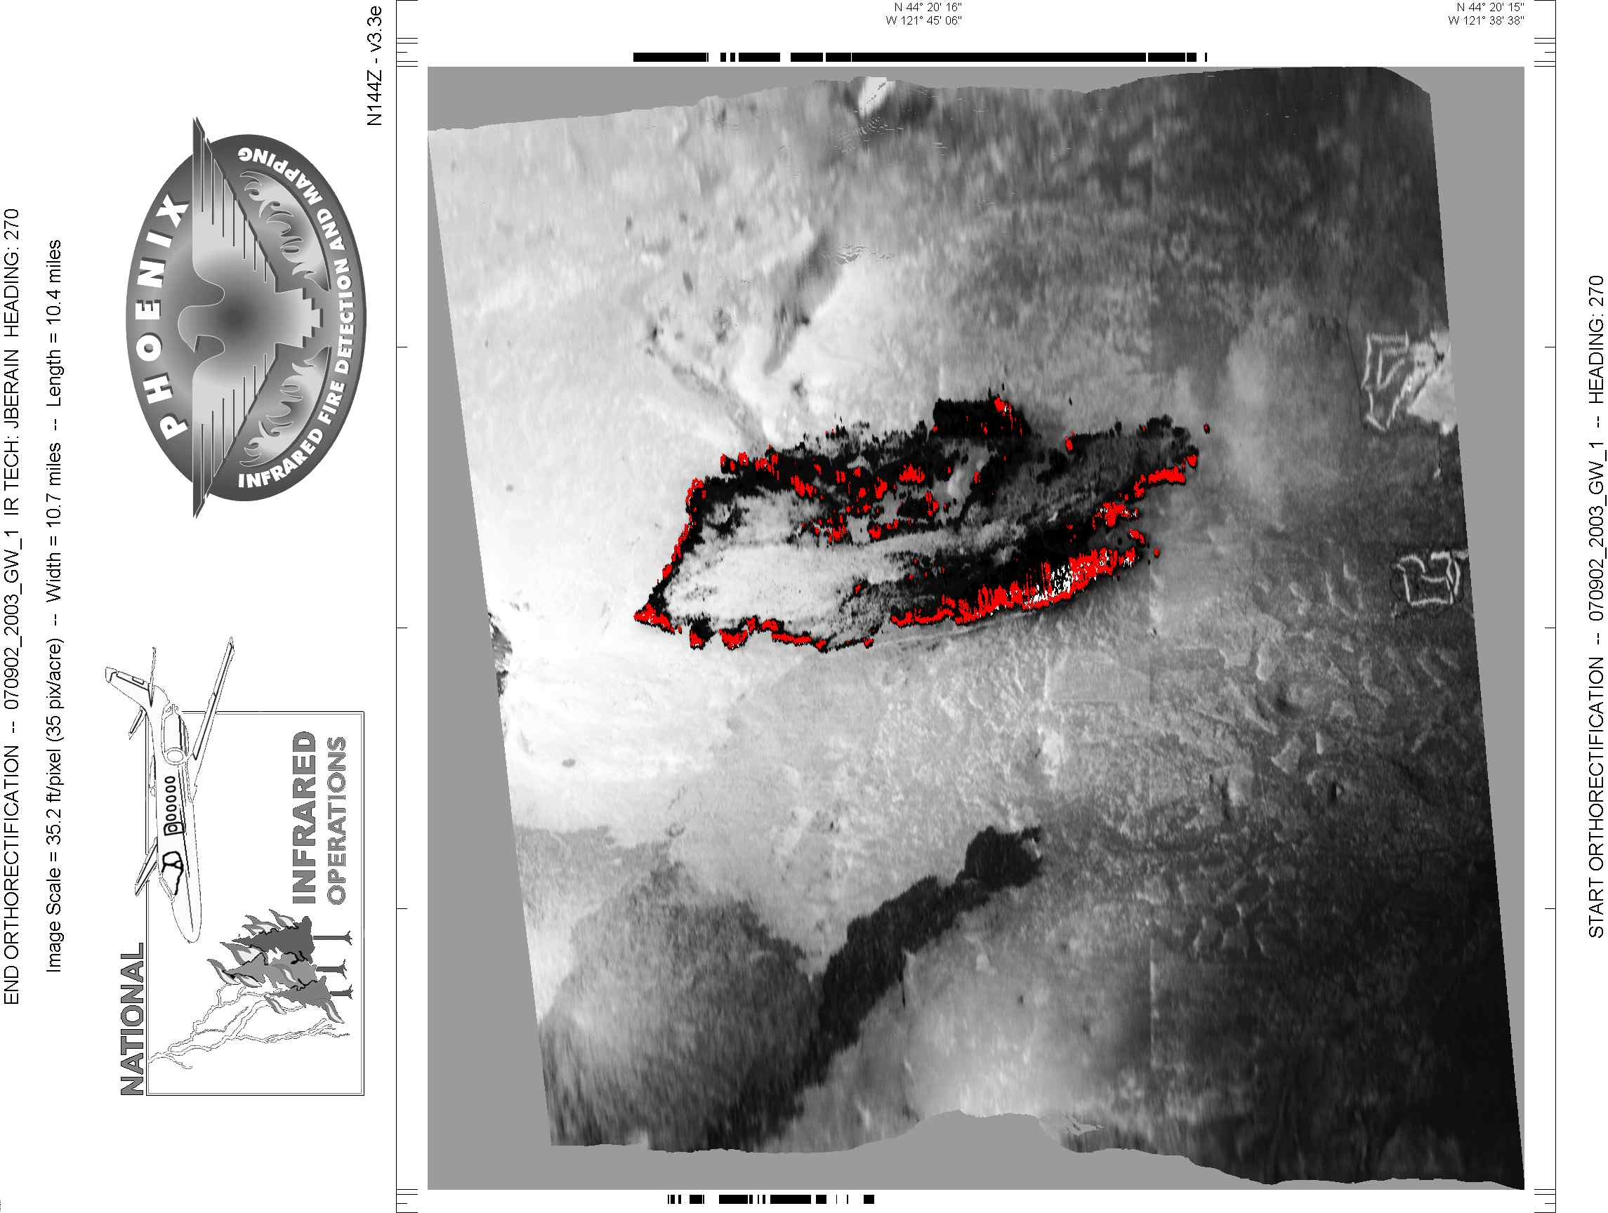
Notes:
A fire just outside of Sisters OR in 2002. Flown at 2000 on July 9. Pretty early for a flight

Slide 54
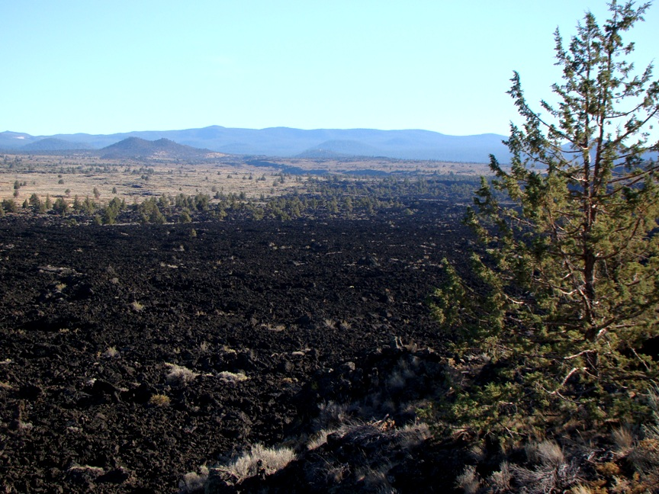

Slide 57
Objectives
Be able to identify the key points of infrared imagery interpretation,
List the primary map and photo features that are usually identifiable on the infrared imagery,
Be able to list the primary features commonly found on infrared imagery that are related to incident mapping.

Slide 58
Questions?

Slide 59
Exercise:
Name 4 of the key points of infrared interpretation
__Tone____________________  _____Scale_________________
__Shape____________________  _____Texture_________________
__Pattern____________________  _____Distortion_________________
Name three primary features commonly found on infrared imagery that are related to incident mapping.
__Roads_, _Streams_, Heat Sources, Control Lines , Lakes__
Which of the following features might you expect to be able to identify within Infrared imagery?
Vegetation Patterns Geographic Features Cultural Features
Timber Ridges Roads
Meadows Drainages Bridges & Tunnels
Clearcuts Rivers airport runways
Partial Tree Removal Lava Flows Parks
Rock Outcrops Lakes & Ponds Golf Courses
Debris Slides Peaks Ski Runs
Avalanche Paths Flat Tops/Mesas Urban areas
Variation in tones
Aspects
Notes:
Hidden slide
Potential unit test.

