Slide 1
Unit 6 – Infrared Aircraft Scanner Requests

Slide 2
Objectives
Identify & describe information needed for ordering IR Aircraft Scanner missions
Review Infrared Aircraft Resource Order
Describe methods to track the aircraft to anticipate data delivery

Slide 3
3 Pieces make the whole:
Aircraft Order (A#)
Scanner Request
IRIN

Slide 4
Aircraft Order (A#)
Assigned by local dispatch
New one for each flight
Scanner Request
Ordered by Incident (IRIN or SITL)
New request for each night
IRIN
Ordered by Incident
Other assignments (GACC or NICC)
Notes:
The three parts of a NIROPS IR request

Slide 5
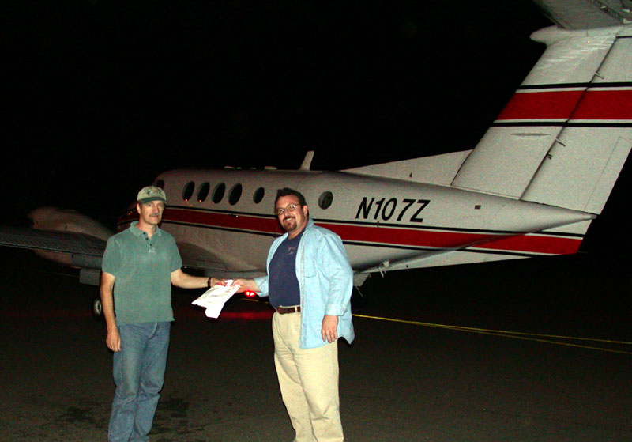
Resource Jurisdiction
The Incident does NOT get the ship…
The Incident receives the SERVICE.
Notes:
NIROPS is a National asset.

Slide 6
Dispatch Process
Notes:
Often the Aircraft responsibilities in Dispatch are NOT turned over to Expanded Dispatch. Frequently you will be speaking directly to the IA Aircraft Dispatcher to get the A#. Emerging incidents and incidents that are nearing the end will often have no expanded dispatch.

Slide 7
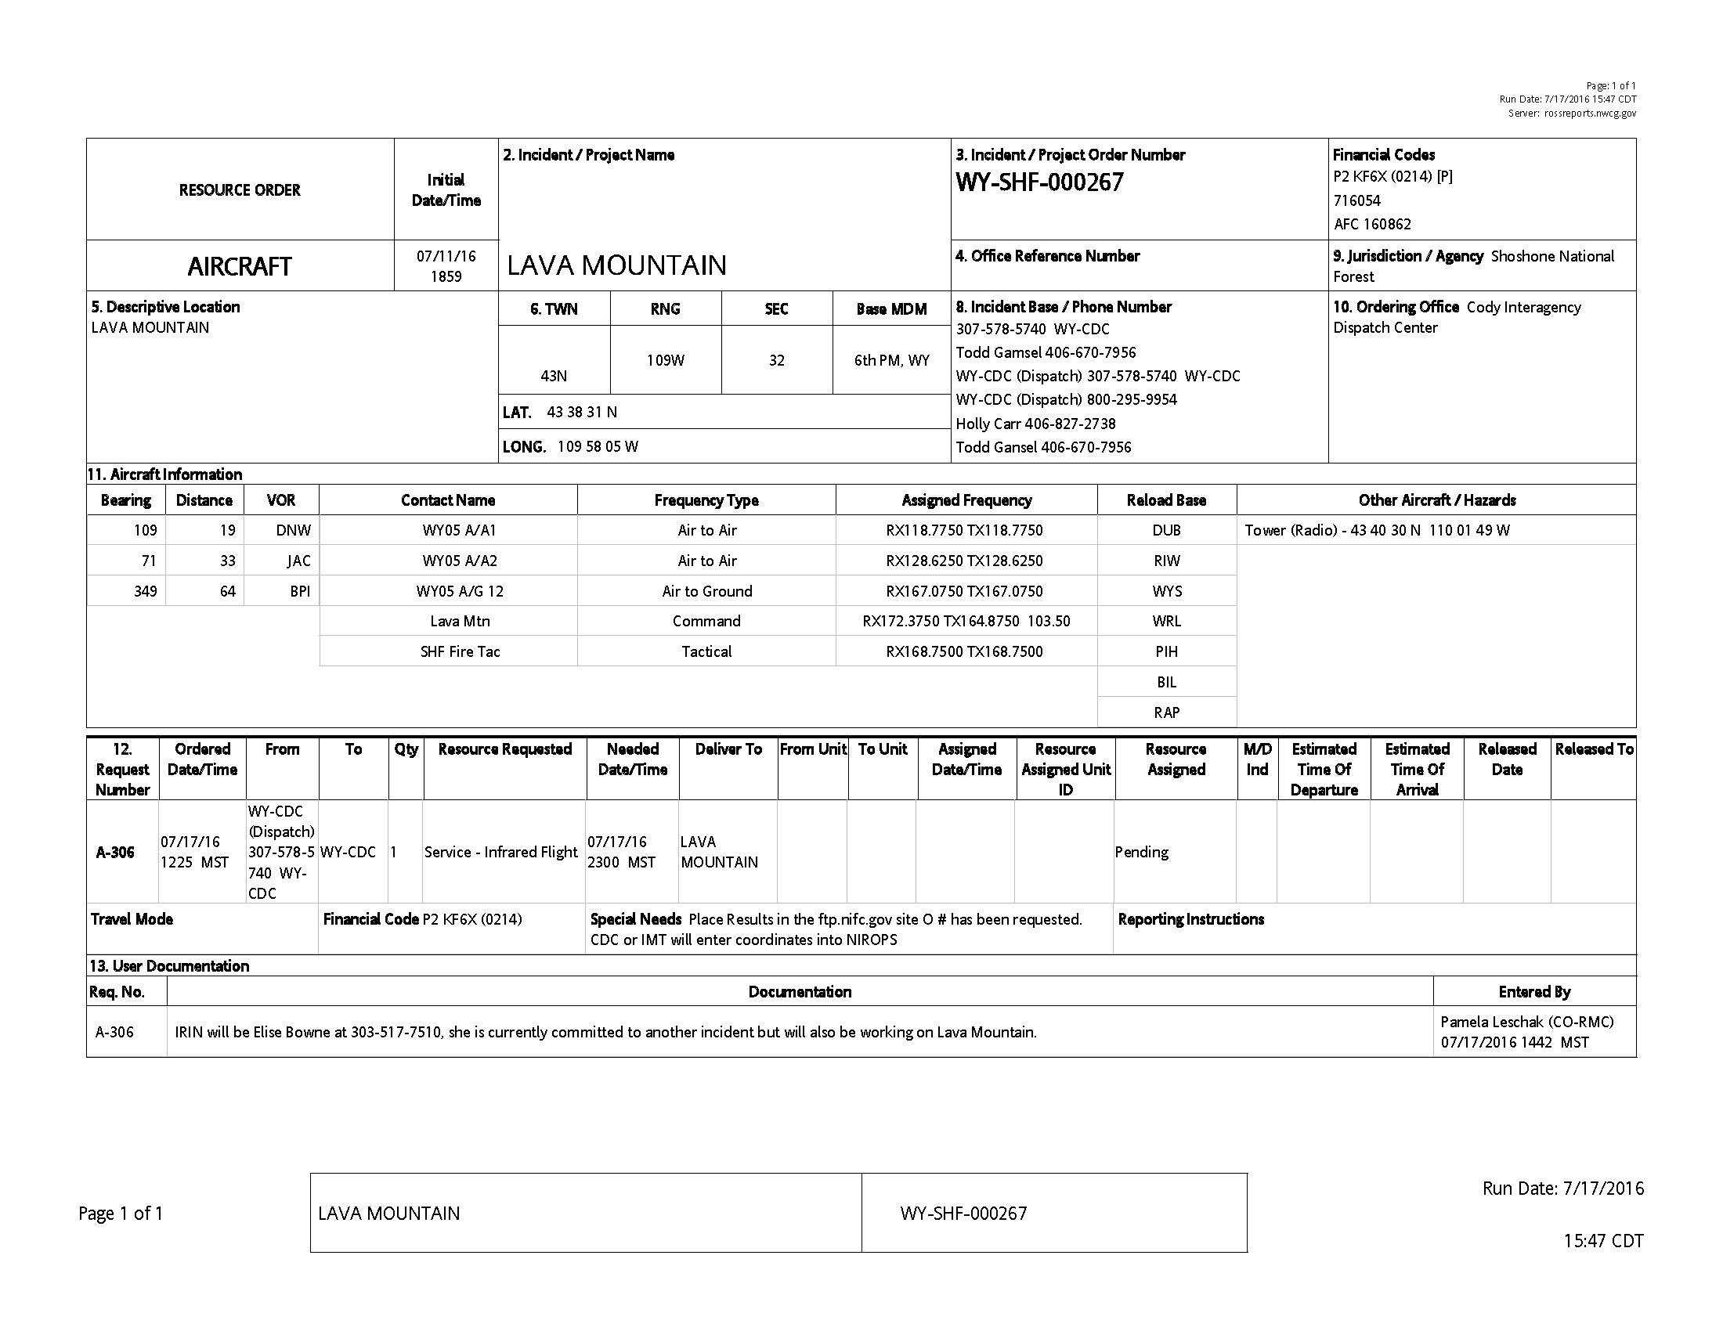
Notes:
Example of an Aircraft Resource Order for an IR scanner request. You will rarely see one of these. Usually we get the A# verbally from dispatch.

Slide 8
Aircraft Order (A#)
An Aircraft Resource Order is submitted by local dispatch for each requested IR Scanner flight
The A# is assigned by local dispatch
The A# is transferred to the IR Scanner Request submitted through the NIROPS website
New A# - for each flight

Slide 9
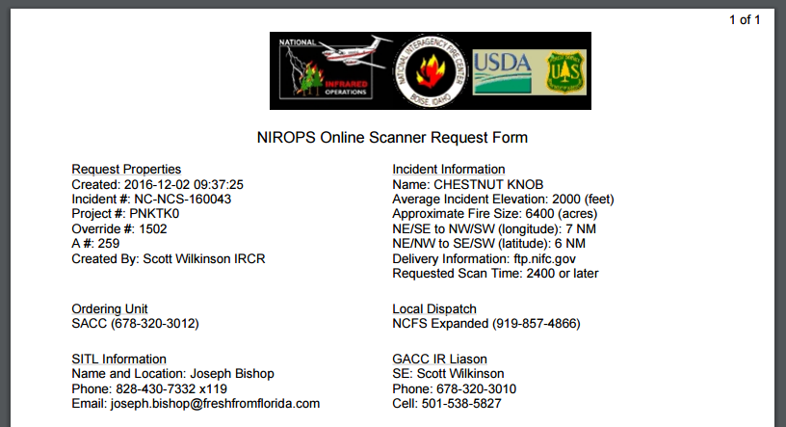
NIROPS Online Scanner Request Form
Notes:
NIROPS Online Scanner request communicates the information about the flight request directly to the IR pilots and IR technicians. Who, What, Where, When, How, Why? Who is ordering it, What (by the virtue of it being a Scanner request, Where (lat/long box), elevation, fire size, When – always for the upcoming evening/night – but time can be specified if necessary – no promises, How/Why – map isolated heat or mapping only west half of fire, detection of spots to the west, etc.

Slide 10
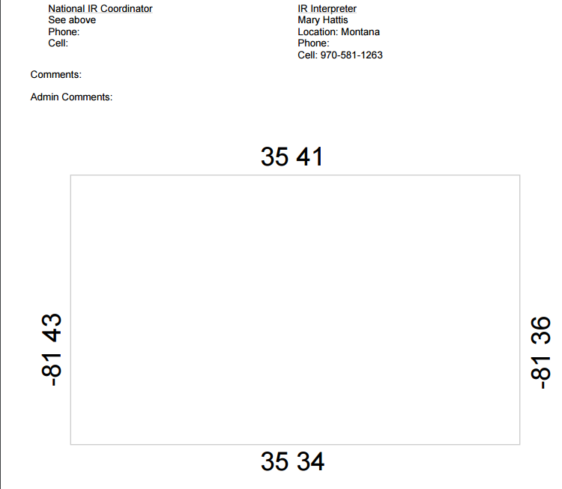

Slide 11
Once order is placed, request is acted upon by:
Local/Expanded dispatch
Entered into ROSS
A# assigned
GACC or IRRC
NICC Aircraft desk or IRCN

Slide 12
Key Duties of IRIN w/Scanner Order
Ensure Scanner Order Requests are submitted in a timely manner.
Due to NICC by 1530 MDT
Ensure accuracy of each new Scanner Order submitted.

Slide 13
Online Scanner Order
https://fsapps.nwcg.gov/nirops/

Slide 15
Notes:
Although other information is accessible from this site, we are focusing on the IR Scanner Order in this unit.

Slide 16
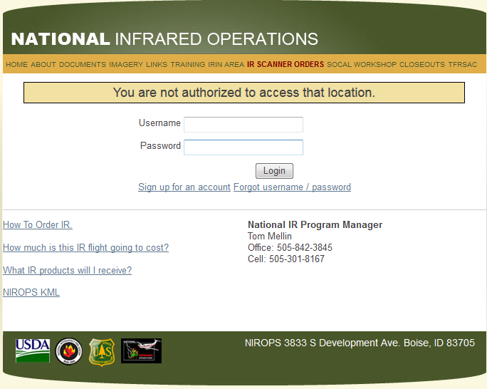
Notes:
Log in. Have to be logged in to place an order.

Slide 17
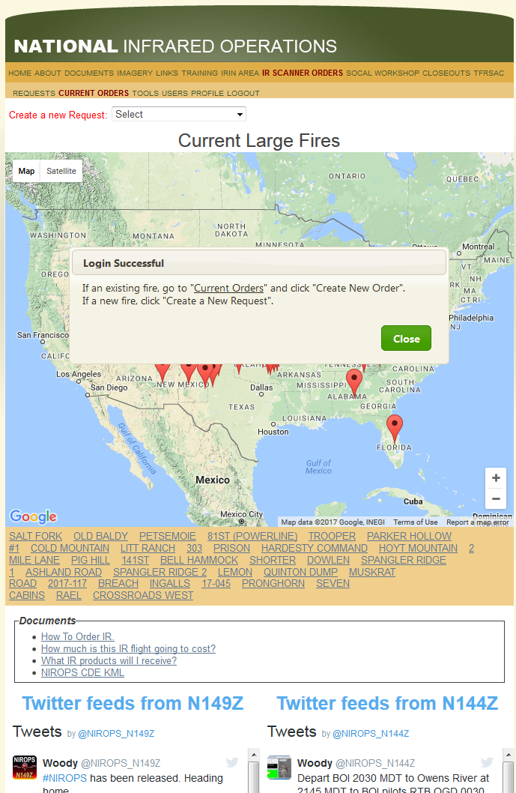
We are going to create an order for a new fire that has not been flown yet:
Notes:
We’re going to create a request for a new fire.

Slide 18
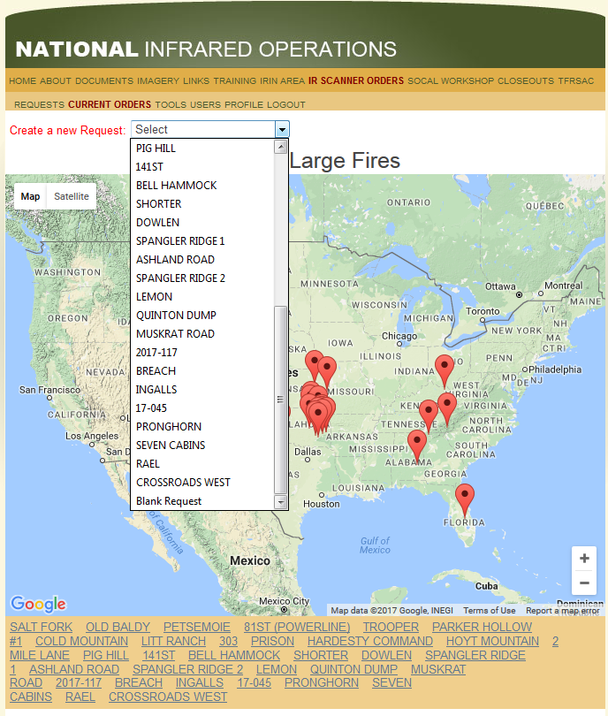
Notes:
If the fire is listed here, the basic information will auto-fill into the form.

Slide 19
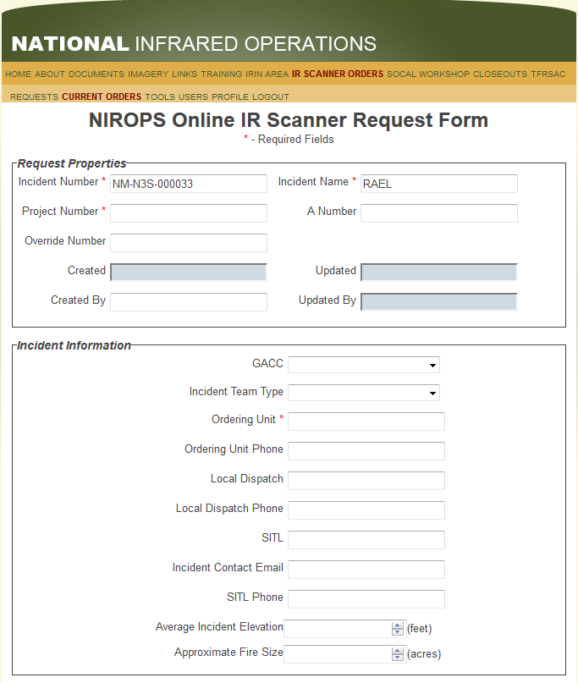
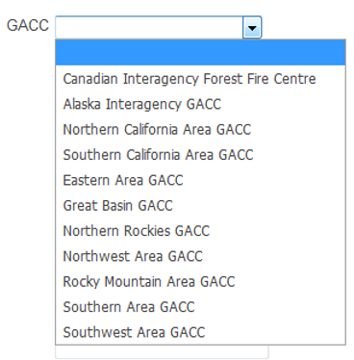
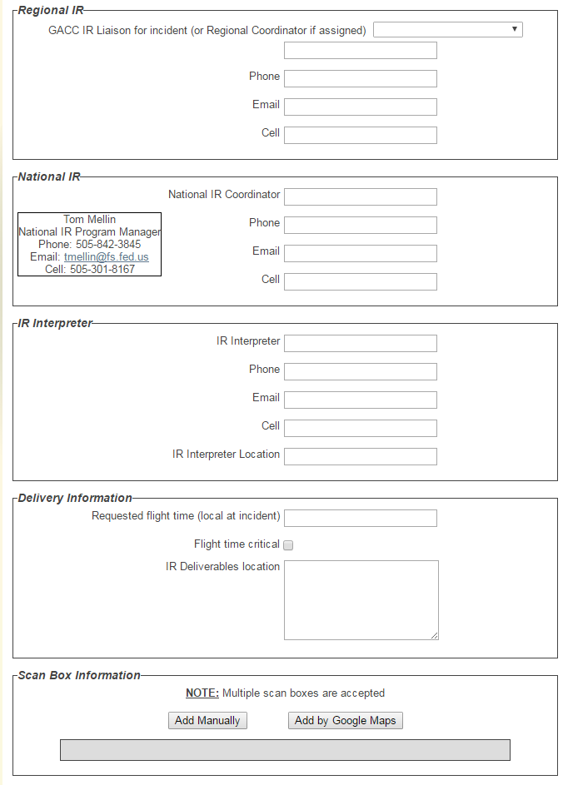
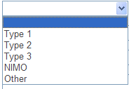
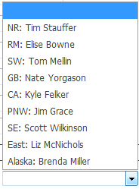
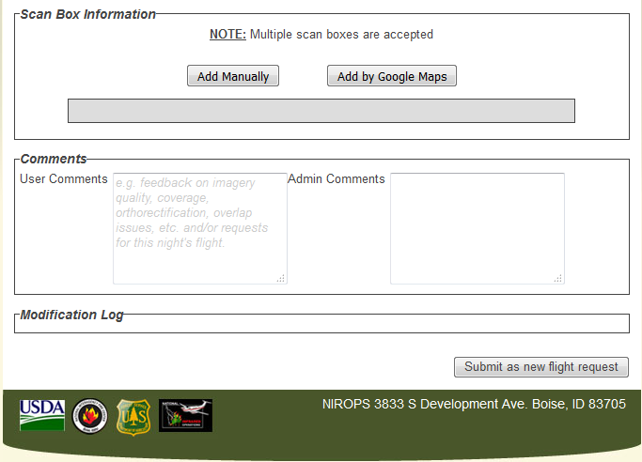
Notes:
If a fire was selected on the previous screen, the Incident Number and the Incident Name will auto-populate. If not, the user will have to provide that information. Fill in as much information as you have. Project Number here is the charge code, usually Pxxxxx, the Override Number is the regionforest number, like 0212, or for fires that are NOT USFS fires, it will likely be 1502

Slide 20
Notes:
Scanner order – top part completed

Slide 21
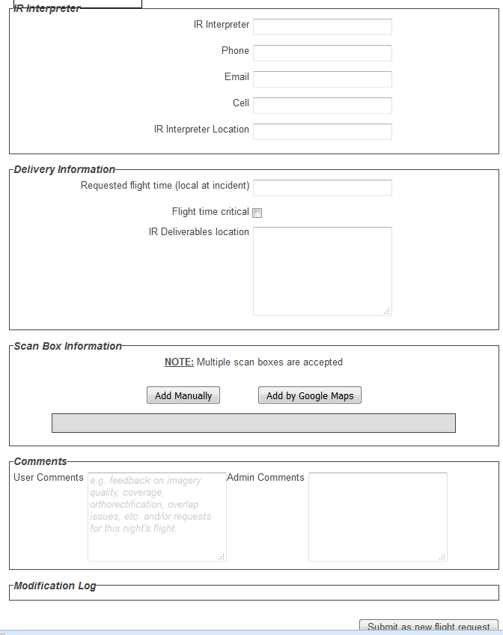
Notes:
Note new box for “Flight time critical” If there is a reason for a critical time – such as after a burnout is completed, or before thunderstorms move it, before a marine layer rolls in, please put that in the User Comments at the bottom of the page.
To enter scan box, either enter the coordinates manually, or by using Google Maps.

Slide 22
Where to get Box Coordinates?
Previous day’s IR map
NIROPS CDE Google Earth KML
Previous perimeter – ArcMap
MODIS or VIIRS satellite thermal data
GeoMac
Notes:
Where to get box coordinates?
From a previous IR mission or a map from the incident.
If have perimeter from fire, can place that in an ArcGIS map session and find the coordinates by having either a grid of lat/long or by changing the coordinates in the Data Frame to Degree Minutes Seconds.
Round up on the north and west – to the closest minute – or add 1 minute.
Round down on the south and east sides – to the closest minute – or add 1 minute.
We do not want boxes that cause extra flight time – increases cost to the incident, reduces number of fires that can be flown in a night, and can expose the flight crew to a bit more risk.

Slide 23
Notes:
First we will add the scan box manually. You need to know the lat/long in degrees and minutes of the north, east, south and west edges of the box the area that needs to be scanned.

Slide 24
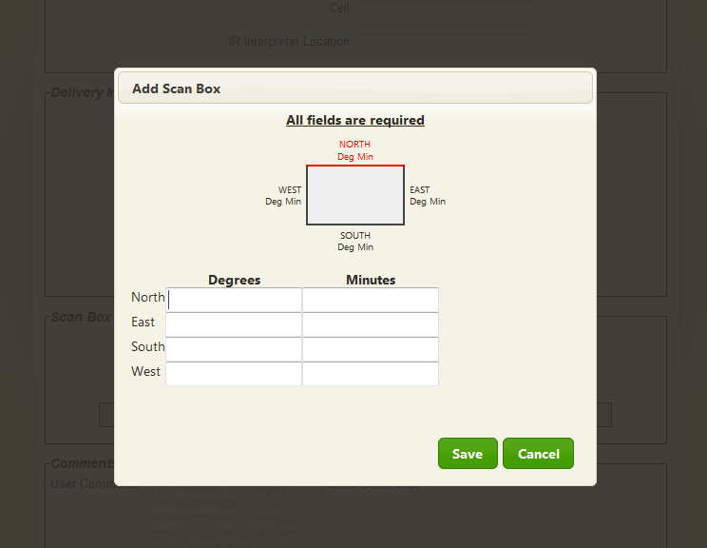
Need screengrab of new manual coord entry box

Slide 25
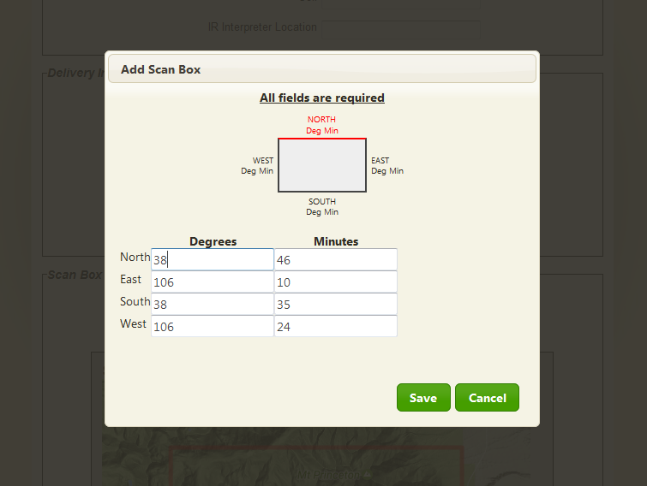

Slide 26
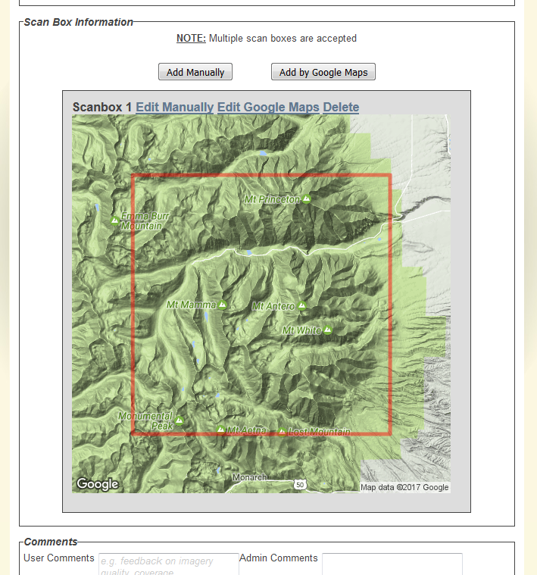
Notes:
Once the scan box edge coordinates are entered manually, a google map will show up and indicate your box. Good time to check and make sure it looks correct. Is it in the right location? Does it cover the entire area that needs to be scanned? Is it too large?

Slide 27
Box Coordinates
Previous day’s IR map
NIROPS CDE Google Earth KML
Previous perimeter – ArcMap
MODIS or VIIRS satellite thermal data
GeoMac
Notes:
Where to get box coordinates?
From a previous mission or a map from the incident.
If have perimeter from fire, can place that in an ArcGIS map session and find the coordinates by having either a grid of lat/long or by changing the coordinates in the Data Frame to Degree Minutes Seconds.
Round up on the north and west – to the closest minute – or add 1 minute.
Round down on the south and east sides – to the closest minute – or add 1 minute.
We do not want boxes that cause extra flight time – increases cost to the incident, reduces number of fires that can be flown in a night, and can expose the flight crew to a bit more risk.
Use of EGP is not recommended due to lock out issues, lack of lat/longs and so forth. If you want, you can bring either the satellite detections or the National Incident Feature Service into ArcMap or ArcPro to get the information as well.

Slide 28
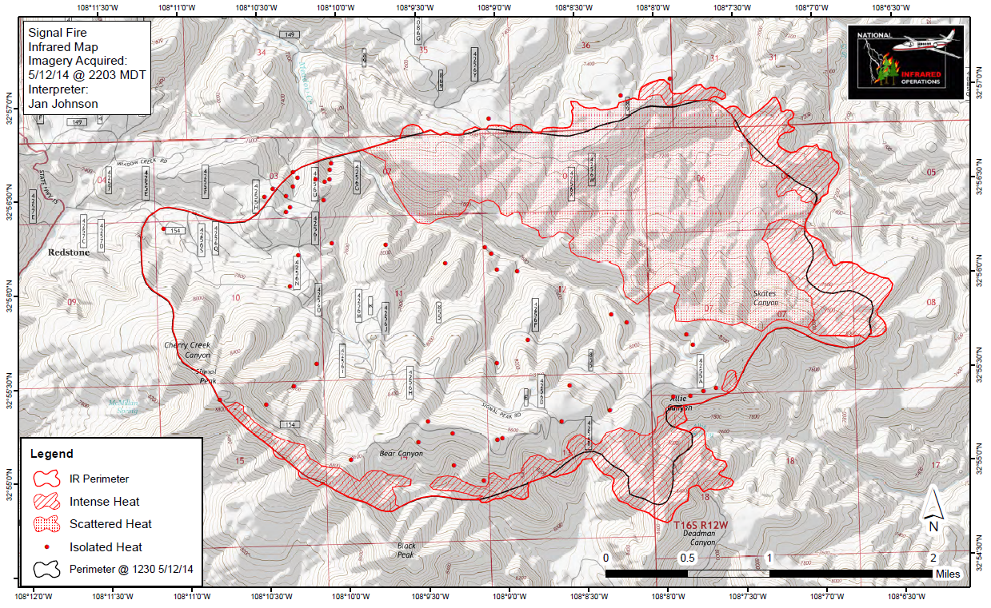
Notes:
Use the grid to come up with the bounding coordinates of the area to be scanned, N, S, E, W

Slide 29
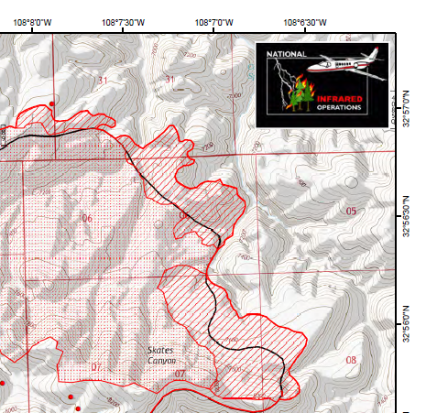
NE Corner
northernmost and
easternmost edges.
Use grids to find nearest degrees and minutes
Round to nearest minute
Add a minute for the north and subtract a minute for the east
Notes:
Use the grid here to get the north and east coordinates. North will be 32˚ 57’ – would put 32˚ 58’ on the form
For the east edge – use 108˚ 07’ or 108˚ 08’.

Slide 30
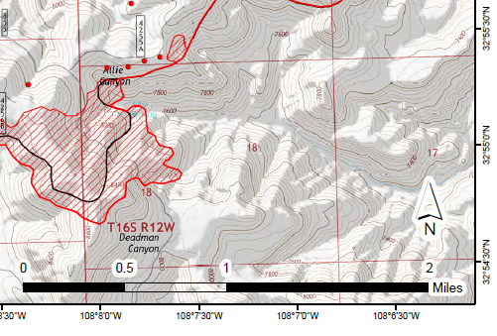
SE Corner
southernmost
Round to nearest minute
Subtract a minute
Notes:
Southern edge – can use the expected fire behavior to decide how far out to move the box. Here round to nearest minute – and make sure the edge is at least 1 minute from active fire edge, but not much more.

Slide 31
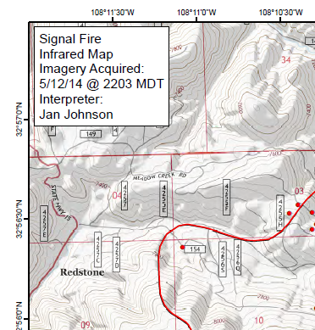
West Edge
Westernmost part of the fire, also the coolest.
Round to nearest minute
Add a minute
Notes:
Western edge – can use the expected fire behavior to decide how far out to move the box. Here there is little heat, so might keep the box very close to the edge of the fire. 108˚12’ would be fine.

Slide 32
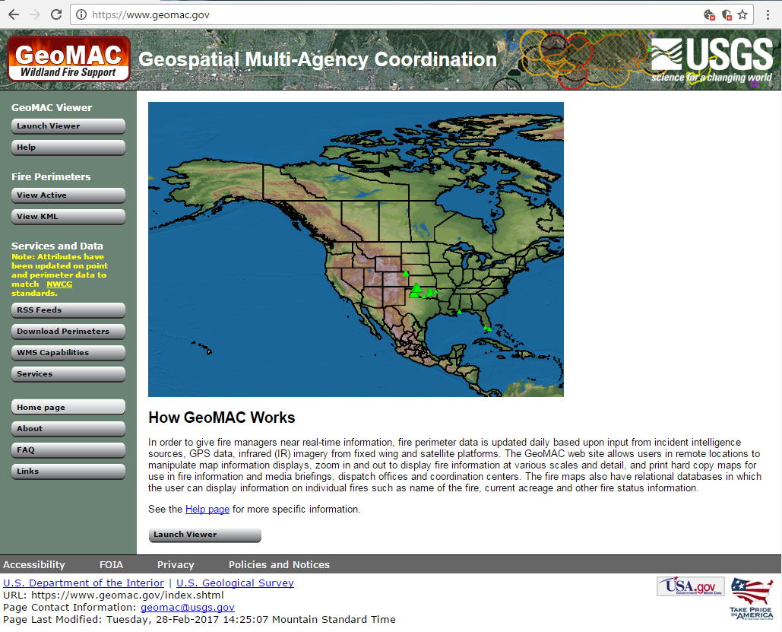
Infrared Aircraft Scanner Request Box Coordinates – from GeoMac
Put in a slide with GeoMac, MODIS, and box

Slide 33
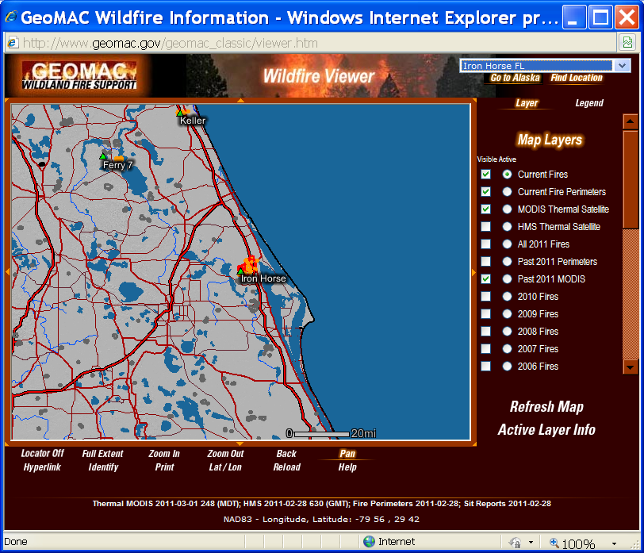
Infrared Aircraft Scanner Request Box Coordinates
Put in a slide with GeoMac, MODIS, and box

Slide 34
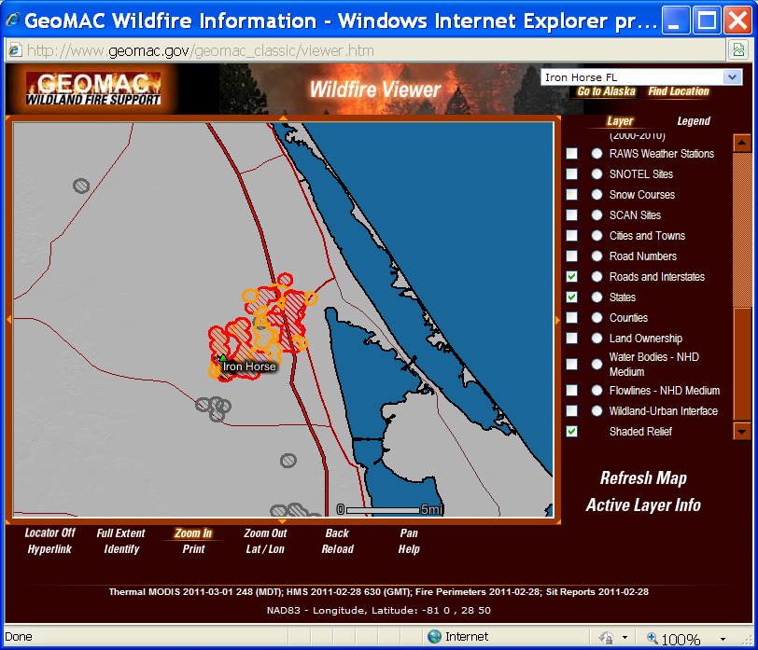
-81 0, 28 50

Slide 35
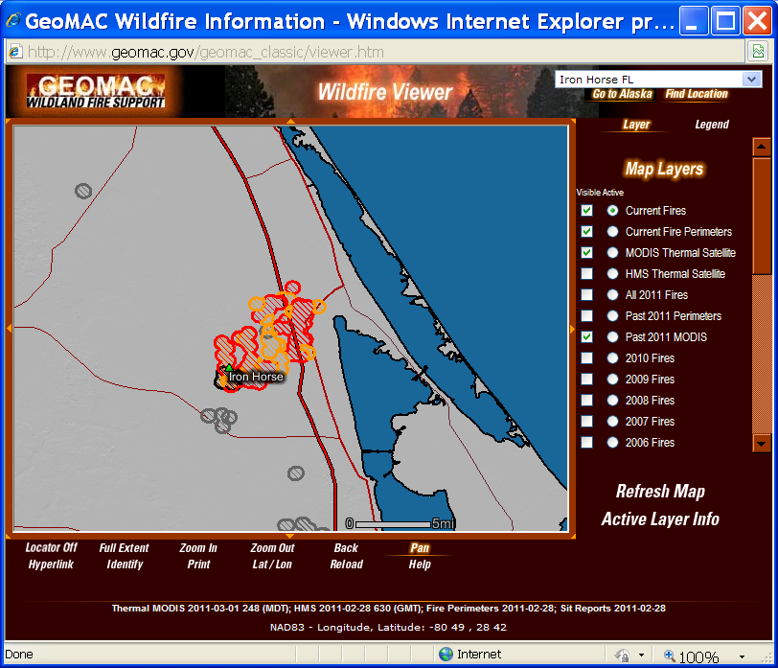
-80 49, 28 42

Slide 36
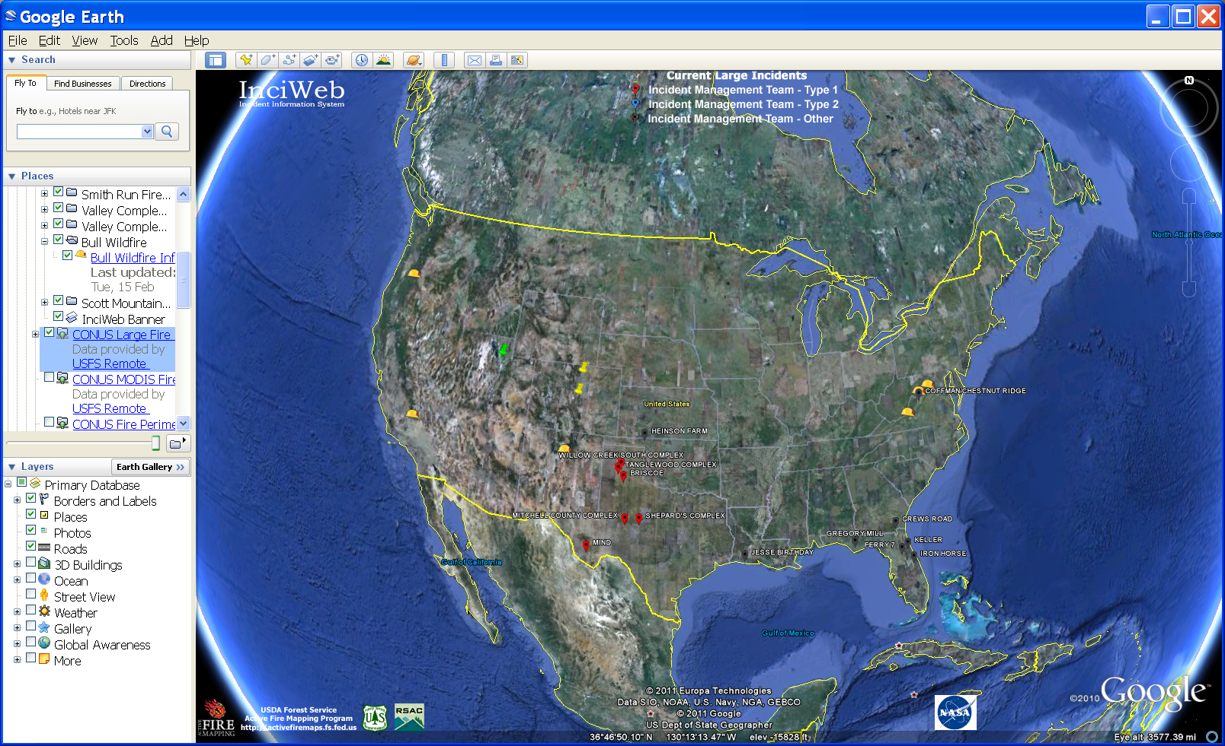
Notes:
From NIROPS CDE KML

Slide 37
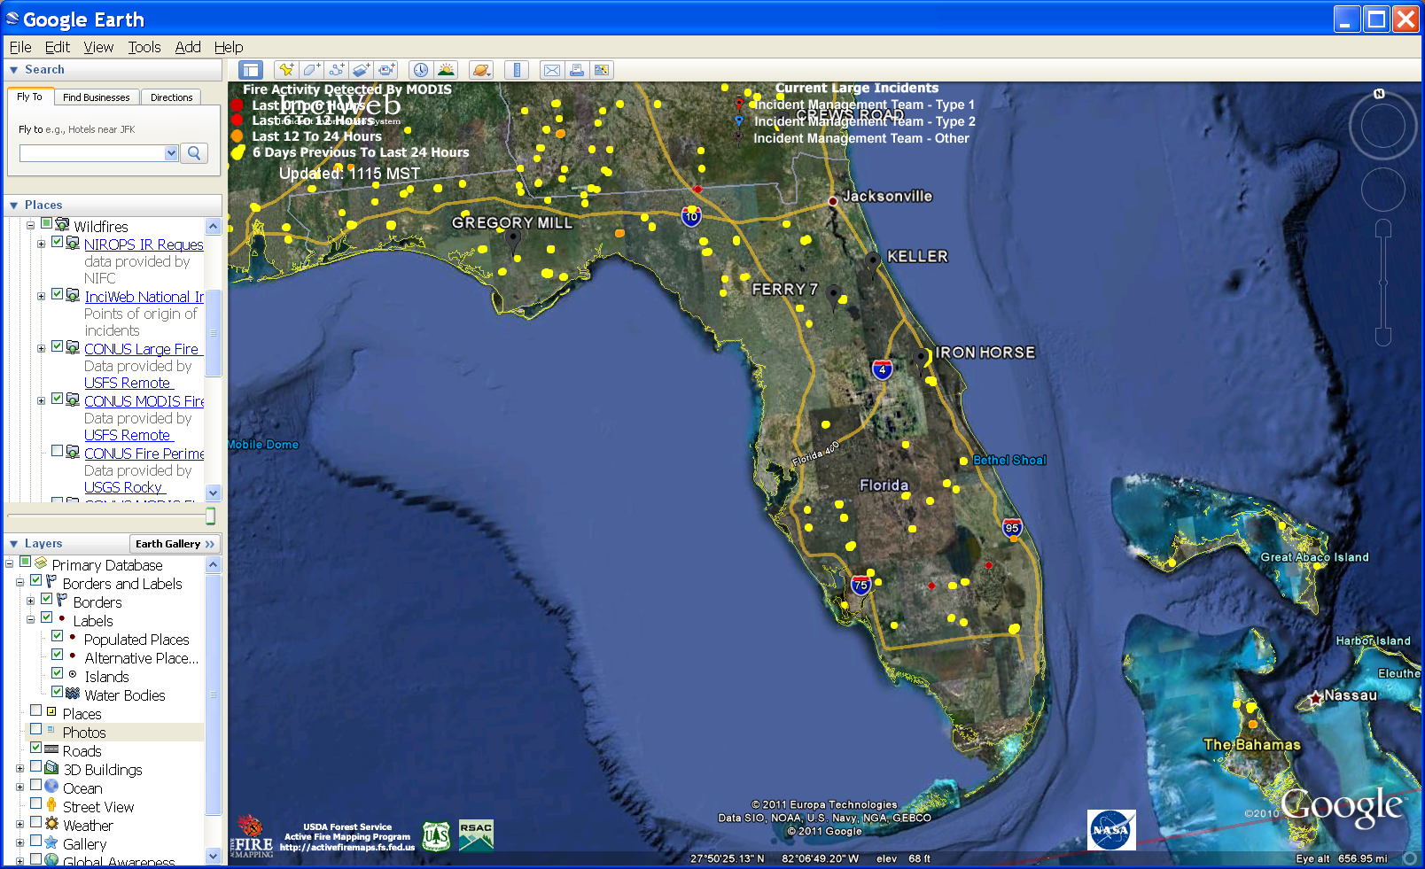
Notes:
Zoom in to area, use cursor to find the lat/longs. Can use the MODIS or VIIRS to help locate the heat. If the fire has been going for awhile, might use a previous perimeter along with the heat from the satellite.
You can also use the previous perimeter, or downloaded satellite data in ArcMap and get the coordinates there.

Slide 38
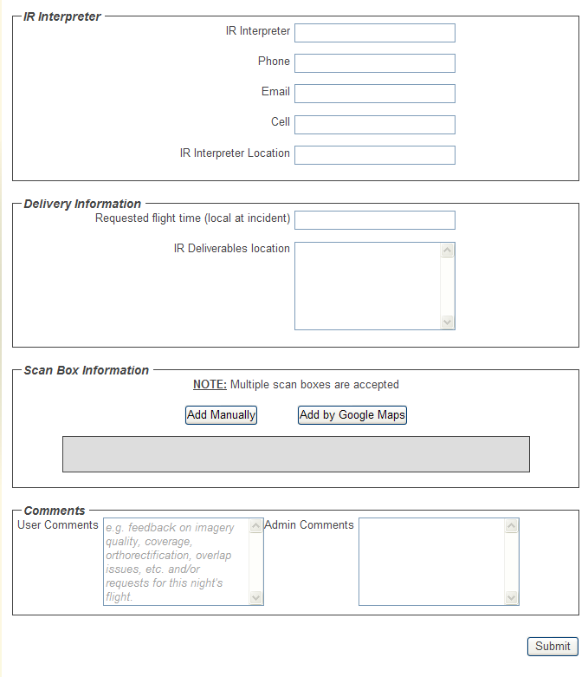

Slide 39
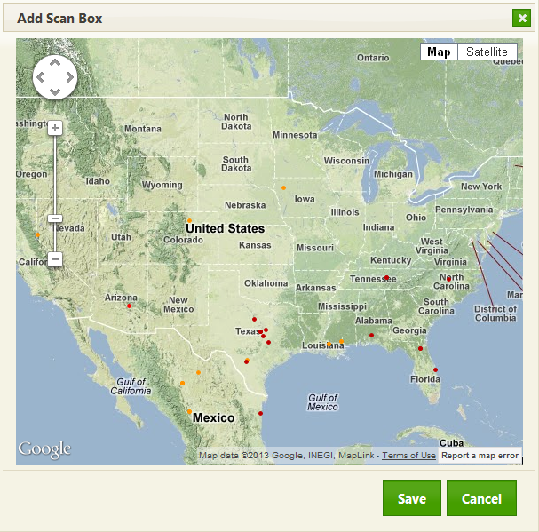

Slide 40
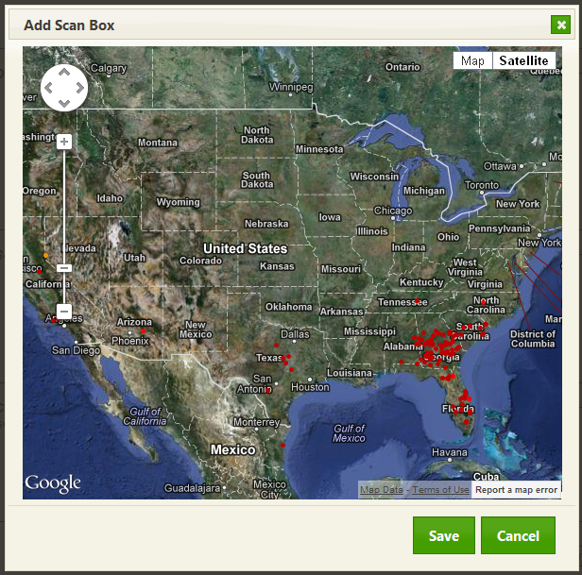
Notes:
Can use map or satellite background

Slide 41
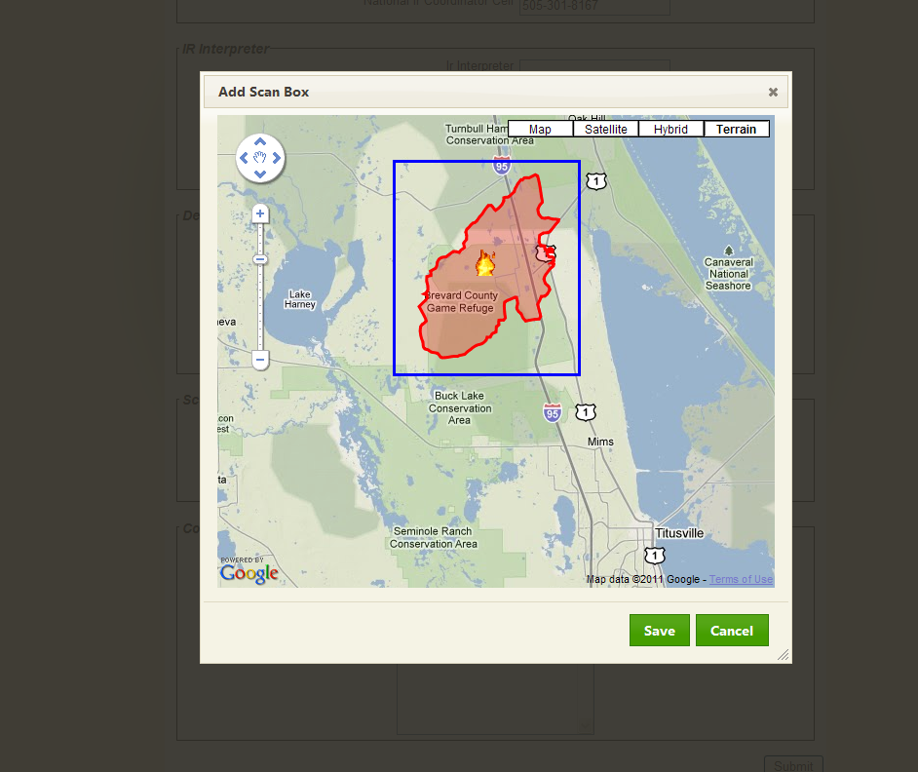

Slide 42
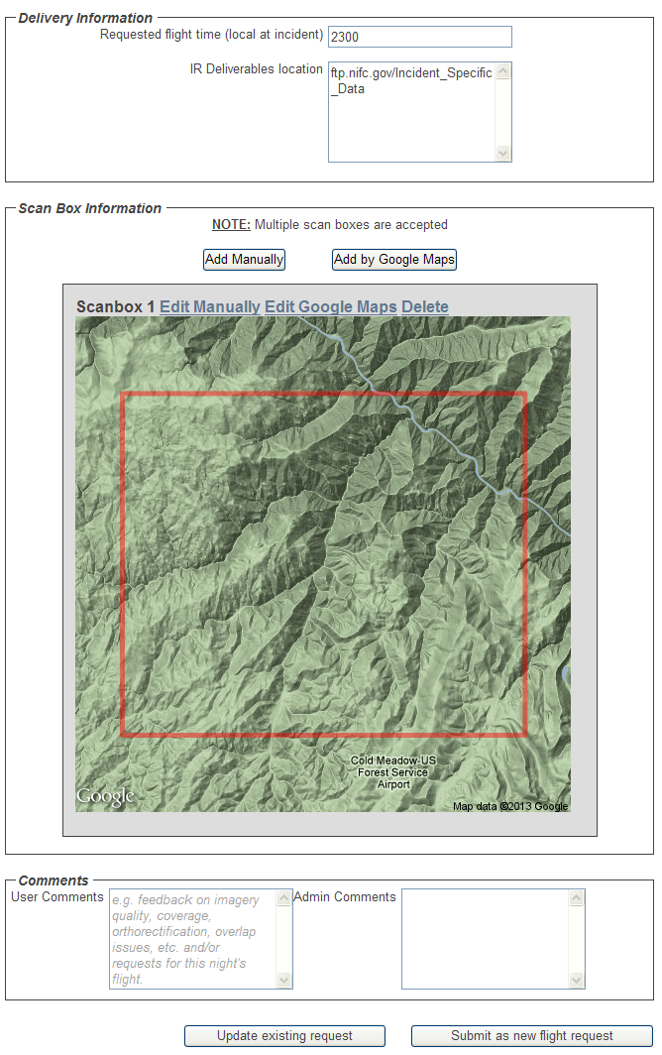
Notes:
This would normally have some heat or something inside the box, but if not, just use the geographic locations and references to make sure you are in the right place. I would recommend getting a report of what you submitted to verify that you have the coordinates in correctly.

Slide 43
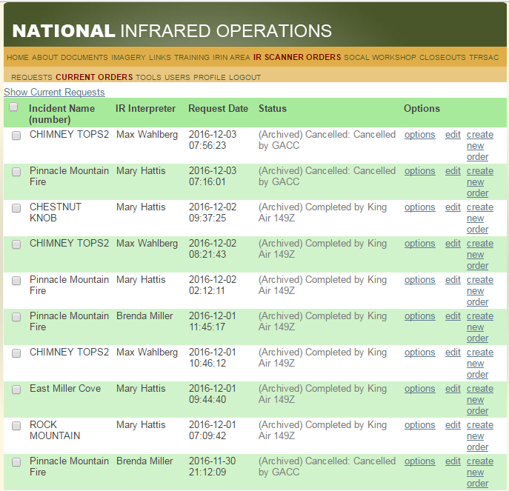
Notes:
To get a copy of the order as it’s going in – a good idea – select Options and

Slide 44
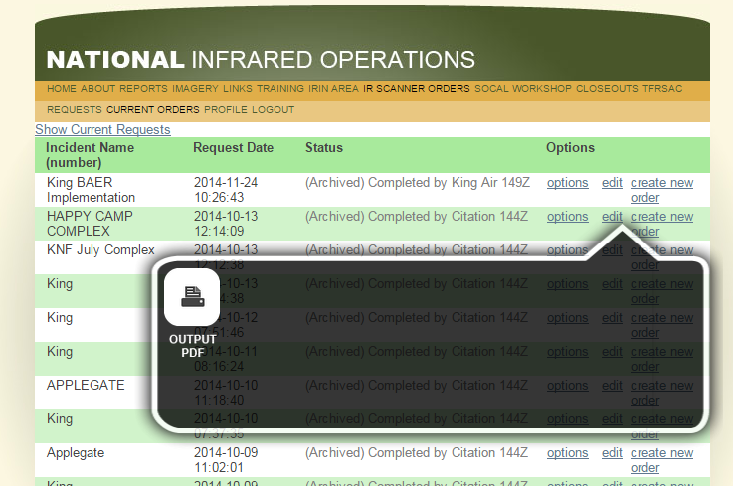

Slide 45
Notes:
Check your information here, especially the Project#, Override #, A#, SITL contact info, and the fire size

Slide 46
Notes:
Check the coordinates here to make sure they make sense

Slide 47
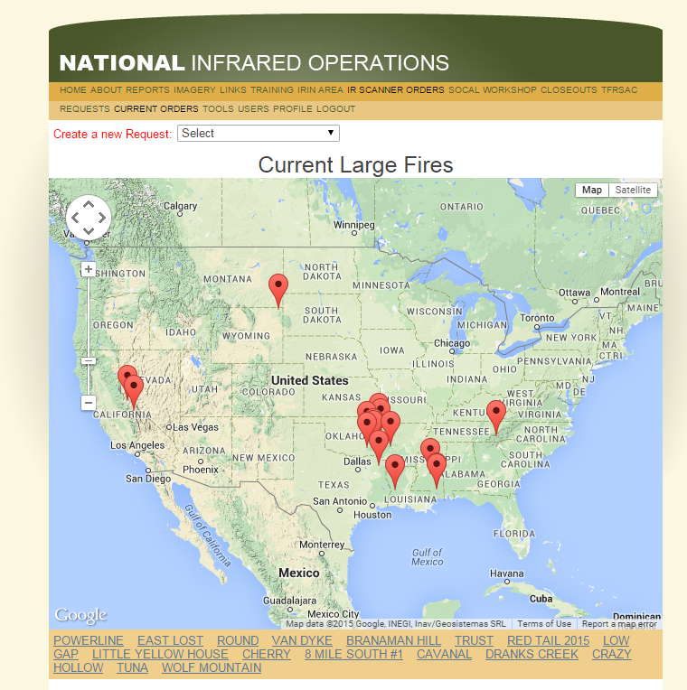
Updating an order with better information – as long as it is done by 1530 MT:
Notes:
If you later get better information – as long as it is by 1530 MT, the box can be changed. Later than that, ensure the techs/pilots are aware of the change

Slide 48
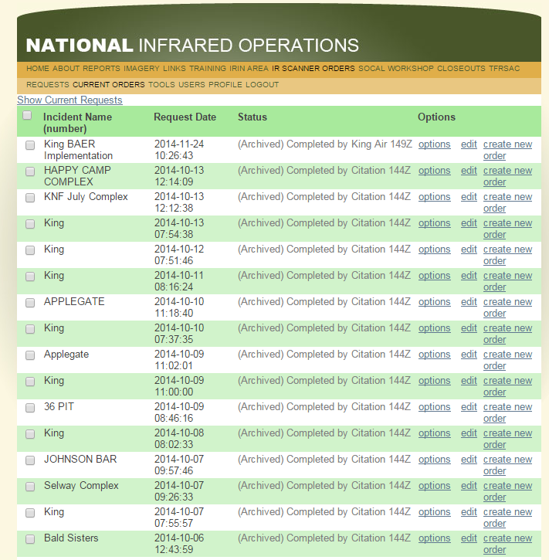
Notes:
Locate the order you put in and select Edit

Slide 49
Notes:
Make the necessary changes, add the A#, update phone numbers, or even change the box, as shown here.

Slide 50
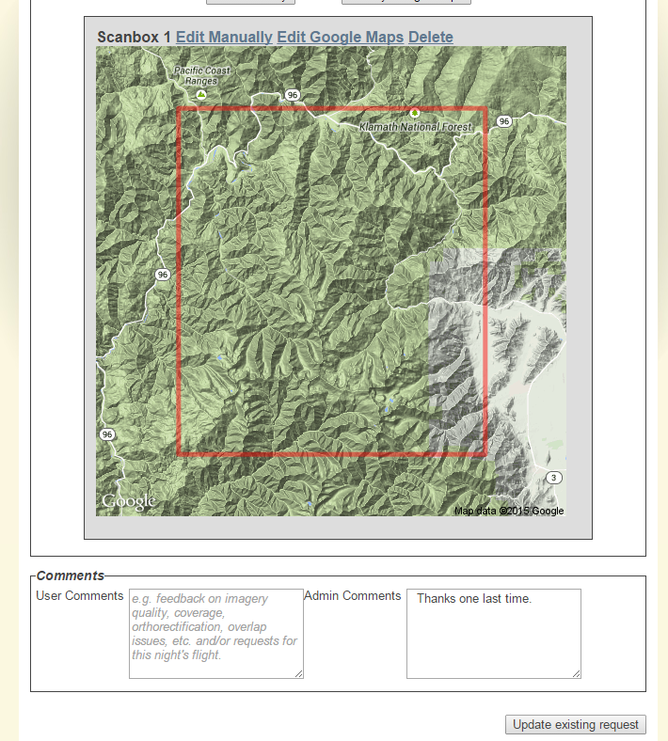
Notes:
Click Update existing request when done with the edits.

Slide 51
Creating IR scanner requests for fires previously flown is much simpler:

Slide 52
Notes:
If this is NOT the first IR flight for an incident, it is MUCH easier to find the previous IR scanner request, edit it and submit it as a new order as shown here.
Find the most recent scanner request and click on Create New Order

Slide 53
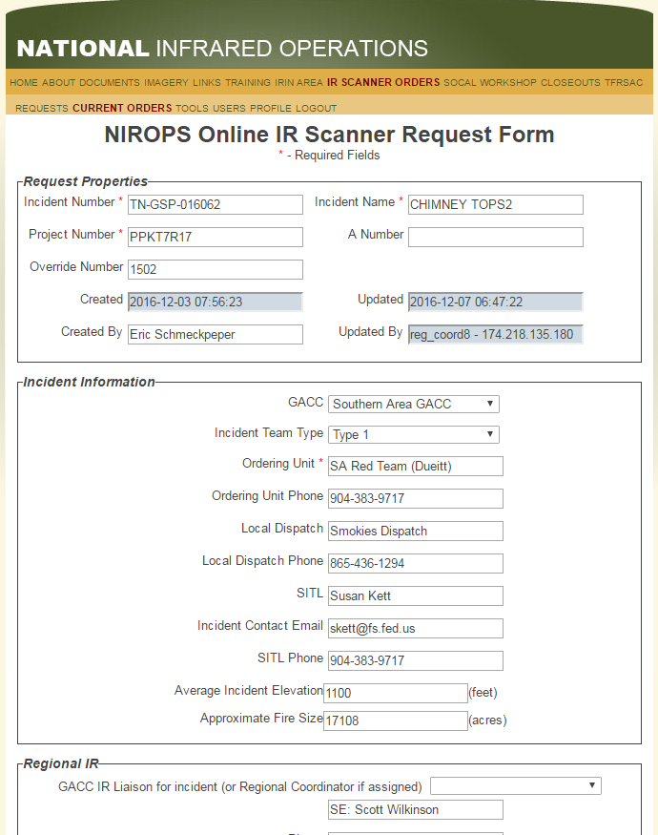
Notes:
Note that the A# is blanked out, this happens automatically. Change the scan box to accommodate any growth or changes to the area to be scanned, put in the new A#, ensure that your contact information is up to date, change the fire size if necessary, and update any of the other contact information for the fire. Especially the Incident Contact Email and SITL phone. We don’t want that person who left the incident a week ago to get a text/email in the middle night with UTF info…

Slide 54
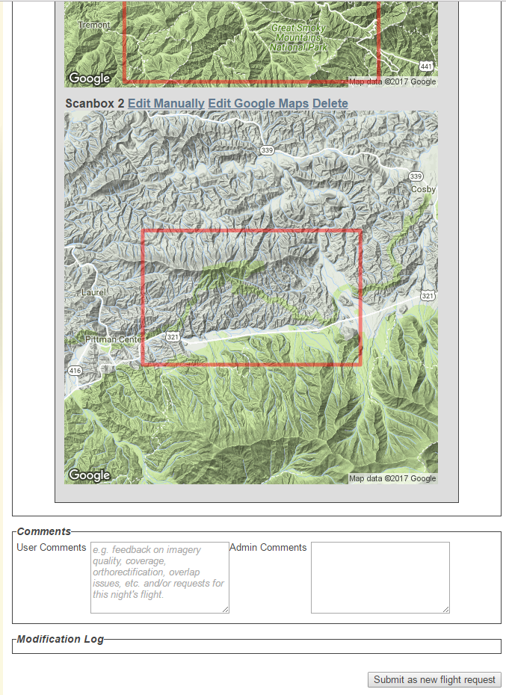
Notes:
Submit as new flight request

Slide 55
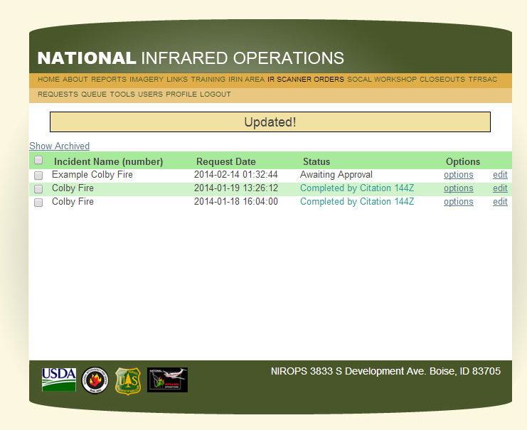
Notes:
Old slide, but nothing to update currently – no orders

Slide 56
IR scanner requests must be submitted by 1530 MT
If possible, submit the scanner request in the morning
Request the A# from dispatch early, it can be attached to the scanner request later.
Notes:
The incident will often want to retain control of submitting the IR scanner request and requesting the A# from Dispatch. Reasons – to allow trainees to do the task, to complete their taskbook, or because they aren’t sure if they want IR for that night, or ?
If this is the case, you can briefly get up around 1500, check to see if the order is in. If it is not, you can check with SITL to see if they plan to order.
Sometimes they will set up a “standing order” with dispatch to get an A# every morning. If there is a national IR coordinator working, they will double-check for missing A#’s but the scanner request is the trigger for this.
Remind incidents that the scanner request can easily be canceled if they decide they don’t want IR that night – best before 1530.

Slide 57
When will I get my data?
Aircraft is assigned online
NIROPS CDE Google Earth KML
AFF, Flightaware
Twitter
Call IRCR, IRCN, NICC (email)
Notes:
When you figure out approximately when the fire will be flown, let the incident know. Also communicate about when you might have the interpretation completed and the products available.

Slide 58
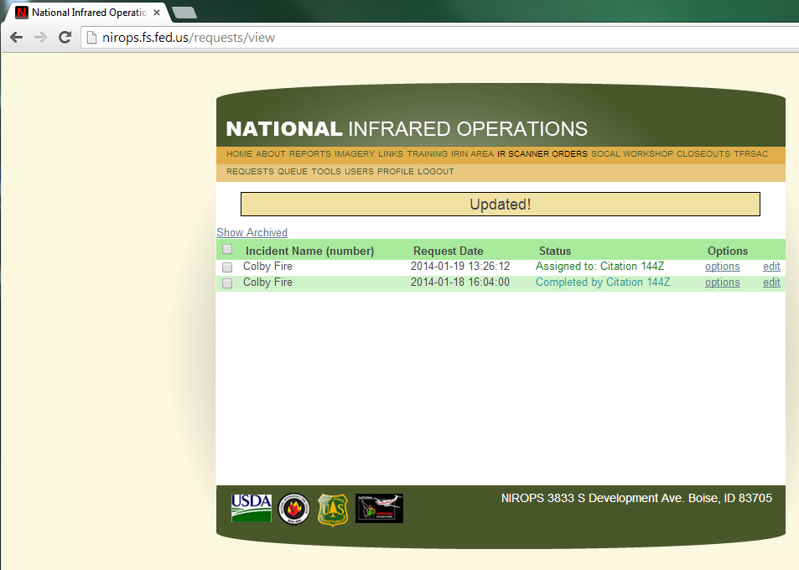

Slide 59
Using AFF to track the aircraft
https://www.aff.gov
Request an account
Log in
Internet Explorer 11 will not work (USFS’s preferred browser)
Notes:
When you figure out approximately when the fire will be flown, let the incident know. Also communicate about when you might have the interpretation completed and the products available.

Slide 60
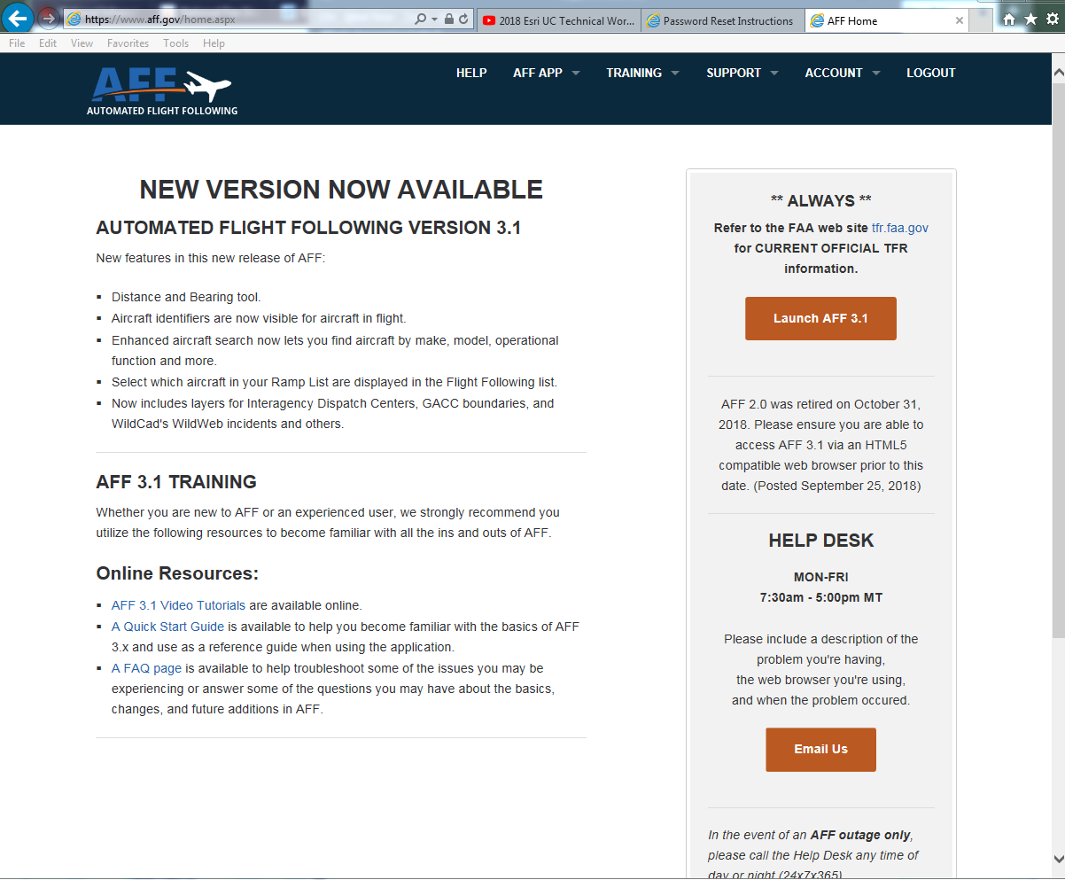

Slide 61
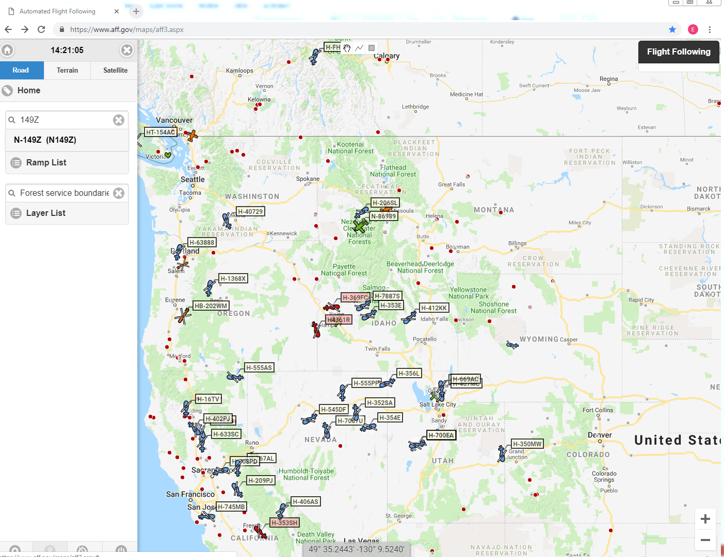

Slide 62
Using Flightaware.com to track the aircraft
https://flightaware.com
No need to log in
Enter XCN44 or XCN49 to show information for the two IR ships.
There is slight delay – meaning aircraft location shown is where it was
Notes:
When you figure out approximately when the fire will be flown, let the incident know. Also communicate about when you might have the interpretation completed and the products available.

Slide 63
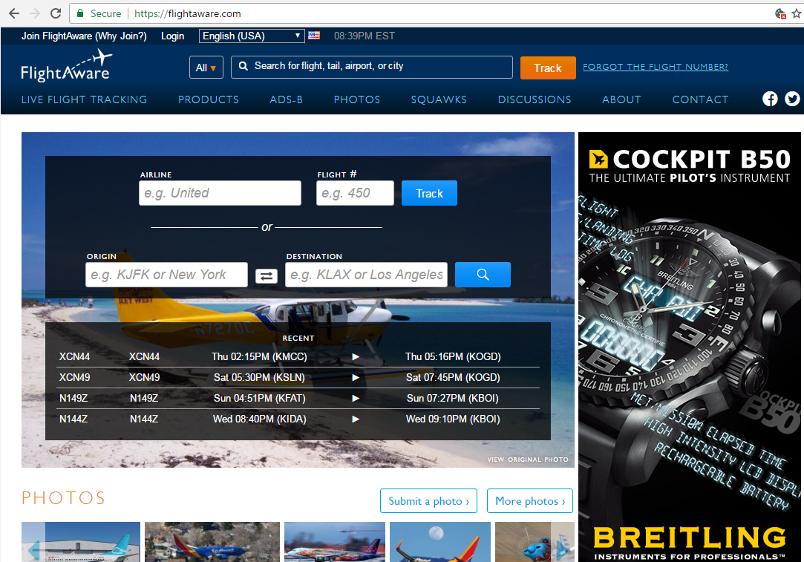
Type in XCN44 or XCN49 here
Notes:
Flightaware

Slide 64
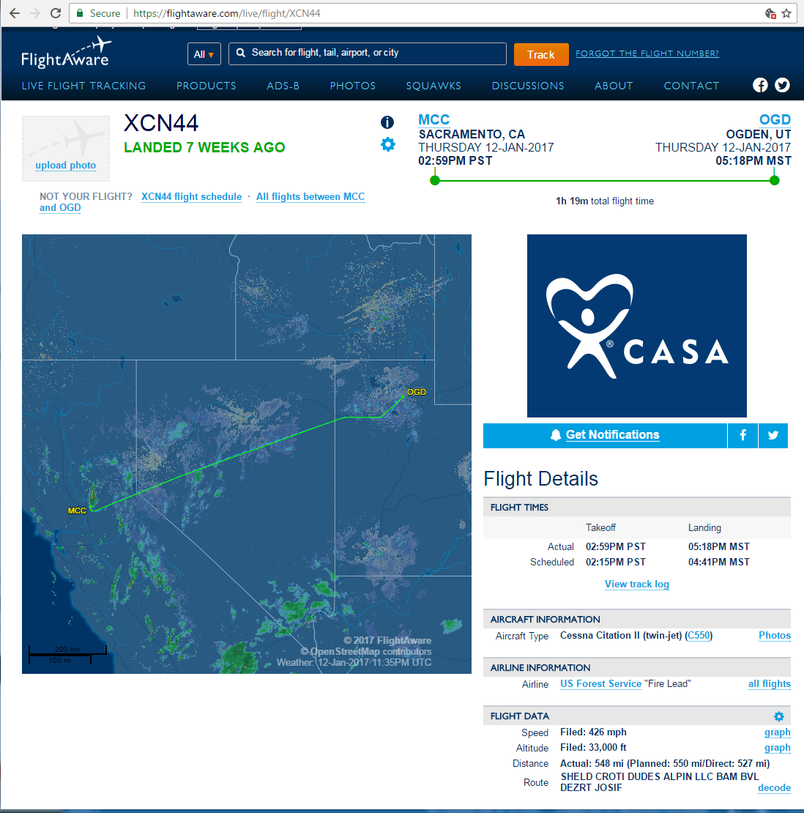

Slide 66
Using Twitter to track the aircraft
Log in to NIROPS website
At bottom of IR Scanner Orders page is the Twitter feed from both aircraft
Recommended – get/use a Twitter account – and follow the aircraft.

Slide 67
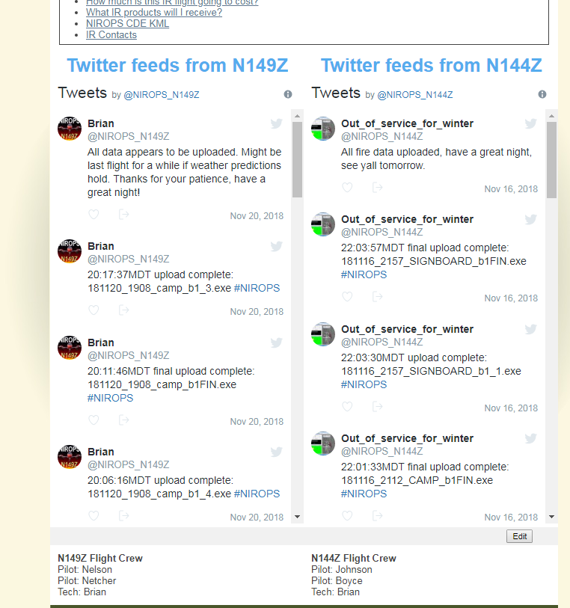
Notes:
Often the techs will tweet their schedule after the flight plan has been calculated. This can give you an estimate of when you might see the data.
Wait to begin downloading your file until the message saying the “upload is complete” is tweeted. Early attempts at downloading the data can actually corrupt the file being uploaded.

Slide 68
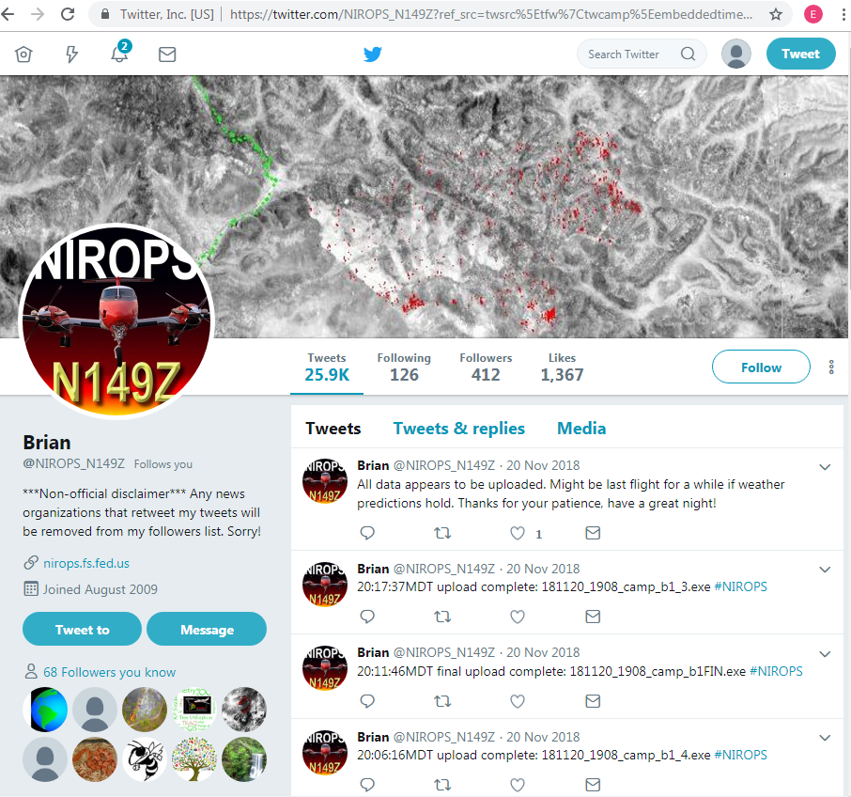
Notes:
You can/should get a twitter account to ease communication with the techs.

Slide 69
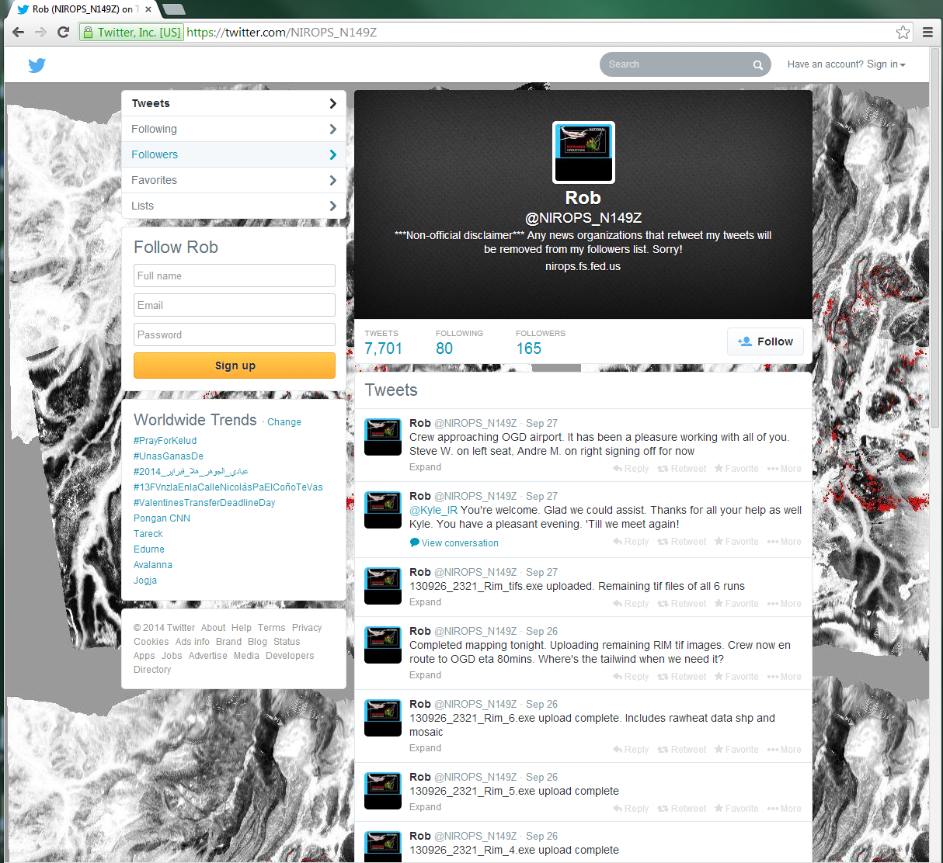

Slide 70
Twitter account use
Create your profile
Follow NIROPS_N144Z and NIROPS_N149Z
Follow IRCN and accept our “follow you” request
Twitter etiquette
Notes:
Remember that what you tweet is visible to all. Stay professional and brief. If need to discuss something, ask the tech to call you when they land. Can also send Direct Messages to the tech. This way they are just between the two of you. Above all stay professional and factual.

Slide 71
Orders for Additional Missions
The request is drafted by the Infrared Interpreter or others.
Recommended by the Situation Unit Leader
Approved by the Planning Section Chief
Sent to IA or Expanded Dispatch
A# assigned by Dispatch

Slide 72
Keep Your Scanner Request up to Date
Second Day
First Day
Longitude
Longitude
Latitude
Latitude
Notes:
As the fire moves and grows, so should the box. If parts of the fire are cold and no longer of interest, you may be able reduce the size of the box to not include cold parts of the fire. Verify this with the SITL. This becomes more important when the number of fires requested each night goes up.

Slide 73
Objectives
Identify & describe information needed for ordering IR Aircraft Scanner missions
Review Infrared Aircraft Resource Order
Describe methods to track the aircraft to anticipate data delivery

Slide 74
Questions?

