Slide 1
Unit 7 – Acquiring Map
Base Data

Slide 2
Unit Objective
On completion of this unit, the student will be able to:
Describe three common sources of base map data
The pros/cons of using services vs. local data

Slide 3
Outline: Base Map Data
Incident data from the GISS
Enterprise Geoportal (EGP)
https://egp.nwcg.gov/egp
ArcGIS™ Image Server
ArcGIS Online
FTP.NIFC.GOV
Not an exhaustive listing of map base data sources
Wildland Fire Decision Support System (WFDSS)
Notes:
EGP you need an account and there are several levels (GISS and read only) can download incident perimeter and data
State GIS resources possibly. Emergency operations centers etc.. Lots of data out there but stick with local copies as services do go down and can hinder your interpretation. Slowness.. Get your log-ins done after the class and attend the yearly irin webinar to go over and changes

Slide 4
Base Map Data: Incident
Getting base map data from GISS ensures that your maps/PDFs are consistent with the incidents’
Many teams have hard drives that they carry data on
Local agency offices (DOI, BLM, FS Park Service ETC)
Best case scenario, but may not always be possible
You may be working the fire remotely
Yours may be one of the first maps generated for the fire

Slide 5
Base Map Data: ArcGIS™ Image Server
Imagery and raster data service
U.S. Forest Service, GTAC (Geospatial Technology and Applications Center)
https://www.fs.fed.us/gstc/
Internal to FS and BLM
Can be accessed through VPN, but very slow.
Service added from within ArcGIS
Notes:
Licensing limited to FS and BLM through contract with I-Cubed (vendor); proprietary data layers eTopo and eSat
Demo added the image services or show the different ways with the GTAC ??
Copy of GTAC 2017 connection instructions will be provided
other GTAC links https://www.fs.fed.us/gstc/
Active Fire Maps
Viirs and other landsat data Modis etc.

Slide 6
Base Map Data: Image Server
Imagery
NAIP: State and CONUS
eSAT: Landsat 15 meter merged imagery of CONUS and Alaska
FS regional imagery layers
GIS Raster Data
eTOPO 1:24K, 1:100K, 1:250K DRG
PBS_GeoTiff
Softcopy 1:24K Primary Base Series for FS administered lands
FS regional data layers

Slide 7
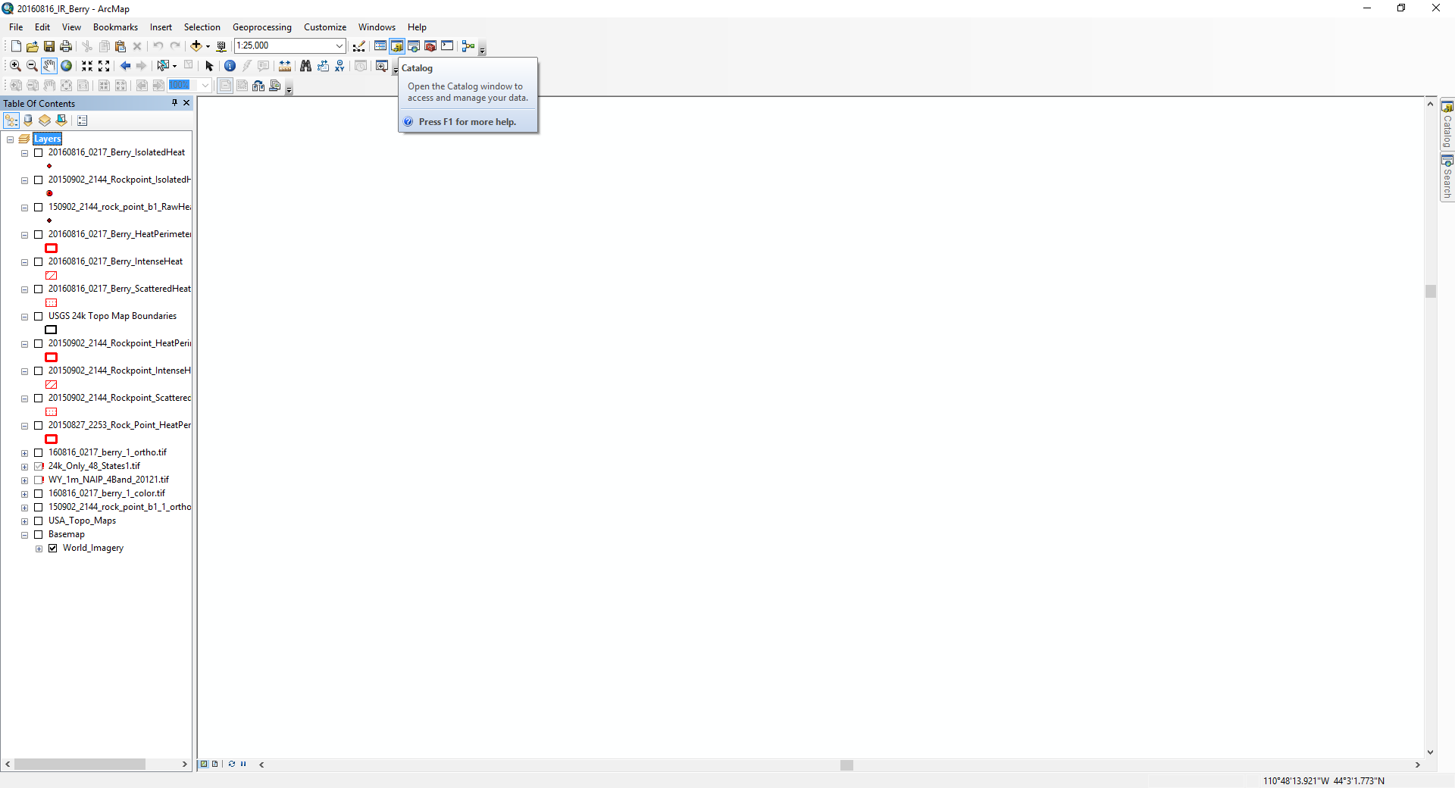
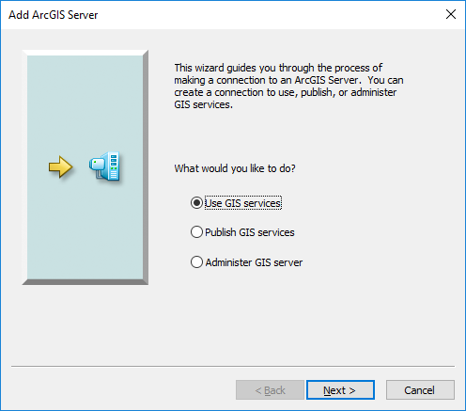
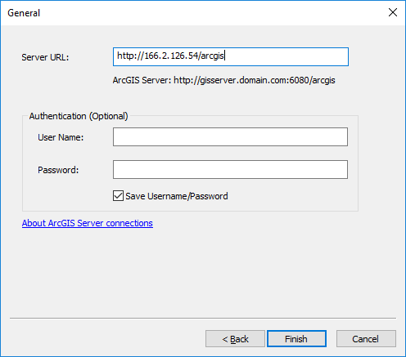
https://image-services.gtac.fs.usda.gov/arcgis

Slide 8
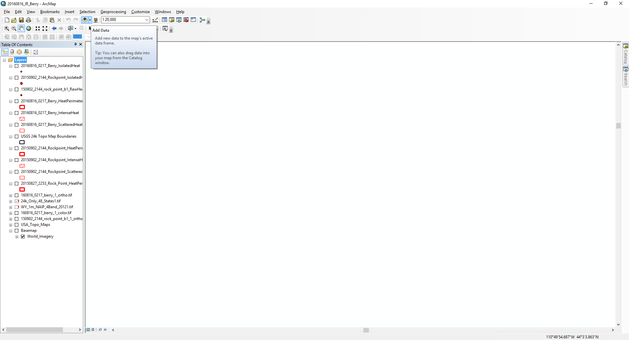
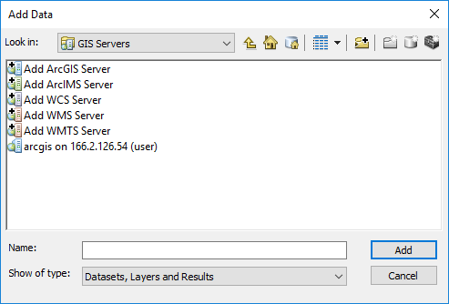
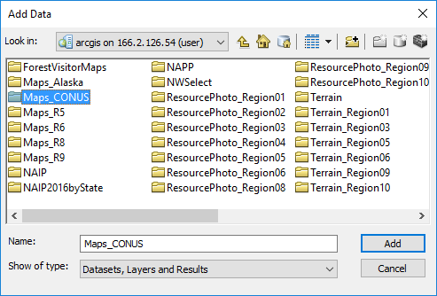

Slide 9
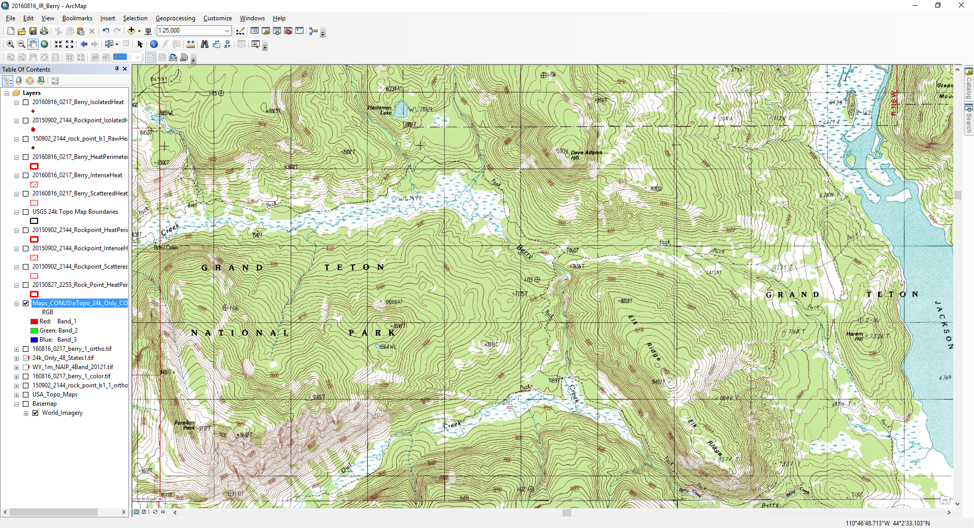
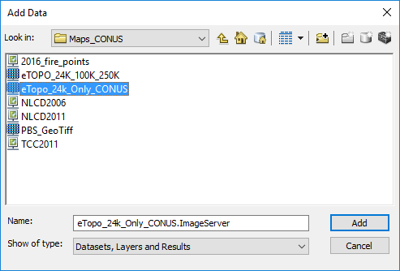

Slide 10
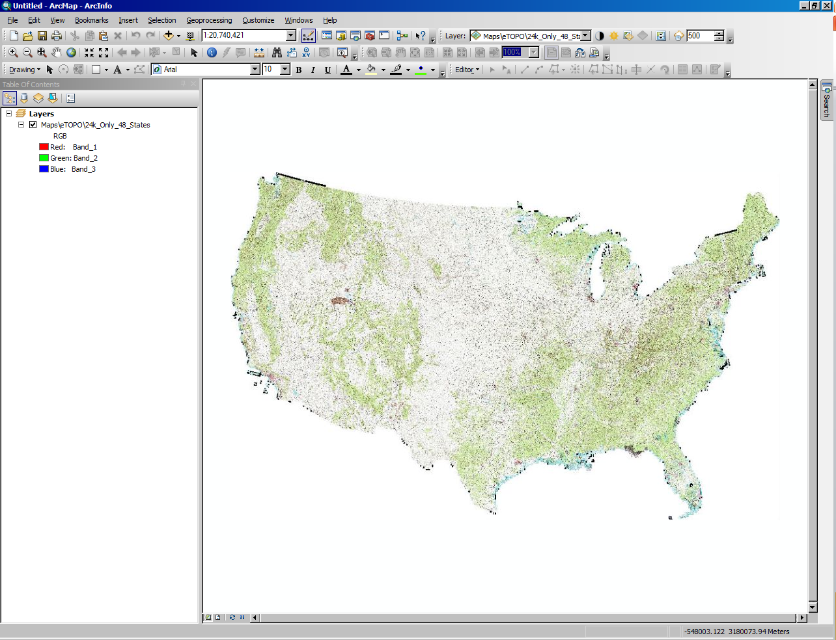
The default projection and datum
may not be the same as your working units

Slide 11
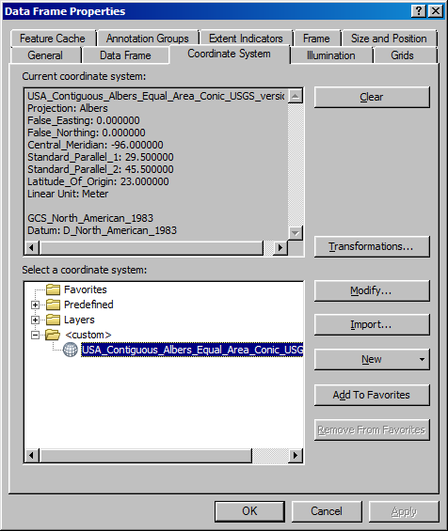
Use Data Frame Properties to set the correct
working units

Slide 12
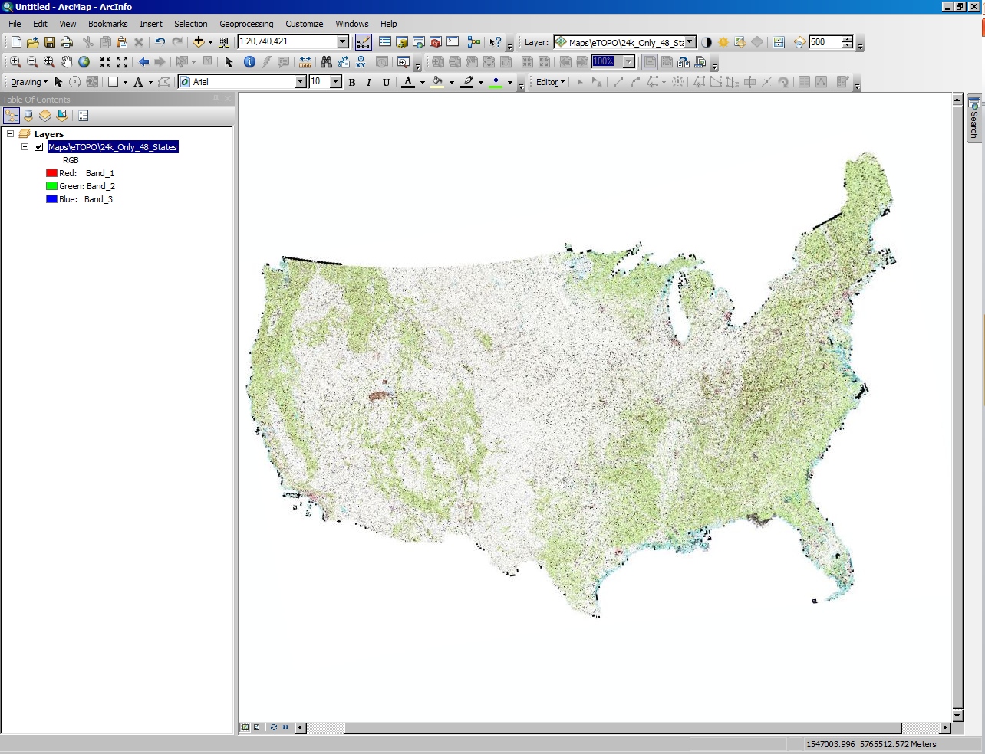

Slide 13
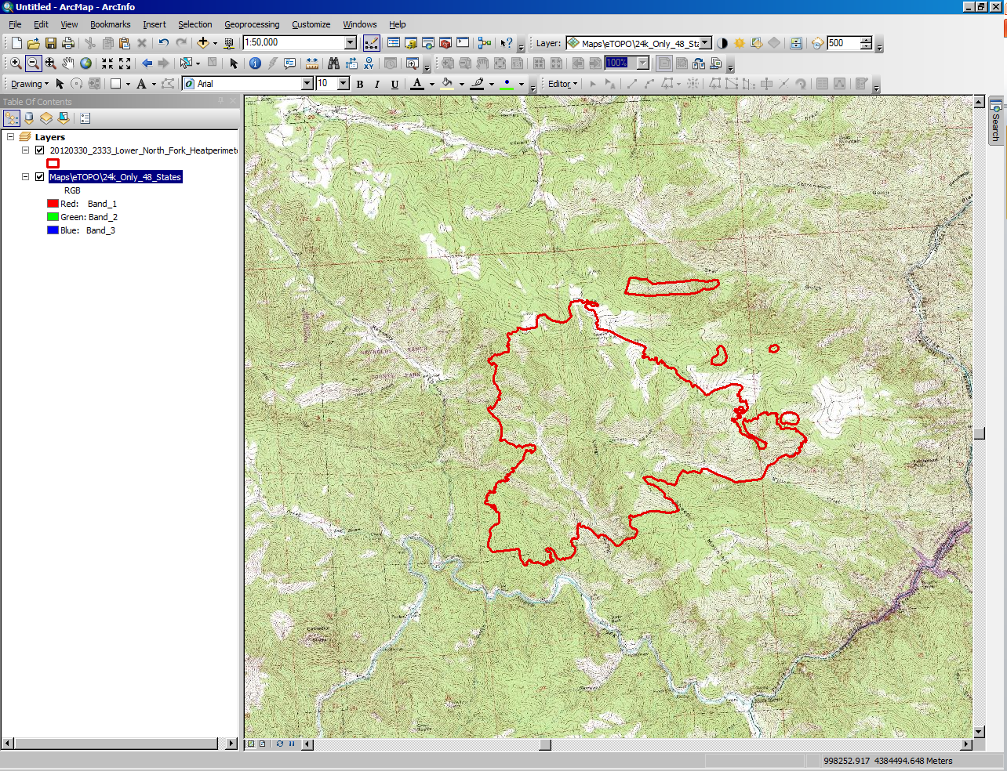
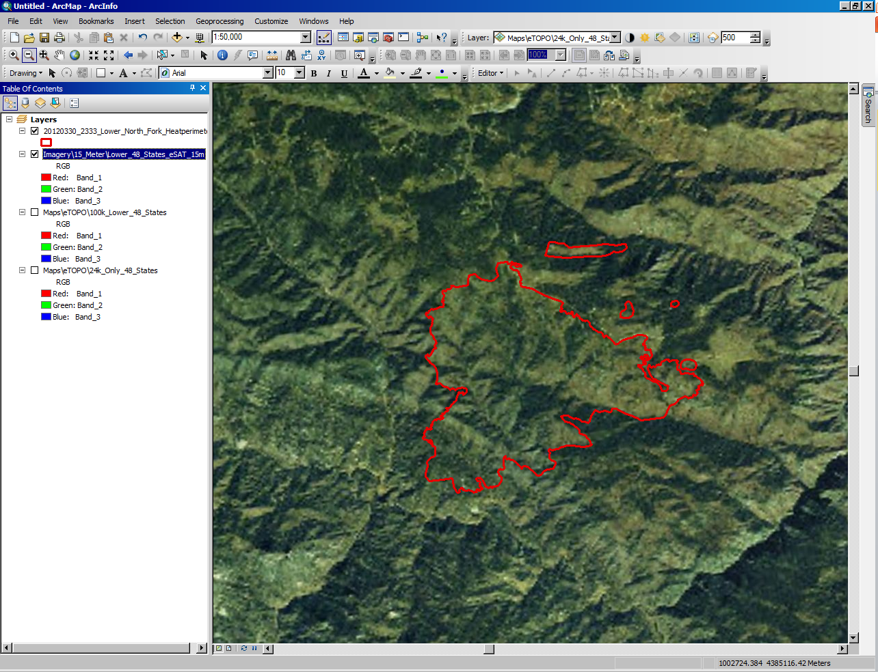
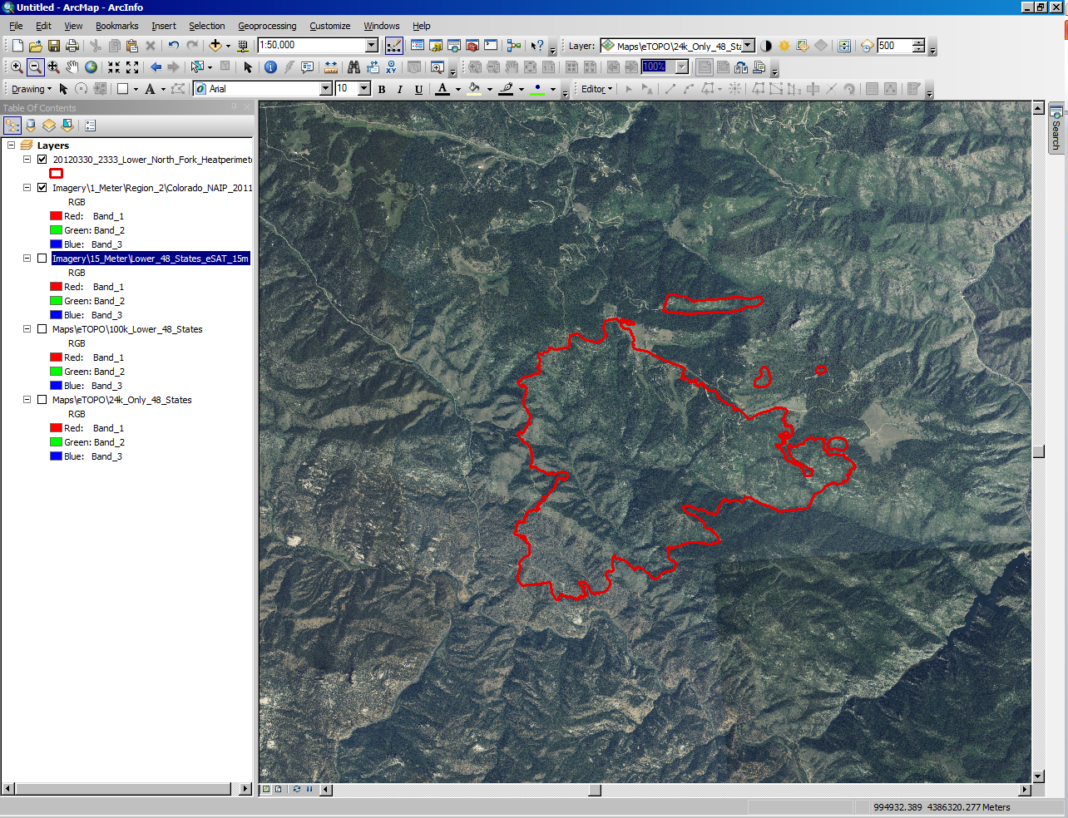
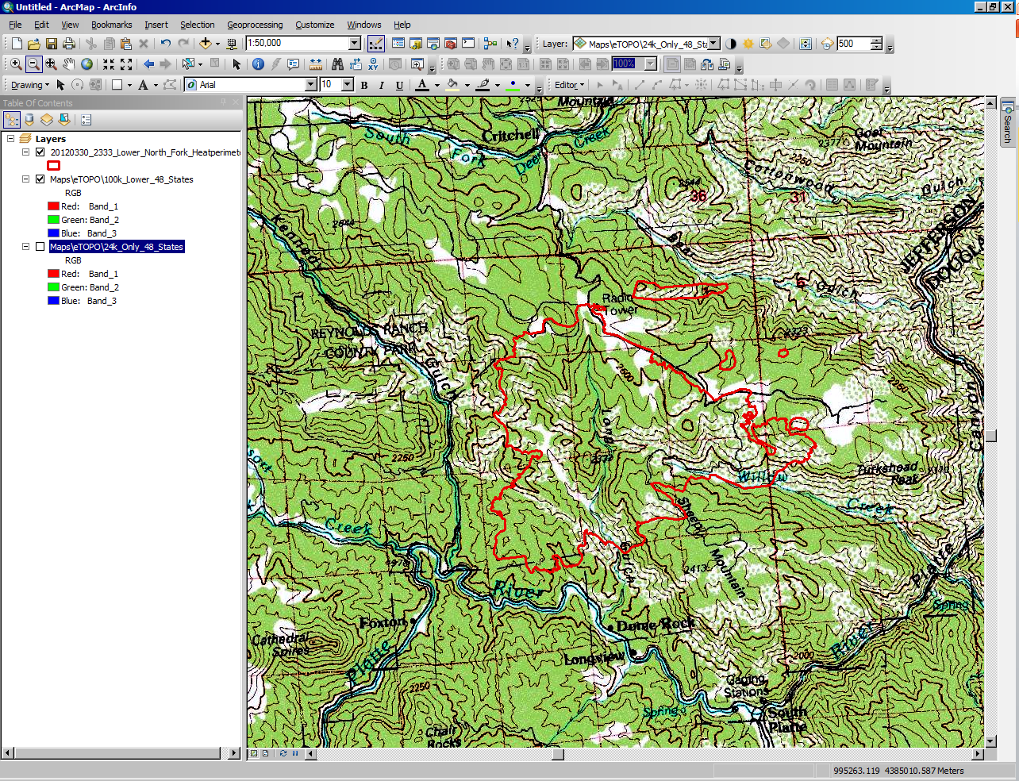
Notes:
Displaying imagery of Lower North Fork Fire: 24k Topo, 100K Topo, 15 Meter eSAT, 2011 Colorado NAIP 1 Meter

Slide 14
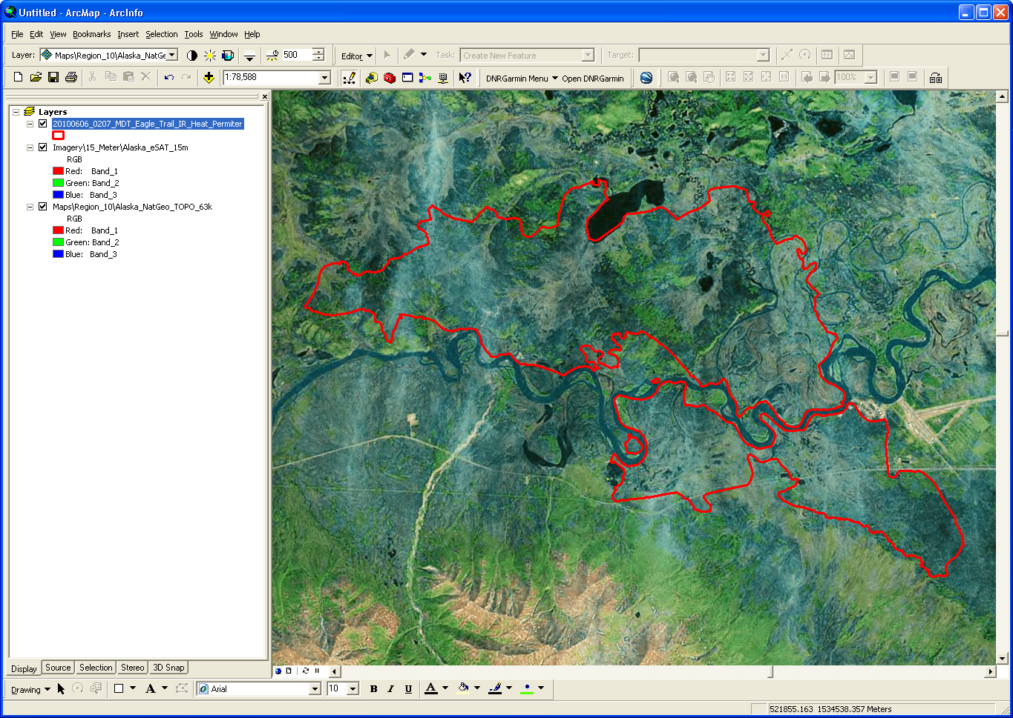
eSat 15m Landsat Layer

Slide 15
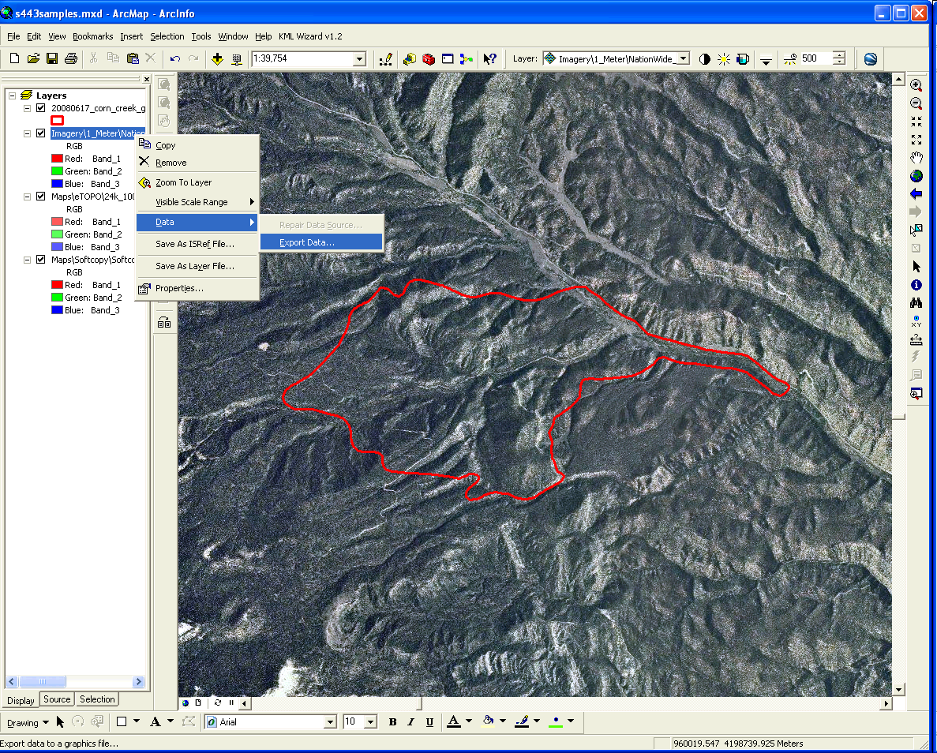
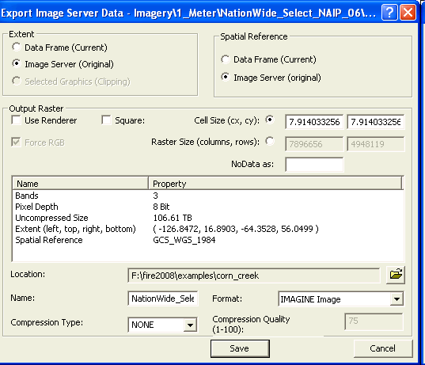
Exporting Data Layers Using Image Server
Defaults

Slide 16
Base Map Data: ArcGIS™ ArcGIS Online
ESRI data and imagery service
Bing Maps and Bing Aerial services will require a key
ESRI World Imagery at 30cm
Some services may be slow
Services will be slower to export final map product while using ArcGIS Online
Service embedded with Arc 10.x

Slide 17
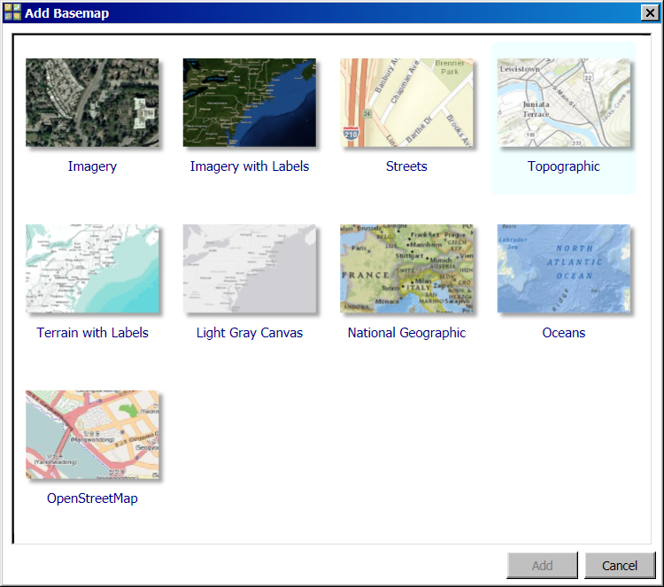

Slide 18
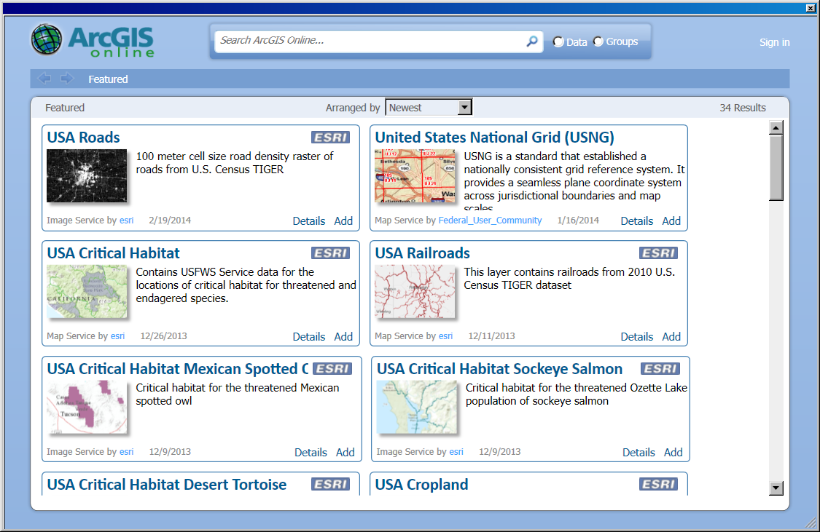

Slide 19
Base Map Data: FTP.NIFC.GOV
Base Topo Maps
/base_info/topo_maps (new geotiffs)
Reliant on FTP site being accessible for download
Base Forest Maps

Slide 20
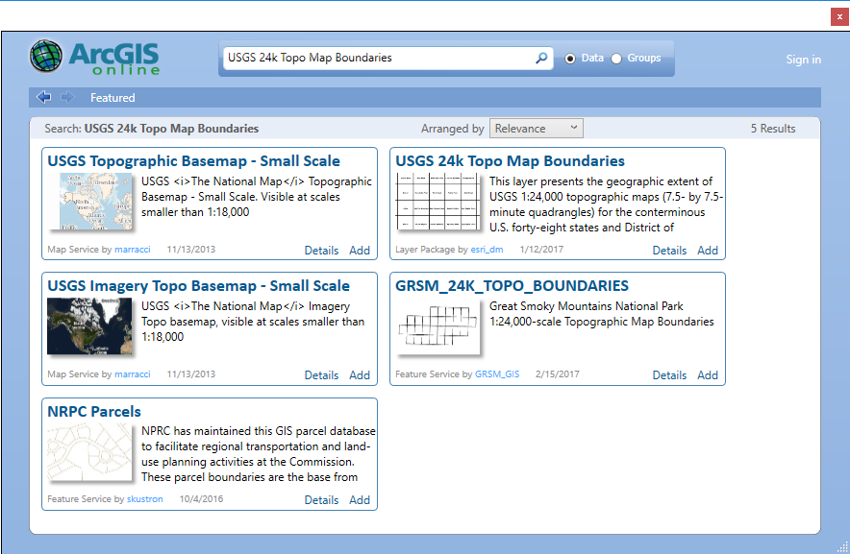

Slide 21
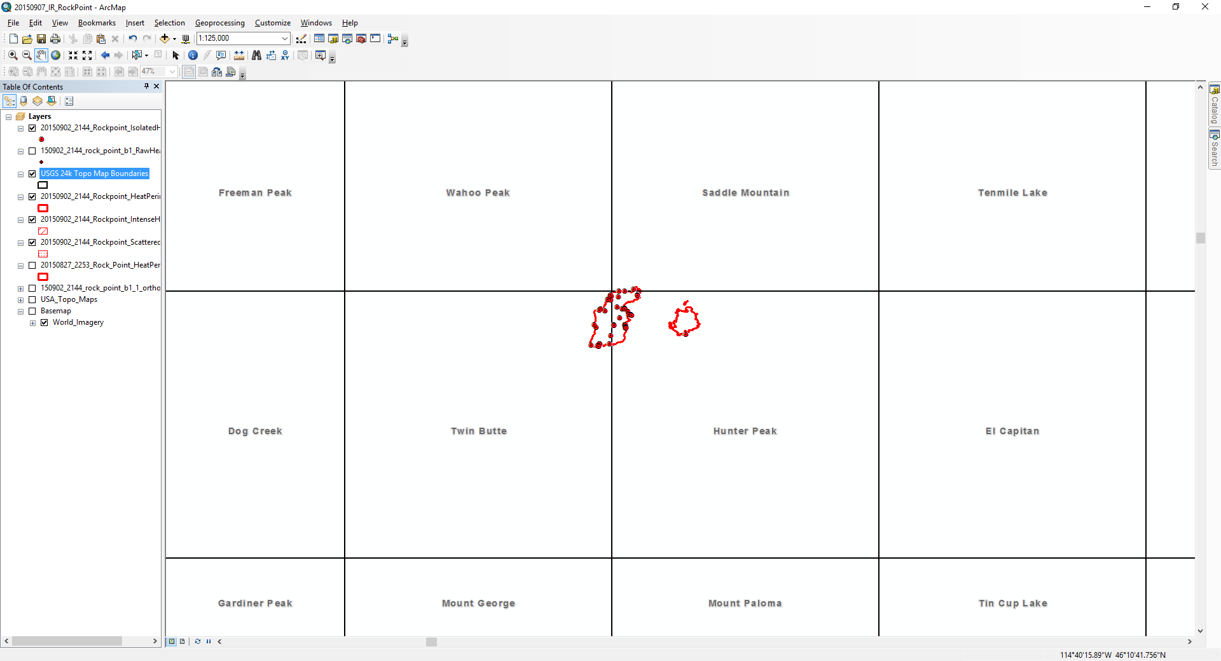

Slide 22
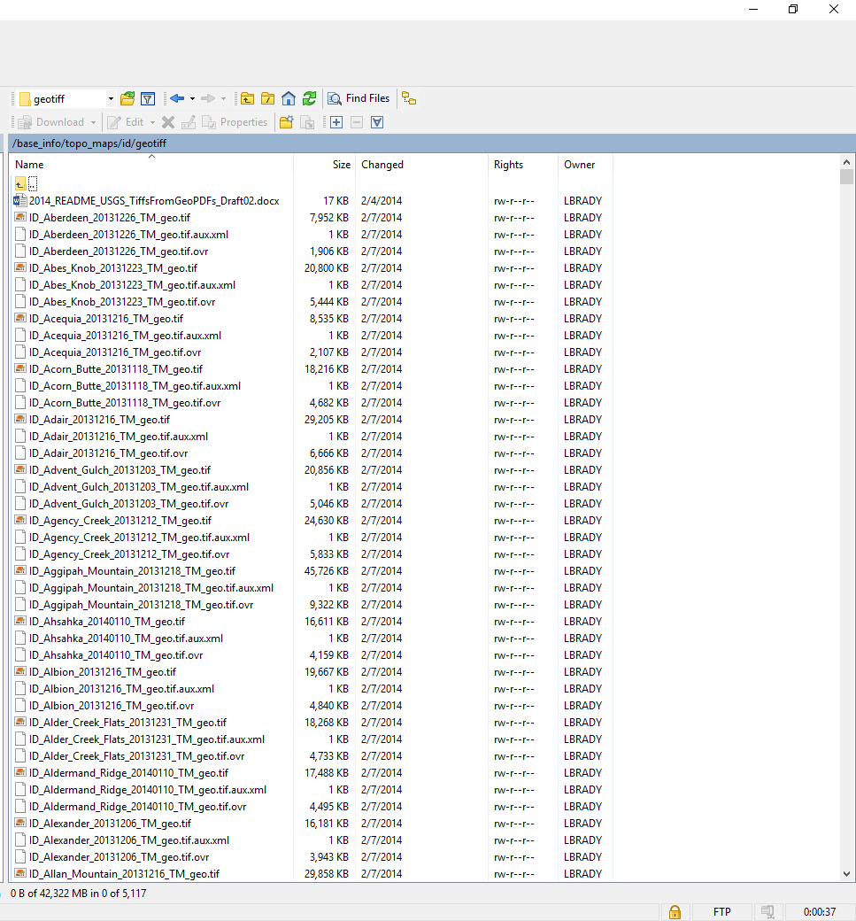

Slide 23
Other Sources of Base Map Data:
State data services
GeoNorth.com (Alaska Geospatial Imagery Services)
inside.uidaho.edu
sco.azland.gov
Wildfire Decision Support System (WFDSS)
GEOMAC
NRCS Data Gateway
USGS topo, Lidar hillshade, interactive map
Organized by state and county
https://gdg.sc.egov.usda.gov/GDGOrder.aspx
Notes:
Other sources of base
EVWHS Enhanced View Web Hosting Service
Digital Globe’s Government access to high resolution satellite images, must request an account
map data include States that house and distribute mapping services.

Slide 24
Review Unit Objective
On completion of this unit, the student will be able to:
Describe three common sources of base map data
The pros/cons of using services vs. local data
NOTE: always have a backup copy of base data!!

Slide 25
Questions?

