Slide 1
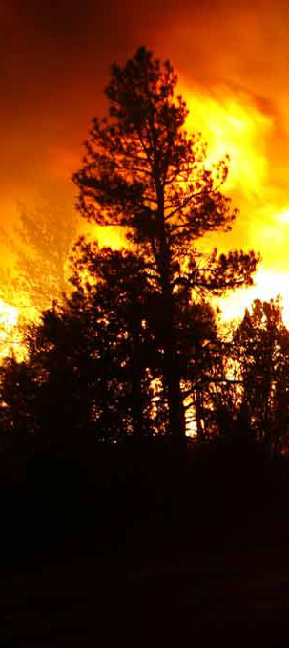
Unit 9
Infrared Product Generation

Slide 2
Objectives
Discuss exercises
Identify nightly workflow for IRIN
Discuss IR imagery packet
Identify correct symbology
Interpret infrared imagery

Slide 3
Class Exercises
Cold Springs, CO 2016 (hardcopy)
Berry, WY 2016 (hardcopy & digital)
Dog Head, NM 2016
Rock Mountain, GA/NC 2016
Camp, CA 2018
Assayii Lake, NM 2014
Final, ? 2018
Notes:
Exercises provide a range of vegetation types and topographic settings

Slide 4
Exercises
Raise hand as you have questions
“Solution” is provided for checking
May be more than one solution
Key is to map all valid heat sources
Scale for digitizing should be in the range of 1:10,000 to 1:20,000
Will vary with size of fire and how much time you have
Digitize areas or points of heat, not pixels

Slide 5
The Work Cycle of an IRIN:
Scanner Request Submitted
By SITL or IRIN using
Online Ordering
IRIN Determines
w/ SITL
Additional Flight
Go to bed
(ROSS A# assigned)
Accurate Shapefiles / Maps/Log/KMZ
Delivered to IMT Before
Morning Briefing
ZZZZZZZZZZZ
Interpretation:
Create Products
Wake up
Check on flight
Eat, get ready
FLIGHT
Expanded dispatch,
AFF, IRCN, IRCR
Imagery Delivered:
Upload to FTP site
Your schedule will change nightly.
Notes:
The work cycle makes it problematic for anyone to do IRIN work (given our standard period of operations) in addition to daytime work whether it be GIS, aerial detection and mapping, etc.
Your schedule will change nightly.

Slide 6
IRIN work – before getting imagery
AM – brief SITL and submit order for next night
Get end of day briefing from SITL
Areas of concern/perimeter growth
Acquire additional base imagery?
Arrange to get most recent perimeter
Track plane and techs twitter feed to know when/what to expect
Inform incident of general flight time
Fire not flown, # and orientation of runs
Prepare new shapefiles/folders using naming conventions
Blank for intense/scattered/isolated heat
Copy previous perimeter into new perimeter shapefile
Set/copy projections, leave time/date as xxxx
Or use Create IR shapefile tool
Get map layout ready to go

Slide 7
IRIN work – after getting imagery
Enter correct date/time stamp for shapefile names and map legend
Bring in *ortho.tifs to *.mxd and check for coverage, image quality, alignment with base imagery – every night, every run
Color.tifs are created from ortho tifs so if ortho tif lines up, the color will as well
Get overall sense of how much heat there is to map and what your timeframe is
If time is tight, digitize priority areas/products first
Raw heat data shapefile useful for
Ensuring you’ve covered everything especially outside perimeter
When done digitizing - clear all selections, calculate acres, turn off layers not needed in map
Produce pdf file, kmz, fill out log, zip shapefiles and post to NIFC ftp site

Slide 8
Getting Your Imagery
Imagery is posted at ftp://ftp.nifc.gov/nirops
Password protected
Access via secure ftp client (WinSCP, Filezilla etc.)
Posted as FreeArc self-extracting file *.exe
Example 130902_2216_CORRAL_COMPLEX.exe
Each run posted individually
Wait until tech tweets that imagery is posted!

Slide 9
Image Packet
Orthocorrected tifs “*_ortho.tif”
Color tifs “*_color.tif”
Also orthocorrected
Mosaic .jpg
Good for quick view, no geo information
Raw Heat Data Shapefile – contains triggered pixels from all runs
Metadata file

Slide 10
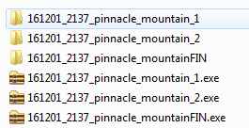
Example Image Packet

Slide 11
Ortho vs Color tif
Two channel thermal IR line scanner
3-5 μm band for intense heat/fire detection
8-12 μm band for background terrain
Ortho tif (gray-scale image)
8-12 μm shown along with red pixels represented trips from fire detection algorithm and post processing
Color tif
8-12 μm background terrain assigned to green
3-5 μm assigned to red
Non-fire/cooler areas appear green
Hotter/fire areas appear orange/yellow

Slide 12
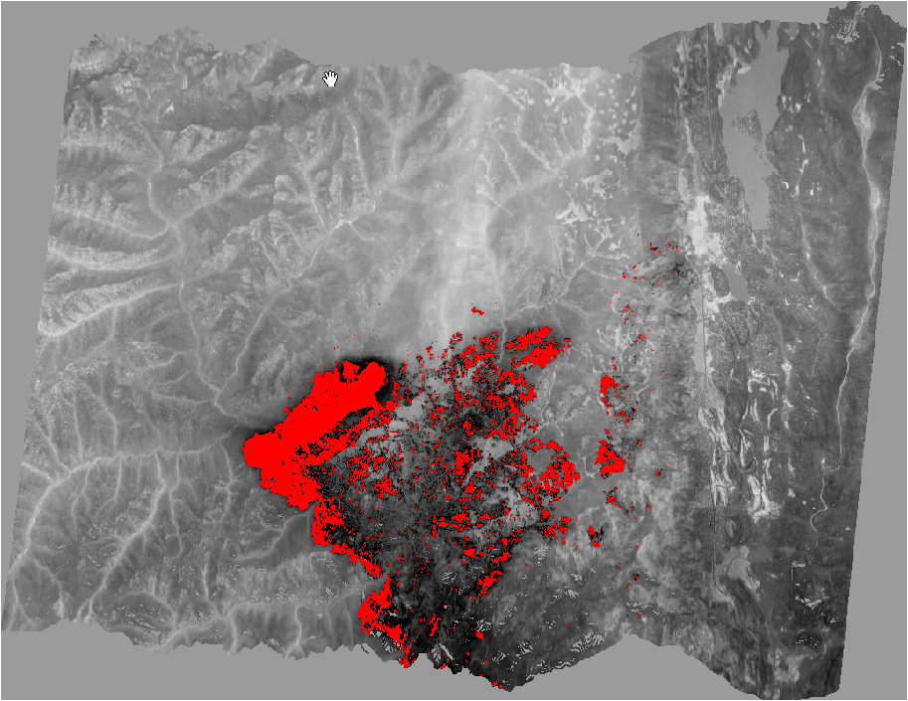
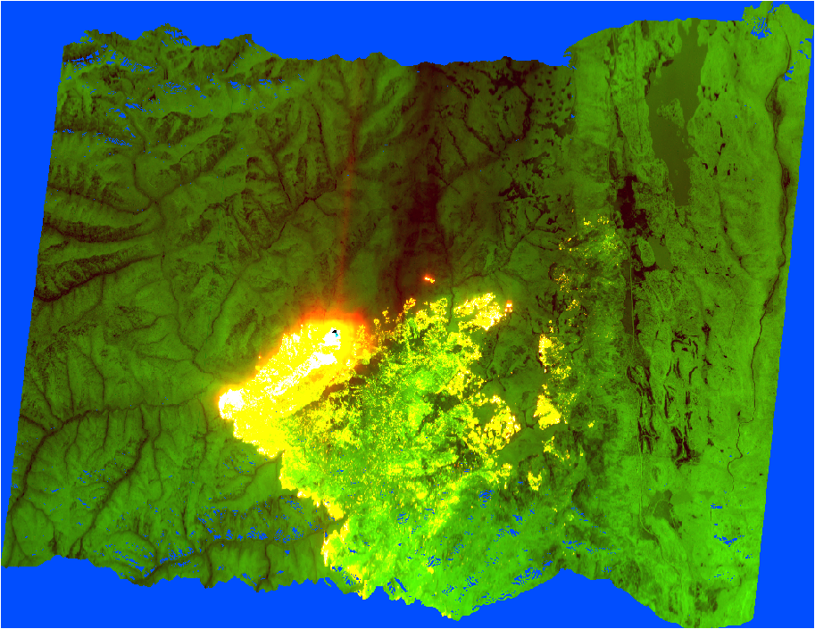
Notes:
180609_2059_416_fire_b2_1_ortho.tif

Slide 13
Image Orientation
Ortho.tif and color.tif will line up correctly in ArcMap
Not the case in other software like Windows PhotoViewer
Don’t rotate in other viewers

Slide 14
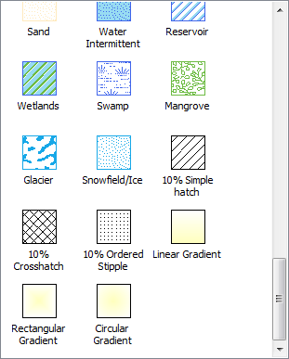
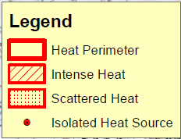
IR Shapefile Symbology
Symbology is in the GSTOP
Make perimeter outline thicker than intense and scattered heat
Rename shapefiles in
layout

Slide 15
IR GIS Products– in order of priority
Heat Perimeter (polygon)
Isolated Heat Sources Outside Perimeter (points)*
Intense Heat (polygon)
Isolated Heat Sources Inside Perimeter (points)*
Scattered Heat (polygon)
*Should be in same file
Notes:
Every data layer will be produced, if applicable, regardless of what is requested by an individual SITL.

Slide 16
Projections
Use whatever the incident is using
e.g. NAD83 Calif Teale Albers,
When in doubt use UTM NAD83
First night of a fire, no previous perimeter, no GISS support, etc.
Never calculate acres in Web Mercator Auxiliary Sphere (doubles UTM acres)
Notes:
CalFire uses NAD83 California Teale Albers

Slide 17
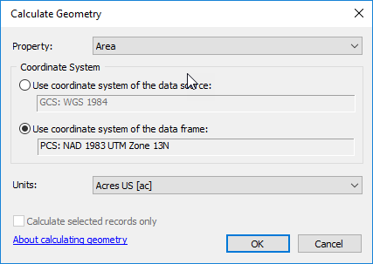
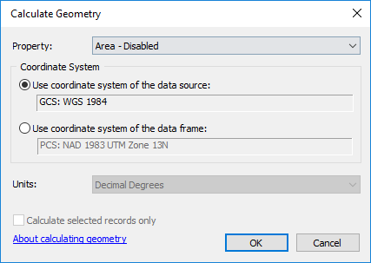
Projections (cont.)
NIFS* perimeters are GCS WGS84
Not a projection so can’t calculate acres
Calculate acres from data frame projection
Do not reproject – leads to “sliver” issues
*National Incident Feature Service

Slide 18
Late Flights
Inform SITL/GISS of schedule
Discuss strategy
Post rough perimeter first, focused on areas of greatest growth and concern
Follow up with more detailed products
On Type 1 & 2 fires, looking for the IR products by 0430

Slide 19
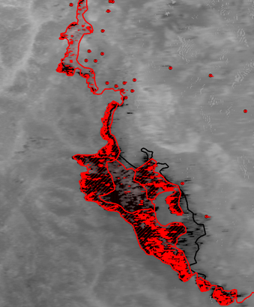
Interpretation
Scattered/intense/isolated?
Geographic concentration of heat
Polygon or point?
Consider scale of map
How much time you have
Greater detail at leading edge
Remember priorities
Notes:
This what we will work with you on during the exercises. Only so much you can show in a powerpoint.

Slide 20
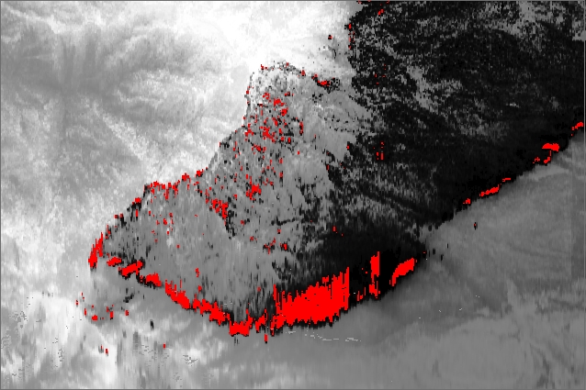
Image Only

Slide 21
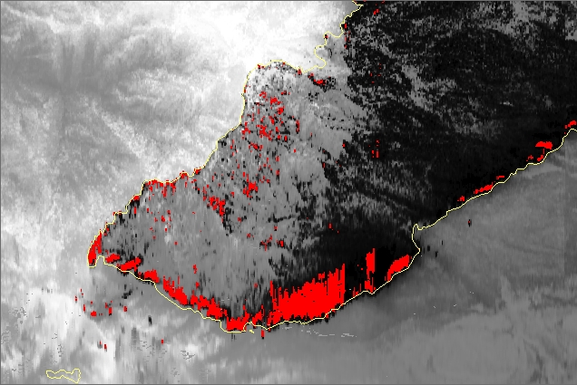
Perimeter Added
Notes:
If it’s a polygon, it should be part of the perimeter

Slide 22
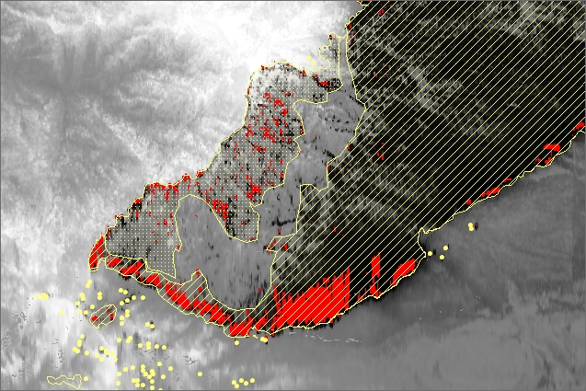
Isolated, Intense, and Scattered
Notes:
IRIN uses best, “closest to nadir”, run for mapping so mapped heat may not match up exactly with what you see in this one run

Slide 23
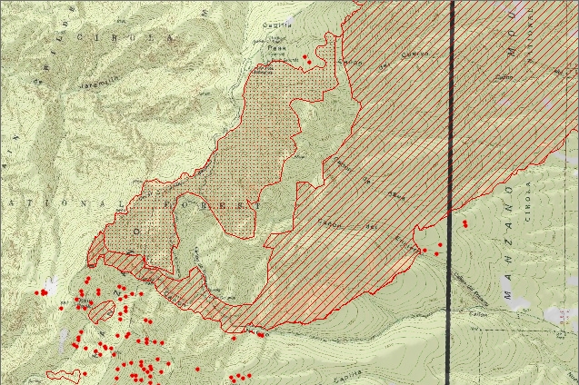
Map

Slide 24
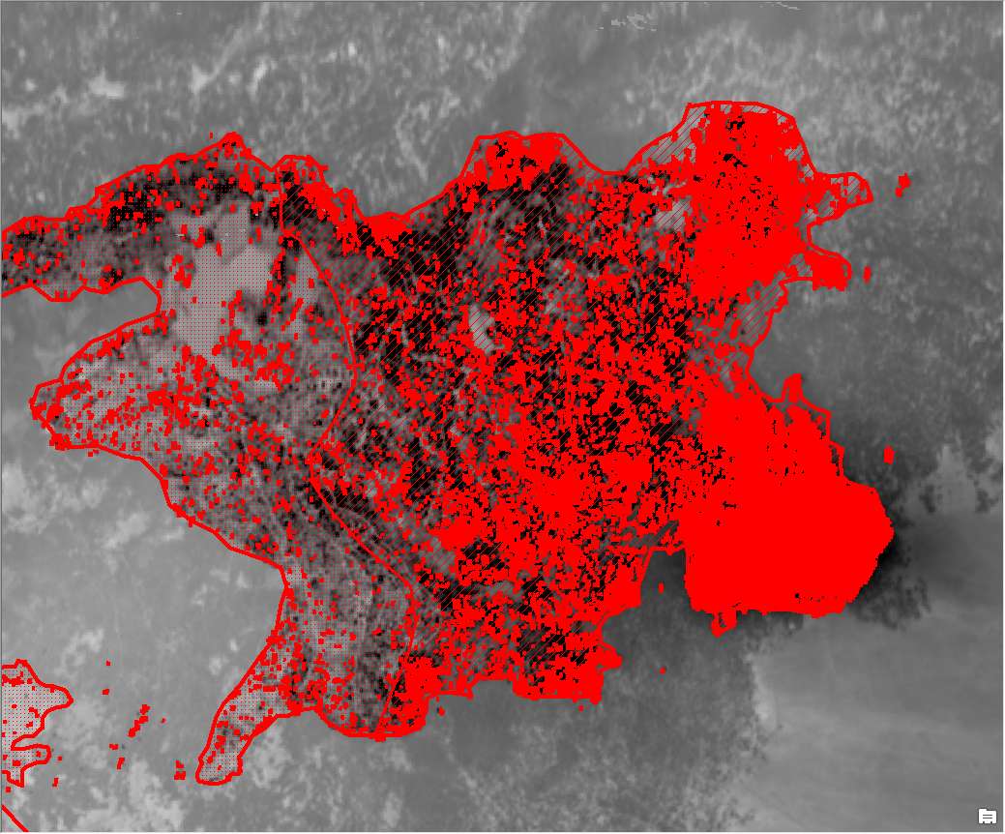
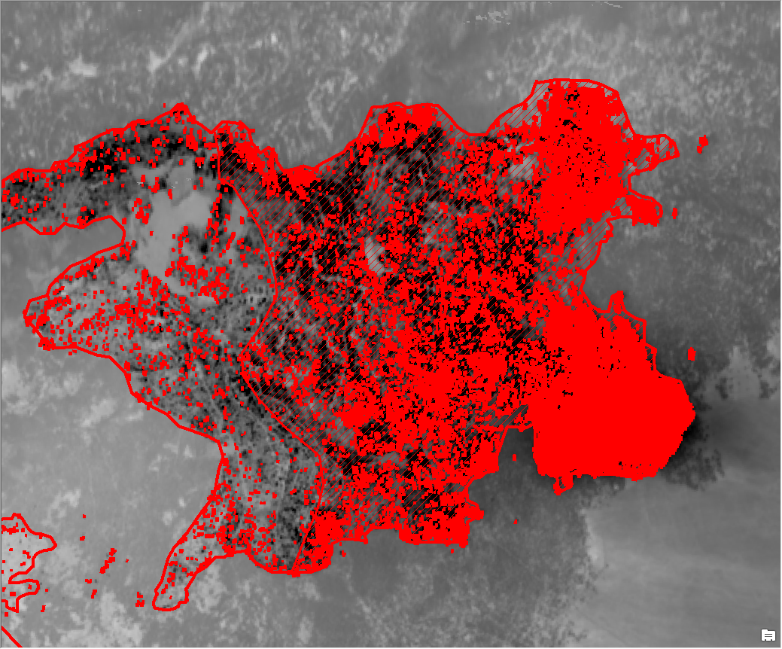
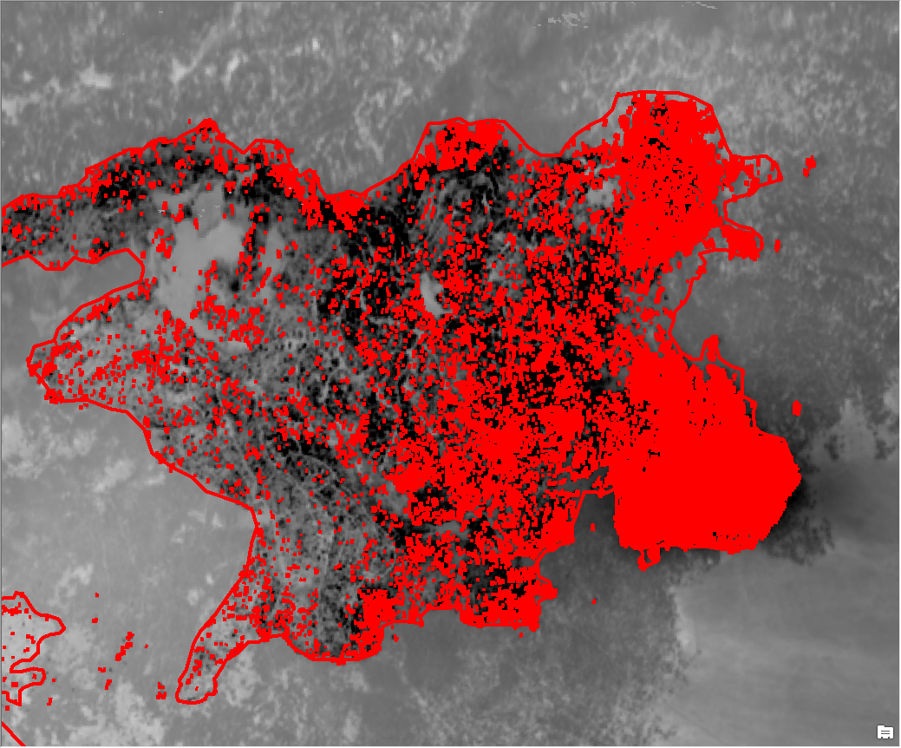
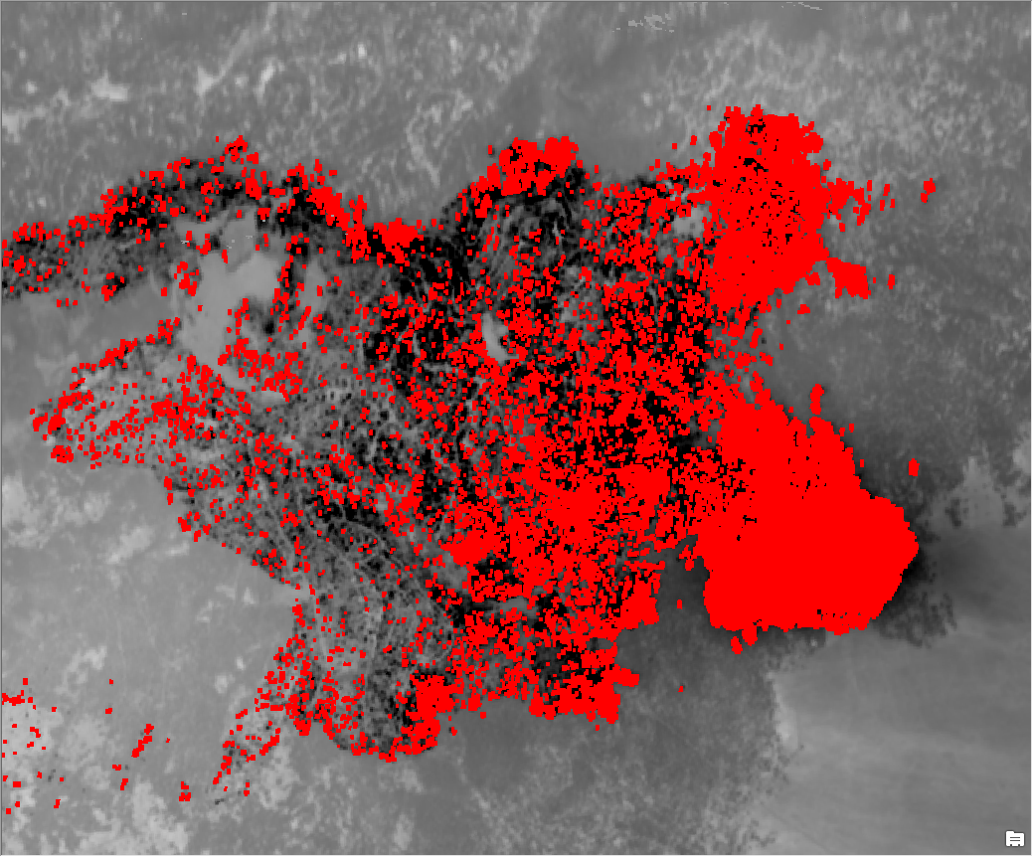
Notes:
Thompson Ridge fire 20130605_0038. Fire grew 5,000 acres on this night to just under 10,000 acres. This shows just a portion of the fire.

Slide 25
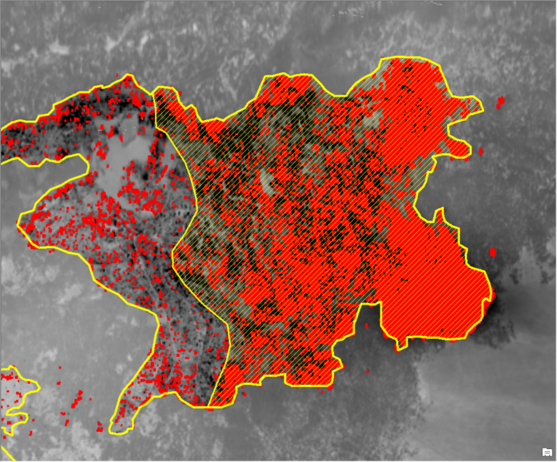
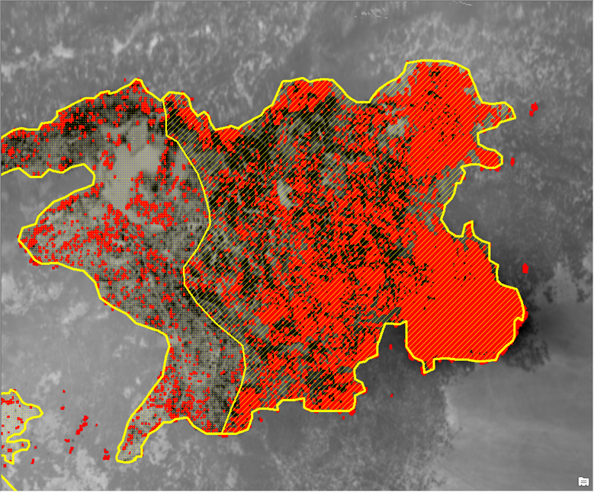
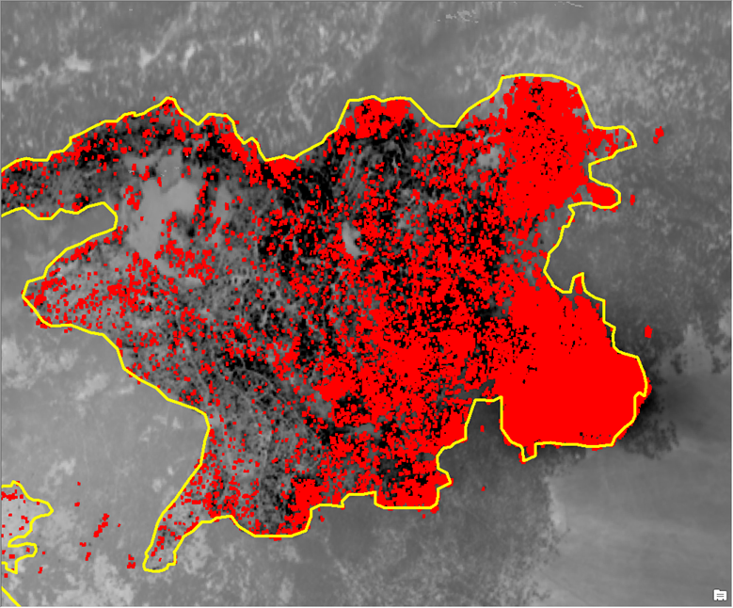
Notes:
Thompson Ridge fire 20130605_0038. Fire grew 5,000 acres on this night to just under 10,000 acres. This shows just a portion of the fire.

Slide 26
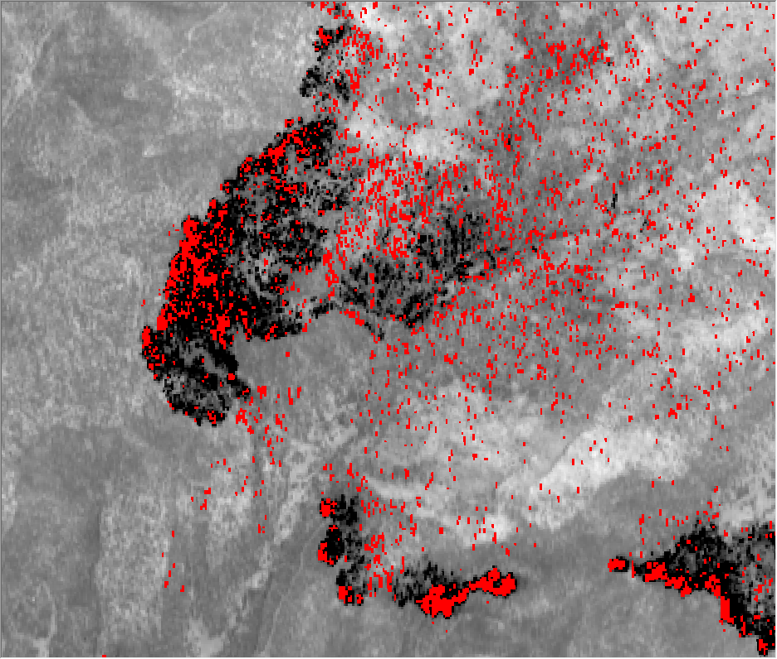
Notes:
Assayii Lake fire NM 2014

Slide 27
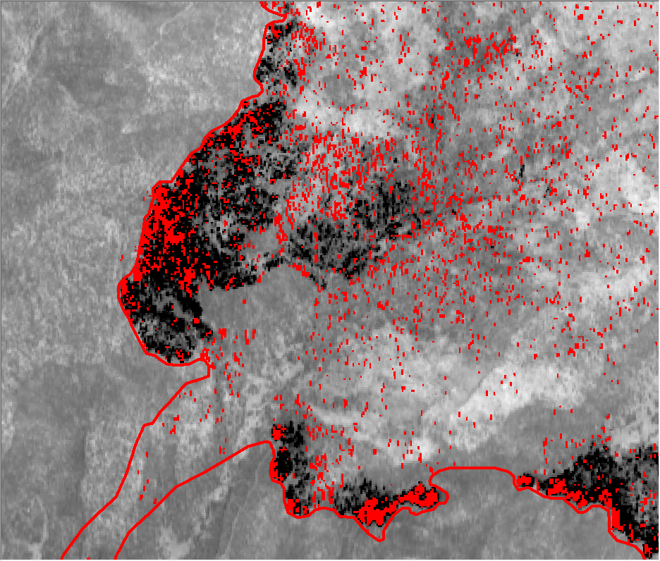
Notes:
Perimeter at lower left is from previous incident provided perimeter

Slide 28
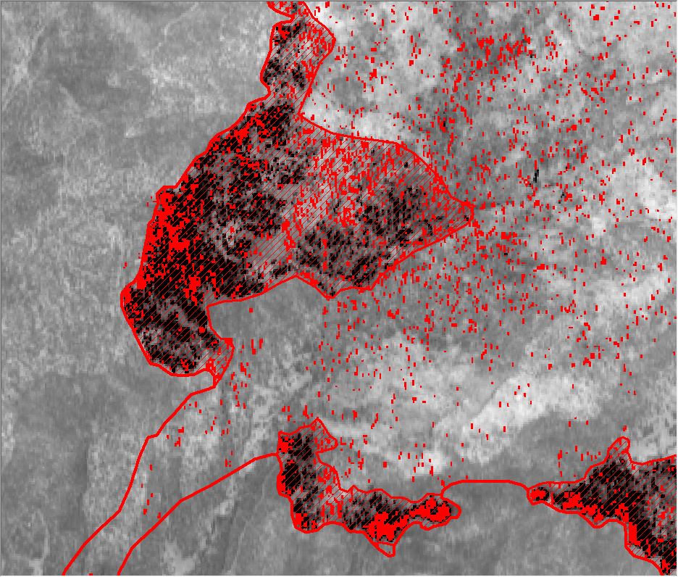

Slide 29
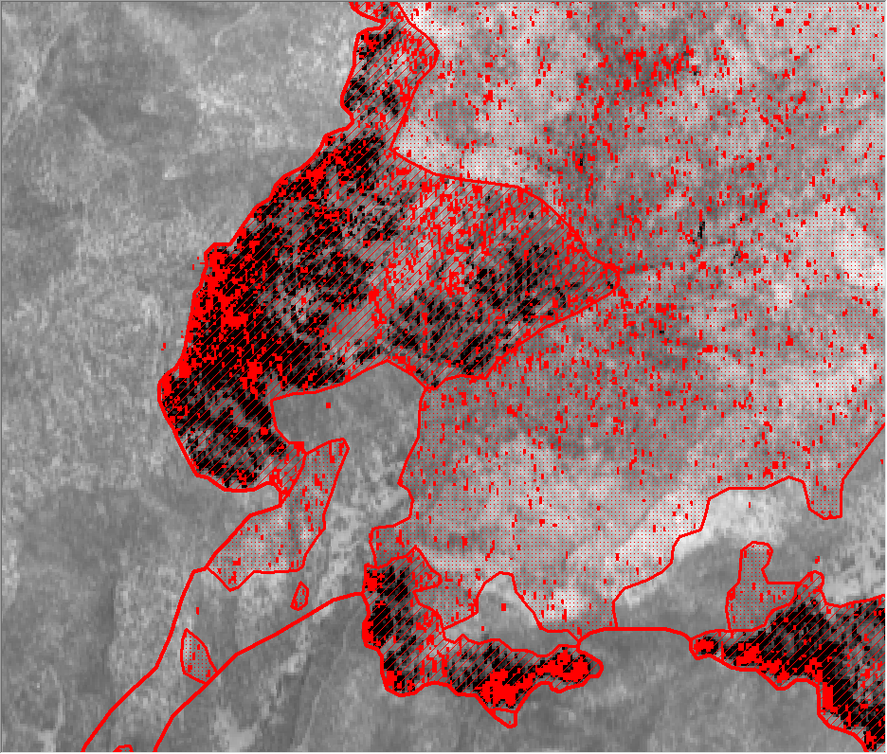

Slide 31
Notes:
Isolated heat sources outside western edge not mapped because they were not in the color tiff.

Slide 32
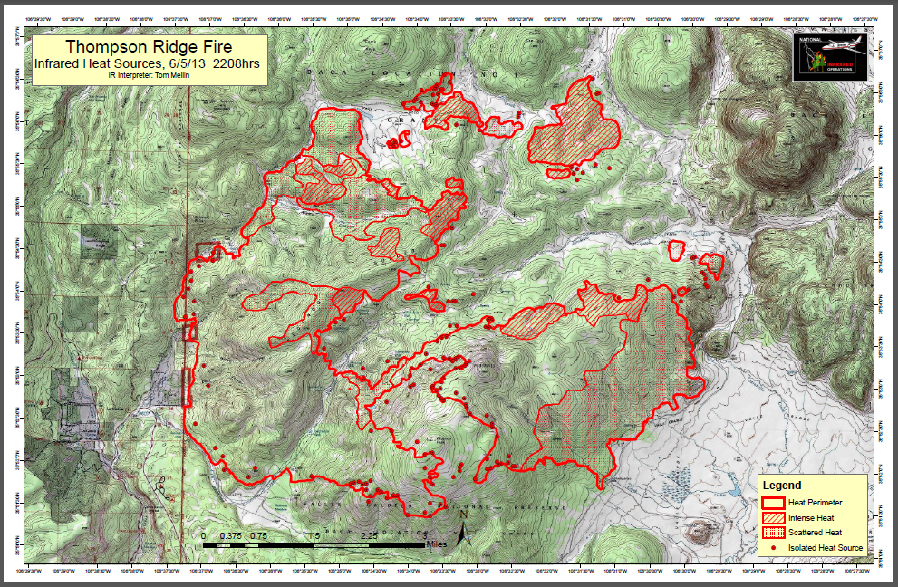
Need to be in perimeter file
Note: Any polygon should be included in perimeter file
Notes:
Add a grid with latitude and longitude use ticks or lines.

Slide 33
Objectives
Discuss exercises
Identify nightly workflow for IRIN
Discuss IR imagery packet
Identify correct symbology
Interpret infrared imagery

Slide 34
QUESTIONS?

